Slide 1
Proposed SIFS and Slot Values
Date: 2012-07-16
Authors:

Slide 2
Outline
Simulation results of several companies in 802.11ah show improved MAC Tput with shorter slot and SIFS times.
Even more important than in 11ah, 11af is supposed to provide high Tput for extended range WiFi applications such as cellular offload and high speed broadband access.
We analyze the components of SIFS and Slot times and propose suitable numbers for 11af

Slide 3
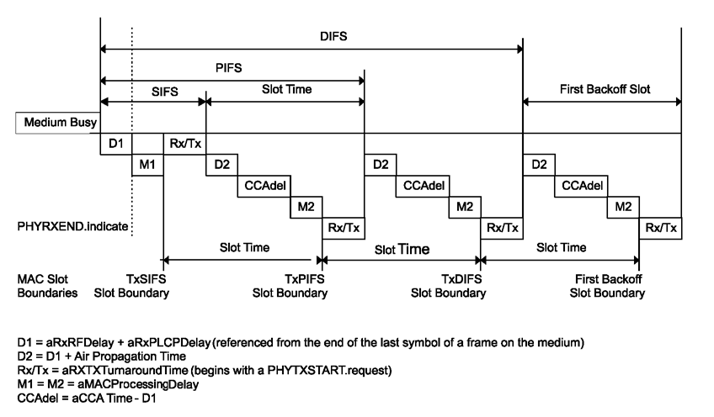
Definitions

Slide 4
Clause 18 Values
As a reference we look at the values for different BW defined in clause 18
Slot time uses a formula of 5+4x20/BW (CCAtime grows with BW, the rest stays the same)
SIFS grows inversely proportional to BW
Specific breakdown of values is in table 18-17 shown fully in the Appendix

Slide 5
Slot
Currently in .11g/n/ac a value of 9uS is used and is the sum of:
CCA time (<4uS) – this value is based on detecting a 20MHz OFDM signal at -82dBm level with >90% probability. Note in reality shorter times are achieved at the SNR level of a signal at -82dBm
Air propagation time (<<1uS), MAC processing delay (M2) (<2uS) and Rx/Tx turnaround time (<2uS). Note that MAC processing delay here (M2) is not the same as MAC processing delay for DATA (M1).
Similarly to clause 18, CCA time grows inversely proportional to BW and the proposed values for clause 23 are :
For 6/7MHz channels 4x20/(51/3)=15uS.
For 8MHz channels 4x20/(71/9)=11.25uS which can be rounded to 11uS
Air propagation time for 11af may increase to account for applications such as cellular offload and we therefore increase the number to 3uS (round trip delay of about 1km).
MAC processing delay and Rx/TX turnaround time do not increase because they are performed ahead of time and this was used in the derivations in clause 18.
M2 (MAC processing delay) is <0.25uS
Tx delay – due to sharper filtering the Tx chain delay will increase and we budget 1uS
Hence, the 5uS used as fixed value in clause 18 may increase here by 3uS but 0.25uS MAC processing delay will offset that value. We assume 2uS total increase in the fixed portion to arrive at a total Slot value of
For 6/7MHz channels 15+5+2=22uS.
For 8MHz channels 11+5+2=18uS

Slide 6
SIFS
Currently in .11g/n/ac a value of 16uS is used and is the sum of Rx/Tx turnaround time and RF/PHY/MAC processing delay (M1). Processing delay assumes packet DATA processing delay
Note this is the SIFS ‘budget’ – actual implementations typically have lower values.
Digital delay – digital delay will increase inversely proportionally with BW but given the reduction in BW of TGaf compared with TGac (a ratio of about 1/3) the internal clock for post FFT PHY and MAC can run twice as fast as with plain downclocking and shorten the digital processing delays.
However, note that unlike clause 18, the basic channel unit (~5MHz) uses a larger FFT size (128FFT vs. 64FFT). Larger FFT size will incur processing delay penalty
FFT processing time can be assumed to be one symbol and hence the penalty is one 64FFT size symbol
Hence we propose the following SIFS times:
For 6/7MHz channels (16+3.2)x20/(51/3)/2=36uS
For 8MHz channels (16+3.2)x20/(71/9)/2=27uS

Slide 7
Straw Poll 1
Do you support the proposed slot values of
For 6/7MHz channels - 22uS.
For 8MHz channels - 18uS
Y
N
A

Slide 8
Straw Poll 2
Do you support the proposed SIFS values of
For 6/7MHz channels - 36uS.
For 8MHz channels - 27uS
Y
N
A

Slide 9
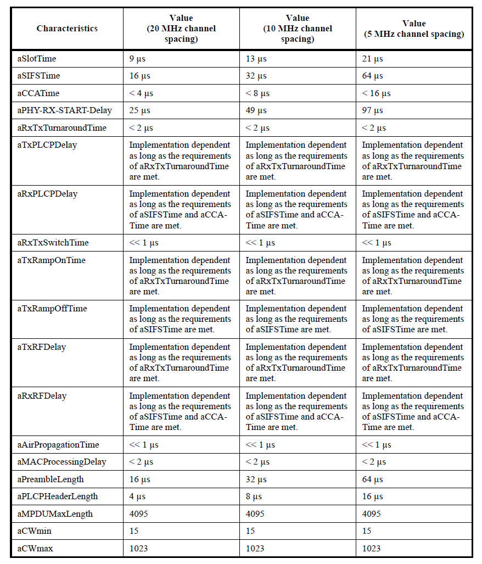
Appendix

