Slide 1
Reducing Overhead in Active Scanning
Date: 2012-07-06
Authors:
Name | Affiliations | Address | Phone | email
Yunsong Yang | Huawei Technologies Co., LTD. | 10180 Telesis Ct. Ste 165, San Diego, CA 92121 |  | yangyunsong@huawei.com
Young Hoon Kwon
Zhigang Rong

Slide 2
Abstract
This document describes a technical proposal for TGai. In this proposal methods are provided to reduce signaling overhead for active scanning during AP discovery.
Related sections of the SFD (12/0151r8)
6. Fast network discovery
6.1 Active scanning

Slide 3
Conformance w/ TGai PAR & 5C
Conformance Question | Response
Does the proposal degrade the security offered by Robust Security Network Association (RSNA) already defined in 802.11? | No
Does the proposal change the MAC SAP interface? | No
Does the proposal require or introduce a change to the 802.1 architecture? | No
Does the proposal introduce a change in the channel access mechanism? | No
Does the proposal introduce a change in the PHY? | No
Which of the following link set-up phases is addressed by the proposal? (1) AP Discovery (2) Network Discovery (3) Link (re-)establishment / exchange of security related messages (4) Higher layer aspects, e.g. IP address assignment | 1

Slide 4
Motivation
Excessive air-time occupancy has been seen as a major drawback for using active scanning in a high-density Wi-Fi device environment, such as in the famous Tokyo train station scenario [1, 2].
TGai has investigated concepts, such as aggregating Probe Responses, filtering Probe Request to limit Probe Response, omission of Probe Request or Probe Response, etc., to reduce air-time occupancy by active scanning [3].
Some of these approaches may have side-effect of increasing response delay (e.g. when aggregating Probe Responses) or adding overhead on the other direction (e.g. adding filtering criteria in the Probe Request to help to reduce the number of Probe Responses).
We noticed that most information transmitted during active scanning are quite common or similar today among STAs. We also noticed that most Probe Request and Probe Response frames are transmitted using the low data rate [1, 2], which makes them quite audible to many STAs nearby.
We investigated how to take advantage of these findings to further improve active scanning, which resulted the following proposed concepts.

Slide 5
Concept 1 – Simplified Probe Request by Referencing to a Received Probe Request (1)
Due to Probe Delay, CSMA/CD and random backoff mechanism, etc., an STA (e.g. STA2) may receive other STAs’ Probe Request(s), while delaying the transmission of its regular Probe Request.
Then STA2 compares the information in the received Probe Request(s) to the information that it wishes to request to identify a Probe Request that it can use as a reference.
Then STA2 sends a simplified Probe Request, which incorporates the Probe Request received from another STA (e.g. STA1) by referencing to that Probe Request, to the AP.
The simplified Probe Request includes a Probe Request Reference Field or IE, which copies, e.g. the Source Address in the received Probe Request, as the reference information. The target recipient(s) of the Simplified Probe Request use(s) the reference information to uniquely identify the referenced Probe Request, which was received by it earlier.

Slide 6
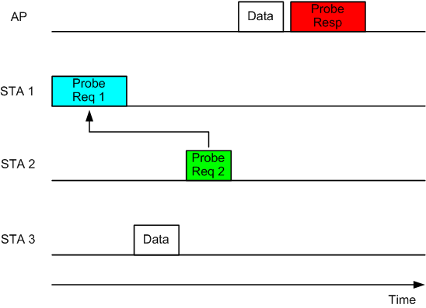
Concept 1 – Simplified Probe Request by Referencing to a Received Probe Request (2)
First, the AP receives a Probe Request from STA1.
Then the AP receives, from STA2, a simplified Probe Request, which incorporates the first Probe Request by referencing to the first Probe Request.
Then the AP sends a Probe Response, at least to STA2, considering both the simplified Probe Request and the referenced Probe Request:
The AP may broadcast a single
Probe Response that provides
response to both STAs’ Probe
Requests; or
The AP may unicast it to STA2.

Slide 7
Concept 2 – Simplified Probe Response by Referencing a Probe Response Sent Earlier (1)
The AP first sends a regular Probe Response frame in response to a Probe Request sent by an STA (e.g. STA1).
Then in response to a Probe Request, whether it is simplified or not, from another STA (e.g. STA2), the AP sends a simplified Probe Response to STA2, by referencing to the regular Probe Response that was sent earlier, as long as the AP knows that STA2 is listening to the regular Probe Response, e.g.
The AP receives the Probe Request from STA2 immediately before it sends out the regular Probe Response; or
The second Probe Request is a simplified Probe Request that references to the first Probe Request, indicating that STA2 must be awaken and listening to the channel since it receives the first Probe Request.

Slide 8
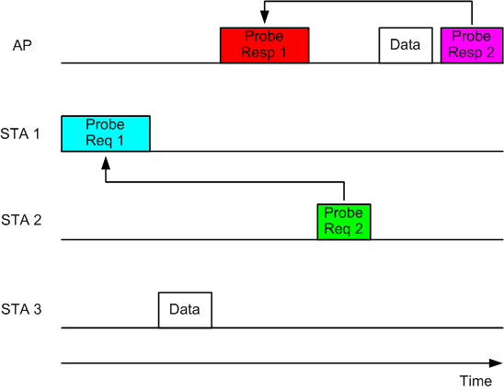
Concept 2 – Simplified Probe Response by Referencing a Probe Response Sent Earlier (2)
The simplified Probe Response includes a Probe Response Reference Field or IE which copies, e.g. the Sequence Control number in the Probe Response that is sent earlier, as the reference information.
The target recipient(s) of the Simplified Probe Response use(s) the reference information to uniquely identify the referenced Probe Response, which was received by it earlier.

Slide 9
Frame Format for the Simplified Probe Request (or Response) frame
Due to a lack of un-used sub-types for management frames, we recommend that TGai reuses and modifies the existing Probe Request (or Response) frame format for the simplified Probe Request (or Response), respectively.
Option 1. Using the reserved Power Management bit (B12) in the FC field in the MAC header of the Probe Request (or Response) to indicate that it is a Simplified Probe Request (or Response)
Then the Probe Request (or Response) Reference Information can be a field in the MAC header
Pro: less overhead Con: requires changes in MAC header
Option 2. Using the presence of the Probe Request (or Response) Reference IE in the frame body to indicate that it is a Simplified Probe Request (or Response)
Then the Probe Request (or Response) Reference Information must be an IE in the frame body.
Pro: more flexible Con: slightly more overhead

Slide 10
Analysis on Overhead
 | Non-Simplified (Bytes) | Simplified Option 1 (Bytes) | Simplified Option 2 (Bytes)
MAC Header | 28 | 28+6 if SA is used as reference; or 28+2 if Sequence Control is used as reference. | 28
Frame Body | 100+ | 0 | 8 if SA is used as reference; or 4 if Sequence Control is used as reference.
FCS | 4 | 4 | 4
Overhead Reduction | N/A | ~100 Bytes! | ~100 Bytes!

Slide 11
Benefits
Reducing the air-time required to complete the same numbers of Probe Request and Probe Response in a high-density Wi-Fi device environment, such as in Tokyo train station scenario, by taking advantage of other’s Probe Requests or Probe Responses. Thus
Reducing link setup time
Allowing more STAs to access the AP for services
Saving the air-time for real traffic payload and boosting data throughputs in busy APs
Improving overall user experience
Simple MAC standard changes

Slide 12
Straw Poll 1
Do you support that a FILS-capable STA may send a simplified Probe Request by referencing to another STA’s Probe Request that was received earlier, thereby removing the redundant information elements that are already in the referenced Probe Request from the simplified Probe Request?
Yes:
No:
Abstain:

Slide 13
Straw Poll 2
Do you support that a FILS-capable AP may send a simplified Probe Response by referencing to another Probe Response that was sent earlier, thereby removing the redundant information elements that are already in the referenced Probe Response from the simplified Probe Response?
Yes:
No:
Abstain:

Slide 14
Straw Poll 3
Do you support Option 1, i.e. using the reserved Power Management bit (B12) in the FC field in the MAC header of the Probe Request (or Response) to indicate that it is a Simplified Probe Request (or Response) and adding a Probe Request (or Response) Reference Information field in the MAC header, respectively?
Yes:
No:
Abstain:

Slide 15
Straw Poll 4
Do you support Option 2, i.e. using the presence of the Probe Request (or Response) Reference IE in the frame body of the Probe Request (or Response) frame to indicate it is a Simplified Probe Request (or Response), respectively?
Yes:
No:
Abstain:

Slide 16
Straw Poll 5
Do you support using the source address (SA) in the referenced Probe Request as the reference information in the simplified Probe Request?
Yes:
No:
Abstain:

Slide 17
Straw Poll 6
Do you support using the Sequence Control number in the referenced Probe Response as the reference information in the simplified Probe Response?
Yes:
No:
Abstain:

Slide 18
Motion 1
Add the following text to “Section 6.1 Active scanning” in the TGai SFD, 12/0151r8:
“6.1.X Simplified Probe Request
STA may send a simplified Probe Request by referencing to a regular Probe Request that was received earlier and by removing the redundant information elements that are already in the referenced Probe Request from the simplified Probe Request.”
Mover:
Seconder:
Result Yes No Abstain___________

Slide 19
Motion 2
Add the following text to “Section 6.1 Active scanning” in the TGai SFD, 12/0151r8:
“6.1.Y Simplified Probe Response
AP may send a simplified Probe Response by referencing to a regular Probe Response that was sent earlier and by removing the redundant information elements that are already in the referenced Probe Response from the simplified Probe Response.”
Mover:
Seconder:
Result Yes No Abstain___________

Slide 20
References
[1] IEEE 802.11-11/1031r0, air-time-consumption-by-beacon-and-probe.
[2] IEEE 802.11-11/1413r3, real-air-time-occupation-by-beacon-and-probe.
[3] IEEE 802.11-12/0151r8, proposed-specification-framework-for-tgai.

