Slide 1
Differentiated Initial Link Setup (Follow Up)
07/05/2012
Authors:
Name | Affiliations | Address | Phone | email
Lin Cai | Huawei | 3601 Algonquin Road, Suite 1000, Rolling Meadows, IL 60008 | 1-847-848-1778 x 379 | Lin.cai@huawei.com
Phillip Barber
George Calcev
Bin Chen

Slide 2
Abstract
This presentation is a follow up contribution that presents differentiated association schemes to ensure fast initial link setup of time-critical connections[1,2].

Slide 3
Conformance w/ TGai PAR & 5C
Conformance Question | Response
Does the proposal degrade the security offered by Robust Security Network Association (RSNA) already defined in 802.11? | No
Does the proposal change the MAC SAP interface? | No
Does the proposal require or introduce a change to the 802.1 architecture? | No
Does the proposal introduce a change in the channel access mechanism? | No
Does the proposal introduce a change in the PHY? | No
Which of the following link set-up phases is addressed by the proposal? (1) AP Discovery (2) Network Discovery (3) Link (re-)establishment / exchange of security related messages (4) Higher layer aspects, e.g. IP address assignment | 1, 3

Slide 4
Introduction
Objective of TGai[1]:
  To minimize the time the STAs spend in initial link setup when a large number of mobile users are entering and leaving the coverage area of WiFi networks
    100 STAs successfully associate with an AP within 1 second
    A STA should successfully associate with an AP in 100ms
[1] TGai Specification Framework Document, 12/0151r3.

Slide 5
Performance Study of WiFi [2]
The capacity of WiFi in support of concurrent channel access is very limited due to the inherent contention nature of CSMA/CA based MAC
To avoid network congestion and to efficiently utilize the channel resource, it is important to maintain the system load of concurrent STAs at a low level
  Very efficient
Distributing concurrent STAs in a large time window can effectively improve the performance under high system load
        [2] L. Cai et.al. “Differentiated initial link set up” doc.: IEEE 802.11-12/0569, May 2012

Slide 6
TGai Use Cases
Bursty user association
  Users may transmit requests in a bursty manner (e.g., after receiving a beacon or a broadcast response)
  Severe collisions result from bursty access of a large number of concurrent STAs attempting to associate with the AP simultaneously
    Collision probability is more than 0.5 when there are 20 concurrent STAs
  Only some users may be able to successfully associate with the AP during a certain time interval
  Bursty association requests will significantly degrade the QoS performance of existing associated STAs

Slide 7
User’s Requirements
Users have different requirements
  Some users may have multimedia applications with different quality of service (QoS) requirements
    Realtime (video streaming) vs non-realtime (ftp file downloading)
  Some users may have new services and applications built upon network discovery run in background
  Some users have NO running application
Users may have different delay tolerance levels for network association; greedy/immediate association only reduces the association efficiency but not guarantee fast link setup

Slide 8
Differentiated Association Services
Allow STAs to associate with an AP at different time intervals, based on their priorities
  To ensure time-critical STAs achieve a shorter delay in fast initial link setup
  To mitigate the negative impact of bursty association on the existing associated STAs
Association priority assignment
  Open for discussion: traffic type, user type, etc.
  Decided by other parties, e.g., WFA

Slide 9
Example 1: EDCA
Different classes can access the channel based on enhanced distributed channel access (EDCA)
AIFS[AC3]
AIFS[AC2]
AIFS[AC1]
AIFS[AC0]
BackOff[AC3]
BackOff[AC2]
BackOff[AC1]
BackOff[AC0]
Access time differentiation of AIFS and contention window is on the order of micro-seconds

Slide 10
Example 2: Extended Case
Class 3
Class 2
Class 1
t0
t1
t2
Class 1
Class 2
Class 3

Slide 11
Example 2 (Cont’d)
STAs receive a (FILS) beacon or a beacon at time t0, when all users start their association process
Class 1 (with the highest priority) can attempt to associate with the AP immediately at t0
Class 2 defers association and starts at t1; and class 3 (lowest priority) starts at a later time of t2
EDCA can be applied to further improve differentiated services
t0
t1
t2
(FILS)
Beacon
Class 1
Class 2
Class 3

Slide 12
Example 3
FILS
Beacon
Class 1
Class 2
Class 3
In the FILS beacon, AP announces the class of STAs which can associate with the it in the following period
AP may allow one class or multiple classes to associate with it in the following period

Slide 13
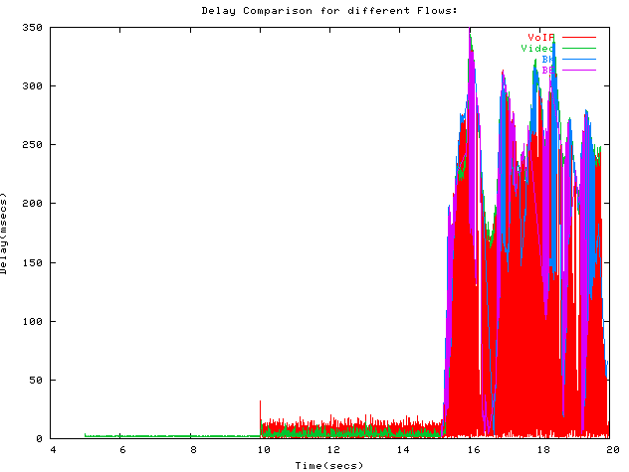
Delay Performance of Legacy MAC[3]
12 STAs:
1 Video (5 seconds)
7 VoIP (10seconds)
1 BK (15seconds)
1 BE (15 seconds)

Slide 14
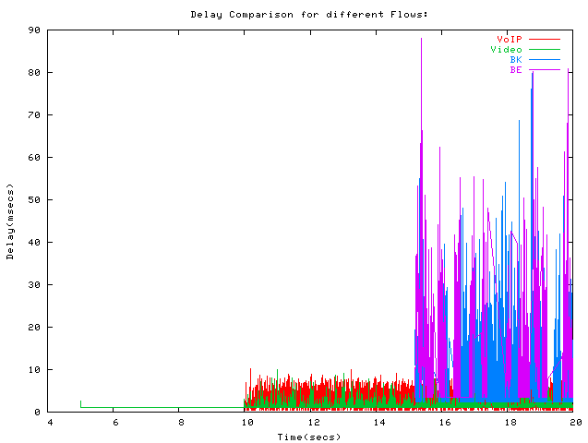
Delay with Differentiated Services[3]
12 STAs:
1 Video (5 seconds)
7 VoIP (10seconds)
1 BK (15seconds)
1 BE (15 seconds)
[]S. Sehrawat et. al. “Performance Analysis of QoS supported by Enhanced Distributed Channel Access (EDCA) mechanism in IEEE 802.11e”, International jnl. of Computer Science, 33:1, 2007.

Slide 15
Straw Poll 1
Do you agree to add the sentence to TGai SFD, 12/0151r3.
  “FILS devices shall support differentiated initial link setup.”?
Yes:
No:
Need more information:

Slide 16
Motion 1
Do you agree to add the sentence to TGai SFD, 12/0151r3.
  “FILS devices shall support differentiated initial link setup.”?
Yes:
No:
Abstain:

Slide 17
Straw Poll 2
Do you agree to add a new section, called “QoS Provision in FILS”, in the TGai SFD, 12/0151r3, i.e.,
6. QoS Provision in FILS
Yes:
No:
Need more information:

Slide 18
Straw Poll 2
Do you agree to add a new section, called “QoS Provision in FILS”, in the TGai SFD, 12/0151r3, i.e.,
6. QoS Provision in FILS
Yes:
No:
Abstain:

Slide 19
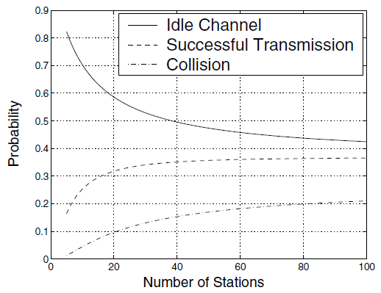
Channel Utilization Degrades with the Number of Concurrent STAs [4]
CSMA/CA operates efficiently only under a small number of concurrent STAs (e.g., less than 20 STAs)
For bursty channel access from a large number of concurrent STAs, we need to distribute them over a large time window
[4] Marcelo M. Carvalho and J. J. Garcia-Luna-Aceves, “Delay Analysis of IEEE 802.11 in Single-Hop Networks”, In Proceedings of the 11th IEEE International Conference on Network Protocols, 2003.

