Slide 1
EAP based Message Flow Optimization for FILS
Date: 2012-07-06
Authors:
Name | Affiliations | Address | Phone | email
Ping Fang Zhiming Ding Phillip Barber Rob Sun | Huawei Technologies Co., Ltd. | Bldg 7, Vision Software Park, Road Gaoxin Sourth 9, Nanshan District, Shenzhen, Guangdong, China, 518057 | +86 755 36835101 | ping.fang@huawei.com dingzhiming@huawei.com pbarber@huawei.com Rob.sun@huawei.com
Dapeng Liu | China Mobile | 32 Xuanwumen West Street Beijng, Xicheng District, 100053 China |  | liudapeng@chinamobile.com

Slide 2
Abstract
This contribution proposes a Fast authentication proposal for FILS. This proposal is based on EAP and mainly focuses on the message optimization of conventional authentication, association, EAP and 4 way handshake.

Slide 3
Conformance w/ TGai PAR & 5C
Conformance Question | Response
Does the proposal degrade the security offered by Robust Security Network Association (RSNA) already defined in 802.11? | No
Does the proposal change the MAC SAP interface? | No
Does the proposal require or introduce a change to the 802.1 architecture? | No
Does the proposal introduce a change in the channel access mechanism? | No
Does the proposal introduce a change in the PHY? | No
Which of the following link set-up phases is addressed by the proposal? (1) AP Discovery (2) Network Discovery (3) Link (re-)establishment / exchange of security related messages (4) Higher layer aspects, e.g. IP address assignment | 3, 4

Slide 4
Background
This contribution is based on 1047r6 and updated based on discussion on1160r9, which merged with 1047 and proposes fast authentication for FILS using EAP/EAP-RP；
This contribution focuses on the optimization of message flows of conventional full EAP authentication and association, providing detailed explain of implementation problem received per discussion on 1160r9.
Comments on this contribution can be updated into 1160r10.

Slide 5
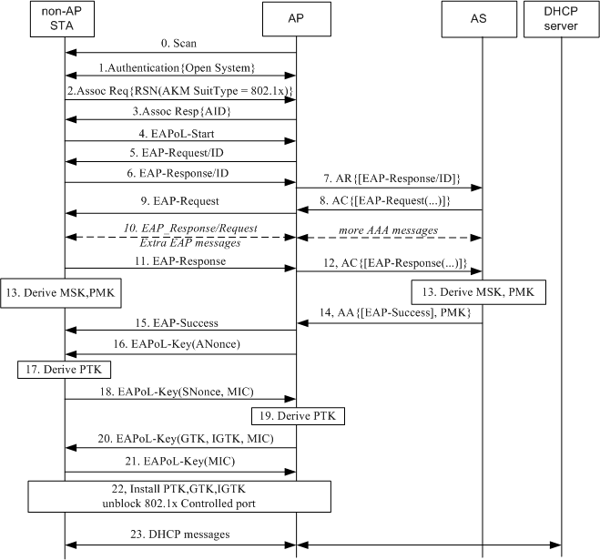
Conventional initial link setup
Authentication frames can be omitted as these two messages do nothing in the flow. But it would be good to start authentication for the state machine
The AKM SuitType in Association Request frame indicates that whether a 802.1x authentication will be called.
According to IEEE 802.1x and RFC 3748, the EAP-Request/Identity and EAP-Response/Identity messages can be omitted if the Authenticator can obtain Identify with other approachs.
Some EAP methods only need one pair of EAP messages like EAP-AKA, but some others need multiple pair of messages.
4-way handshake is started by AP. AP will not accept any unexpected EAPoL-Key message in order to avoid DOS attacking. See sub-clause 11.6.6.6 4 of 802.11-2012.
802.1x controlled port is unblocked here, when the AP believes the non-AP STA holds the same PTK.

Slide 6
Principle of FILS
FILS shall be compatible with current standard, so Authentication and Association frames shall be remained to comply with current state definitions in subclause 10.3 of IEEE 802.11-2012.
FILS shall not degrade the security currently offered by Robust Security Network Association (RSNA) already defined in IEEE 802.11, so 11ai shall make the most reuse of current mechanism e.g. 802.1x and 4-way handshake and must be cautious in involving unproved new authentication scheme.
Considering to interwork with other heterogeneous network e.g. 3GPP which is the most important 3G wireless communication network and in which the EAP-AKA/EAP-AKA’ authentication method is used only, so EAP must be supported in FILS.

Slide 7
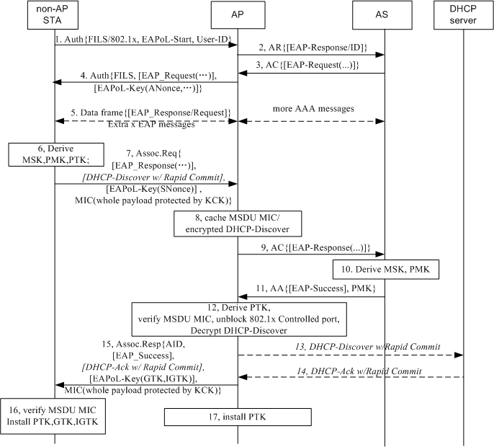
Optimized EAP with concurrent PTK handshake
Step 1: Non-AP STA indicates FILS with 802.1x is expected, and includes the User ID and EAPoL-Start message in Authentication First frame. The AP Generates an EAP-Response/ID message. So the pair of EAP-Req/ID and EAP-Resp/ID messages can be omitted on the air.
Step 4: The AP receives an EAP-Request (1st message of EAP method). The AP sends an Authentication Second frame to the non-AP STA and the EAP-Request message and an first message of 4-way handshake which includes ANonce are piggybacked in the frame.
Step5: Extra EAP messages for some EAP methods are as normal EAPoL messages packed in data frames.
Step7: Once the non-AP STA derived MSK, then it also derives PTK, it sends an Association Request frame to the AP and the last EAP-Response message and an second message of 4-way handshake which includes SNonce are piggybacked in the frame.
Step 15: The AP sends Association Response frame. An EAP-Success and a third message of 4-way handshake are piggybacked in the frame.
A quick DHCP exchange is suggested to be concurrent with Association frames.

Slide 8
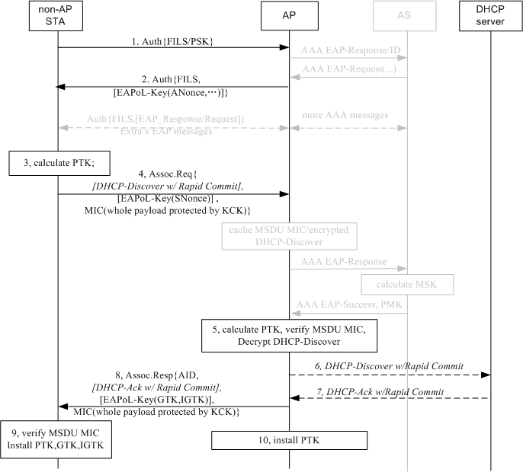
PSK authentication under the same framework
In principle, we don’t suggest designing FILS for WPA2-Personal case. But this architecture can be used for WPA2-Personal case, the same framework can work.
The gray entities are remained in this figure to compare with Optimized EAP flow.
Step 1 indicates FILS with PSK is expected.
Step 2, 4 and 8 fulfill the first 3 steps of 4-way handshake in current standard. Current 4-way handshake mechanism is not changed just the last step of 4-way handshake is omitted.

Slide 9
Analysis of Optimized EAP based FILS
Any EAP method can be deployed e.g. EAP-AKA/EAP-AKA’ for interworking with 3GPP or EAP-TTLS for interworking with WiMAX.
Step 4, 7, 15 included EAPoL-Key messages which fulfils the first three messages of 4-way handshake. The last message of 4-way handshake is just a confirm of message 3 and it is can be omitted actually. So the security of PTK handshake will not be downgrade. Note that current 4-way handshake is a good design which can avoid DOS attack by the non-AP STA or a fake AP sending first 4-way HS message to the non-AP STA. See subclause 11.6.6.6 in 802.11-2012.
DHCP message is forwarded after step 12 at which the AP verified the non-AP STA holds the same PTK with itself so the 802.1x controlled port can be unblocked. It complies 802.1x.
For step 7: The non-AP STA knows when it gets MSK, so it knows when it shall send Association Request.
For step 11: If the AP receives more EAP-Request but not a EAP-Success or EAP-Failure from the AS, the AP can exchange EAP messages by data frames like possible step 5 with the non-AP STA and defer sending Association Response frame.

Slide 10
Implementation of EAP Authenticator
If the FILS with Optimized EAP is invoked, the MAC entity of AP will send the Identity received from an STA to the EAP Authenticator. The EAP Authenticator will generate an EAP-Response/ID message if it has got the Identity and send the message to AS side (maybe send to a AAA Client module in AP first), or the EAP Authenticator will generate an EAP-Request/ID message and send the message to the non-AP STA to ask a Identity.

Slide 11
Conclusion
Proposal Summary
4-way handshake is carried out concurrently with Authentication and Association frames to reduce message rounds and the main mechanism of current 4-way handshake is kept.
Existing EAP Method can be called so the interworking between cellular technology and WiFi technology will not be affected.
The EAP-Request/ID and EAP-Response/ID messages are omitted to reduce messages on the air interface.
FILS over EAP and FILS over PSK can work under the same framework.

Slide 12
SP
Do you support to add the FILS proposal defined in slide 7 into 11ai SFD security section?
Yes
No
Abstain

Slide 13
Motion
Do you support to add the FILS proposal defined in slide 7 into 11ai SFD security section?
Yes
No
Abstain

Slide 14
Reference
[1] 11-11-1160-09-00ai-fast-re-authentication
[2] 11-11-1047-06-00ai-using-upper-layer-message-ie-in-tgai

