Slide 1
Multi-Channel PHY
Date: 2012-05-17
Authors:
Slide 1

Slide 2
Outline
Contribution 12/0699 defines the PHY for one channel and the location of the pre-VHT field for multi-channel transmission
We provide here details of the rest of the PHY for multiple channels based on option A in contribution 12/616 (also shown in the last slide of this contribution)
Slide 2

Slide 3
Proposal
The same number of DATA /Pilot tones and MCS for one channel as defined in 12/699 shall be used for each of the channels used in a contiguous or non-contiguous multi-channel transmission
This is identical to the design of non-contiguous 80+80 and contiguous 160 in 11ac
This also simplifies the design and enables simple extension to any number of channels
The location of the VHT fields for 2 contiguous channels shall be centered around tones -72 and 72 and with 4 contiguous channels around tones -216, -72, 72, 216
Identical to the pre-VHT fields
An interleaver with structure as defined in 11ac (for VHT20/40/80) is applied before mapping to tones in any multi-channel transmission. The interleaver parameters Ncol and Nrot for 2 and 4 channel transmission (contiguous or non-contiguous) are TBD
Slide 3

Slide 4
Straw Poll
Do you support the proposed design in slide 3?
Y
N
A
Slide 4

Slide 5
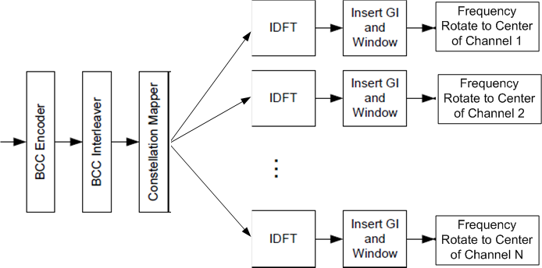
Cont. – Option A
This option uses an optimally designed interleaver to maximize diversity gain across channels (whether contiguous or non-contiguous).
All channels have the same MCS
The figure shows one encoder and one interleaver but multiple encoders and interleavers may be used if the data rate can’t be supported by one encoder (especially with >1 spatial streams).
Support for multiple spatial streams uses 11ac stream parser.
The interleaver parameters Ncol and Nrot need to be defined to accommodate 108x2 and 108x4 tones.
Interleaver design is simple and well understood (256 interleaver in 11ac and 32FFT interleaver in 11ah were designed)
Slide 5

