Slide 1
Service Discovery Proposal
Date: 2012-5-16
Authors:

Slide 2
What is a Service?
For IEEE 802.11, knowledge of “services” supported by a device help in the selection of the appropriate STA/AP for subsequent communications
Examples might include:
  Finding the right AP to connect to a print service
  Finding a near-by WLAN supporting a particular application
  Find a network (AP) with appropriate network connectivity and services for a particular set of applications
  Find a AP/STA that can reach a particular application and user

Slide 3
What would this service discovery look like?
Who has service “foo”?
I have “foo”
I have “bar”

Slide 4
More on “Services”
There are many different existing ways to define application level services, possible examples include: UPnP, Bonjour, XML, OIDs, OUI fields, Bluetooth ids, URLS, Wi-Fi Alliance types (e.g. WFD), etc.
Some of the above can be very large (e.g. UPnP)
Many different organizations want to control and register identifiers to ensure interoperability (they want a single rooted hierarchy)
Rapid growth of new mobile applications requires a simple process to ensure unique identification from many different organizations.

Slide 5
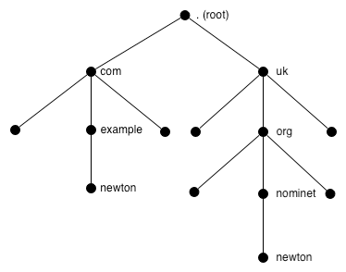
Mapping services to a unique identifier
Most identifiers are made unique by creating hierarchies that are controlled by a central authority with sub branches delegated within a limited name space
(e.g. DNS names and IANA)
A powerful alternative is to define identifiers within a very large address space where the address space is so large that every identifier is guaranteed to a very high probability to be unique
16 octets can define a very large address space (2^128) to provide unique identifiers and is actually shorter in octets than most hierarchical naming schemes
A hash function can be used to define a process for the creation of unique identifiers
Very large set of possible identifiers. Used identifiers are a very small set within name space

Slide 6
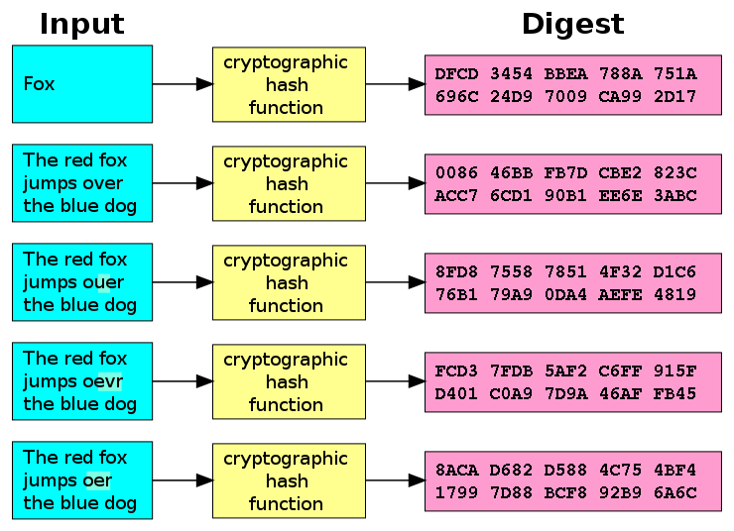
Cryptographic Hash Functions
A hash takes a block of data and returns a fixed size octet string such that any change in the data has a high probability of changing the hash value (aka digest)
A “good’ cryptographic hash function has the property that it is infeasible to generate a message for a given hash
Examples of well known cryptographic hash functions include: MD5, SHA-1,
SHA-256
http://en.wikipedia.org/wiki/Cryptographic_hash_function

Slide 7
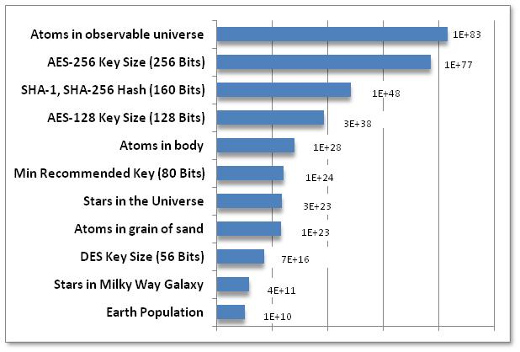
Very Big Numbers
“Astronomy has long been humanity's go-to subject when it comes to contemplating the truly enormous. But actually, if 2¹²⁸ is so much more vast than the number of stars in the observable universe (10¹⁵ times more vast*, or 4,000,000,000,000,000 in long-hand notation), then even the name "astronomical" is rather inadequate.”
  -- from Economist
  http://www.economist.com/blogs/johnson/2011/01/big_numbers

Slide 8
Process to define hash based identifiers
Any group can get together and define a service
Definition of “foo” service
Each service needs to define an appropriate string (text or octets) to define there service
Definition of “bar” service
A cryptographic has is used to create a unique identifier and may be a truncated version of the full hash
Hash Function
Hash Function
“foo” Service Id
“bar” Service Id
Resulting identifiers are unique and any device that recognizes the identifier will have knowledge of it’s usage

Slide 9
Service Discovery Proposal
Define Service Discovery frames as new IEEE 802.11 Management frame(s) of subtype Public Action.
Public Action frames carry opaque “Service Id” octet string(s) that are created as a hash of some application specific information that uniquely identifies a service.
For a Service Id, there may be an optional Service Capability field to provide service specific additional constraints
Service Discovery is performed by:
  Service Discovery request/response sequence
  (request may be unicast or broadcast for a Service Id)
  Service Announcement, a unsolicited broadcast/multicast of a Service Id
46 bits of the Service Id can be used to create a multicast address for requests or announcements.
Service Discovery frames may be constructed to allow request or indication of more than one service, however limitations on the fields should constrain the size of the Service Id fields, Service Capability fields and total size of the Discovery Frames.

