Slide 1
A Modest Proposal To Change TGai Process
Date: 2012-05-17
Authors:

Slide 2
Abstract
This submission proposes to change the TGai process

Slide 3
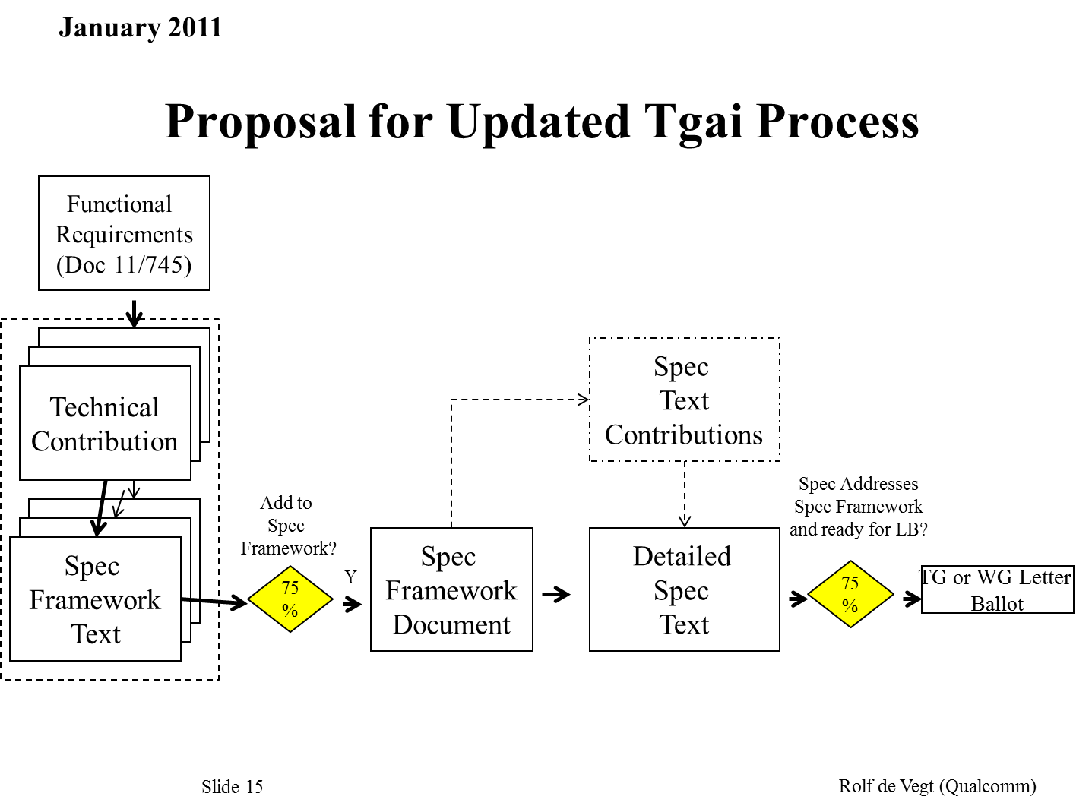
Old Proposal

Slide 4
Proposal (1) for Updated TGai Process
Functional
Requirements
(Doc 11/745)
Technical
Contributions
(for draft)
Legend
You are here
Technical
Contributions
(for Spec
framework)
Spec
Framework
75%
Formal document
flow
add to TGai
draft
influences
content and decisions,
cannot restrict
add to spec
framework
Spec
Framework
Text
TGai
Draft
75%

Slide 5
Proposal (2) for Updated TGai Process
Functional
Requirements
(Doc 11/745)
Technical
Contributions
(for draft)
Technical
Contributions
(for Spec
framework)
Spec
Framework
75%
add to TGai
draft
add to spec
framework
Spec
Framework
Text
TGai
Draft
75%

Slide 6
References
11-12-0147-00-00ai-tgai-spec-development-process-update-proposal.pptx

