Slide 1
Low-rate compatible BCC for IEEE 802.11ah lowest MCS
Date: 2012-05-06
Authors:

Slide 2
Abstract
We propose an efficient ¼-rate compatible binary convolutional code (BCC) for IEEE 802.11ah lowest MCS on the 1 MHz mode.
It is compatible with the original half-rate BCC, and just introduces small complexity overhead.
It is much better than the new MCS0- 2x Repetition mode, and then SNR gain is up to 0.85 dB at PER=0.1 .
.

Slide 3
Overview
According to the document 1294r0^{[1]}, the group adopted the following:
    An 802.11ah STA shall support reception of 1 MHz and 2 MHz PHY transmissions.
Subsequently, the document 1482r0^{[2]} proposed that an MCS0-Rep2 mode in 1MHz is needed for good indoor coverage.
The document 1484r0^{[3]} proposed the 11ah data transmission flow, both for regular MCS and for a new MCS0- 2x Repetition mode .
An improved ¼-rate BCC of the data transmission flow for 1 MHz mode is proposed, and obtains much better performance than the MCS0-2x Repetition mode with only small complexity overhead.

Slide 4
MCS0 ¼-rate BCC Mode in 1MHz
We propose a ¼-rate BCC mode that just imposes minimal Tx and Rx design change from regular MCSs.
  The first two generator polynomials of the compatible ¼-rate BCC shall use the original generator polynomials g₀=133₈ , g₁=171₈,
  The other two new generator polynomials are g₂=117₈ , g₃=165₈.
¼ -rate compatible Convolutional encoder

Slide 5
MCS0 ¼-rate BCC Tx Flow
IFFT
GI &
Window
Analog
& RF
Ncol = 8
FEC
BPSK
mapper
Scrambler
Interleaver
:
:
Spatial Mapping
Interleaver parameters are the same as regular MCS0
IFFT
GI &
Window
Analog
& RF
New ¼ rate BCC

Slide 6
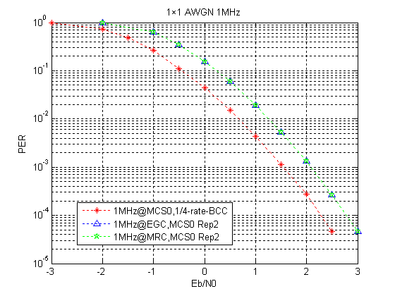
Performance in AWGN
New ¼-rate BCC Parameters | Value
Information bits | 516
Code Rate | 1/4
Modulation Type | BPSK
Bandwidth | 1.0 MHz
Number of OFDM | 86
FFT | 32
number of data subcarriers | 24
Subcarrier Bandwidth | 31.25 kHz
¼-rate BCC obtains 0.7 dB SNR gain at PER=0.1 compared with Rep2x.

Slide 7
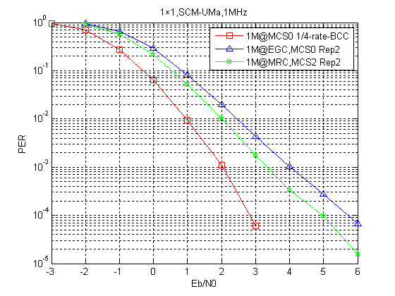
Performance in SCM-UMa
New ¼-rate BCC Parameters | Value
Information bits | 516
Code Rate | 1/4
Modulation Type | BPSK
Bandwidth | 1.0 MHz
Number of OFDM | 86
FFT | 32
number of data subcarriers | 24
Subcarrier Bandwidth | 31.25 kHz
New ¼-rate BCC obtains 0.85 dB and 1.2 dB SNR gain at PER=0.1 compared with MRC and EGC Rep2x schemes, respectively.

Slide 8
Complexity Discussions
BCC Viterbi decoder complexity depends mainly on the state number.
  ¼ -rate BCC has the same state number 64 and Trellis diagram as the ½-rate BCC, and the only difference lies in the branch probability computation.
  Number of additions and multiplications in different schemes.(assumptions: l information bits+Viterbi decoding)
    For EGC Rep2x, 134*l additions
    For MRC Rep2x,134*l additions and 4*l multiplications
    For ¼-rate BCC, 176*l additions
    Conclusion: The new complexity is almost as the MRC Rep2x

Slide 9
Conclusions
  An improved ¼-rate BCC data transmission flow for 1 MHz mode is proposed.
  It obtains much better performance than the MCS0-2x Repetition mode, which is up to 0.85 dB SNR gain at PER=0.1
  It is compatible with the original half-rate BCC, and just introduces small complexity overhead.
  It is suitable for the case where the transmit power is strictly restricted.

Slide 10
Straw poll
Do you accept the proposed ¼-rate BCC transmission flow in slides 4~5 as an enhanced scheme for IEEE 802.11ah lowest MCS?
  -Yes
  -No
  -Abstain

Slide 11
References
[1] 11-11-1294-00-00ah-spec-framework-text-of-11ah- bw-modes
[2] 11-11-1482-00-00ah-preamble-format-for-1-MHz
[3] 11-11-1484-00-00ah-11ah-phy-transmission-flow

