Slide 1
Enhanced Uplink Channel Access for 802.11ah
Date: 2012-05-15
Authors:

Slide 2
Abstract
Simulation results in earlier contributions suggest PCF or DCF to be enhanced in 802.11ah for:
Short, bursty traffic with large number of STAs (11-10/1511r0)
FTP traffic with Wifi-offloading (11-11/1515r0)
We present further simulation results on scenario #5 of 11-11/0905r5 and show fairness issues in uplinks and downlinks.
We present a mechanism for coordinated access to the wireless medium.

Slide 3
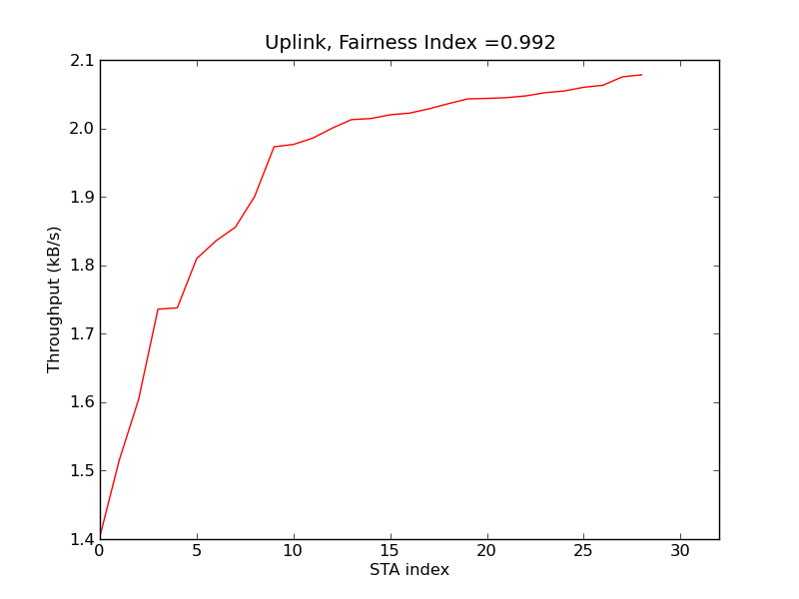
Use Case 3: Extended Range Wi-Fi
Parameters
29 STAs + 1 AP
2MHz channel, 600kbps
UDP traffic, 512 B payload
Uplink ~ 16kbps
Downlink ~ 240 kbps
Observation
Low downlink
Unfair
~ 70% utilization
Uplink: 1.5 ~ 2.1kB/s per STA
Downlink: 2.8 kB/s total

Slide 4
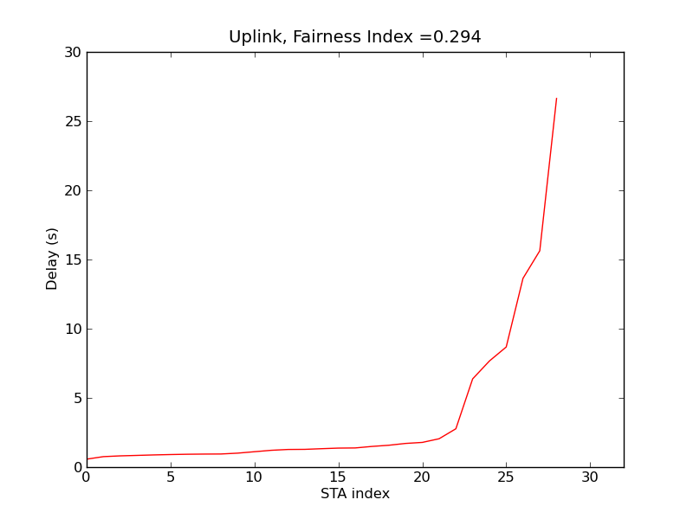
Use Case 3: Extended Range Wi-Fi (cont’d)
Uplink delay performance
Sorted in increasing values
Unfair
Delay values are not ideal for VoIP
Downlink delay performance
10 ~ 40s
Larger than STAs

Slide 5
Issues
Problem
High delay
Low utilization
Unfairness between STAs and AP
AP can coordinate uplink access through
Point Coordination Function (PCF)
Power-Saving Multi-Pull (PSMP)
But these functions are not desirable in OBSS cases
Frames are separated by SIFS
No CCA can be performed
Cause interference to neighbor BSS

Slide 6
Proposal
AP to facilitate grouping and coordinating uplink access
Smaller group sizes
Manage fairness within a group
Including downlink
Suggest to use backoff duration to coordinate traffic
Basic EDCA mechanism is still the same: CCA is performed
Address OBSS issues
Improve delay performance

Slide 7
Example
aSlotTime
STA 1 -> 2
STA 2 -> 4
STA 3 -> 6
AP
DIFS
DIFS
STA 1
CCA
Uplink MPDU
STA 2
CCA
CCA
Uplink MPDU
DIFS
1 2 3
4 5
STA 3
CCA
No uplink
5 6
OBSS
STA x
CTS
Receive

Slide 8
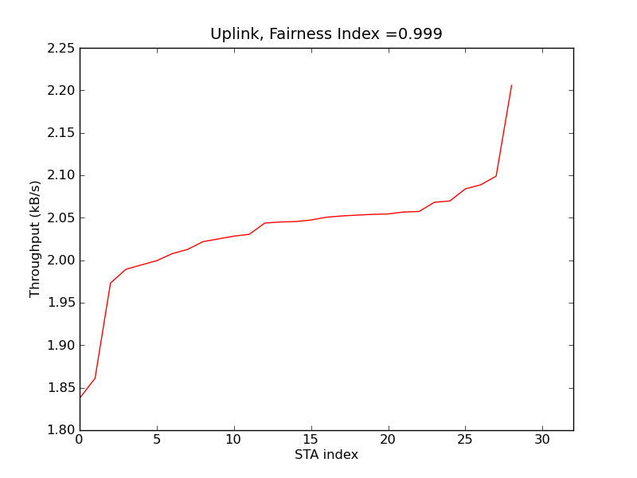
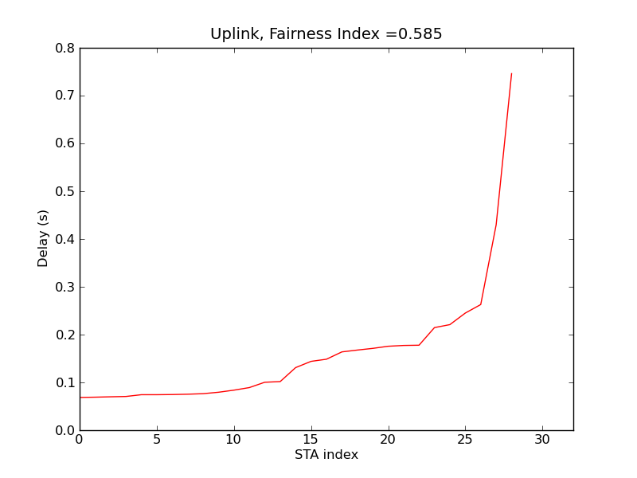
Preliminary Results
Uplink: 1.8 ~ 2.2 kB/s
Compare original: 1.5 ~ 2.1 kB/s
Downlink: 10.55 kB/s total
Compare original: 2.8 kB/s
~ 91% Utilization
Compare ~ 70%
Low delay
0.09s ~ 0.75s
Compare original: 10~40s

Slide 9
Conclusion
Use Case 3: Extended Range Wifi Problems
High contention for small number of STAs
High delay, unsuitable for target applications
Unfairness between STAs and AP
Low channel utilization
There is a need for AP to facilitate grouping and coordinating uplink access
Smaller group sizes
Suggest use of backoff duration to coordinate uplink traffic

Slide 10
References
[1] 11-11/0905r5, TGah Functional Requirements and Evaluation Methodology Rev 5.
[2] 11-10/1511r0, Fairness of DCF.
[3] 11-11/1515r0, 802.11ah Wi-Fi Offloading Considerations.

