Slide 1
Target PER at receiver sensitivity power level for use case 1g
Date: 2012-05-XX
Authors:

Slide 3
Abstract
Propose target PER at receiver sensitivity power level for use case 1g ^{[1]}.

Slide 4
Background and motivation
Straw poll result of DCN 11-12-0244r0 at the last F2F meeting was
“Do you agree that in addition to MCS0 rep2 other technique to improve link margin should to be devised and included in Spec Framework?”
RESULT: YES: 28 NO: 0 ABSTAIN: 21
A comment “Link budget depends on target PER.” was received about DCN 11-12-0244r00 at IEEE802 Plenary Meeting Mar 2012.
Target PER should be clarified for fair comparison to decide the above other techniques in simulation.

Slide 5
Basic policy to decide target PER
Target PER for 802.11ah should be equal to or better than the IEEE802.15.4g
Why?
Use case 1g (i.e. HEMS, BEMS) ^{[1]} is similar to one target application of IEEE802.15.4g.
Devices of 11ah might not be used if 11ah devices’ performance was worse than devices of 15.4g for senor networks.

Slide 6
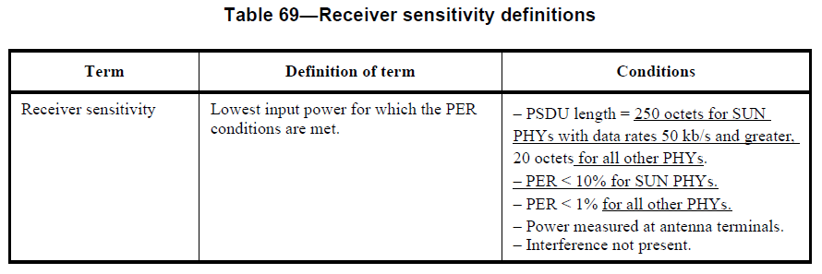
IEEE802.15.4g target PER
A few 100 octets packet size is needed for use case 1g ^{[1]}.
PER specification of IEEE802.15.4g at receiver sensitivity power level is
PER < 10 % for a packet with 250 octets.
802.15.4g-2012.pdf (official version) specifies the following PER.
SUN stands for Smart Utility Network

Slide 7
TGah target PER for use case 1g
Target PER at receiver sensitivity level should be better or equal to the IEEE802.15.4g PER for use case 1g.
Therefore,
PER at receiver sensitivity level shall be less than 10% for PSDU length 250 octets for use case 1g.

Slide 8
Straw Poll
Do you agree that
for determining receiver sensitivity level requirements PER shall be
less than 10% and PSDU length 250 octets for use case 1g?
Yes:
No:
Abstain:

Slide 9
References
[1] DCN 11-11-0457r0

Slide 10
Annex

Slide 11
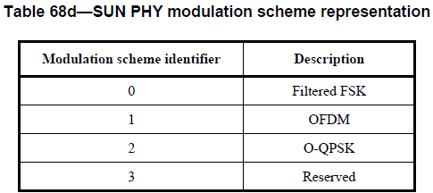
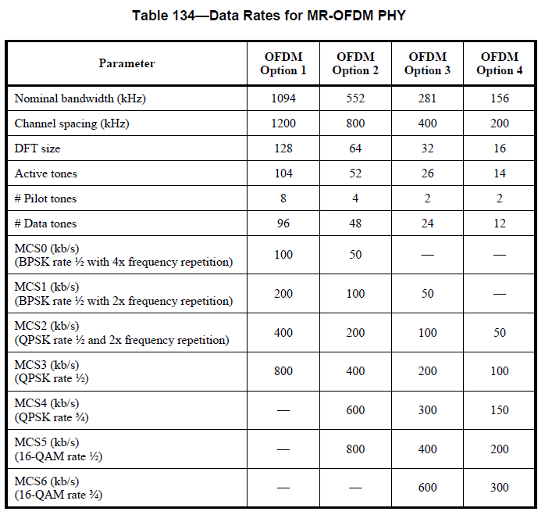
Definition of SUN PHY (15.4g)
Sub-carrier modulation techniques defined by 15.4g is very close to MCSs defined by TGah.

Slide 12
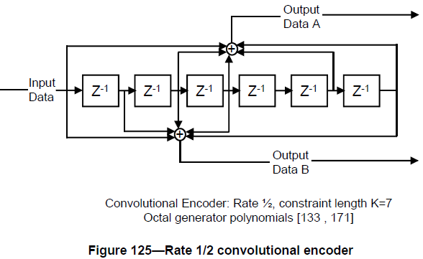
FEC of 15.4g OFDM
16.2.3.4 Forward error correction (FEC) (d7P802-15-4g_Draft_Standard.pdf)
The DATA field shall be coded with a convolutional encoder of coding rate R = 1/2 or 3/4, corresponding to the desired data rate. The convolutional encoder shall use the generator polynomials expressed in octal representation, g0 = 133₈ and g1 = 171₈, of rate R = ½, as shown in Figure 125. The convolutional encoder shall be initialized to the all zeros state before encoding the PHR and then reset to the all zeros state before encoding the PSDU.
R=1/2
K = 7
FEC technique of IEEE802.15.4g when coding rate R is ½ is as same as the MCS0 defined by TGah.
Difference between 15.4g and TGah is repetition technique.
15.4g: frequency domain repetition, TGah: time domain repetition
Comparison with 15.4g target PER can be reasonable.

