Slide 1
Extended Sleep mode for battery powered STAs
Date: 2012-09-07
Authors:
Name | Affiliations | Address | Phone | Email
Rojan Chitrakar | Panasonic R&D center Singapore | Blk1022 Tai Seng Ave #06-3530 Singapore | +65-65505347 | Rojan.Chitrakar@sg.panasonic.com
Ken Mori | Panasonic Corp |  |  | Mori.ken1@jp.panasonic.com
Chittabrata Ghosh | Nokia | Berkeley, CA | +1 650 200 7566 | chittabrata.ghosh@nokia.com
Klaus Doppler | Nokia
Taejoon Kim | Nokia
Sayantan Choudhury | Nokia
Minyoung Park | Intel | Hillsboro, OR | +1 503 712 4705 | minyoung.park@intel.com
Tom Tetzlaff | Intel
Emily Qi | Intel
Thomas Kenney | Intel
Yongho Seok | LG Electronics
Jinsoo Choi | LG Electronics
Jeongki Kim | LG Electronics
Jin Sam Kwak | LG Electronics
ChaoChun Wang | MediaTek
James Wang | MediaTek
Jianhan Liu | MediaTek
Vish Poonampalam | MediaTek
James Yee | MediaTek
Thomas Pare | MediaTek
Kiran Uln | MediaTek

Slide 2
Authors:
Name | Affiliations | Address | Phone | Email
Huai-Rong Shao | Samsung Electronics
Chiu Ngo | Samsung Electronics
Yong Liu | Marvell
Hongyuan Zhang | Marvell
Sudhir Srinivasa | Marvell
Simone Merlin | Qualcomm | San Diego, CA | +1 858 845 1243 | smerlin@qualcomm.com
Santosh Abraham | Qualcomm
Menzo Wentink | Qualcomm
Alfred Asterjadhi | Qualcomm
Amin Jafarian | Qualcomm
Hemanth Sampath | Qualcomm
VK Jones | Qualcomm
Osama Aboul-Magd | Huawei
George Calcev | Huawei | Rolling Meadows,IL
Young Hoon Kwon | Huawei
Betty Zhao | Huawei
David Yangxun | Huawei
Bin Zhen | Huawei
Minho Cheong | ETRI
Jae Seung Lee | ETRI
Hyoungjin Kwon | ETRI
Heejung Yu | ETRI
Jaewoo Park | ETRI
Sok-kyu Lee | ETRI
Sun, Bo | ZTE
Lv, Kaiying | ZTE

Slide 3
Authors:
Name | Affiliations | Address | Phone | Email
Eric Wong | Broadcom | Sunnyvale, CA | +1 408 922 6672 | ewong@broadcom.com
Matthew Fischer | Broadcom |  |  | mfischer@broadcom.com
Haiguang Wang | I2R
Shoukang Zheng | I2R
Yeow Wai Leong | I2R
Zander Lei | I2R
Jaya Shankar | I2R
Anh Tuan Hoang | I2R
Joseph Teo Chee Ming | I2R

Slide 4
Background
12-0069r5 introduced mechanism to extend the Max Idle Period to days and even months and also added capability for the AP to support multiple Max Idle Periods extension in order to support multiple device categories.

Slide 5
Prior Proposals
In 12-0656r0, we introduced mechanism to extend the WNM-Sleep Interval of battery powered STAs by using different scaling factors. Fair amount of support was received in the two straw polls:
  SP1: Do you agree that mechanisms must be considered to extend the WNM-Sleep Interval? 14 Y: 0 N: 22 A
  SP2: Do you support having different scaling factors for WNM-Sleep Interval (using one or two bits to represent different types of units for WNM-Sleep Interval and the remaining bits for the actual value)? 9 Y: 0 N: 22 A
In this presentation, we follow up on our earlier work and propose unified mechanism to extend BSS Max Idle Period, Listen Interval and WNM-Sleep Interval.

Slide 6
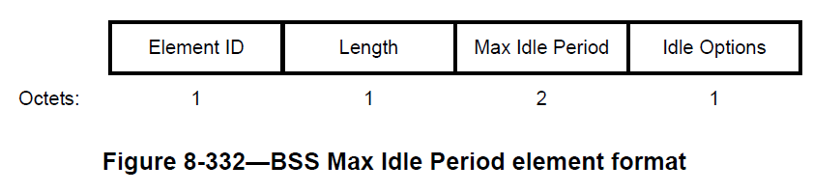
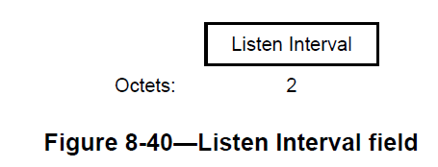
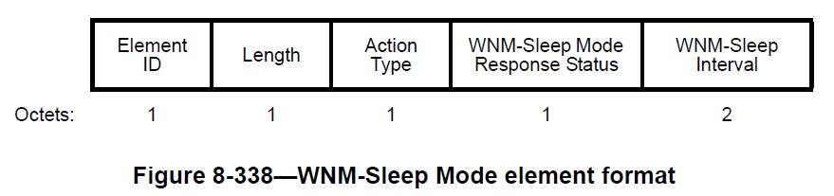
Scaling Factor
All of the concerned fields: BSS Max Idle Period, Listen Interval and WNM-Sleep Interval are two bytes long. In order to extend the range of BSS Max Idle Period, Listen Interval and WNM-Sleep Interval, we propose using the first two MSB to represent the Scaling Factor (SF) and the remaining 14 bits to indicate the actual value.
Scaling
Value
16 | 15 | 14 | 13 | 12 | 11 | 10 | 9 | 8 | 7 | 6 | 5 | 4 | 3 | 2 | 1
B1B2 | Scaling Factor (SF)
00 | 1
01 | 10
10 | 1000
11 | 10000

Slide 7
Minimum and Maximum Value
The minimum step size as well as the Maximum value achievable with the proposed scaling method is described in the table below:
 | Unit | Min. Step Size (SF = 1) | Max. Value (SF = 10000)
BSS Max Idle Period | 1000TU | 1000TU = 1.024s | 16383*10000*1000TU = 4660hrs ~ 1941 days
Listen Interval | BI | BI | 16383*10000*BI (4550 hrs ~189 days if BI = 100ms)
WNM-Sleep Interval | DI | DI | 16383*10000*DI (13652 hrs ~ 568 days if BI = 100ms & DI = 3*BI)

Slide 8
Benefits
Benefits of using the 2 + 14 bits method:
No additional signaling required between AP and STAs to negotiate the Scaling Factor.
No changes required to the current frame formats; only the interpretation of certain fields are different.
Since the Scaling Factors are carried together with the Intervals, there is no need for AP to store the Scaling Factor used by different STAs thereby saving AP’s resources.

Slide 9
Conclusion
By using unified Scaling Factors for BSS Max Idle Period, Listen Interval and WNM-Sleep Interval, we can extend the sleep duration of both TIM and non-TIM STAs.

Slide 10
References
[1] 12-127r1 Low Power Medium Access
[2] 12-615r0 Non-TIM Stations in 11ah
[3] 12-0069r5 Consideration on max-idle period extension for 11ah power-save
[4] 12-0618r0 Listen interval for sensor devices

Slide 11
Straw Poll 1
Do you support extending the BSS Max Idle Period, Listen Interval and WNM-Sleep Interval by introducing unified Scaling Factors i.e.. using the first two MSB bits to represent the Scaling Factor (SF) and the remaining 14 bits to indicate the actual value?
Y: N: A:
Scaling
Value
16 | 15 | 14 | 13 | 12 | 11 | 10 | 9 | 8 | 7 | 6 | 5 | 4 | 3 | 2 | 1

Slide 12
Straw Poll 2
Do you support using the Scaling Factors as shown in the table below?
Y: N: A:
B1B2 | Scaling Factor (SF)
00 | 1
01 | 10
10 | 1000
11 | 10000

Slide 13
Annex

Slide 14
Background: WNM Sleep Mode
WNM-Sleep mode enables a non-AP STA to signal to an AP that it will be sleeping for a specified length of time. This enables a non-AP STA to reduce power consumption and remain associated while the non-AP STA has no traffic to send to or receive from the AP.
Association Request
1) Max Idle Period negotiation:
STA indicates to the AP that it supports WNM-Sleep Mode by setting the WNM-Sleep Mode field to 1 in the Extended Capabilities IE in the Association Request Frame.
AP decides the Max Idle Period it can support based on the available resources and notifies the STA in the Association Response Frame.
Association Response
⁞
WNM Sleep Mode Request
2) WNM-Sleep Mode Setup:
STA requests permission to enter WNM-Sleep Mode and optionally also indicates the actual wake up time in the “WNM-Sleep Interval” field in the WNM-Sleep Mode Request frame if the STA wishes to receive group-addressed traffic indicated in the DTIM.
AP grants/denies permission to enter WNM-Sleep Mode.
WNM Sleep Mode Response
AP
STA

Slide 15
WNM Sleep Mode Setup
The WNM-Sleep Interval field (16 bits) indicates to the AP how often a STA in WNM-Sleep Mode wakes up to receive Beacon frames, defined as the number of DTIM intervals.
According to 802.11-2012 Base Specification, the WNM-Sleep Interval field shall be less than BSS Max idle period.

Slide 16
Motion 1
Move to add to SFD mechanism to extend the BSS Max Idle Period, Listen Interval and WNM-Sleep Interval by introducing Unified Scaling Factors i.e. using the first two MSB to represent the Scaling Factor (SF) and the remaining 14 bits to indicate the actual value.
Y: N: A:
Scaling
Value
16 | 15 | 14 | 13 | 12 | 11 | 10 | 9 | 8 | 7 | 6 | 5 | 4 | 3 | 2 | 1

Slide 17
Motion 2
Move to add to SFD the definition of the Unified Scaling Factors as shown in the table below:
Y: N: A:
B1B2 | Scaling Factor (SF)
00 | 1
01 | 10
10 | 1000
11 | 10000

