Slide 1
Grouping Methodology
Date: 2012-05-14
Authors:

Slide 2
Abstract
We specify the grouping operation in 802.11ah

Slide 3
Motivation
DCF performance deteriorates when a large number of STAs contend for medium access [1]
  Overall number of MAC retries and total transmission delay grow exponentially with the number of STAs
Grouping based on contention factor was proposed in [2]
  AP sends in Beacon contention factor Q in [0,1] and time interval T
Subsequently energy and delay savings of an enhanced grouping approach compared to DCF were shown in 12/28r1 [3]
  Considers use case 1a Smart Grid - Meter to Pole (6000 STAs per AP) [4]
    Sensors measure power/gas/water

Slide 4
Motivation (Cont’d)
DCF performance also deteriorates under overloading
System overloading cannot always be prevented with planning e.g.
    Users may all decide to check stocks at opening/closing of market
    If activation trigger for sensors (or M2M devices) is not time-dependent it may require that they contact the network at the same time e.g.,
      Different sensors in system monitoring of e.g., shopping mall will all report at the same time in presence of smoke, fire, or water detectors and if there is fire
        Desirable as fire department knows extent of fire, smoke, sprinkler condition
The performance gains in terms of delay, energy, and fairness of the enhanced grouping in 12/28r1 compared to DCF were shown under an overloaded system in 374r2 [5]
  Use case 1c: Extended range hotspot [4] (in addition to 1a)
  Scenarios include extended home coverage, campus and mall coverage

Slide 5
Grouping In a Nutshell
The purpose of grouping is to reduce collisions in STA transmission and minimize STA energy consumption as presented in [3], [5]
Originally AP can create only a single group with contention factor =1
  Everyone can access as currently - DCF operation is in use
  All STAs are assigned to that group, until AP’s threshold is exceeded
  Threshold can be e.g., AP implementation dependent/tuned depending on use case
If the number of associated STAs within a group is larger than a threshold
  AP adds a new group
  Grouping becomes enabled when there are at least two groups
  Managing the number of groups can be AP implementation dependent
    Maximum number could be defined in the standard
If number of STAs in the groups drops below a threshold
  AP removes a group
Support of grouping from AP can be indicated at Association to STAs
  AP can give grouping parameters used at that moment in that Association signaling

Slide 6
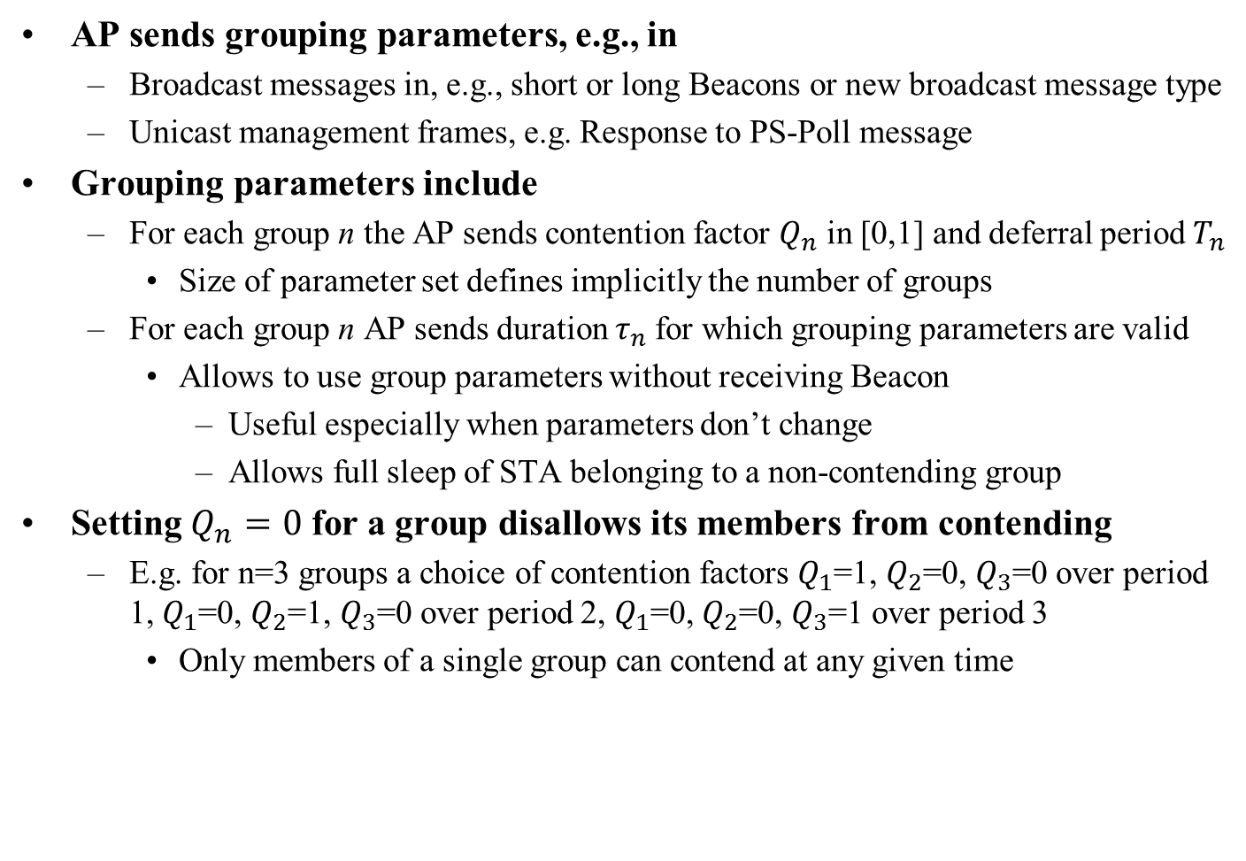
Grouping Parameters
AP sends grouping parameters, e.g., in
  Broadcast messages in, e.g., short or long Beacons or new broadcast message type
  Unicast management frames, e.g. Response to PS-Poll message
Grouping parameters include
  For each group n the AP sends contention factor $Q_{n}$ in [0,1] and deferral period $T_{n}$
    Size of parameter set defines implicitly the number of groups
  For each group n AP sends duration $τ_{n}$for which grouping parameters are valid
    Allows to use group parameters without receiving Beacon
      Useful especially when parameters don’t change
      Allows full sleep of STA belonging to a non-contending group
Setting $Q_{n}=0$ for a group disallows its members from contending
  E.g. for n=3 groups a choice of contention factors $Q_{1}$=1, $Q_{2}$=0, $Q_{3}$=0 over period 1, $Q_{1}$=0, $Q_{2}$=1, $Q_{3}$=0 over period 2, $Q_{1}$=0, $Q_{2}$=0, $Q_{3}$=1 over period 3
    Only members of a single group can contend at any given time

Slide 7
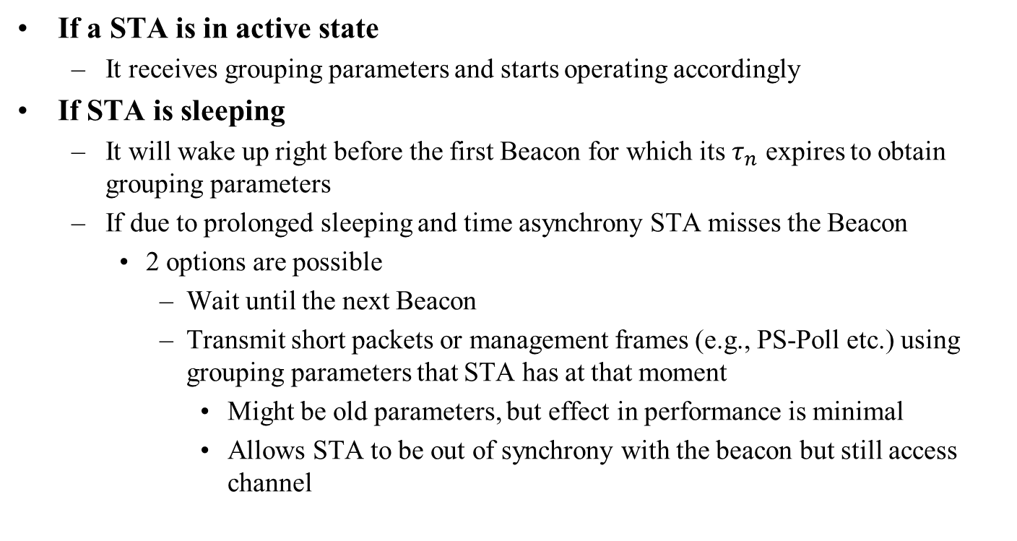
STA Operation in Different States
If a STA is in active state
  It receives grouping parameters and starts operating accordingly
If STA is sleeping
  It will wake up right before the first Beacon for which its $τ_{n}$ expires to obtain grouping parameters
  If due to prolonged sleeping and time asynchrony STA misses the Beacon
    2 options are possible
      Wait until the next Beacon
      Transmit short packets or management frames (e.g., PS-Poll etc.) using grouping parameters that STA has at that moment
        Might be old parameters, but effect in performance is minimal
        Allows STA to be out of synchrony with the beacon but still access channel

Slide 8
STA to Group Assignment
Define scheme with low signaling overhead
To reduce overhead AP does not send STA to group assignment along with grouping parameters
AP sends a function to the STAs among several function options and lets them compute the group they should join
STAs can be preconfigured with this function
The simplest form of this function is: AID mod # groups
  Other functions TBD
By assigning AID properly, AP can force similar STAs in the same group
AP assigns group implicitly through function and AID assignment

Slide 9
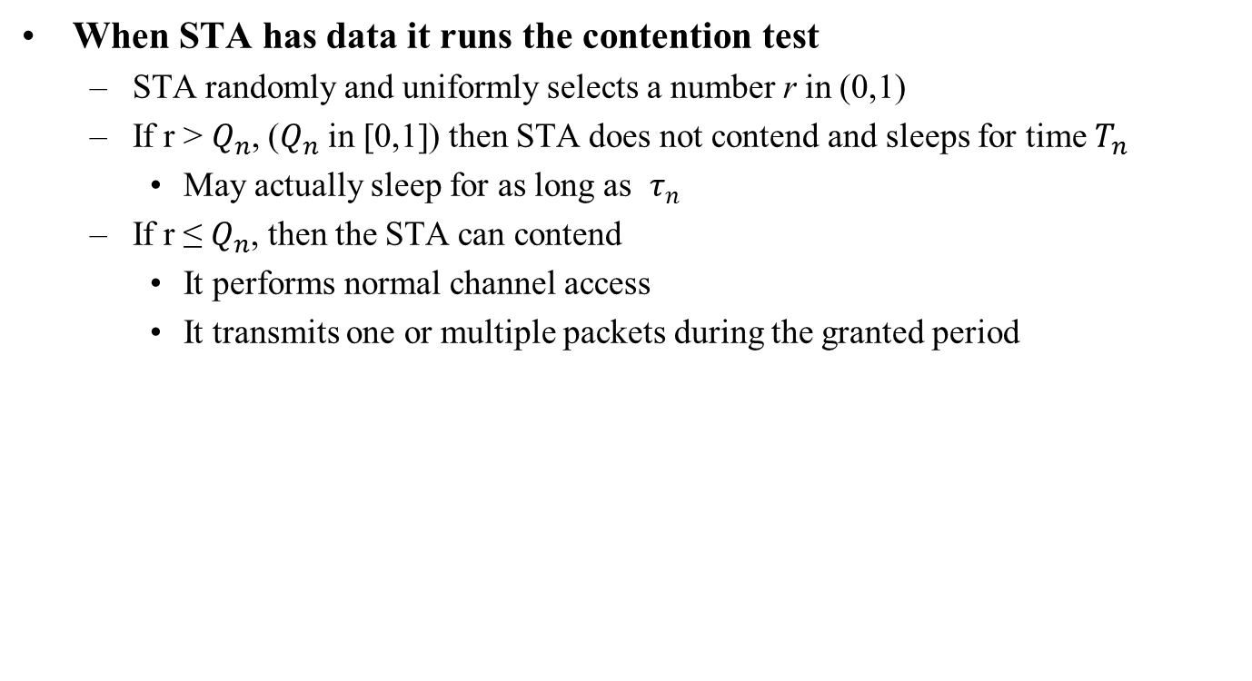
Controlling Access
When STA has data it runs the contention test
  STA randomly and uniformly selects a number r in (0,1)
  If r > $Q_{n}$, ($Q_{n}$ in [0,1]) then STA does not contend and sleeps for time $T_{n}$
    May actually sleep for as long as $τ_{n}$
  If r ≤ $Q_{n}$, then the STA can contend
    It performs normal channel access
    It transmits one or multiple packets during the granted period

Slide 10
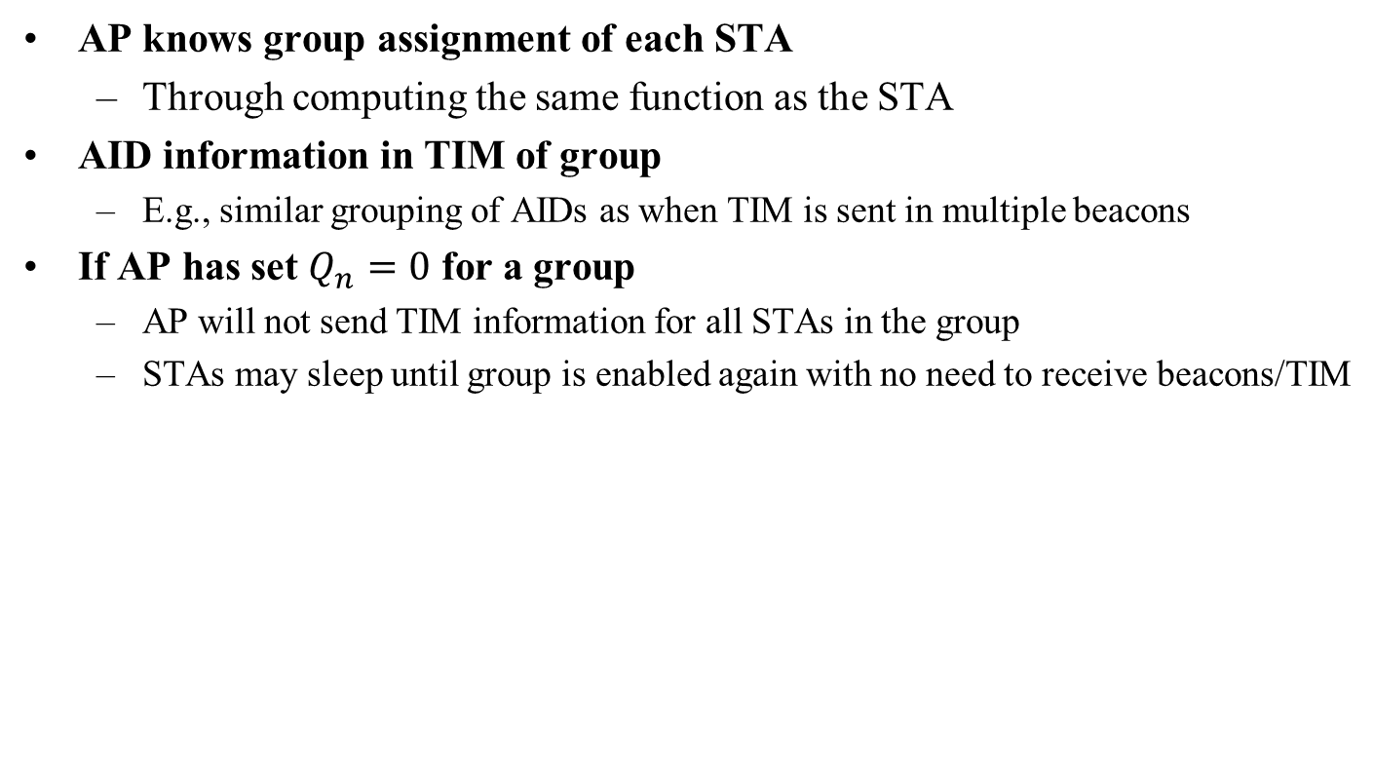
Grouping and TIM Information
AP knows group assignment of each STA
  Through computing the same function as the STA
AID information in TIM of group
  E.g., similar grouping of AIDs as when TIM is sent in multiple beacons
If AP has set $Q_{n}=0$ for a group
  AP will not send TIM information for all STAs in the group
  STAs may sleep until group is enabled again with no need to receive beacons/TIM

Slide 11
Conclusions
Grouping was introduced to control channel access when a large number of STAs are associated with an AP
Subsequently, an enhancement of grouping was shown to additionally provide energy savings
Presented a methodology on how this enhanced grouping may work in 802.11ah

Slide 12
Straw Poll 1
Do you agree to introduce grouping of STAs to 802.11ah amendment for controlling the number of STAs performing channel access and to save energy?
Y: N: A:

Slide 13
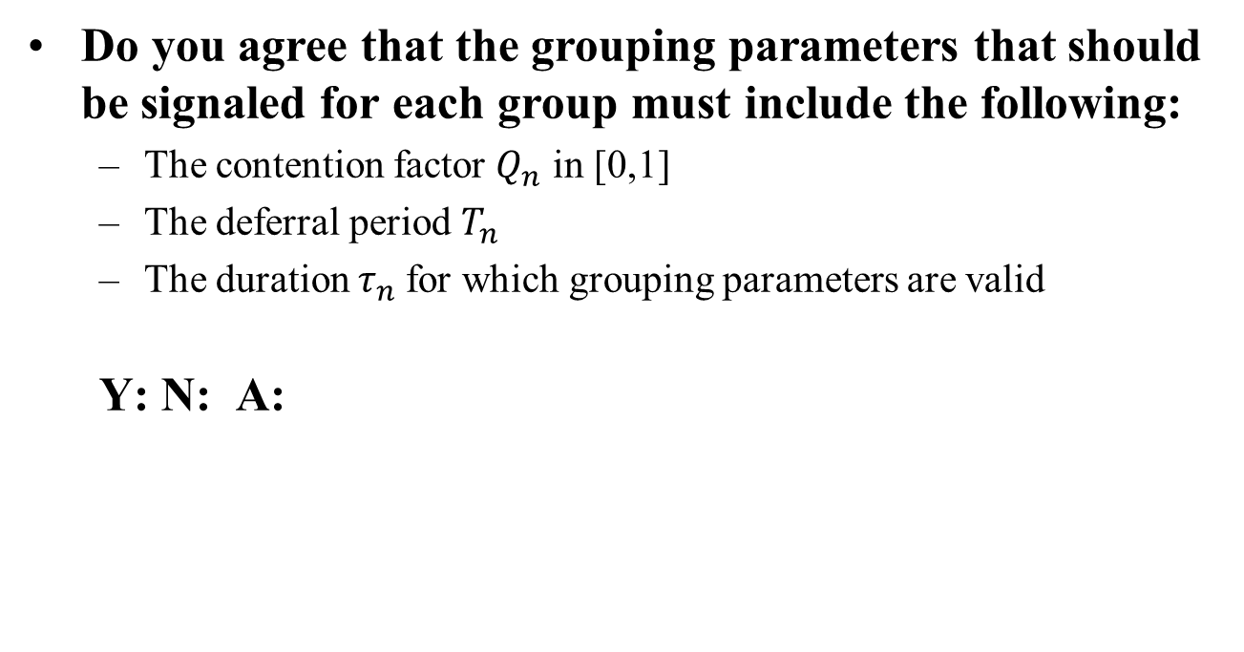
Straw Poll 2
Do you agree that the grouping parameters that should be signaled for each group must include the following:
  The contention factor $Q_{n}$ in [0,1]
  The deferral period $T_{n}$
  The duration $τ_{n}$for which grouping parameters are valid
  Y: N: A:

Slide 14
References
[1] 11-11-1019-01-00ah-simulation-large-number-of-stas-support
[2] 11-11-1255-00-00ah-dcf-enhancements-for-large-number-of-stas
[3] 11-12-0028-01-00ah-power-saving-possibilities-for-networks-supporting-a-large-number-of-stas
[4] 11-11-0457-00-00ah-potential-compromise-of-802-11ah-use-case-document
[5] 11-12-0374-02-00ah-grouping-for-11ah-networks

