Slide 1
Open-Loop Link Margin Index for Fast Link Adaptation
Date: 2012-05-10
Authors:

Slide 4
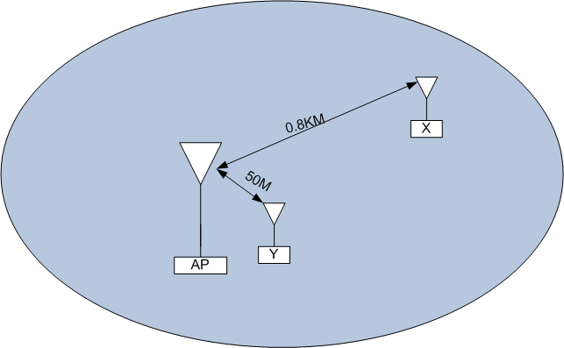
Path Loss Difference in Wide Area BSS
In a wide area BSS, there are STAs close to AP and STAs far away from AP
  For Example, the path loss of STA X is log2(800/50)*6=24dB more than STA Y

Slide 5

Open-loop link adaptation
Transmission Scenario for low duty cycle STAs
  Extra handshaking packet exchange for close-loop link adaptation introduces significant overhead
  Using optimal MCS reduces channel time and power consumption
Open-loop link-adaptation
  Avoid extra overhead of exchanging frames
  Avoid re-transmissions
  Increase link capacity

Slide 6
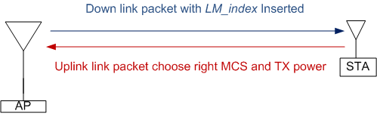
Open-Loop Link Margin Index
Down link
Uplink
Define Open-Loop Link Margin Index
Insert in a certain downlink frame
: Minimum required received power for MCS0 Rep2

Slide 7

Format of Open-Loop Link Margin Index
Open-Loop Link Margin Index can be included in any management frame as an Information Element
  1 Byte Open-Loop Link Margin Index is good enough
    With Granularity 0.5dB, the indication range is 128dB
      Dynamic Range due to MCS: 30dB (MCS 0 to MCS9)
      Difference due to BW: 12dB (1MHz to 16MHz)
    The lowest link margin can from -127dBm to 0dBM
      1MHz Channel Noise Floor is -109dBm (assume 5dB Noise figure)

Slide 8
Usage of Open-Loop Link Margin Index
Variations of RX sensitivity
  AP with 4 antennas can have 6dB better sensitivity than AP with single Antenna
  AP made by different vendors may have different implementations
  AP may experience long-term small interference due to wide area BSS
Usage of Open-Loop Link Margin Index
  Open-Loop Link Margin Index is mainly for low-duty cycle sensors and meters which are mostly stationary
  A STA that knows its position changing quickly should avoid or be more conservative on using Open-Loop Link Margin Index
  Including Open-Loop Link Margin Index is optionally in beacon or other management frames

Slide 9
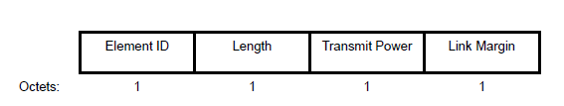
Compared to TPC Report Element
The format of TPC report element (802.11 REVmb/D12, page 536)
Contain Transmit power only (802.11 REVmb/D12, page 1107)
  TPC Report element can only contain transmit power information in the Transmit Power field with the Link Margin field set to 0 in any Beacon frame or Probe Response frame it transmits.
Weakness of TPC Report Element
  Open-loop link adaptation based on TPC report element is not accurate
    Rx Sensitivity varies for different implementations and environments
    Rx Sensitivity also varies for AP with different MRC capability
  Needs 4 Bytes

Slide 10
Conclusions
Open-loop link adaptation is required in 11ah for low duty cycle STAs
  Avoid extra overhead of exchanging frames
  Avoid re-transmissions
  Increase link capacity
Open-loop Link Index is defined as an Information Element

Slide 11
Straw poll
Do you agree to include Open-Loop Link Margin Index information element defined as
where the Open-Loop Link Margin Index is computed according to the equation
-The detailed format and description are TBD.

