Slide 1
Overlapping IEEE 802.11ah Networks of Different Types
Date: 2012-05-12
Authors:

Slide 2
Abstract
In this contribution, we present performance results for the overlapping BSSs of sensor and data offloading networks. We found that collisions from OBSS of different network types may cause excessive operation cost.

Slide 3
Motivation
IEEE 802.11ah standard may be used for different applications such as data offloading and sensor networks. Different networks may be deployed with overlapping coverage, sharing the same channel. It is necessary to study coexistence issues and address them in the design if necessary.
The AP and STAs of a long range sensory BSS may not hear the traffic of short range offload BSSs enclosed in the area covered by the long range sensory BSS.

Slide 4
Simulation Parameters
Simulator
  Qualnet network simulator
Simulation parameters
  DCF mode with 2 MHz bandwidth as specified by 802.11ah frame work
  PHY modulation: MCS0-REP2
  Transmission range: 350 meters to1 km (depending on transmission power)
Basic parameters
Parameter | Value | Parameter | Value
Data Rate | 300 Kbps | Backoff Win | 15 - 1023
Number of Nodes | 50- 3000 | Maximum Short Retry | 7
DIFS | 250 us | Maximum long Retry | 4
SIFS | 160 us | Time slot | 45 us

Slide 5
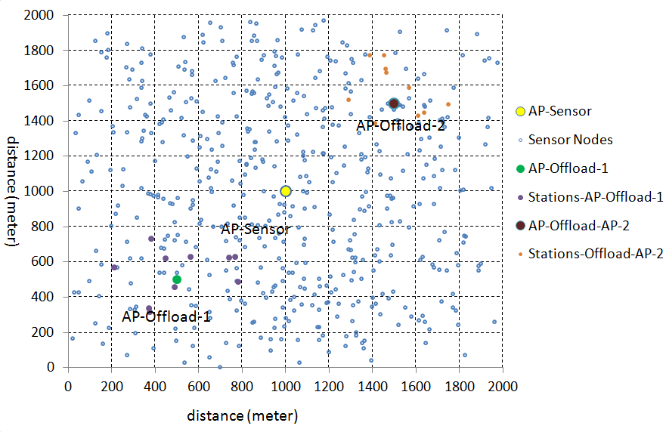
Network Topology

Slide 6
Configuration Parameters for Sensor Networks
Parameter | Value | Parameter | Value
AP | AP-Sensor | Number of Sensors | 500
Tx Power | 30 dBm | Transmission Range | 1 km
Beacon Interval | 1 second | Traffic | CBR (1 data pkts/5 minutes/station)

Slide 7
Configuration Parameters for Data Offloading Networks
Parameter | Value | Parameter | Value
AP | AP-Offload-1 AP-Offload-2 | Number of Data Offload Stations | 20
Tx Power | 7 dBm | Beacon Interval | 100 milliseconds
Transmission range | 350 meters | Traffic | HTTP Traffic Models provided by Qualnet.

Slide 8
Performance Results: Isolated Networks
Three networks are studied separately and only one network is in operation in each experiment.
  Server receives more authenticate request than the response sends back:
    Server drop some authenticate request if its management queue is overflowed.
Table 1: Management Frames Transmitted/Received by AP-Sensor and AP-Offloading without Co-located APs.
Item Name | AP-Sensor | AP-Offload-1 | AP-Offload-2
Authentication Request received | 1553 | 10 | 10
Authentication Response transmitted | 511 | 11 | 11
Association Request received | 500 | 10 | 10
Association Response transmitted | 510 | 10 | 10
Total | 3074 | 41 | 41

Slide 9
Performance Results: OBSS Networks
Three networks are turned on at the same time and studied in the same experiment.
  Excessive transmissions in authentication/association are observed.
  Reason: sensors/offload stations may lose beacons consecutively due to collisions and keep on triggering the authentication/associations at these affect stations.
    Transmissions from offloading networks collide with beacons from AP-Sensor.
    Transmissions from sensors collide with beacons from AP-Offload.
Table 2: Management Frames Transmitted/Received by AP-Sensor with Co-located data offloading APs
Item Name | AP-Sensor | AP-Offload-1 | AP-Offload-2
Authentication Request received | 5113 | 68 | 44
Authentication Response transmitted | 4191 | 83 | 61
Association Request received | 2190 | 42 | 30
Association Response transmitted | 4553 | 74 | 49
Total | 16047 | 267 | 184

Slide 10
Conclusion
For the IEEE 802.11ah based networks, different types of OBSS networks may interfere to each other and cause excessive management traffic.
TGah should address such OBSS issues and develop methods for minimizing interference between the overlapping networks.
Future work will consider the impact of data traffic of different applications.

