Slide 1
TGaf PHY Proposal
Date: 2012-05-14
Authors:
Slide 1

Slide 2
Outline
Propose PHY details for one and multiple channels
Topics discussed:
  Frame format based on 11ac with tweaks based on 11ah
  Sampling frequency
  Structure for multiple contiguous and non-contiguous channels
Slide 2

Slide 3
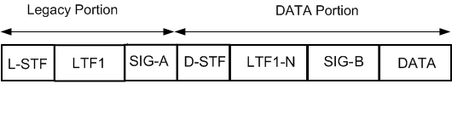
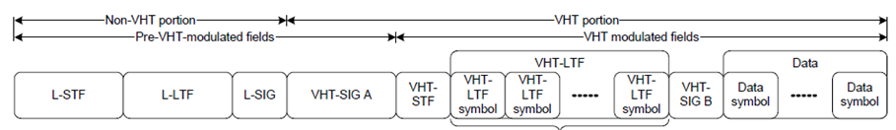
Frame Format
The proposed frame format is shown below
  Identical to 11ac format with the exception that the VHT-SIG field has been merged into the L-SIG field
  VHT portion renamed as DATA portion
  This format is identical to 11ah long preamble format.
  In general, the mathematical formulation of the legacy and data portions follow the 11ac mathematical formulation of the non-VHT and VHT portions respectively
  11ac format reminder
Slide 3

Slide 4
FFT Choice for One Channel
Two FFT choices were discussed previously, namely 64FFT and 128FFT with known tradeoffs [1][2][3]
  128FFT supports higher delay spread, larger BW (impact of sharp filters reduced) but has higher preamble overhead
We have found that between the two options only 128FFT is suitable in order to meet the following requirements:
  Supported delay spread for cellular offload applications
  Support for sharp filtering required to meet the spectral mask (the filter ‘eats’ considerable amount of the GI for 64FFT – see Appendix A discussion)
The same FFT size will be used for TVWS 6MHz and 8MHz channels (using different sampling frequencies)
Slide 4

Slide 5
Legacy Portion Details
Although TGaf doesn’t have to deal with ‘legacy’ devices we expect that this spec will effectively become the 11a of TVWS and future improvements/changes due to regulatory changes will use this legacy portion for backward compatibility
  Note that at this point the regulatory is clear in only one country
Hence it is important to leave enough reserved bits and ‘reset’ the content of the SIG field in a similar fashion to what’s been done in 11ah
Slide 5

Slide 6
Cont – STF and LTF fields
The STF field consists of two symbols modulated by the sequence used to modulate the 64FFT. The sampling frequency for the STF field is the same as the rest of the packet.
Using the 64FFT structure is done in order to enable the same packet acquisition circuitry as in current 802.11 devices
  Note the STF is a time domain signal that doesn’t require an FFT (hence no need for two different FFT sizes)
The LTF field uses two 128FFT symbols modulated exactly as the corresponding VHT-LTF in 11ac
Slide 6

Slide 7
Cont – SIG field
The SIG field consists of one 128FFT symbol supporting up to 54 information bits
  Note that one channel is the minimum TVWS unit and the DUP structure is not needed and unnecessarily reduces Tput
The proposed SIG field content is similar to the
current 11ah SIG field content only modifying the length
field and the number of supported spatial streams from 11ac
Similar to 11ah there is no need to support more than 4
spatial streams in 11af
Exact definition of the fields is in 11ah spec framework
document (1137)
 | SU | MU
SU/MU Indication | 1 | 1
Length / Duration | 9 | 9
MCS | 4
BW | 2 | 2
Aggregation | 1
STBC | 1 | 1
Coding | 2 | 5
SGI | 1 | 1
GID |  | 6
Nsts | 2 | 8
PAID | 9
Reserved | 12 | 11
CRC | 4 | 4
Tail | 6 | 6
Total | 54 | 54
Slide 7

Slide 8
128FFT Sampling Frequency
From the recent FCC-12-36A1 ruling (5.5MHz DATA, 250KHz roll-off)
802.22 spec – 2K FFT with sampling frequency 6.856MHz, # of tones 1680 => DATA BW is 5.62MHz
  Note that 2K FFT allows sharper filtering with less impact on performance due to the longer GI
In order to accommodate the GI length of a 128FFT we have decided to double the roll-off guard band assumed by the FCC to about 500KHz.
500KHz roll-off guard band is equivalent to 5.5MHz sampling clock
  117/128*5.5MHz=5MHz
Appendix B provides simulation results of the filtering impact with that sampling frequency.
Similarly for TVWS 8MHz channels the sampling frequency is (TBD - 22/3MHz) assuming similar spectral mask restrictions.
We are therefore increasing the PSD limit for each category of
TV bands device by 0.4 dB, which will allow a TV bands device to operate at the maximum permissible
power in a bandwidth of 5.5 MHz instead of 6 MHz. This will allow 250 kHz for a roll-off from the inband
signal to each adjacent channel
Slide 8

Slide 9
Multi-Channel Support
TGac supports non-contiguous 80+80 channels (using the 256FFT PHY).
In TGaf fragmentation of 6MHz channels in urban areas in the US (and perhaps other regions) is expected [4].
Hence TGaf differs from TGac in the sense that non-contiguous operation is based on the basic channel unit.
Similar to 11ac design we propose to define the non-contiguous mode based on the PHY design for one channel which is based here on 128FFT
However, unlike 11ac, in order to facilitate coexistence of wider and narrower transmission BW and maintain the same filtering requirements for wider channels, we propose that multi-channel support, whether contiguous or non-contiguous, shall use the basic 128FFT PHY as a building block per channel allowing each channel to be filtered separately in the digital domain and then digitally frequency rotated and combined to create one contiguous channel before being converted to analog.
This architecture also simplifies the design as only one digital front end design is used regardless of the number and proximity of the channels.
Slide 9

Slide 10
Cont.
The resulting spectrum of 4 channels:
Note again that trying to use one IFFT for
the four channels will require 4x longer filter
which is not practical
In addition, unlike TGac, TGaf needs to accommodate three new observations:
  When used indoors or when the channel has similarly short delay spread, diversity in one 6MHz channel is far below what was assumed in TGac for 80MHz (the equivalent building block of non-contiguous) -> maximizing diversity across channels is key
  Channels will have unequal noise floor due to constant interference from TV signals. See for example [5] from the Cambridge trial results
  TVWS channels have much higher path loss difference and hence resulting SNR than in the 5GHz
We therefore propose two design options to accommodate those issues
Slide 10

Slide 11
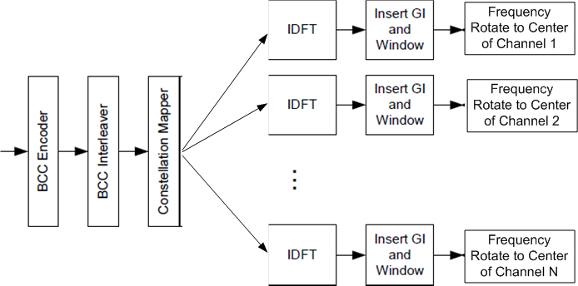
Cont. – Option A
This option uses an optimally designed interleaver to maximize diversity gain across channels (whether contiguous or non-contiguous).
  All channels have the same MCS
  The figure shows one encoder and one interleaver but multiple encoders and interleavers may be used if the data rate can’t be supported by one encoder (especially with >1 spatial streams).
  Support for multiple spatial streams uses 11ac stream parser.
The interleaver parameters Ncol and Nrot need to be defined to accommodate 108x2 and 108x4 tones.
  Interleaver design is simple and well understood (256 interleaver in 11ac and 32FFT interleaver in 11ah were designed)
Slide 11

Slide 12
Cont. – Option B
In this option each channel has its own separate encoding process (a pure duplicate of the 128FFT PHY) but each channel is allowed to have its own MCS in order to perfectly fit to the SNR observed on that channel
  This is a crude form of bit loading used in DSL
Interleaving across the channels is less crucial in this case (and more complicated since they have different MCS)
Current 11ac doesn’t support multiple MCS and several changes will be required to support signaling and recommendation of MCS per channel
Variant B1 – combine options A and B to benefit from diversity and separate MCS per channel by designing the interleaver in option A to support different MCS per channel
Slide 12

Slide 13
Summary
Described TGaf PHY based on 128FFT as a building block for one and multiple channels with minor tweaks to 11ac frame format reflecting current accomplishments in 11ah
Slide 13

Slide 14
Straw Poll 1
Do you support the PHY design for one channel as described in slides 3-8
Y
N
A
Slide 14

Slide 15
Straw Poll 2
Which option do you prefer for multi-channel support
Option A
Option B
Option B1
Slide 15

Slide 16
References
        [1] 11-11-1544-00-00af-initial-proposal-for-tgaf-phy.pptx
        [2] 11-12-0424-00-00af-tgaf-phy-downclocking.pptx
        [3] 11-12-0330-00-00af-considerations-on-down-clocking-ratio.pptx
[4] 11-11-0499-03-00af-us-metro-mhzpops.xls
[5] http://www.cambridgewireless.co.uk//Presentation/CWS-Arqiva_Simon%20Mason.pdf
Slide 16

Slide 17
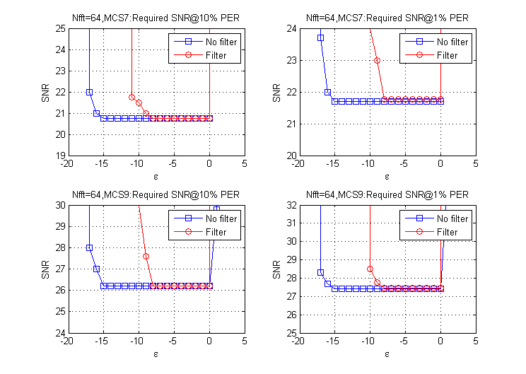
Appendix A – Impact of Filtering on 64FFT
With 64FFT as the PHY choice for one channel we assumed sampling frequency of 5MHz (the low end of what was SP in March) as even with this BW the filtering impact is severe
A 30tap FIR filter running
at 4x baseband clock was used
Shown are timing degrees
of freedom (how much the
filter ‘eats’ into the GI) in
AWGN
Slide 17

Slide 18
Appendix B – Impact of Filtering on 128FFT
With 128FFT as the PHY choice for one channel we assumed sampling frequency of 5.5MHz
A 52tap FIR filter running at 4x baseband clock was used and the resulting spectrum is shown (actual packet PSD)
Slide 18

Slide 19
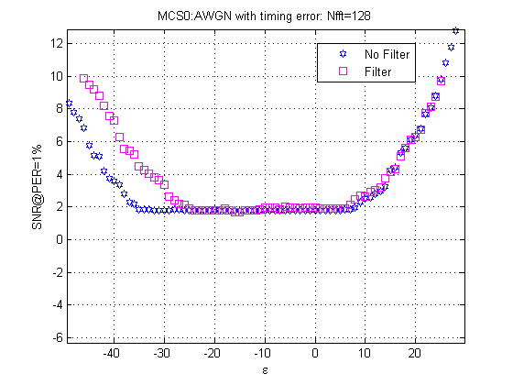
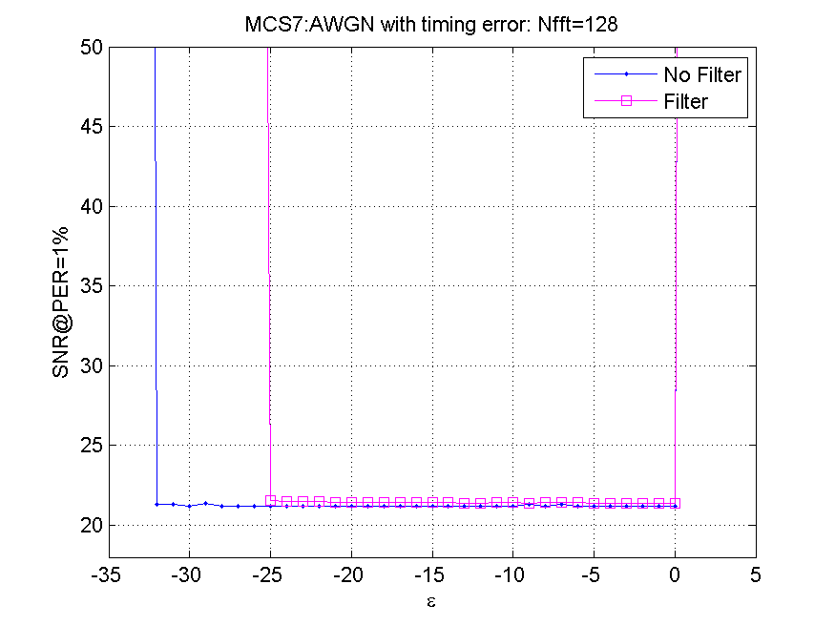
Cont. – timing degrees of freedom
Similarly to the 64FFT case we show the portion of the GI ’eaten’ by the filter
Slide 19

Slide 20
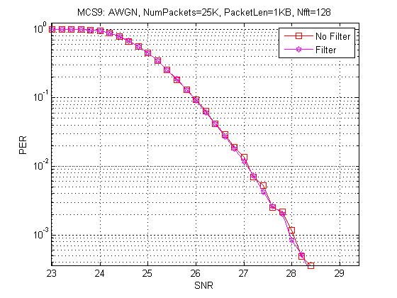
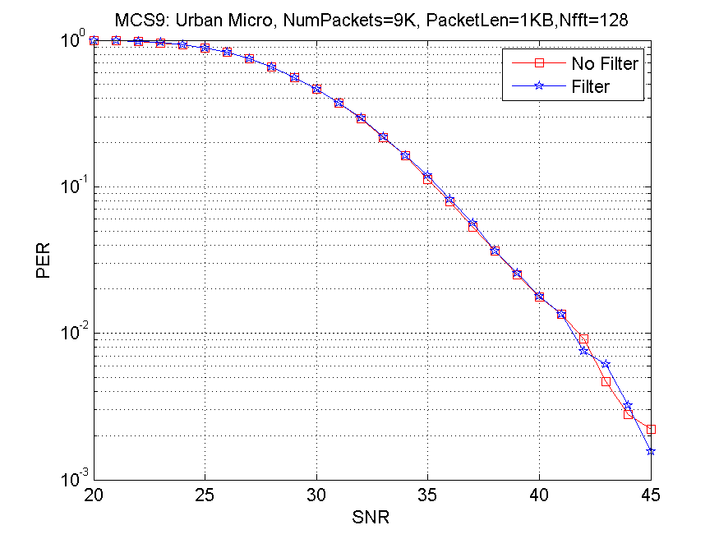
Cont. – Performance in AWGN and Urban Micro
No filtering impact on performance
Slide 20

Slide 21
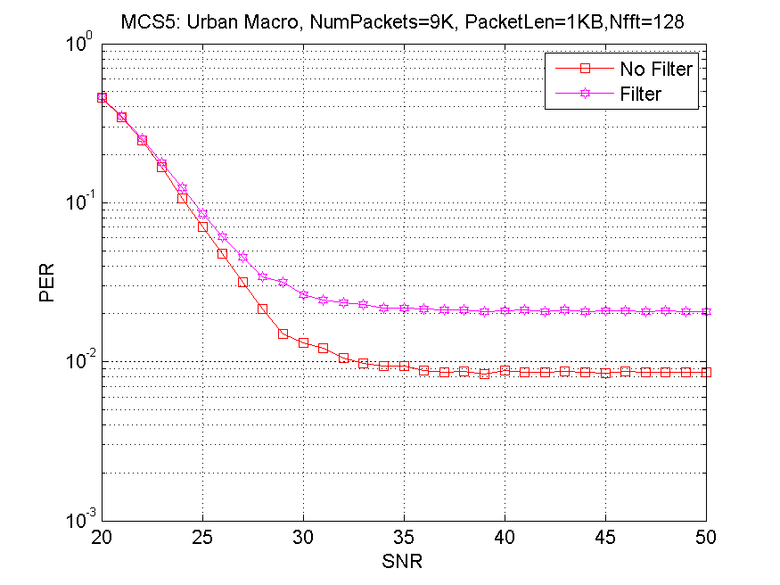
Cont. – Performance in Urban Macro
Urban Macro has very long delay spread in some of the channels. Thos channel with delay spread close or beyond the GI will experience worse performance due to the filter increasing the combined delay spread
Slide 21

