Slide 1
US Channelization
Date: 2012-05-14
Authors:
Slide 1

Slide 2
Authors continued:
Slide 2

Slide 3
Authors continued:
Slide 3

Slide 4
Outline
  Propose channelization structure for the US
Slide 4

Slide 5
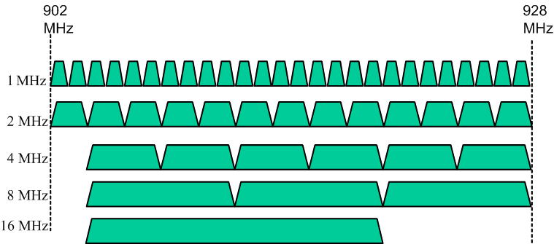
Proposal
The proposal utilizes to the maximum the available BW as is done in other countries – 26 1MHz channels, 13 2MHz channels, 6 4MHz channels, 3 8MHz channels and one 16MHz channel
Slide 5

Slide 6
Discussion
  Many contributions proposed various channelization options for the US in every IEEE 11ah meeting since September
  After many discussions on the topic we concluded that the best option maximizes the number of 1MHz and 2MHz channels to allow the maximum flexibility of deploying many large sensor networks while minimizing interference.
    Sub 1GHz spectrum has high value and utilizing efficiently the available 26MHz is important.
  Coexistence issues – many other systems are defined for operation in 900MHz (such as variants of the 802.15 and 802.16 family of standards) and 802.11 has a coexistence mechanism in place namely CCA energy detect.
    The current value used for 20MHz systems for non 802.11 systems is -62dBm. 11ah may choose a different value
Slide 6

Slide 7
Straw Poll
Do you support the US channelization proposal in slide 5?
Y
N
A
Slide 7

