Slide 1
Uplink Channel Access
Date: 2012-05-14
Authors:

Slide 2
Authors:

Slide 3
Introduction
11ah use case includes a large outdoor network [1]
For an outdoor smart grid network, the number of STAs can be 2007+
TIM element may cover few hundreds to few thousands STAs
Bits set to one in the TIM element may trigger too many PS-Poll/trigger frame transmissions from the STAs within a short period of time
Many stations at the edge of the coverage area could be hidden from each other for uplink transmissions due to a much higher path loss between STA-STA than AP-STA [2]
This presentation proposes a uplink channel access scheme using information from an AP (e.g. TIM information) to mitigate the hidden node problem

Slide 4
TIM Triggered Hidden Node Problem
Too many bits set in the TIM element may trigger too many PS-Poll/trigger frame transmissions right after the beacon frame within a short period of time
Increase collisions between the hidden nodes
TIM
(n bits set to 1)
Beacon interval
STA1
PS-Poll/trigger frame
STA2
…
STAn
n transmissions within a short period of time
(e.g. few mS)
AP
STA1’s transmission range
STA2’s transmission range
STA1
STA2

Slide 5
Basic Concept
Utilize information from an AP (e.g. TIM element) to spread uplink transmissions over a period of time so that the uplink transmissions are not overlapping with each other
TIM
(n bits set to 1)
Beacon interval
STA1
PS-Poll/trigger frame
STA2
…
…
STAn
Spread n transmissions over a much longer time period

Slide 6
Option 1
Randomly spread uplink transmission over a period of time
The total number of time slots, N, may be determined based on the number of paged (and unpaged) stations, n, indicated in the received TIM (e.g. N = f (n))
The time slot duration T may be chosen to be large enough to complete PS-Poll/trigger+SIFS+DATA+SIFS+ACK (e.g. 20 ~ 40 mS)
A STA randomly chooses a time slot to start its uplink channel access
If two or more hidden STAs choose the same time slot, they may collide
TIM (n paged STAs)
Total N time slots, each time slot duration = T
T
STA 10
STA 6
STA 9
STA 4
STA 3
STA 1
STA 7
STA 5
STA 2,8 (may collide)

Slide 7
Option 2
Deterministically spread uplink transmission over a period of time
The total number of time slots, N, may be determined based on the number of paged stations, n, indicated in the received TIM (e.g. N = n)
The time slot duration T may be chosen to be large enough to complete PS-Poll/trigger+SIFS+DATA+SIFS+ACK (e.g. 20 ~ 40 mS)
AP assigns a time slot for a STA
Example: AID bit position of TIM may be used to determine the assigned time slot
Each STA starts to access the channel at the assigned time slot following EDCA
TIM bitmap
1
1
…
0
Total N time slots, each time slot duration = T
1
0
0
1
1
STA1
STA10
STA 1, 2, 3, 4, 5, 6, 7, 8, 9, 10

Slide 8
Simulation Setup 1
STA3 is hidden from STA1 for ~10% of time
STA4 is hidden from STA1 for ~30% of time
1 AP and 10 STAs
STAs transmit Data frames
AP replies with Ack frame
Parameters
PHY rate = 600Kbps, packet size = 260 bytes
Packet Tx time = ~3.7msec
Use AC_VO, max number of retransmissions = 11
Uplink channel access schemes
CW32 20mS Slot: each STA randomly chooses a 20mS time slot out of 32 time slots for uplink channel access
CW64 20mS Slot: each STA randomly chooses a 20mS time slot out of 64 time slots for uplink channel access
Deterministic 20mS Slot: a 20mS time slot for uplink channel access is determined by each STA’s AID bit position of the TIM bitmap
Deterministic 40mS Slot: a 40mS time slot for uplink channel access is determined by each STA’s AID bit position of the TIM bitmap
STA5,6,7 are hidden to STA1 for ~55% of time
STA3
STA4
STA2
STA5
STA1
AP
STA6
STA10
STA7
STA9
STA8

Slide 9
Uplink Channel Access Schemes - Examples
TIM bitmap
1
1
…
0
1
0
0
1
1
TIM
Uniform(5mS)
Each STA starts to access channel at time t chosen from ~Uniform(5mS)
TIM
STA 1~10 uplink channel access
CW32 20mS Slot
32 time slots, each time slot duration = 20 mS
STA 10
STA 6
STA 9
STA 4
STA 3
STA 1
STA 7
STA 5
TIM
STA 2,8 (may collide)
CW64 20mS Slot
64 time slots, each time slot duration = 20mS
STA 10
STA 2
STA 3
STA 7
STA 5
STA 1
STA 4
STA 9
STA 6
STA 8
TIM
Deterministic (D)
20mS Slot
10 time slots, each time slot duration = 20mS
STA 1, 2, 3, 4, 5, 6, 7, 8, 9, 10
TIM
Deterministic (D)
40mS Slot
10 time slots, each time slot duration = 40mS
STA 1
2
3
4
5
6
7
8
9
10

Slide 10
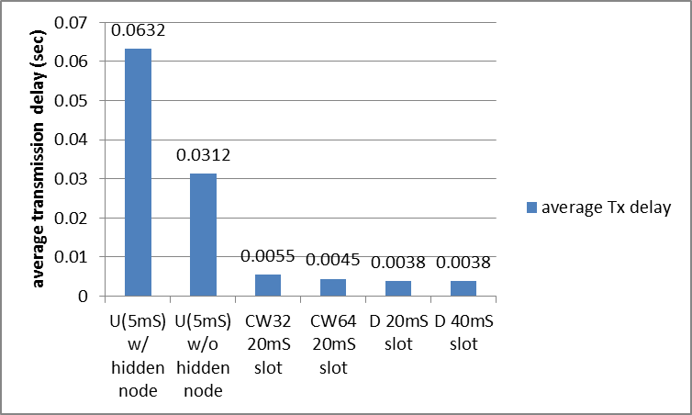
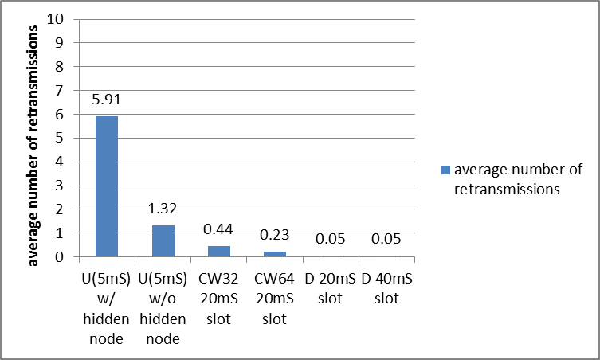
Comparisons 1 (AC_VO)
CWmin[AC_VO]=3, CWmax[AC_VO]=7
Average Tx delay (=active duration) = medium access delay + time until successful packet transmission
Average number of retransmissions
Effect of hidden nodes
STA active time reduced by 94%
Effect of hidden nodes
99% less retransmissions
When hidden nodes are present in the network, spreading the uplink channel accesses over a much longer period of time significantly reduces
the transmission delay by 94%* and
the retransmissions by 99%*.
*) D 20mS slot gain over U(5mS)

Slide 11
Uplink Channel Access using TIM Information -OBSS Example
OBSS case
If a STA’s uplink channel access is delayed to the next time slot due to OBSS transmissions, the STA may contend with the other station in the next time slot.
TIM bitmap information of
AID1~16
OBSS transmissions
TUT of STA with AID6
Un-paged STAs may also have uplink
data to transmit
1
1
…
0
1
0
0
1
1
t₀
Slot Time T
(e.g. 20-40mS)
PS-Poll or
Null-Data or
Data frame
AID1
2
3
4
5
6
2
6
7
8
9
10
11
12
13
14
15
16

Slide 12
OBSS Scenarios Simulation Setup 2
STA3 is hidden from STA1 for ~10% of time
STA4 is hidden from STA1 for ~30% of time
1 AP and 10 STAs + 2 STAs (OBSS)
10 STAs transmit Data frames, AP replies with Ack frame
AC_VO
OBSS: STA12 → STA11
AC_BE
Parameters
PHY rate = 600Kbps, packet size = 260 bytes
Packet Tx time = ~3.7msec
Max number of retransmissions = 11
OBSS traffic:
PHY rate=600Kbps
Packet size=1500 bytes, Tx time~20mS
Packet inter-arrival time:
Uniform(.1S) → occupies ~40% channel
Uniform(.2S) → occupies ~20% channel
Full buffered traffic
STA5,6,7 are hidden to STA1 for ~55% of time
STA3
STA4
STA2
STA5
STA1
STA12
AP
STA11
STA6
STA10
STA7
STA9
STA8

Slide 13
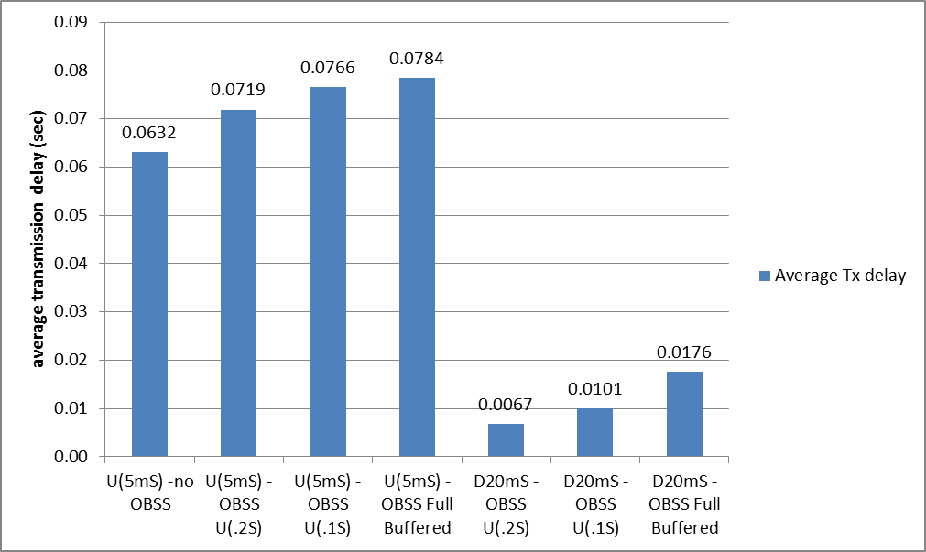
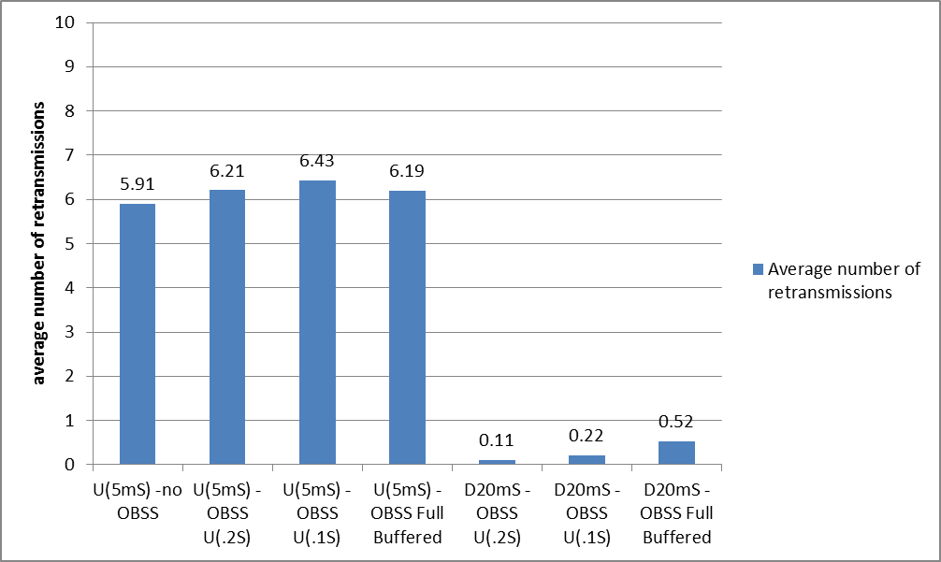
OBSS Scenarios 2 - Comparisons
Average Tx delay (=active duration) = medium access delay + time until successful packet transmission
Average number of retransmissions
Effect of OBSS traffic
STA active time reduced by 78 ~91%
92-98%% less
retransmissions
Observation
From the comparison between U(5mS) without OBSS and U(5mS) with OBSS shows that contentions between the hidden nodes are the major contributor for the large transmission delay and retransmissions.
Spreading the uplink channel accesses over a longer period of time reduces both the transmission delay and the number of retransmissions significantly even when there is OBSS traffic.

Slide 14
OBSS Scenario Setup 3 – Hidden Node
1 AP and 10 STAs + 2 STAs (OBSS)
10 STAs transmit Data frames, AP replies with Ack frame
AC_VO
OBSS: STA12 → STA11
AC_BE
Parameters
PHY rate = 600Kbps, packet size = 260 bytes
Packet Tx time = ~3.7msec
Max number of retransmissions = 11
OBSS traffic:
PHY rate=600Kbps
Packet size=1500 bytes, Tx time~20mS
Packet inter-arrival time:
Full buffered traffic
STA3 is hidden from STA1 for ~10% of time
STA4 is hidden from STA1 for ~30% of time
STA5,6,7 are hidden to STA1 for ~55% of time
STA3
STA4
STA2
STA5
STA1
AP
interference
STA6
STA12
Full buffered
traffic
STA11
STA10
STA7
BSS2
STA9
STA8
BSS1

Slide 15
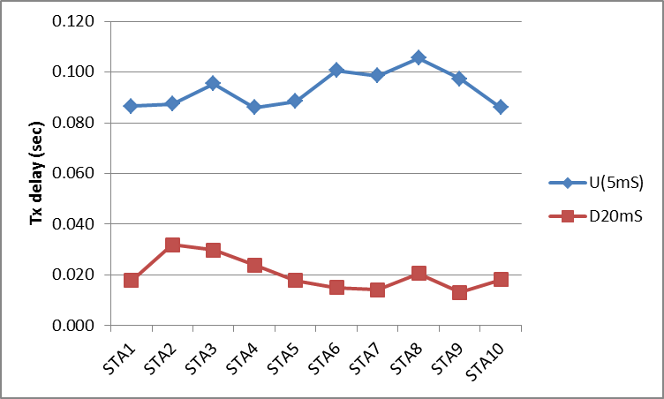
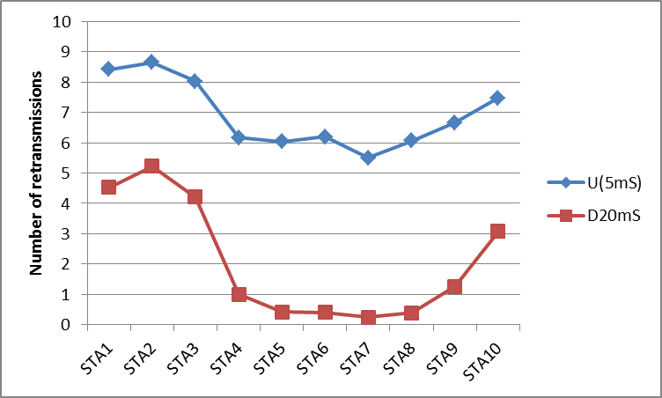
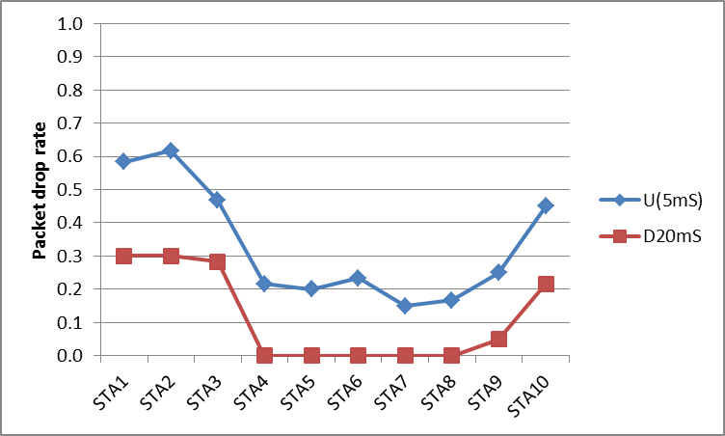
OBSS Scenarios 3 - Comparisons
Tx delay, retransmissions, and packet drop rate
STA1, STA2, STA3, STA10 are hidden from STA12
Observation
STA1, STA2, STA3, STA10 are hidden from STA12
The hidden nodes (STA1, STA2, STA3, STA10) suffer from very high packet drop rate (45-62%)
Even in the OBSS with a hidden node with full buffered traffic, spreading the uplink channel accesses over a longer period of time reduces both the transmission delay and the number of retransmissions significantly.

Slide 16
Summary
11ah use case includes a large outdoor network
Many stations at the edge of the coverage area could be hidden from each other
The 11ah channel model [2] shows that the channel between STA-STA experiences a higher path loss than the channel between AP-STA.
Bits set in the TIM element may trigger collisions between the hidden nodes
Uplink data transmissions from the hidden nodes within a short period of time (e.g. ~ few mS) also result in collisions at the AP
When hidden nodes are present in the network, spreading the uplink channel accesses over a period of time so that the uplink transmissions are not overlapped with each other significantly reduces
the transmission delay (STA active time) by 94%* and
the number of retransmissions by 99%*.
*) Deterministic 20mS time slot gain over Uniform(5mS)
We propose to utilize the information from the AP to spread out the uplink transmissions (e.g. PS-Poll/Data) over a period of time to mitigate the hidden node problem
The exact definition of the information from the AP is TBD (e.g. TIM element)
The definition of the period of time is TBD
E.g. DTIM interval or (the number of STAs in a TIM bitmap) x (the slot time duration) may be used

Slide 17
Straw Poll 1
Do you support the concept of utilizing information from an AP to spread out uplink transmissions over a period of time to mitigate the hidden node problem?
Y:
N:
A:

Slide 18
Motion 1
Move to accept the concept of utilizing information from an AP to spread out uplink transmissions over a period of time to mitigate the hidden node problem in the TGah Specification Framework document.
Y:
N:
A:

Slide 19
Reference
[1] Potential compromise of 802.11ah use case document, 802.11-11/457r0
[2] TGah Channel Model, 802.11-11/968r3

Slide 20
Backup

Slide 21
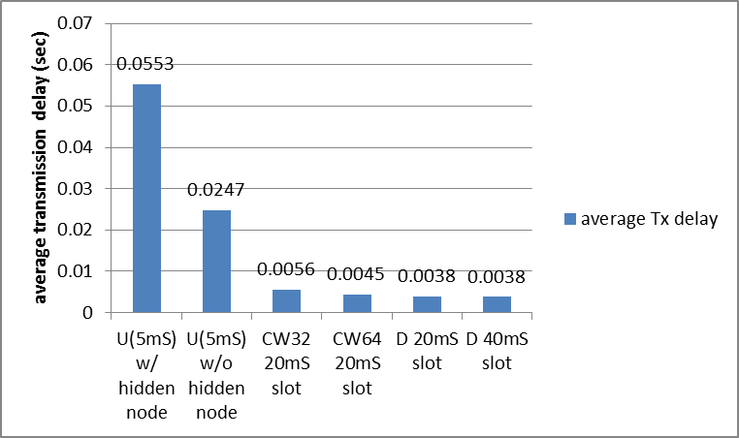
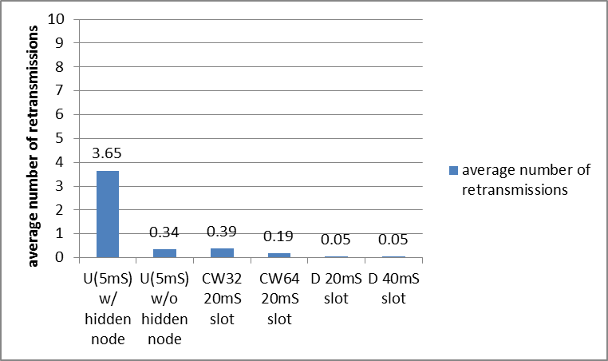
Comparisons 1 (AC_BE)
CWmin[AC_BE]=15, CWmax[AC_BE]=1023
Average Tx delay (= active duration) = medium access delay + time until successful packet transmission
Average number of retransmissions
STA active time
reduced by 93%
99% less
retransmissions

