Slide 1
Repetition and interleaver design for MCS0-Rep2
Date: 2012-05-14
Authors:

Slide 2
Abstract
This presentation proposes alternative repetition/ interleaver designs that enhance frequency diversity for the MCS0-Rep2 mode.

Slide 3
Repetition & Interleaving
2 times block wise repetition of OFDM symbols and interleaving over each OFDM symbol has been adopted for MCS0-Rep2[1].
As a whole, repetition and interleaving can actually allow us to operate over 2 OFDM symbols.
  Instead of 1 currently.
  May provide better frequency diversity to counter frequency selective channel.
Propose new repetition/ interleaving functions operating over 2 OFDM symbols.

Slide 4
Proposed general design
Design for a single spatial stream.
We can interchange order of repetition & interleaving.
Interleaver will use the proposed specification Ncol = 8.
Receiver performs diversity combining over 2 OFDM symbols using MRC.
current
proposed

Slide 5
1) Frequency shift of repetitive symbol
Enhances frequency diversity.
Cyclic shift of the repetitive symbol in the frequency domain.

Slide 6
1) Frequency shift of repetitive symbol
Coded bits in the repetitive OFDM symbol are cyclic shifted by 12 in frequency.

Slide 7
2) Low delay interleaving design
To reduce transmit-receive delay, useful to reduce interleaving delay.
  Interleaving delay is caused by waiting and buffering the coded data bits in 1st OFDM symbol.
Coded bits are buffered without interleaving for symbol 1.
Buffered bits are interleaved and cyclic shifted for symbol 2.

Slide 8
2) Low delay interleaving design
Cyclic shift by 12 subcarriers after interleaving enhances frequency diversity.

Slide 9
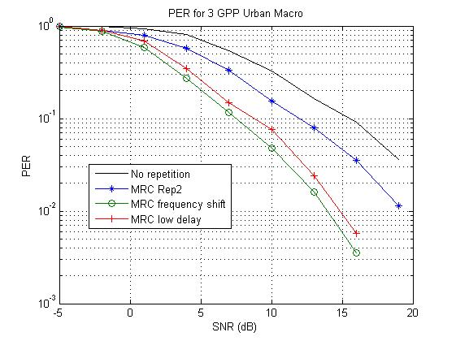
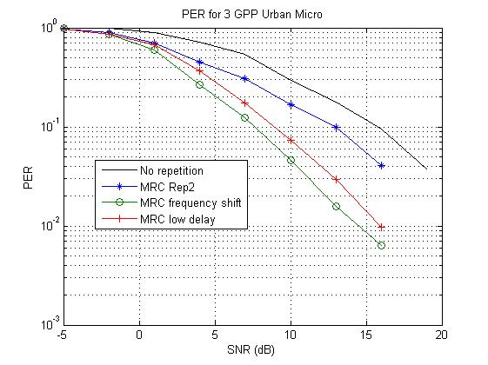
Simulations
Use 3GPP urban macro and urban micro models [2]
256 bytes per packet, ideal receiver

Slide 10
Conclusions
Current MCS0-Rep2 repetition/ interleaving per OFDM symbol may not fully exploit frequency diversity.
Performance gain using repetition/ interleaver operating over 2 OFDM symbols in 3GPP channels.
  Proposed designs which enhance frequency diversity and reduce transmit-receive delay.

Slide 11
Straw poll 1
Do you agree with using a repetition/ interleaver design that operates over 2 OFDM symbols to enhance frequency diversity as in Slide 4?

Slide 12
Straw poll 2
Do you agree with interleaving the 1st OFDM symbol and frequency shifting the interleaver output for the 2nd OFDM symbol, to enhance frequency diversity, as in Slides 5-6 ?

Slide 13
Straw poll 3
Do you agree with the low delay repetition/ interleaver design over 2 OFDM symbols, to reduce delay and enhance frequency diversity, as in Slides 7-8 ?

Slide 14
References
[1] "Proposed specification framework for TGah, IEEE 802.11-11/1137r6," IEEE, March 2012.
[2] J. Salo et al, ‘MATLAB implementation of the 3GPP spatial channel model (3GPP TR 25.996)“, Jan. 2005.

