Slide 1
SIG Field 4-Bit CRC
Date: 2012-07-17
Authors:

Slide 2
Authors continued:
Slide 2

Slide 3
Authors continued:

Slide 4
Abstract
This presentation relates to the CRC used in SIG Fields.

Slide 5
Overview
July 2012
Current 11ah spec framework uses 4-bit CRC in 1MHz SIG and 2MHz SIG(A), and uses 8-bit CRC in 2MHz SIGB (long preamble).
Propose to use the 4 LSB of the 8-bit CRC as the 4-bit CRC in SIG fields.
Simulations show strong enough false positive probability compared with the SIG field decoding error rate (refer to next slide).
Easy for implementation for “multi-clock” devices, and for devices that support both short and long preambles.

Slide 6
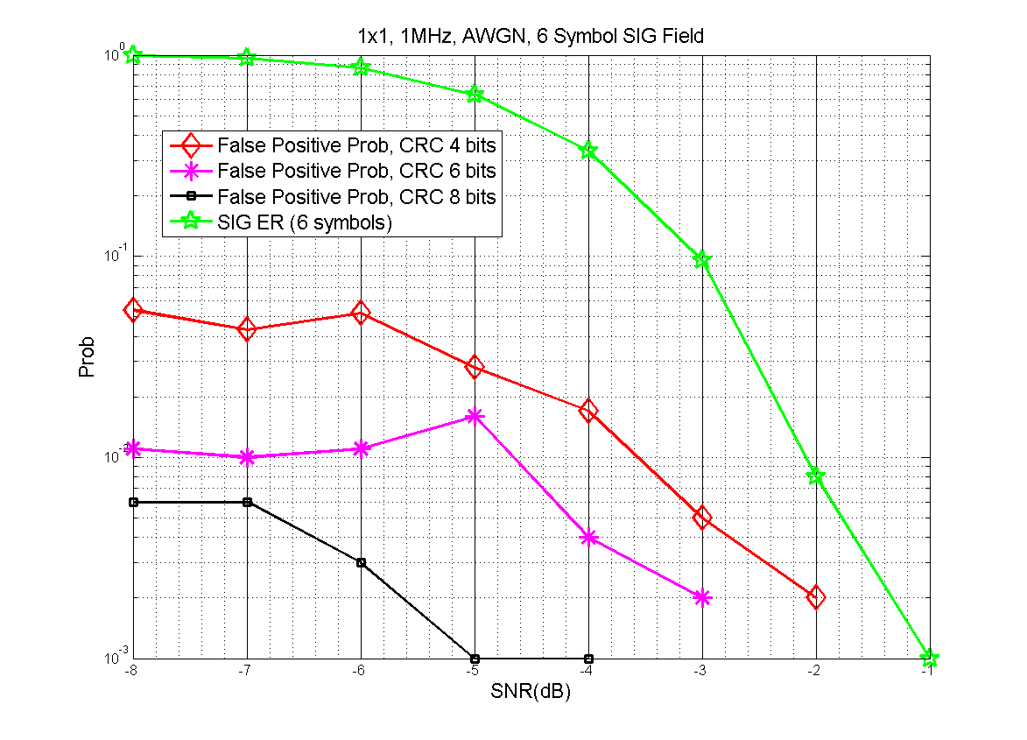
CRC Simulation
1MHz SIG Field, 6 symbols, modulated using MCS0-Rep2.
4-bit CRC uses 4 LSB of 8-bit CRC, similar scheme is applied for 6-bit CRC.

Slide 7
Discussions
Results in the previous slide show that the false positive prob. of 1MHz SIG when using 4-bit CRC is approximately one magnitude lower than the error rate of 1MHz SIG field.
False positive happens at such a low SNR where most likely packet detection and timing synchronization will fail anyway.

Slide 8
Straw Poll-1
Do you agree to use the 4 LSB of the 11n HTSIG field 8-bit CRC for the 4-bit CRC in 11ah 2MHz and 1MHz SIG(A) fields, and use the same 11n HTSIG field 8-bit CRC in SIGB field of the >=2MHz long preamble?
Passed

Slide 9
Motion-1
Move to use the 4 LSB of the 11n HTSIG field 8-bit CRC for the 4-bit CRC in 11ah 2MHz and 1MHz SIG(A) fields, and use the same 11n HTSIG field 8-bit CRC in SIGB field of the >=2MHz long preamble?
Passed

Slide 10
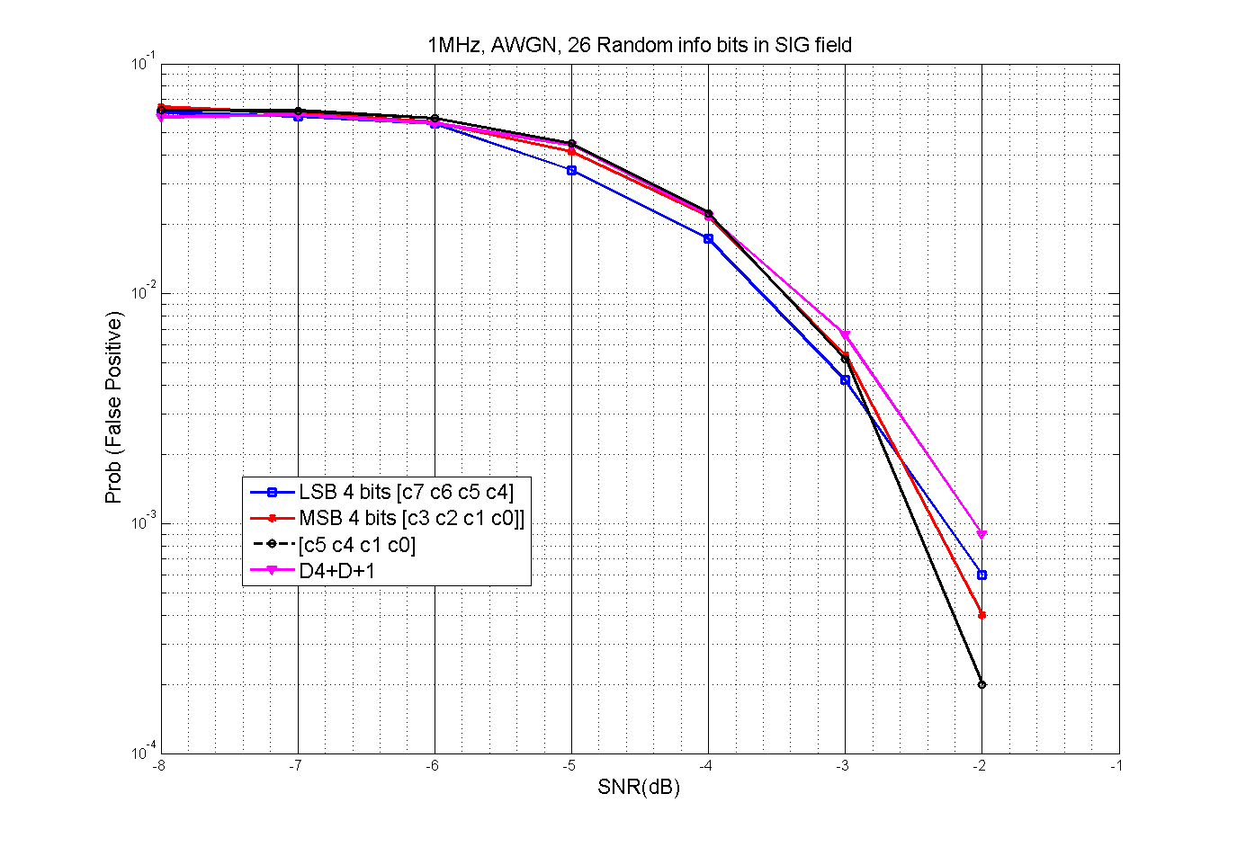
More Simulation Results-1 (new in r1)
Assume 1MHz SIG field with 26 info bits, each with random 0/1 value

Slide 11
More Simulation Results-2 (new in r1)
Assume 1MHz SIG field with 26 info bits, with the following subfield ordering and bit assumptions.
SIG Field | Bits | Comments
N_{sts} | 2 | Number of space-time-streams
SGI | 1 | Short Guard Interval
Coding | 2 | 1st bit is coding type (LDPC/BCC), 2nd bit is for LDPC N_{sym} ambiguity
STBC | 1 | Same as in 11ac
Reserved bit | 1 | If any PHY technique needs a bit, it is good to place it here
MCS | 4 | The MCS for SU case
Aggregation bit | 1 | Signals use of AMPDU
Length | 9 | Length field (in symbols when aggregation is ON, is in bytes when aggregation is OFF, Mandate AMPDU for packet sizes > 511 bytes
ACK Indication | 2 | 00: Ack; 01: BA; 10: No Ack; 11: reserved
Reserved | 3 | Details TBD
CRC | 4 | 4 bits of CRC should be enough
Tail | 6 | 6 BCC Tail bits
Total | 36

Slide 12
Cont’d
Bit Assumptions;
Nsts: b00
SGI: b0
Coding: b00
STBC: b0
Reserved: b1
MCS: b1010 (means MCS10—BPSK1/2-Rep2)
Aggr: b0
LENGTH: 9 bit uniformly distributed as U(14, 511) bytes
ACK Indication: b00
Reserved: b111

Slide 13
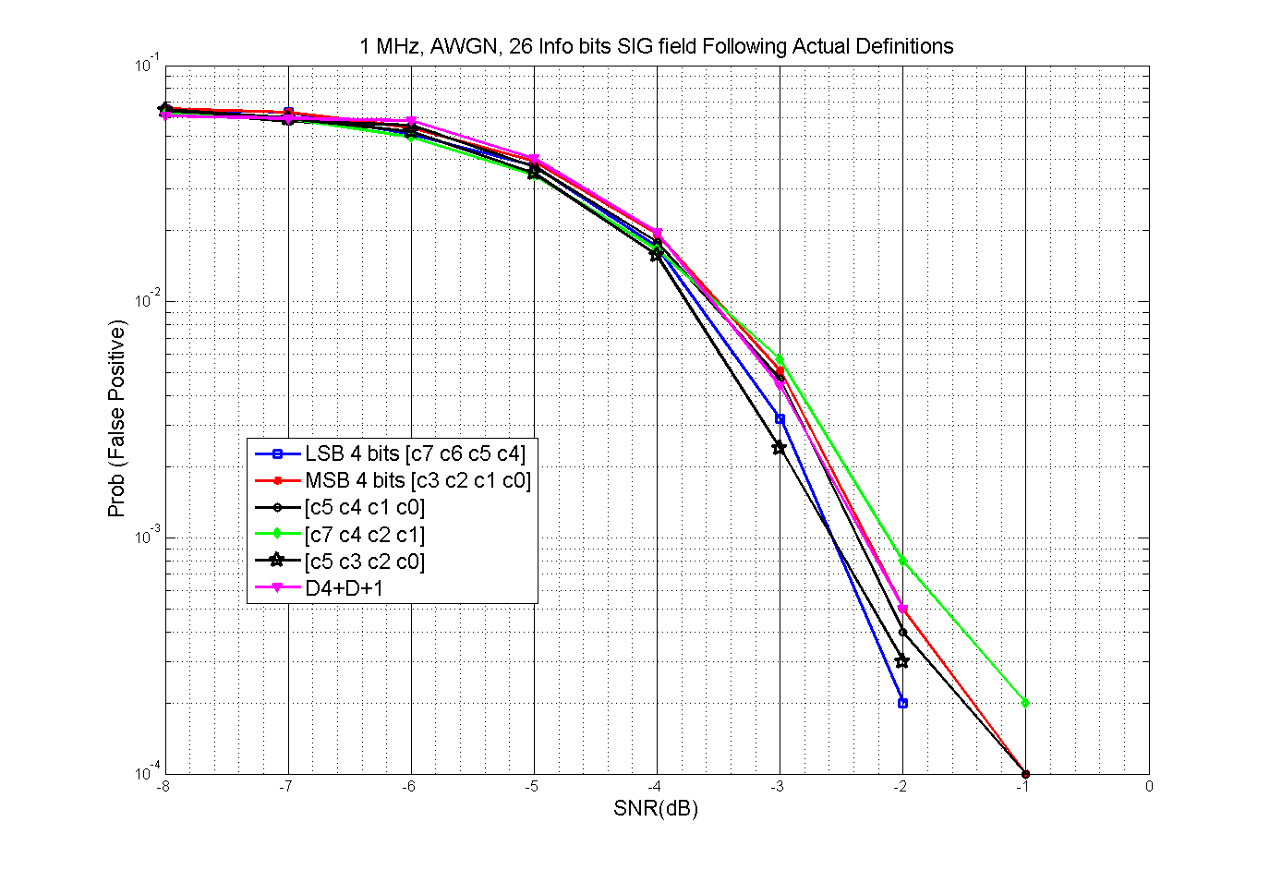
Cont’d

Slide 14
Discussions
New sim results in r1 show little difference between CRC using LSB 4 bits and CRC using other 4-bit combinations of the 8-bit CRC.
Especially when assuming an actual SIG field bit allocation.
The tiny differences on false positive probabilities are well under the packet miss-detection probability (~-3dB@10% Miss-Det Rate in AWGN).
CRC can hardly be the bottleneck of the whole system.

