Slide 1
SIG Field 4-Bit CRC
Date: 2012-05-15
Authors:

Slide 2
Authors continued:
Slide 2

Slide 3
Authors continued:

Slide 4
Abstract
This presentation relates to the CRC used in SIG Fields.

Slide 5
Overview
May 2012
Current 11ah spec framework uses 4-bit CRC in 1MHz SIG and 2MHz SIG(A), and uses 8-bit CRC in 2MHz SIGB (long preamble).
Propose to use the 4 LSB of the 8-bit CRC as the 4-bit CRC in SIG fields.
Simulations show strong enough false positive probability compared with the SIG field decoding error rate (refer to next slide).
Easy for implementation for “multi-clock” devices, and for devices that support both short and long preambles.

Slide 6
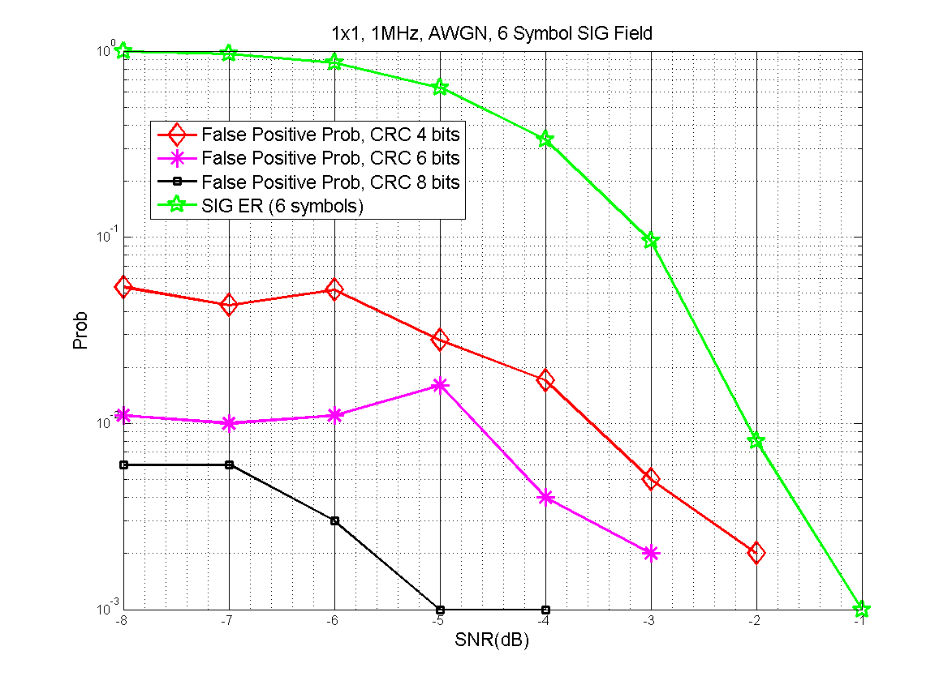
CRC Simulation
1MHz SIG Field, 6 symbols, modulated using MCS0-Rep2.
4-bit CRC uses 4 LSB of 8-bit CRC, similar scheme is applied for 6-bit CRC.

Slide 7
Discussions
Results in the previous slide show that the false positive prob. of 1MHz SIG when using 4-bit CRC is approximately one magnitude lower than the error rate of 1MHz SIG field.
False positive happens at such a low SNR where most likely packet detection and timing synchronization will fail anyway.

Slide 8
Straw Poll-1
Do you agree to use the 4 LSB of the 11n HTSIG field 8-bit CRC for the 4-bit CRC in 11ah 2MHz and 1MHz SIG(A) fields, and use the same 11n HTSIG field 8-bit CRC in SIGB field of the >=2MHz long preamble?

Slide 9
Motion-1
Move to use the 4 LSB of the 11n HTSIG field 8-bit CRC for the 4-bit CRC in 11ah 2MHz and 1MHz SIG(A) fields, and use the same 11n HTSIG field 8-bit CRC in SIGB field of the >=2MHz long preamble?

