Slide 1
Security and Ease of Use Considerations for
Low-Power Constrained Networks
René Struik
―
E-mail: rstruik.ext@gmail.com

Slide 2

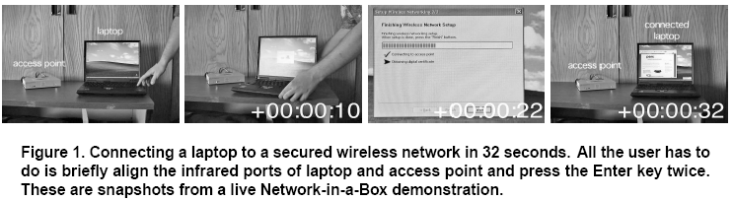
The “Holy Grail”: Security and Ease of Use
“Computer users have been taught for years that computer security systems can’t be effective unless they are complex and difficult to use. In reality, this conventional wisdom
is completely wrong.”
⎯ Lorrie Faith Cranor, Carnegie Mellon University
Security technology can make trust lifecycle management
intuitive and hidden from the user.
Source: D. Balfanz, G. Durfee, R.E. Grinter, D.K. Smetters, P. Stewart, “Network-in-a-Box: How to Set Up a Secure
Wireless Network in under a Minute,” in Proceedings of the 13th USENIX Security Symposium, August 9-13, 2004.

Slide 3
Ease of Configuration and Reconfiguration
Ease of configuration:
Merging of networks
Partitioning of networks
Device portability and orphaning
Hand-over of control (remote, backup)
Synchronization and failure recovery

Slide 4
Conventional wisdom: Symmetric-key cryptographic functionality, let alone public- key cryptographic functionality, are expensive to implement with sensor networks.
Status anno 2012: conventional wisdom challenged for all but most mundane devices.
Examples: Bluetooth v2.1, ZigBee Smart Metering, RFID e-Passport.
Feasibility of Crypto on Small Devices
ZigBee Smart Energy (SE1.x) Profile Certificate Structure:
Low-energy hardware implementations:
22 octets
8 octets
8 octets
10 octets
(total: 48 octets)
Public Key Device
DeviceId
CA Id
AttributeData
Ctrl
ProfileId
Serial#
ManufacturerData
Less than energy expenditure
single IEEE 802.15.4 frame!
Smart Sensors¹ RFID²
clock frequency 2 MHz 10 MHz
#gates ~10 kgates ~100 kgates
CMOS process 130nm 250nm
Energy exp.: ~ 250 μJ < 100 μJ
Computation signature verify point multiply
Sources:
¹Private communication
²SAC 2008 conference

Slide 5
Deployment Scenarios vs. Security Design
Diverse deployment scenarios
Home Automation RFC 5826 - Home Automation Routing Requirements in Low-Power and Lossy Networks (April 2010)
Building Automation RFC 5826 - Building Automation Routing Requirements in Low-Power and Lossy Networks (June 2010)
Urban Settings RFC 5548 - Routing Requirements for Urban Low-Power and Lossy Networks (May 3009)
Industrial Control RFC 5673 - Industrial Routing Requirements (October 2009)
Smart Grid NIST IR 7628 – Guidelines for Smart Grid Cyber Security, Vol. 1 - Strategy, Architecture, High-Level
Requirements (August 2010)
Internet of Things draft-ietf-core-coap – Constrained Application Protocol (draft March 12, 2012)
Actual security design
Unified design that fits these diverse deployment scenarios
concise set of cryptographic and security mechanisms;
single security policy framework;
configuration parameters application-dependent.
This allows for mass-scale production, while still allowing for customization (e.g., as to security services provided, granularity of assurances, used keys, device roles, etc.)
This requires consideration of system perspective, taking into account the entire system and device lifecycle and ease-of-use and ease-of-deployment

Slide 6
Security Architectural Framework: Overview
ACL
initialization
ACL
initialization
ACL
Maintenance
ACL
ACL
ACL
Maintenance
CA key
initialization
CA key
initialization
Wrapped public
key info
Wrapped public
key info
Certificate
maintenance
Public key
verification
A
Authentication,
key establishment
B
Public key
verification
Certificate
maintenance
Extracted public
key info
Extracted public
key info
(Link key, A, B)
(Link key, A, B)
Upper layers
Upper layers
Wrapped
data key info
Wrapped
data key info
Data key
maintenance
Data key
repository
A
key distribution
B
Data key
repository
Data key
maintenance
Key
info
Data
key
Network and down
Network and down
Data
key
Key
info
Wrapped data
data transfer
Wrapped data
data
Encryptor/
decryptor
A
B
Encryptor/
decryptor
data

Slide 7
Security Architectural Framework – Design Aspects
Various aspects, including
Security Policy and Trust Model
Configuration and Installation
Protocol design aspects
For details, see, e.g., draft-struik-6lowapp-security-considerations-00
draft-garcia-core-security-03
Adhoc networks
No centralized management
Promiscuous behavior
Unreliability
Sensor networks
Low energy consumption
Low manufacturing cost
Security constraints
Decentralized key management
Flexible configuration and trust model
Low impact key compromise
Automatic lifecycle management
Low communication overhead
Low implementation cost

Slide 8
Full stack device, including per-layer and shared parameters
Device
Device-
wide
parameters
APP
functions
APP
parameters
Transport
functions
Transport
parameters
Network
functions
Network
parameters
DeviceID
Data Link
functions
Data Link
parameters
Keying material
Security
policies
PHY
functions
PHY
parameters
Security protocols
Trust binding
AES
ECC
RNG
communication
stack
layer-specific
parameters
shared functions
and parameters

Slide 9
Full stack device, including per-layer and shared parameters
Device
Device-
wide
parameters
APP
functions
APP
parameters
Transport
functions
Transport
parameters
Network
functions
Network
parameters
DeviceID
Data Link
functions
Data Link
parameters
Keying material
Security
policies
PHY
functions
PHY
parameters
Security protocols
Authorizations
(policy state machine)
AES
ECC
RNG
communication
stack
layer-specific
parameters
shared functions
and parameters

Slide 10
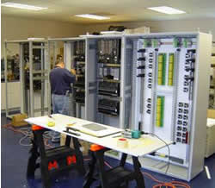


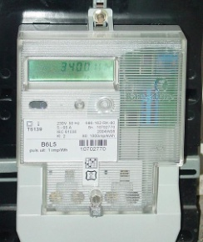
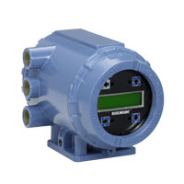

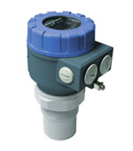
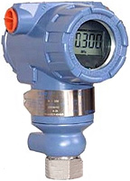


Configuration
Acceptability test based on
Device Id
Tag Name
Device Label
Open enrolment
Proximity-based techniques
…
Trust
management
via device
identities
Acceptability test: Yes/No?
- AES, ECC, RNG
- Security policy
engine
- Storage of keys
Trusted
module

Slide 11
Deployment Scenarios¹
  Scenario #1:
  mix-and-match of nodes from different vendors
  Scenario #2:
  addition of nodes to operational network
  Scenario #3:
  security audit
  Scenario #4:
  device repair and replacement (roaming in/out different user sites)
  Scenario #5:
  network separation (devices joining wrong network)
  Scenario #6:
  thwarting malicious attacks by (former) insiders
  Scenario #7:
  thwarting attacks by outsiders via insiders (held at ‘gunpoint’)
  Scenario #8:
  addition of subsystem (‘skid’) assembled elsewhere to operational network
¹Deployment scenarios discussed with ZigBee, ISA SP100.11a, Smart grid user community

Slide 12
Desired Features and Benefits (1)
Ease of use. Trust lifecycle management appears the same as that of an unsecured network and relies on
Proper identification of devices (e.g., reading off a label of physical module);
Proper management of device roles (e.g., adding these to, resp. removing these
from a white list, e.g., via a workstation GUI).
Thus, trust lifecycle management relies completely on handling of public information.
Flexibility. Virtually no restrictions w.r.t. support for
Mix-and-match of devices from different vendors;
Changes to network topology (merging or partitioning of networks, device
replacement or addition, addition of pre-assembled subsystem);
Changes to device roles (e.g., smooth hand-over of system manager, security manager
roles, via ‘soft reboot’);
Back-up and failure recovery (since management fully relies on public information).

Slide 13
Desired Features and Benefits (2)
Minimize trust dependencies.
Reduced reliance on trustworthy personnel;
Virtually no training requirements for operational personnel;
Virtual removal of trust dependencies between different entities in value chain
(whether OEM, vendor, system integrator, installer, or user).
Ease of security auditability.
Support for flexible deployment and business models.
Network topology changes or device role changes present a ‘clean’ logical separation between state prior to and after such an event (thus, allowing subscription-based services, outsourced management, re-contracting, etc.).
Enforcement of standards compliance. Enforcement possible by only issuing a certificate to devices from vendors that passed conformance testing.
No reliance on configuration tools and out-of-band configuration steps. A configuration tool may be used, but is not strictly necessary for trust enforcement.

Slide 14
Implications for FILS (1)
Security and ease of use
No online reliance on third parties for authentication (since networks may be spotty)
Support for heterogeneous trust models (mix-and-match of multi-sourced devices)
May involve (local) third party for authorization policy enforcement only
Support for device swap in the field, topology changes, role changes
No client/server model (since relationships may be peer-to-peer)
Low configuration overhead (billions of devices must be to cheap to deploy securely)
No “prediction” of where devices may end up in the field (no “site survey”)
Protocol aspects
Minimize number of protocol passes (sleepy devices, reduced channel interference)
Maximize potential to parallelize computations, etc.
Support piggy-backing (if only since it may help reducing traffic, energy expenditure)

