Slide 1
Differentiated Initial Link Setup
Date: 05/02/2012
Authors:
Name | Affiliations | Address | Phone | email
Lin Cai | Huawei | 3601 Algonquin Road, Rolling Meadows, IL 60008 | 1-847-818-1778 | Lin.Cai@huawei.com
George Calcev | Huawei | 3601 Algonquin Road, Rolling Meadows, IL 60008 | 1-847-818-1778 | George.Calcev@huawei.com
Bin Chen | Huawei | 3601 Algonquin Road, Rolling Meadows, IL 60008 | 1-847-818-1778 | Bin.Chen@huawei.com

Slide 2
Abstract
This presentation studies the capacity limitation of WiFi system in terms of the number of concurrent STAs; due to the limited capacity of concurrent channel access, differentiated association is required to ensure fast initial link setup of time-critical connections[1].
[1] Huawei, Differentiated Association Service Provisioning in WiFi Networks, 12/0249r2.

Slide 3
Conformance w/ TGai PAR & 5C
May 2012
Conformance Question | Response
Does the proposal degrade the security offered by Robust Security Network Association (RSNA) already defined in 802.11? | No
Does the proposal change the MAC SAP interface? | No
Does the proposal require or introduce a change to the 802.1 architecture? | No
Does the proposal introduce a change in the channel access mechanism? | No
Does the proposal introduce a change in the PHY? | No
Which of the following link set-up phases is addressed by the proposal? (1) AP Discovery (2) Network Discovery (3) Link (re-)establishment / exchange of security related messages (4) Higher layer aspects, e.g. IP address assignment | 1, 3

Slide 4
Introduction
Objective of TGai[2]:
  To minimize the time the STAs spend in initial link setup when a large number of mobile users are entering and leaving the coverage area of WiFi networks
  100 STAs successfully associate with an AP within 1 second
    Multiple message exchanges including Probe request/response, authentication, GAS …
    Associating STAs need to contend with each other and with associated STAs for channel access
[2] TGai Specification Framework Document, 12/0151r3.

Slide 5
WiFi MAC Protocol
CSMA/CA based MAC:
  Asynchronous distributed random access is very flexible and robust, but it also introduces large overheads in contention avoidance (carrier sensing, exponential backoff, window freezing, etc.)
  Large protocol overhead lead to very limited channel access capacity of WiFi in support of concurrent STAs [3]
    Only 10-11 G.711 voice calls can be supported in IEEE 802.11b WLAN
[3] L. Cai et. al., “Voice Capacity Analysis in IEEE 802.11 WLAN with Unbalanced Traffic,” IEEE Transactions on Vehicular Technology, 2006.

Slide 6
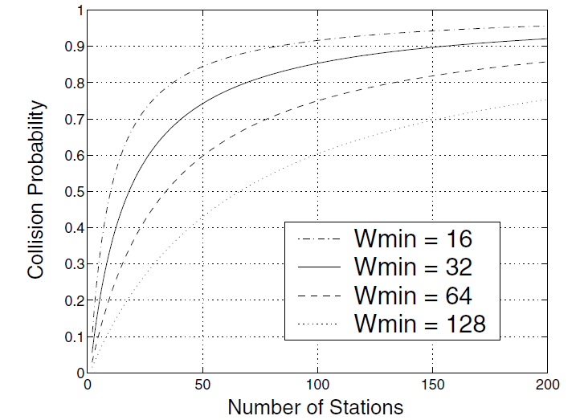
Collisions Increase with the Number of Concurrent STAs[4]
Assumptions:
  Perfect sensing in a single BSS
  Ideal channel condition
    Transmission is successful when there is no collision; No capture effect.
  No hidden terminal problem
    All STAs in the network can hear each other;
NS-2
Random network of 20m * 20m
Raw date rate: 2Mbps
Minimum contention window: from 16 to 128 slots
Maximum contention window: 1024 slots
Packet size: 1500 Byte (with RTS/CTS)
    Collision probability is more than 0.5 when there are 20 concurrent STAs
[4] Marcelo M. Carvalho and J. J. Garcia-Luna-Aceves, Delay Analysis of IEEE 802.11 in Single-Hop Networks, In Proceedings of the 11th IEEE International Conference on Network Protocols, 2003.

Slide 7
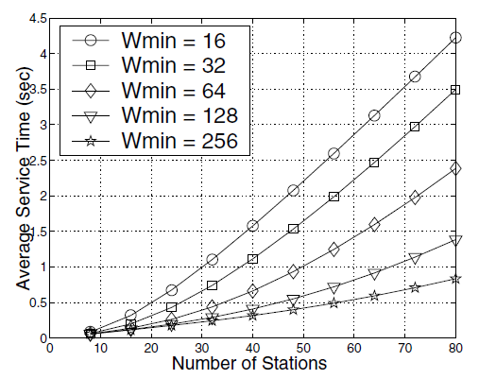
Channel Access Delay Increases with the Number of Concurrent STAs [4]
Channel access delay increases drastically with the number of concurrent STAs
Distributing concurrent STAs over a larger time window can significantly improve delay performance
[4] Marcelo M. Carvalho and J. J. Garcia-Luna-Aceves, “Delay Analysis of IEEE 802.11 in Single-Hop Networks”, In Proceedings of the 11th IEEE International Conference on Network Protocols, 2003.

Slide 8
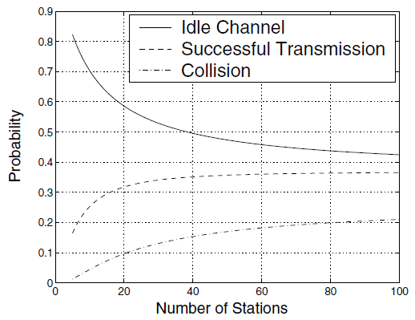
Channel Utilization Degrades with the Number of Concurrent STAs [4]
CSMA/CA operates efficiently only under a small number of concurrent STAs
For bursty channel access from a large number of concurrent STAs, we need to distribute them over a large time window
[4] Marcelo M. Carvalho and J. J. Garcia-Luna-Aceves, “Delay Analysis of IEEE 802.11 in Single-Hop Networks”, In Proceedings of the 11th IEEE International Conference on Network Protocols, 2003.

Slide 9
Hidden Station Problem
STAs A and B are within the AP’s coverage, but A and B are out of the carrier-sensing range of each other
A
AP
B
Hidden stations will further degrade the performance of CSMA/CA and result in a much longer delay

Slide 10
Other Impacts
Error-prone propagation wireless channel
  Packet loss and retransmissions; rate adaptation
Multiple overlapping BSSs
  Inter-BSS interference
Other components of delays
  Processing delay, queueing delay, etc.

Slide 11
Summary of Performance Study
The capacity of WiFi in support of concurrent channel access is very limited due to the inherent contention nature of CSMA/CA based MAC
To avoid network congestion and to efficiently utilize the channel resource, it is important to maintain the system load of concurrent STAs at a low level
Distributing concurrent STAs in a large time window can effectively improve the performance under high system load

Slide 12
TGai Use Cases
Bursty user association
  Users may transmit requests in a bursty manner (e.g., after receiving a beacon or a broadcast response)
  Severe collisions result from bursty access of a large number of concurrent STAs attempting to associate with the AP simultaneously
    Collision probability is more than 0.5 when there are 20 concurrent STAs
  Only some users may be able to successfully associate with the AP during a certain time interval
  Bursty association requests will significantly degrade the QoS performance of existing associated STAs

Slide 13
User’s Requirements
Users have different requirements
  Some users may have multimedia applications with different quality of service (QoS) requirements
    Realtime (video streaming) vs non-realtime (ftp file downloading)
  Some users may have new services and applications built upon network discovery run in background [5]
  Some users have NO running application
Users may have different delay tolerance levels for network association; greedy/immediate association only reduces the association efficiency but not guarantee fast link setup
[5] WFA Neighbor Awareness Networking Marketing Task Group, “Market & Motivation for Interoperability Testing of Neighbor Awareness Networking,” Section 3, 2012

Slide 14
Differentiated Association Services
Allow STAs to associate with an AP with different priorities
  To ensure time-critical STAs achieve a shorter delay in fast initial link setup
  To mitigate the negative impact of bursty association on the existing associated STAs
Association priority assignment is open for further discussion
  Traffic type, user type, … …
Details of the differentiated association scheme need further investigation

Slide 15
Conclusion
Capacity limitation in concurrent channel access
Differentiated association for fast initial link setup

Slide 16
Reference
[1] Huawei, Differentiated Association Service Provisioning in WiFi Networks, 12/0249r2.
[2] TGai Specification Framework Document, 12/0151r3.
[3] L. Cai et. al., “Voice Capacity Analysis in IEEE 802.11 WLAN with Unbalanced Traffic,” IEEE Transactions on Vehicular Technology, 2006.
[4] Marcelo M. Carvalho and J. J. Garcia-Luna-Aceves, “Delay Analysis of IEEE 802.11 in Single-Hop Networks,” In Proceedings of the 11th IEEE International Conference on Network Protocols, 2003.
[5] WFA Neighbor Awareness Networking Marketing Task Group, “Market & Motivation for Interoperability Testing of Neighbor Awareness Networking,” Section 3, 2012
[6] Fu-Yi Hung, “Access Delay Analysis of IEEE 802.11 DCF in the Presence of Hidden Stations,” In Proceedings of IEEE Global Telecommunications Conference, 2007.

Slide 17
Stroll Poll -1
Do you agree to add a new section, called “QoS Provision in FILS”, in the TGai SFD, 12/0151r3, i.e.,
6. QoS Provision in FILS
Yes:
No:
Abstain:

Slide 18
Stroll Poll -2
Do you agree to add the sentence to TGai SFD, 12/0151r3.
  “FILS devices shall support differentiated initial link setup.”?
Yes:
No:
Abstain:

Slide 19
Voice Capacity in WiFi
The maximum number of low rate voice calls that can be supported with satisfactory QoS in a WiFi system is very limited
 | G.711 | G.729
802.11b (11Mbps) | 10~11 | 5~6
802.11a/g (54Mbps) | 48~56 | 27~32
Voice Capacity of WiFi System

Slide 20
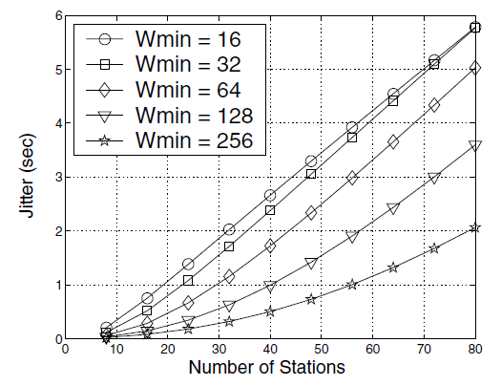
Delay and Jitter

Slide 21
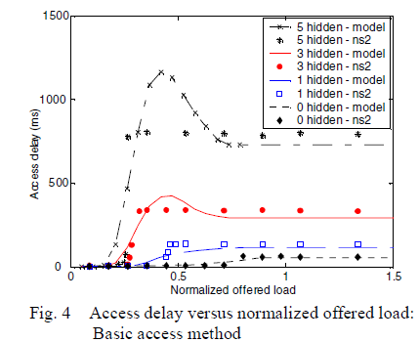
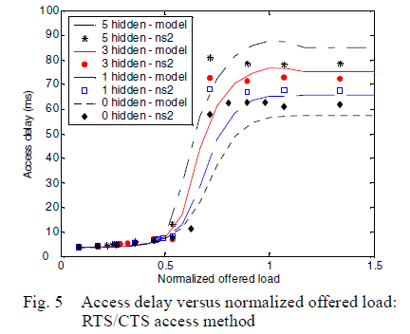
Impacts of Hidden Stations [6]
A network with one AP and 16 STAs in a ring topology. The carrier sensing range is adjusted s.t. 1/3/5 nodes are hidden from others.
Transmission rate: 1Mbps
Packet size: 250 Bytes
[6] Fu-Yi Hung, “Access Delay Analysis of IEEE 802.11 DCF in the Presence of Hidden Stations,” In Proceedings of IEEE Global Telecommunications Conference, 2007.

