Slide 1
Authentication and Upper-Layer Messaging
Date: 2012-05-04
Authors:

Slide 2
Abstract
This submission discusses problems with the acceptance (and processing) of upper-layer messages prior to authentication.

Slide 3
Challenging Goals in 11ai
Fast link set-up
Authentication and upper-layer protocol messaging (e.g. address assignment, plus DAD, plus….) with a minimum of delay
Cannot degrade RSN security
Mutual authentication
No replay attacks (“liveness” proof)
etc
Handle the use case of hundreds of STAs trying to connect simultaneously
The doors of the train open and everyone’s phone/PDA tries to connect to wireless network in the station

Slide 4
Handling of Upper Layer Messages
Piggy-back the upper-layer message on an L2 frame that is conveying its own message
Put (some of) the upper-layer messages into (some of) the authentication frames
Do as much as possible in parallel

Slide 5
Simultaneous Address Assignment w/ERP
First message from client has both authentication and DHCP message
Server simultaneously asks AS to authenticate peer and asks DHCP server for an address
Server validates DHCP discover after receipt of DHP ACK

Slide 6
Problems with Simultaneous Address Assignment w/ERP
Handling is problematic
Infrastructure may require authenticated identity to determine appropriate address to assign
An address is requested upon receipt of a single unauthenticated message
Request is processed before it is validated!
This opens up the network to a resource exhaustion attack
The network is unable to discriminate between an attacker spraying hundreds of bogus (but semantically valid) messages from fake MAC addresses and hundreds of legitimate users requesting access
Remember the train station use case: network must be able to handle hundreds of nascent connections

Slide 7
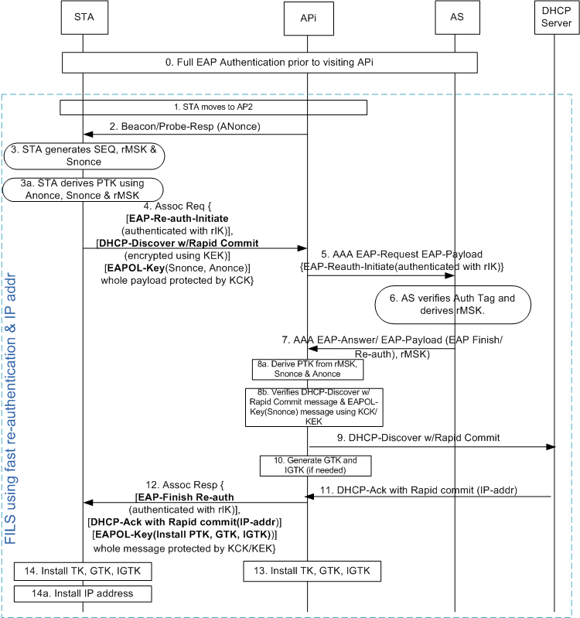
“Concurrent” IP Address Assignment w/ERP
First message from client has both authentication and DHCP message
Server relays ERP message to AS, and retains rest of client message
If AS authenticates client the rest of the client message is validated and a DHCP discover is sent to obtain an IP address

Slide 8
Problems with Concurrent IP Address Assignment w/ERP *
It requires a significant amount of state to be maintained on the AP upon receipt of a single unauthenticated message
The AP must create per-STA state after receipt of a probe request!
ERP message– name, cryptosuite, tag and DHCP offer must be retained until AAA server responds
The DHCP offer can be encrypted, making validity heuristics impractical-- impossible to distinguish between an encrypted offer with many attributes and a very large amount of garbage
Cost of single request/response is not amortized across all STAs
Benefit of “single” request/response is illusory
The client doesn’t know whether the AP is implementing “concurrent” or “simultaneous”, how long does it wait?
Since it’s 2 round trips to 2 servers the cost is the same as 2 messages
* these problems are also inherent to Simultaneous IP Address Assignment with ERP

Slide 9
How to Process Authentication and Upper-Layer Messaging
Sequentially! Authentication then DHCP
To do otherwise opens the network up to resource exhaustion attack
In an honest and fair manner
Don’t hide two 2-message protocols as one 2-message protocol
The client should get feedback on where in the protocol it is
Timers can be set realistically without guessing or over compensating
The AP should not bear the full cost of hundreds of simultaneous connections when amortizing the cost over all clients is possible
Susceptibility to resource exhaustion attacks should not be a requirement for FILS
Some cost should be amortized over all STAs (per-STA load will be trivial)

Slide 10
How to Process Authentication and Upper-Layer Messaging
There are two separate things going on, do them separately
In a single 2 round-trip exchange– one round-trip for authentication, one round-trip for DHCP
Like 11-11/1488r1 (as presented in 11-11/1429r2)
Minimal initial resource allocation requirements
per-STA state on the network is session id plus nonce
per-connection state on the STA is session id plus nonce
No built in resource exhaustion attack
DHCP request is still integrity protected and can still, optionally, have privacy protection
Authenticated identity always known prior to address assignment
Authorization attributes can be used to determine IP/VLAN assignment

Slide 11
References
11-11/1160r6
11-11/1488r1
11-11/1429r2

