Slide 1
Extend 802.1X for higher layer configuration in FILS
Date: 2012-04-21
Authors:
Name | Affiliations | Address | Phone | email
Dapeng Liu | China Mobile | Beijing | +86-13911788933 | liudapeng@chinamobile.com

Slide 2
Abstract
This document proposes extend 802.1X to carry the higher layer configuration information in FILS scenario.

Slide 3
Conformance w/ Tgai PAR & 5C
Conformance Question | Response
Does the proposal degrade the security offered by Robust Security Network Association (RSNA) already defined in 802.11? | No
Does the proposal change the MAC SAP interface? | No
Does the proposal require or introduce a change to the 802.1 architecture? | No
Does the proposal introduce a change in the channel access mechanism? | No
Does the proposal introduce a change in the PHY? | No
Which of the following link set-up phases is addressed by the proposal? (1) AP Discovery (2) Network Discovery (3) Link (re-)establishment / exchange of security related messages (4) Higher layer aspects, e.g. IP address assignment | 3,4

Slide 4
Background
802.1X is used for 802.11 authentication. The authentication and IP address configuration procedure is separated in current specification. It normally requires a DHCP or RA procedure after the authentication to configure the IP address and other higher layer information after the authentication. This will increase the link set up time.

Slide 5
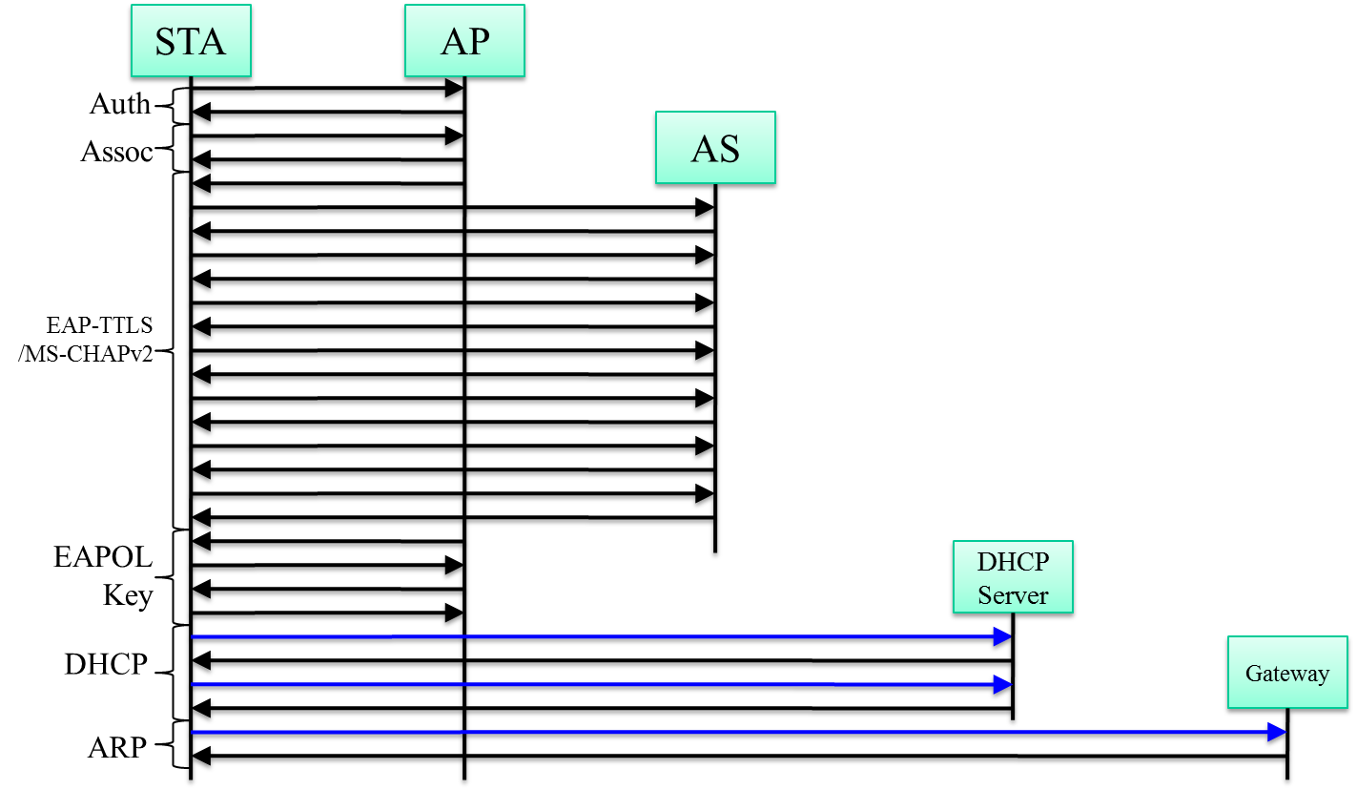
Current authentication and higher layer configuration procedure
Additional procedure for IP address and other
higher layer configuration will increase the link
set up time
Authentication procedure
IP address and other
Higher layer configuration

Slide 6
Proposal: Combine IP address configuration and higher layer configuration with authentication
STA
AP
Auth
Assoc
AS
EAP-TTLS
/MS-CHAPv2
Combine authentication and
higher layer configuration
EAPOL
Key
802.1X extension
to carry IP
and higher layer configuration
IP address and higher layer configuration
After authentication, the IP address and other IP layer configuration is done

Slide 7
802.1X extension
Define new 802.1X message to carry higher layer configuration information
Packet type: EAPOL-configuration
Payload:
IP address
Subnet mask
Default gateway

Slide 8
Questions?

