Slide 1
Aggregated Probe Response
Date: 2012-05-17
Authors:

Slide 2
Abstract
The presentation describes an improvement to the Active Scanning mechanism to reduce the Probe flooding effect by providing a controlled method for Probe Response aggregation.

Slide 3
Conformance w/ TGai PAR & 5C
Conformance Question | Response
Does the proposal degrade the security offered by Robust Security Network Association (RSNA) already defined in 802.11? | No
Does the proposal change the MAC SAP interface? | No
Does the proposal require or introduce a change to the 802.1 architecture? | No
Does the proposal introduce a change in the channel access mechanism? | Yes
Does the proposal introduce a change in the PHY? | No
Which of the following link set-up phases is addressed by the proposal? (1) AP Discovery (2) Network Discovery (3) Link (re-)establishment / exchange of security related messages (4) Higher layer aspects, e.g. IP address assignment | 1,2

Slide 4
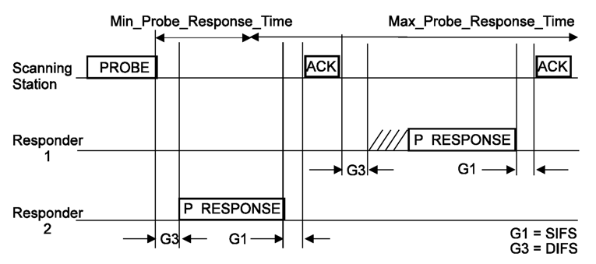
Recap, Active Scanning Procedure
Active scanning procedure is defined in 10.1.4.3.3 and is very effective in certain environments:
Short procedure results in good power consumption a 669.3uJ/attempt [1].
Negligible effect where the WM is partially utilized or while out of AP coverage.
Short latency for AP and NW discovery – approximately 10msec/channel.
Passive scanning STAs may benefit from Probe Response replacing the need for Beacon detection.

Slide 5
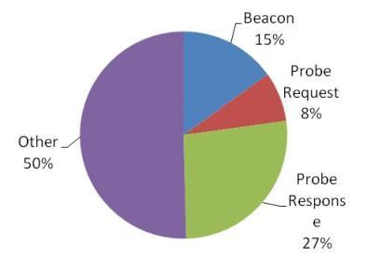
Recap, Active Scanning Procedure
However is certain environments Active scanning has his drawbacks:
Probe Response storm in certain deployments.
WM occupancy on loaded channels.
Temporal high collision rate in certain scenarios may hinder QoS of existing admitted connections.
*[2]:

Slide 6
Recap, Active Scanning Procedure
Some proposals were made to improve the probing mechanism and reduce the Probe Response effect:
Broadcast Probe Response
Filtering of Probe Responses.
STA 3
STA 2
STA 1
AP1
AP2
AP3
Probe Request (broadcast)
Probe Request (broadcast)
Probe Response(broadcast)
Probe Response(unicast)
×
Filtered

Slide 7
Non-deterministic Broadcast Probe Response
Some proposals were made to improve the probing mechanism and reduce the Probe Response effect:
These methods currently relies on the non deterministic behavior of various STAs and APs and on the momentary WM load: the short AP response duration of 2-10msec greatly limiting the aggregation of Probe Responses.
STA 3
STA 2
STA 1
AP1
AP2
AP3
2-10msec
Probe Request (broadcast)
Probe Request (broadcast)
Probe Response(broadcast)
What’s the probability of this actually happening on an opportunistic basis?

Slide 8
Non-deterministic Broadcast Probe Response
Assumptions:
Probing request rate of 100STA/Sec on average.
STAs access channel independently.
Thus:
The STAs access are Poissonically distributed with λ = 100.
Hence the probability for k responses over interval T [sec] is:
Using non deterministic Broadcast Probe Response T is the AP response time which less than MAX_PROBE_RESPONSE_TIME:
Thus, the probability that K > 1:
STA 3
STA 2
STA 1
AP1
AP2
AP3
2-10msec
Probe Request (broadcast)
Probe Request (broadcast)
Probe Response(broadcast)

Slide 9
Non-deterministic Broadcast Probe Response
And the probability for Probe Response to answer more than one Probe Request is:
T = 2msec: 1.75%
T = 5msec: 9.02%
T = 10msec: 26.42%
Current WFA maximum AP response time is set to 5msec on an unloaded channel.
Some enterprise grade APs may have a response time as good as 2msec reducing the number of answered STAs per Probe Response.

Slide 10
Suggested Improvement
Enable APs to respond to a Probe Request using a short broadcast message indicating the correct reception of Probe Request and referring to the beacon (or other message) providing the complete information.
Probe Request instance
Short response
Beacon
T
AP 1 TBTT
AP 2 TBTT

Slide 11
Suggested Improvement (con.)
AP1 and AP2 are independent each with its own load, response latency, TBTT, TSF etc’.
STAs perform WM access procedure as done today using the basic access procedure.
STA 2 Probe Req
STA 3 Probe Req
STA 1 Probe Req
Probe Request instance
TSF,
TBTT offset,
Beacon interval
Short response
Beacon
T
TSF,
TBTT offset,
Beacon interval
AP 1 TBTT
AP 2 TBTT

Slide 12
Suggested Improvement (con.)
The APs use a short response message to indicate:
Correct reception
Basic AP identity enabling filtering and AP prioritizing.
Reference to the nearest message providing the complete information.
AP1 Short responses
AP2 Short responses
Probe Request instance
Short response
Beacon
T
AP 1 TBTT
AP 2 TBTT

Slide 13
Suggested Improvement (con.)
The nearest message providing the information maybe:
A regular Beacon – by referring to its next periodic transmission.
A Measurement Pilot – by referring to its next periodic transmission.
FILS Beacon – by indicating the maximum time without FILS beacon transmission.
A Probe Response message – by transmitting it during one of the above schedules.
AP1 regular Beacon
AP2 regular Beacon
Probe Request instance
TSF,
TBTT offset,
Beacon interval
Short response
Beacon
T
TSF,
TBTT offset,
Beacon interval
AP 1 TBTT
AP 2 TBTT

Slide 14
Suggested Improvement (con.)
The nearest message providing the information maybe:
A regular Beacon – by referring to its next periodic transmission.
A Measurement Pilot – by referring to its next periodic transmission.
FILS Beacon – by indicating the maximum time without FILS beacon transmission.
A Probe Response message – by transmitting it during one of the above schedules.
AP1 MP
AP2 MP
Probe Request instance
TSF,
MP offset,
MP interval
Short response
Full message at MP timing
T
TSF,
MP offset,
MP interval
AP 1
Measurement
Pilot
AP 2
Measurement
Pilot

Slide 15
Suggested Improvement (con.)
The nearest message providing the information maybe:
A regular Beacon – by referring to its next periodic transmission.
A Measurement Pilot – by referring to its next periodic transmission.
FILS Beacon – by referring to its next periodic transmission.
A Probe Response message – by transmitting it during one of the above schedules.
AP1 MP
AP2 MP
Probe Request instance
TSF,
MP offset,
MP interval
Short response
Full message at FILS beacon
timing
T
TSF,
MP offset,
MP interval
AP 1
FILS beacon
AP 2
FILS Beacon

Slide 16
Suggested Improvement (con.)
The nearest message providing the information maybe:
A regular Beacon – by referring to its next periodic transmission.
A Measurement Pilot – by referring to its next periodic transmission.
FILS Beacon – by referring to its next periodic transmission.
A Probe Response message – by transmitting it during one of the above schedules.
AP1 Probe-RSP
AP2 Probe-RSP
Probe Request instance
TSF,
MP offset,
MP interval
Short response
MP/FILS beacon timing
T
TSF,
MP offset,
MP interval
AP 1
Measurement
Pilot
AP 2
Measurement
Pilot

Slide 17
Suggested Improvement (con.)
And the probability for Probe Response using control aggregated Probe Response is:
T = 20msec: 59.3%
T = 30msec: ~80%
Probe Request instance
TSF,
MP offset,
MP interval
Short response
Aggregation duration
MP instance
T
AP 1
Measurement
Pilot
AP 2
Measurement
Pilot

Slide 18
Suggested Improvement (con.)
Advantages:
Known and controlled (by AP) aggregation duration of Probe Req to single Probe Rsp:
No dependency on AP delay and momentary channel load.
Scalable: Memory size of AP is fixed and does NOT increases linearly by number of Probing STAs.
AP can deterministically and easily mange responsiveness (i.e. delay) vs. transmission overhead by selecting the referred beacon or MP and its instance.
Prevents Probe Response storm by Aggregation of multiple Probe Responses into a single one in a controlled fashion.
TSF,
TBTT offset,
Beacon interval
Probe Request instance
Short response
Beacon
TSF,
TBTT offset,
Beacon interval
T
AP 1 TBTT
AP 2 TBTT

Slide 19
References
[1] IEEE 802.11-12/0239r2 Improvement of Passive Scanning by Jarkko Kneckt
[2] IEEE 802.11-11/1413r3 Real air-time occupation by beacon and probe by Katsuo Yunoki
[3] IEEE 802.11-12/0257r2 Prioritized Active Scanning in TGai by Giwon Park

Slide 20
Backup

Slide 21
Framework document – straw poll 1
Insert the following text on clause 6 of the SFD (11-12/0151r07):
The amendment will define a mechanism to aggregate Probe Responses in a method controlled by the AP.
Do you agree to make changes to the TGai framework specification as described above.
Yes:
No:
Abstain:

Slide 22
Framework document – straw poll 2
The amendment will define a mechanism to aggregate Probe Responses in a method controlled by the AP.
Insert the following text on clause 6 of the SFD (11-12/0151r07):
The mechanism will aggregate unicast Probe Responses to a Broadcast Probe Response where the aggregation duration is controlled by the AP and is Independent of the Min_Probe_Response_Time and Max_Probe_Response_Time.
Do you agree to make changes to the TGai framework specification as described above.
Yes:
No:
Abstain:

Slide 23
Comparing opportunistic and non opportunistic Broadcast Probe Response
Opportunistic Probe Response:
Transmit a Probe Request indicate Max_Probe_Response_Time of STA to AP.
AP register Probe Response associated with it.
When transmitting it clears the memory associated with that STA.

Slide 24
Suggested Improvement (con.)
Advantages:
Easily adapted to prioritized response:
AP with lower priority reference to more distant instance of the complete information.
AP identify some STAs as having higher priority than others using information included in the Probe Request delay their NW entry by referring to more distant MP or Beacon.
STA 1,2 Probe-Req from other SP STA
STA 3 Probe-Req from other SP STA
Probe Request instance
Short response
Beacon
T
TSF,
MP offset,
MP interval
1st MP instance
From AP # 1
2nd MP instance
From AP # 1

