Slide 1
Aggregated Probe Response
Date: 2012-05-02
Authors:

Slide 2
Abstract
The presentation describes an improvement to the Active Scanning mechanism to reduce the Probe flooding effect by providing a controlled method for Probe Response aggregation.

Slide 3
Conformance w/ TGai PAR & 5C
Conformance Question | Response
Does the proposal degrade the security offered by Robust Security Network Association (RSNA) already defined in 802.11? | No
Does the proposal change the MAC SAP interface? | No
Does the proposal require or introduce a change to the 802.1 architecture? | No
Does the proposal introduce a change in the channel access mechanism? | Yes
Does the proposal introduce a change in the PHY? | No
Which of the following link set-up phases is addressed by the proposal? (1) AP Discovery (2) Network Discovery (3) Link (re-)establishment / exchange of security related messages (4) Higher layer aspects, e.g. IP address assignment | 1,2

Slide 4
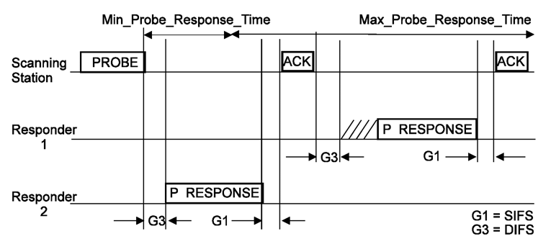
Recap, Active Scanning Procedure
Active scanning procedure is defined in 10.1.4.3.3 and is very effective in certain environments:
Short procedure results in good power consumption a 669.3uJ/attempt [1].
Negligible effect where the WM is partially utilized or while out of AP coverage.
Short latency for AP and NW discovery – approximately 15msec/channel.
Passive scanning STAs may benefit from Probe Response replacing the need for Beacon detection.

Slide 5
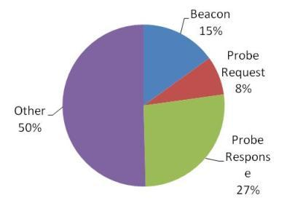
Recap, Active Scanning Procedure
However is certain environments Active scanning has his drawbacks:
Probe Response storm in certain deployments.
WM occupancy on loaded channels.
Temporal high collision rate in certain scenarios may hinder QoS of existing admitted connections.
*[2]:

Slide 6
Recap, Active Scanning Procedure
Some proposals were made to improve the probing mechanism and reduce the Probe Response effect:
Broadcast Probe Response
Filtering of Probe Responses.
These methods currently relies on the non deterministic behavior of various STAs and APs and on the momentary WM load: the short AP response duration of 2-15msec greatly limiting the aggregation of Probe Responses.
STA 3
STA 2
STA 1
AP1
AP2
AP3
Probe Request (broadcast)
Probe Request (broadcast)
Probe Response(broadcast)
Probe Response(unicast)
×
Filtered

Slide 7
Suggested Improvement
Enable APs to respond to Probe Request with short broadcast message indicating the correct reception of Probe Request and indication to the beacon providing the complete information.

Slide 8
Suggested Improvement
Enable APs to respond to a Probe Request using a short broadcast message indicating the correct reception of Probe Request and indication to the beacon providing the complete information.
Probe Request instance
TSF,
TBTT offset,
Beacon interval
Short response
Beacon
T
TSF,
TBTT offset,
Beacon interval
AP 1 TBTT
AP 2 TBTT

Slide 9
Suggested Improvement
AP1 and AP2 are independent each with its own load, response latency, TBTT, TSF.
WM access procedure is as done today using the basic access procedure.
Short response maybe MP, FILS beacon.
Probe Request instance
TSF,
TBTT offset,
Beacon interval
Short response
Beacon
T
TSF,
TBTT offset,
Beacon interval
AP 1 TBTT
AP 2 TBTT

Slide 10
Suggested Improvement
Advantages:
Enables deterministic aggregation of multiple Probe Responses into a single one.
Prevents a Probe Response storm by bounding the number of Probe Responses to a limit selected by the AP.
Measurement pilots may be used as a response, and instance of MP can be replaced with full beacon for this response purposes.
Reduces and prevents the temporal WM load caused by Probe Responses.
Enable differentiation of high and low priority APs.
Probe Request instance
TSF,
TBTT offset,
Beacon interval
Short response
Beacon
TSF,
TBTT offset,
Beacon interval
T
AP 1 TBTT
AP 2 TBTT

Slide 11
References
[1]
[2]

Slide 12
Backup

Slide 13
Framework document – straw poll 1
Insert the following text on clause 6 of the SFD (11-12/0151r07):
The amendment will define a mechanism to aggregate Probe Responses in a method controlled by the AP.
Do you agree to make changes to the TGai framework specification as described above.
Yes:
No:
Abstain:

Slide 14
Framework document – straw poll 2
Insert the following text on clause 6 of the SFD (11-12/0151r07):
The amendment will define a mechanism to aggregate Probe Responses in a method controlled by the AP without an increase to the Min_Probe_Response_Time and Max_Probe_Response_Time
Do you agree to make changes to the TGai framework specification as described above.
Yes:
No:
Abstain:

