Slide 1
Passive and Active Scanning Mixture
Date: 2012-05-02
Authors:

Slide 2
Abstract
The presentation describes an improvement to the scan mechanism to better comply with the probe flooding effect of Active Scanning and the power consumption of passive scanning by creating a mix of STA performing Active and Passive scanning.

Slide 3
Conformance w/ TGai PAR & 5C
Conformance Question | Response
Does the proposal degrade the security offered by Robust Security Network Association (RSNA) already defined in 802.11? | No
Does the proposal change the MAC SAP interface? | No
Does the proposal require or introduce a change to the 802.1 architecture? | No
Does the proposal introduce a change in the channel access mechanism? | Yes
Does the proposal introduce a change in the PHY? | No
Which of the following link set-up phases is addressed by the proposal? (1) AP Discovery (2) Network Discovery (3) Link (re-)establishment / exchange of security related messages (4) Higher layer aspects, e.g. IP address assignment | 1,2

Slide 4
Recap, Passive Scanning Procedure properties
Low wireless medium occupancy (using the beacon) - Highly suitable for heavily loaded deployments.
Subdued effect on QoS of incoming mass on the Tokyo metro station scenario for STAs with already existing active connections.
Fixed latency – STA cannot select between high power/short latency and low power/high latency AP discovery.
High power consumption per AP discovery instance – given 100-300msec beacon interval.

Slide 5
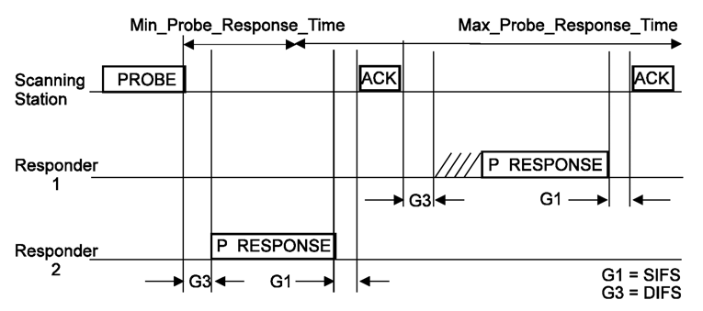
Recap, Active Scanning Procedure
Active scanning procedure is defined in 10.1.4.3.3 and is very effective in certain environments:
Short procedure results in good power consumption a 669.3uJ/attempt [1].
Negligible effect where the WM is partially utilized or while out of AP coverage.
Short latency for AP and NW discovery – approximately 15msec/channel.
Passive scanning STAs may benefit from Probe Response replacing the need for Beacon detection.

Slide 6
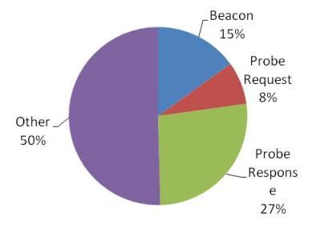
Recap, Active Scanning Procedure
However is certain environments Active scanning has his drawbacks:
Probe Response storm in certain deployments.
WM occupancy on loaded channels.
Temporal high collision rate in certain scenarios may hinder QoS of existing admitted connections.
*[2]:

Slide 7
Recap, Active Scanning Procedure
We need a mechanism to enable effective mixture of Active and Passive Scanning for the benefit of the larger part while minimizing the impact to the each single STA:
Enable Passive scanning STAs to shorten the delay and Power used for AP/NW discovery by using Probe Responses.
Enable Active scanning STAs to use low power low latency procedure for AP/NW discovery.
Subsides the effect of Active Scanning’s Probe storm.
Easy to control process preventing greedy STAs.

Slide 8
Suggested Improvement
Mandate STAs to draw a dice using uniform distribution for active and passive scanning.
STA performs either passive or active scanning according to result of draw.
Each attempt a dice is retaken.

Slide 9
Suggested Improvement (con.)
Start scanning procedure
Set/Reset parameters
Draw a dice and select
Scanning type
Perform scanning
Scanning complete?
True
False
Perform association
Possible update of
Scanning parameters
Scanning procedure
complete

Slide 10
Suggested Improvement (con.)
The probability function is uniform distribution and may take a bias depending on whether the system wants to optimize on power/latency or WM occupancy:
Existing mechanisms (passive and active scanning) without change.
Threshold conditions to maximize on power may be used to improve power consumption – long durations of no AP coverage or long durations without Probing.

Slide 11
Suggested Improvement (con.)
Benefits:
Takes on the benefit of Active and passive scanning.
All STAs chip in at the effort and benefit from the procedure.
Creates a controlled mixture of Passive and Active scanning for the benefit of all.

Slide 12
References
[1] 12-0277r4 Hybrid Scanning by Katsuo Yunoki
[2] IEEE802.11-11/1413r3 Real air-time occupation by beacon and probe by Katsuo Yunoki

Slide 13
Backup

Slide 14
Framework document – straw poll 1
Insert the following text on clause 6 of the SFD (11-12/0151r07):
The amendment will define a mechanism to create a mixture of STAs performing Active Scanning and passive scanning.
Do you agree to make changes to the TGai framework specification as described above.
Yes:
No:
Abstain:

Slide 15
Framework document – straw poll 2
Insert the following text on clause 6 of the SFD (11-12/0151r07):
The mixture creation mechanism is based on drawing a dice to select scan type per each scan attempt while conforming to the existing scanning procedures.
Do you agree to make changes to the TGai framework specification as described above.
Yes:
No:
Abstain:

