Slide 1
TGai Second Vice Chair Candidate Overview:
Robert Stacey
Date: 2012-04-17
Authors:

Slide 2
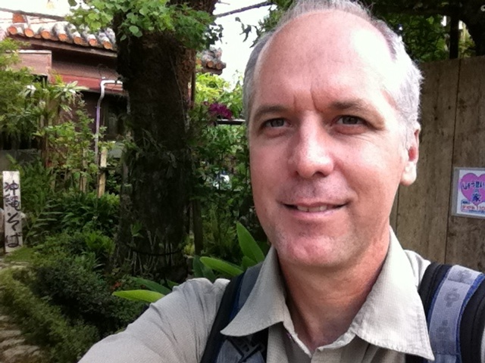
Background
Attending IEEE 802.11 since 2003
Contributor to many task groups,
with significant contributions in
802.11n, 802.11ac and 802.11ad
Officer positions (current):
  TGac Technical Editor
  TGac MU-MIMO ad-hoc co-chair
Published author:
  Next Generation Wireless LANs: Throughput, Robustness and Reliability in 802.11n, Cambridge University Press, 2008
Okinawa, 2011 – best picture I could find

Slide 3
Goals for TGai “Security” ad-hoc
Early work:
  Co-ordinate consensus building process around technical concepts
  Find volunteers to produce required text
    Spec framework text
    Draft amendment text
WG letter ballot:
  Co-ordinate comment resolution on “security” related topics
    Solicit volunteers to write comment resolutions
    Ensure that resolutions are discussed and approved by the task group

Slide 4
Practical Issues
I won’t be attending the May session
  (I’m on vacation … in a more exotic location)
I will thus be standing for election in abstentia
I hope you remember me and vote for me anyway

