Slide 1
6-10GHz_extensions_to_802.11ac_part4
Date: 2012-05-14
Authors:

Slide 2
Abstract
This document discusses some of the market opportunities of using existing shared spectrum allocation in 6-10.5GHz as an extension frequency band for an 802.11ac PHY with a 500MHz bandwidth. It is a follow up to document 12/375r0, 12/0096r0, 11/743r0, and 11/385r1

Slide 3
Introduction
Previous presentations on using 6-10GHz spectrum for WLAN have focussed on the Technical aspects
But Standards development is more than just Technical Feasibility, it also includes analysis of the Market Demand
This presentation aims to start an initial analysis of some of the market Demand

Slide 4
802.11ac Market Projection
Market for 802.11ac products expected to exceed 2130m units by 2016
802.11ac + 802.11n is expected to be the dominant technology for Wi-Fi
Over 90% of WLAN enabled devices will support 802.11ac by 2016
Units, millions
Source: ABI August 2011
WI-FI Chipset Evolution
From 802.11n to 802.11ac and 802.11ad

Slide 5
Market Size By Segment
Embedded WLAN = 79 % of total WLAN market by 2016
Market Segment | 2011 | 2012 | 2013 | 2014 | 2015 | 2016
Cellular handset | 488.9 | 593.2 | 693.9 | 786.8 | 874.9 | 956.0
Media Tablets | 52.9 | 77.4 | 99.6 | 112.8 | 115.7 | 117.8
MIDs | 1.1 | 0.9 | 0.7 | 0.5 | 0.4 | 0.2
Portable Game Console | 32.6 | 38.5 | 36.9 | 34.2 | 32.7 | 32.1
Portable Media Player | 24.6 | 25.3 | 26.1 | 29.3 | 34.3 | 40.0
Digital Imaging Device | 19.7 | 33.7 | 49.9 | 65.7 | 78.9 | 89.3
PC Accessory | 33.9 | 43.1 | 52.2 | 60.5 | 74.2 | 89.2
Adapters | 15.7 | 14.8 | 14.1 | 13.6 | 13.0 | 12.8
Set-top Box | 7.3 | 9.5 | 11.6 | 13.7 | 16.0 | 17.8
Flat Panel TVs | 35.1 | 58.7 | 86.4 | 116.4 | 143.6 | 163.8
Blu-ray, PVRs, Media Players, | 22.8 | 33.9 | 50.1 | 74.7 | 99.0 | 108.2
Game Console | 33.7 | 32.7 | 34.6 | 40.0 | 47.6 | 50.1
Other Embedded | 43.4 | 55.2 | 64.6 | 76.2 | 90.6 | 101.1
Access Point | 83.8 | 95.2 | 104.9 | 112.6 | 119.1 | 125.2
Desktop | 9.0 | 9.9 | 11.2 | 12.9 | 14.3 | 14.5
Laptop | 202.2 | 226.9 | 252.6 | 280.7 | 297.0 | 318.0
Netbook | 31.5 | 29.1 | 27.2 | 25.8 | 24.7 | 24.2
Total (millions, units) | 1138.3 | 1377.9 | 1616.7 | 1856.2 | 2076.0 | 2260.4
}
Embedded Mobile
Market 2016
= 1235.4m units
55% of total WLAN market
CAGR of 15%
}
Embedded Non Mobile
Market 2016
= 543m units
24% of total WLAN market
CAGR of 23%
}
PC / Networking
Market 2016
= 481.9m units
21% of total WLAN market
CAGR of 8%
Source: ABI August 2011
WI-FI Chipset Evolution From 802.11n to 802.11ac and 802.11ad

Slide 6
Key Requirements for Embedded Mobile Devices
Small Solution Size | Restricted size of mobile devices requires small solution size
Low Current Consumption | Restricted battery size of mobile devices requires low power consumption
Low Solution Cost | Mobile devices targeted at the consumer market so have to meet consumer price points to achieve large volumes
“Easy” software integration | Software integration is the long-haul part of embedded device development. Developers want to build on existing technologies where possible
Adoption | Consumer devices require large-scale adoption of technologies to enable eco-system to develop
Ease-of-use | Technologies must be “granny-proof”

Slide 7
Wireless Technologies – Embedded Devices Suitability
May, 2012
Technology | Size | Current Consumption | Cost | Software Integration | Adoption | Ease of Use
802.11ac | ✓ | ✓ | ✓✓ | ✓✓ | ✓✓ | ✓✓
WiGig / 802.11ad | ✗ | ✗ | ✓ | ✓ | ? | ✓✓
Wireless HD | ✗ | ✗ | ✗ | ✗ | ✗ | ?
WHDI | ? | ✗ | ✓ | ✓ | ✗ | ?
UWB | ✓ | ✓✓ | ✓ | ✗ | ? | ✗
6-10GHz WLAN | ✓ | ✓✓ | ✓✓ | ✓✓ | ? | ✓✓
Richard Edgar, et al

Slide 8
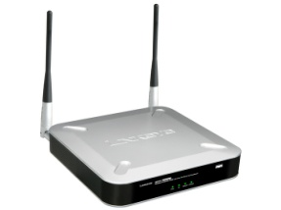
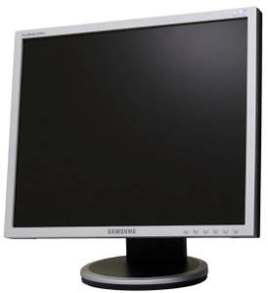
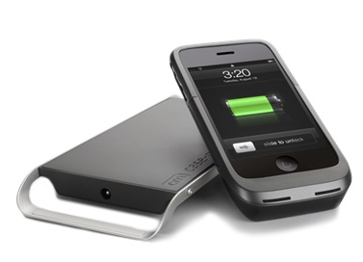
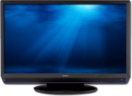
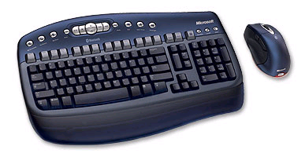
Use Case - Wireless Docking
Simultaneous internet and wireless docking with wireless display
Internet access
(11ac)
Office / Desktop
(6-10GHz)
Home /Entertainment
(6-10GHz)
Optional wireless charging
Meeting room
(6-10GHz)
Optional wireless keyboard/mouse
(6-10GHz)
Richard Edgar, et al

Slide 9
Wireless Docking Requirements for Success
Wireless docking similar to that demonstrated on UWB radio
But use 802.11ac Wi-Fi radio with 6-10GHz additional capacity
Key features:
Low latency
Mouse movements, typing
Scrolling
Video conferencing
Lossless transmission
Graphics and text
Low power
Radio optimisations
Optimise compression/data rate
Simultaneous internet access with wireless display
Richard Edgar, et al

Slide 10
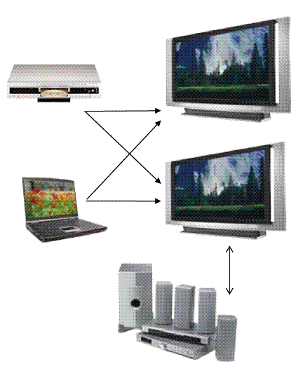
Wireless Display Technologies
Wide range of initiatives addressing “wireless display”
DLNA
Wireless HD
WFA Wi-Fi Display
Intel WiDi
IEEE 802.11ad / WiGig
IEEE 802.11aa
WHDI
These developments are aimed at a single use-case: video streaming around the home
Either they don’t address graphics-intensive office or gaming applications
Or they aren’t designed with mobile devices in mind
802.11 can add significant value to customers and end-users by supporting a wide range of use cases at mobile power levels
Normal “desktop” applications such as web browsing, spreadsheets, presentations, document editing and review
Richard Edgar, et al

Slide 11
Wireless Display Technologies
May, 2012
Standard | Description | Wireless Docking Suitability
Digital Living Network Alliance | Service discovery and compressed video streaming over home network | Lossy compression of video data – high power, poor graphics & text, high latency
Wireless HD | 60GHz Video area network; lossless FullHD video streaming at up to 10m | First generation products available, low latency but high power
WFA Wi-Fi Display | Video and audio transport using MPEG over TCP/IP/802.11 | Lossy compression of video data – high power, poor graphics & text, high latency
IEEE 802.11aa | “Robust Audio Video Transport Streaming” - changes to MAC: better multicast, alternate AC & OBSS | Complementary technology
WiGig / IEEE 802.11ad | 60GHz Wi-Fi, standards development in progress | Many unknowns: power, antennas, beamsteering, chip design & operation, industrial design will all slow adoption
WHDI™ (Wireless Home Digital Interface) | High-quality, light compression Full HD video wireless delivery for homes; 5GHz radio similar to 802.11n using 40MHz channels with proprietary, video-optimised encoding | First generation products available; supports low latency and has low power modes
Sony TransferJet | Very short-range (~10cm), high-speed wireless for file transfer, c.375Mbps | Targetted at file sharing rather than displays (OBEX/SCSI)
Richard Edgar, et al

Slide 12
Wireless Display Technologies – Handset Docking Suitability
May, 2012
Technology | Cost | Video | Graphics | Power | Latency | Adoption | Overall
6-10GHz WLAN | ✓ | ✓ | ✓ | ✓ | ✓ | ? | ✓
DLNA | ✓ | ✓ | ✗ | ✗ | ✗ | ✓ | ✗
Wireless HD | ✗ | ✓ | ? | ✗ | ✓ | ✓ | ?
Wi-Fi Display | ✓ | ✓ | ✗ | ✗ | ✗ | ✓ | ✗
802.11aa | ✓ | ✓ | ✗ | ✗ | ✗ | ? | ✗
WiGig / 802.11ad | ✗ | ✓ | ✗ | ✗ | ✓ | ? | ✗
WHDI | ? | ✓ | ✓ | ? | ✓ | ✓ | ?
Transfer Jet | ? | ✗ | ✗ | ✓ | ✓ | ? | ✗
Richard Edgar, et al

Slide 13
Addressing Customer’s Concerns
They don’t like new radios:
Another chip
Another antenna
New host software
Unproven technology
And they don’t like proprietary lock-ins
Alternative suppliers
Little industry adoption
Need compatible displays
Re-use of 802.11ac PHY as an alternative to other technologies
Standards based extensions to Wi-Fi MAC/ PHY for improved performance
Optimised radio for low-power, high throughput
Address coexistence of Wi-Fi with wireless docking
IEEE 802.11 standardisation resolves this
6-10GHz WLAN enables new capabilities and use cases to 802.11ac radios with minimal additional cost or complexity
Richard Edgar, et al

Slide 14
Summary
802.11ac is expected to be the dominant PHY standard by 2016
Embedded mobile will is expected to be over 50% of the total 802.11ac market
802.11ac does not fully meet the needs of embedded mobile WLAN
Power consumption is the major challenge
6-10GHz WLAN enables new capabilities to 802.11ac radios with minimal additional cost or complexity to meet the needs of tomorrows mobile WLAN enabled devices

Slide 15
References
https://mentor.ieee.org/802.11/dcn/12/11-12-0375-00-0wng-6-10ghz-extensions-to-802-11ac-part3.ppt
https://mentor.ieee.org/802.11/dcn/12/11-12-0096-00-0wng-6-10ghz-extensions-to-802-11ac-part2.ppt
https://mentor.ieee.org/802.11/dcn/11/11-11-0743-00-0wng-6-9ghz-extensions-to-802-11.ppt
https://mentor.ieee.org/802.11/dcn/11/11-11-0385-01-0wng-ultrwideband-spectrum-for-802-11.ppt

