Slide 1
TIM Compression
Date: 2012-11-8

Slide 4
Motivation
Based on our study on TIM compression, we find that AID differential encoding (ADE) can further enhance the hierarchy-OLB encoding method specified in the IEEE 802.11ah framework and achieve a higher compression ratio. Therefore, we propose to include ADE as an option for TIM bitmap compression

Slide 5
TIM Encoding Framework in TGah SFD
Partial Virtual Bitmap is encoded in Block level
Partial virtual bitmap consists of one or more encoded Blocks of a single Page
Block encoding:
Block Control(3 bits) + Block Offset (5 bits) + Block Bitmap (1octet) + Sub-Block Bitmaps (0-8octets)
Block Control field: controls how the Block Bitmap and the Sub-Block Bitmap fields are used
Block bitmap encoding: AID = [Page Index(2b), Block Offset(5b), n(3b), m(3b)]
The n-th bit position of the Block Bitmap indicates whether the n-th Sub-Block Bitmap is present in the Sub-Block field
The m-th bit position of the Sub-Block Bitmap indicates whether the m-th STA has data buffered at the AP
Single AID: AID = [Page Index(2b), Block Offset(5b), Block Bitmap[5:0]]
When there is a single AID in a Block, 6 bits of the Block Bitmap field is used to indicate the 6 LSBs of the AID
The Sub-Block field is not present
Inverse bitmap: if there are many 1s in the bitmap of a Block, inverse the bitmap and encode the inversed bitmap
Can expect many cases where STAs sleep for a long period of time
Bitmap Control
Partial Virtual Bitmap
Block L
Block M
…
Block P
Block Control field:
Block Bitmap
Single AID
‘Offset+Length+Bitmap’
+
Inverse bitmap
Bitmap Control (1 octet)
1 octet
1 octet
0-8 octets
TBD
Page
Index
Block
Control
Block Offset
Block Bitmap
Sub-Blocks (variable)
2 bits
3 bits
5 bits
1 octet
Sub-Block
Bitmap 1
Sub-Block
Bitmap 2
…
Sub-Block
Bitmap M

Slide 6
Offset+Length+Bitmap (OLB)
‘Offset+Length+Bitmap’ mode: encodes more than 8 Sub-Block Bitmaps.
The Block Bitmap field is used to indicate the length of Sub-Block Bitmaps following the Block Bitmap field.
AID = [Page Index (2b), Block Offset(5b),zeros(6b)]+ p, the p-th bit position of the Sub-Block Bitmap field indicates whether the p-th STA has data buffered at the AP.
This mode is used when more than 8 contiguous Sub-Blocks are transmitted.
Bitmap Control
Partial Virtual Bitmap
Block n
Block n+1
…
Block n+m
Block p
…
Block v
Bitmap Control (1 octet)
2 octets
L octets
OLB mode
TBD
Page
Index
Block
Control
Block Offset
Length (L)
L Sub-Block Bitmaps
2 bits
3 bits
5 bits
1 octet

Slide 7
Using AID Directly in TIM Bitmap
When the number of bits being enabled (set to’1’) in the Partial Virtual Bitmap is sparse, representing AID directly in a binary form can reduce the size of TIM IE significantly. The scheme should include
A way to specify the number of bits required to encode AID.
All AIDs are encoded with the same number of bits.
Length of the block with encoded AIDs.
Using differential encoding can further reduce the size of TIM IE when AIDs are encoded in binary
Encode Word
Length
Length
AID 1
AID 2
. . .
AID N

Slide 8
Concept: AID Differential Encoding (ADE)
Denote n AIDs in ascending order as AID₁, AID₂, …, AID_{n}
Compress AID₁, AID₂, …, AID_{n} with differential encoding as follows:
∆AID₁ = reference value, for example, AID₁
∆AID_{i} = AID_{i} – AID_{i-1}, i = 2, …, n.
Concatenate the binary form of ∆AID₁, ∆AID₂, …, ∆AID_{n} with the fields:
Encode word length (EWL): number of bits required to encode differential values
Length: length of the block (in number of bytes).
An example of structure
Encode Word
Length
Length
∆AID ₁
∆AID ₂
. . .
∆AID _{n}

Slide 9
Proposal: ADE Mode
Partial Virtual Bitmap is encoded in Block level
Partial virtual bitmap consists of one or more encoded Blocks of a single Page
Block encoding:
Block Control(3 bits) + Block Offset (5 bits) + Block Bitmap (1octet) + Sub-Block Bitmaps (0-8octets)
Block Control field: controls how the Block Bitmap and the Sub-Block Bitmap fields are used
Block bitmap encoding
Single AID
Offset+Length+Bitmap (OLB)
AID with Differential Encoding (ADE)
Inverse bitmap
Bitmap Control
Partial Virtual Bitmap
Block Control field:
Block Bitmap
Single AID
‘Offset+Length+Bitmap’
‘AID with Differential Encoding’
+
Inverse bitmap
Block L
Block M
…
Block P
Bitmap Control (1 octet)
1 octet
1 octet
0-8 octets
TBD
Page
Index
Block
Control
Block Offset
Block Bitmap
Sub-Blocks (variable)
2 bits
3 bits
5 bits
1 octet
Sub-Block
Bitmap 1
Sub-Block
Bitmap 2
…
Sub-Block
Bitmap M

Slide 10
AID Differential Encoding (ADE) Mode
Each block encodes up to 256 consecutive AIDs.
Last block can be shorter.
The Block Bitmap field consists of following fields:
Encoded Word Length (EWL) (3 bits): number of bits required to encode differential AID value.
Length (5 bits): the length of encoded block bitmap, in number of octets
Concatenated bits of differential encoded AID values of paged STAs: ∆AID₁, ∆AID₂, …, ∆AID_{m}
∆AID₁ = AID₁ – Block Offset*8
∆AID_{i} = AID_{i} – AID_{i-1}, i = 2, …, m.
Padding(1-7 bits): padding the encoded block to the boundary of octets and indicating the termination state
Bitmap Control
Partial Virtual Bitmap
Block n
Block n+1
…
Block n+32
Block p
…
Block v
Bitmap Control (1 octet)
2 octets
X octets
ADE mode
TBD
Page
Index
Block
Control
Block Offset
EWL
Length
∆AID₁, ∆AID₂, …, ∆AID_{m}
Padding
2 bits
3 bits
5 bits
3 bits
5 bits
2 octets
Y octets
Block
Control
Block Offset
EWL
Length
∆AID₁, ∆AID₂, …, ∆AID_{m}
Padding
3 bits
5 bits
3 bits
5 bits

Slide 11
Decoding of TIM Bitmap in ADE Mode
When STA receives TIM IE, if the block control field indicates that a bitmap block is encoded with ADE mode, it may use following steps to decode the TIM bitmap:
Obtain the Block Offset value
Obtain the values of ∆AID₁, ∆AID₂, …, ∆AID_{n} from the encoded octets based on the information from EWL and length field.
Decode AID_{i} by:
AID₁ = Block Offset*8 + ∆AID₁
AID_{i} = AID_{i-1} + ∆AID_{i} for i = 2, …, n

Slide 12
Performance Results
Comparison with TIM encoding method in the current framework: Hierarchy + OLB [1].

Slide 13
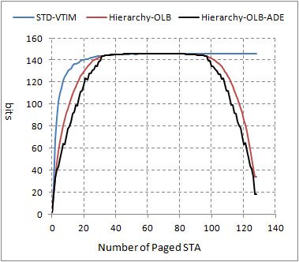
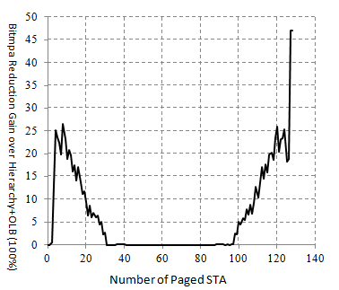
128 Stations
Scenario 1: 128 STAs
128 STAs associated with AP
X axis indicates the number of paged STAs
randomly distributed AIDs in [1:128]
Averaged over 10,000 iterations
Y axis represents the size of the compressed bitmap
Curves
Hierarchy + OLB: Block level compression with ‘Offset + Bitmap + Length’ mode (indicated as ‘Adaptive’ in Y-axis)
Hierarchy + OLB + ADE: with AID differential encoding
STD-VTIM: Standard virtual TIM map

Slide 14
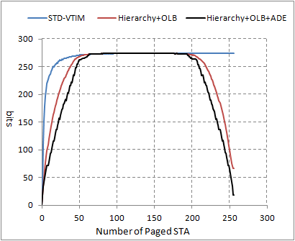
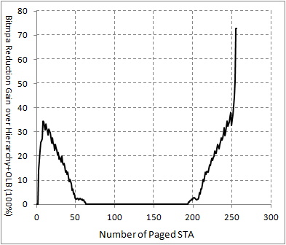
256 Stations
Scenario 2: 256 STAs
256 STAs associated with AP
X axis indicates the number of paged STAs
randomly distributed AIDs in [1:256]
Averaged over 500 iterations
Y axis represents the size of the compressed bitmap
Curves
Hierarchy + OLB: Block level compression with ‘Offset + Bitmap + Length’ mode (indicated as ‘Adaptive’ in Y-axis)
Hierarchy + OLB + ADE: with AID Differential encoding
STD-VTIM: Standard virtual TIM map

Slide 15
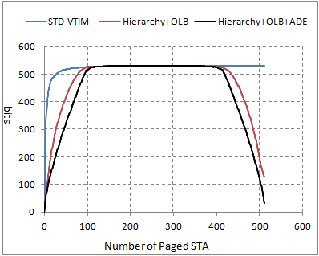
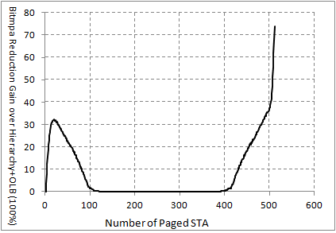
512 Stations
Scenario 3: 512 STAs
512 STAs associated with AP
X axis indicates the number of paged STAs
randomly distributed AIDs in [1:512]
Averaged over 500 iterations
Y axis represents the size of the compressed bitmap
Curves
Hierarchy + OLB: Block level compression with ‘Offset + Bitmap + Length’ mode (indicated as ‘Adaptive’ in Y-axis)
Hierarchy + OLB + ADE: with AID Differential encoding
STD-VTIM: Standard virtual TIM map

Slide 16
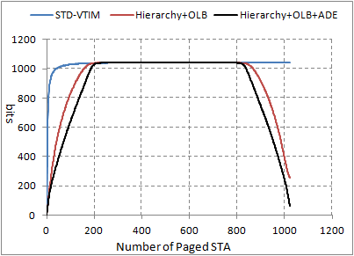
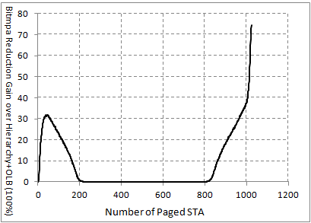
1024 Stations
Scenario 4: 1024 STAs
1024 STAs associated with AP
X axis indicates the number of paged STAs
randomly distributed AIDs in [1:1024]
Averaged over 500 iterations
Y axis represents the size of the compressed bitmap
Curves
Hierarchy + OLB: Block level compression with ‘Offset + Bitmap + Length’ mode (indicated as ‘Adaptive’ in Y-axis)
Hierarchy + OLB + ADE: with AID differential encoding
STD-VTIM: Standard virtual TIM map

Slide 17
Conclusions
In this contribution, we propose AID differential encoding (ADE) for binary AID form in TIM IE to further reduce the size of TIM IE. We have compared ADE with the encoding methods proposed in [1]. The simulation shows that the improvement can be as high as 30% or more.

Slide 18
References
[1] Minyoung Park, “Proposed Specification Framework for TGah”, IEEE 802.11-11/1137r11, September 2012

Slide 19
Straw Poll
Do you support to include in the IEEE 802.11ah SFD the AID differential encoding (ADE) specified in slide 10 as an TIM encoding mode optional at both transmitter and receiver sides in the TIM encoding framework?
Y:
N:
Abs:

