Slide 1
Differentiate transmissions of probe responses
Date: 2012-05-04
Authors:
Name | Affiliations | Address | Phone | email
Jing-Rong Hsieh | HTC Corp. | 1F, 6-3 Baoqiang Road, Xindian district, New Taipei City, Taiwan |  | jing_hsieh@htc.com
ChaoChun Wang | MediaTek USA | 2860 Junction Ave, San Jose, CA USA |  | chaochun.wang@mediatek.com
James Yee | MediaTek, Inc. | No. 1, Dusing 1st Rd, Hsinchu, Taiwan |  | james.yee@mediatek.com

Slide 2
Abstract
This document describes a technical proposal for TGai which addresses the following phase
  AP Discovery
Prioritizing the responses from desired APs helps reduce the time for the scanning STA to discover suitable APs

Slide 3
Background
Three kinds of active scanning are defined in the current IEEE 802.11 standard (12/257r1)
  Broadcasted Probe Request (Wildcard SSID)
  Unicasted Probe Request (SSID)
  Multicasted Probe Request (SSID list)
There may be extra sub-type for Broadcasted Probe Request
  When the SSID List element is present in the Probe Request frame, one or more of the SSID elements may include a wildcard SSID (10.1.4.1, 802.11-2012)
  When a STA scans for a BSS whose AP does not support the SSID List element, or for a BSS for which AP support of the SSID List element is unknown, the SSID element with an SSID or wildcard SSID shall be included in the MLME-SCAN.request primitive. (10.1.4.1, 802.11-2012)
    Analogy: Is Bob or anybody here?
    (Say Bob is an acquaintance and belongs to one of the “anybody” for sure.)
  So one or more SSIDs may be included in either SSID element or in a SSID List element
    Specific SSID(s) only
    Wildcard SSID only
    Specific SSID(s) + wildcard SSID

Slide 4
Background (12/0151r7, SFD)
6.1.1 802.11ai shall define a mechanism to optimise the MLME-SCAN.confirm primitive to indicate the discovered APs fast and without additional delays.
    The order of discovered AP matters if there is desired AP
6.1.6 An FILS Capable AP may omit transmission of Probe Response frame to FILS capable STAs if the TBTT occurs within a predefined time interval.
  Will Beacon frame pre-empt a pending probe response? The answer seems to be yes, and the probe response is not cancelled by the beacon currently
6.1.7 STA may include a wait-time-for-Probe-Response element to Probe Request to provide a max listening duration for which the STA indicates it will wait for Probe Response transmission.
  Lower prioritizing the transmission of probe responses from non-desired APs help increase the chance to cancel them

Slide 5
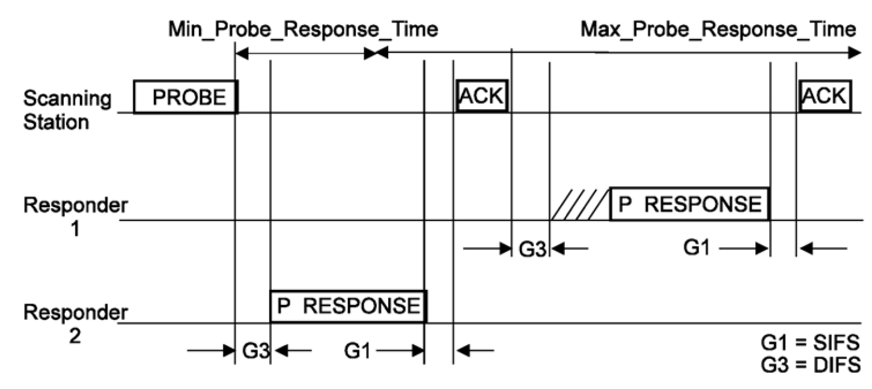
Current rules for sending probe responses
There is rule for which AP shall reply to the probe request
  APs matching the address info criteria shall respond with a probe response
There is no rules for when and how an AP shall reply
  Basic access procedures is adopted
  If QMF is enabled, AC_BE is used. Otherwise, AC_VO seems to be used (See appendix)

Slide 6
Prioritize preferred APs to respond
To help FILS, AP shall prioritize the timing of sending probe responses based on the ID addressing scheme in probe request
  The probe requests with
    Only specific ID
    Only broadcast/wildcard ID addresses
    Both broadcast/wildcard ID addresses and specific ID
Possible solution
  Adopt EDCA parameters for giving higher priority to respond to probe request carrying specific ID address over wildcard SSID address.
    Specific ID case uses parameters for AC_VO or AC_VI
      AC_VI has larger contention window size
    The wildcard case remains the same or uses those for AC_BE
  Replace DIFS with shorter inter-frame space, such as PIFS

Slide 7
AP behavior after receiving probe request
Specific ID(s) only (unicasted + multicasted)
  Send probe response using higher priority access parameter, such as AC_VO (CWmin 3, CWmax 7) or AC_VI (CWmin 7, CWmax 15)
    AC_VI is more immune to potential collision problem
  A shorter IFS such as PIFS can also be considered
Wildcard SSID only
  Send probe response using original access parameter or AC_BE (CWmin 15, CWmax 1023) (as defined in TGae)
Specific ID(s) + wildcard SSID
  If the AP is identified in one of the specific ID, it shall send probe response using higher priority access parameter, such as AC_VO or AC_VI. A shorter IFS such as PIFS can also be considered
  If the AP is not identified in any of the specific ID, it shall send probe response using original access parameter or AC_BE (as defined in TGae)
* CWmin and CWmax are PHY-dependent. AIFSN[VO]=AIFSN[VI]=2, AIFSN[BE]=3

Slide 8
Summary
Prioritizing the responses from the preferred/selected APs helps reduce the time for the scanning STA to discover suitable APs
The proposed idea generally complements the requirements in SFD about timely report of found BSSs and the whitelist that the STA intending to join
    The order of discovered AP matters if there is desired AP
In the wildcard case, a complementary mechanism to cancel pending unnecessary probe responses would further help alleviate congestion on wireless medium
    Lower prioritizing the transmission of probe responses from non-desired APs help increase the chance to cancel them

Slide 9
Motion 1
Concept
  An AP shall respond to probe request addressed to the AP with higher priority over probe request with wildcard ID.
Motion
  Do you support to add the above concept into Section 6
  “Fast Network Discovery” of the TGai spec framework?
    Yes
    No
    Abstain

Slide 10
Motion 2
Concept
  An AP shall respond to probe request directed at the AP with higher priority EDCA parameters, such as those for AC_VO or AC_VI.
Motion
  Do you support to add the above concept into Section 6
  “Fast Network Discovery” of the TGai spec framework?
    Yes
    No
    Abstain

Slide 11
Appendix
HTC, MediaTek

Slide 12
Received comments in March and responses
Collision avoidance
  The default priority in TGae may harm FILS
  Parameters for AC_VI alleviate the collision concerns if multiple desired APs exist
Influence on legacy STAs sending broadcasted probe request
  For a user without any acquaintance here, usually the user is more acceptable to the latency occurred in finding an SSID to use
  On the other hand, for a user revisiting the same place or going to a place which is known to provide service, long latency is generally not acceptable
The priority and queuing of management frame and data frame in the same AP
  Seems to be treated equally (not specified)
Examine the list may take a long time
  The proposal does not focus on the organization of the ID list, but a compact ID is desirable for this comment
HTC, MediaTek

Slide 13
IEEE 802.11-2012
9.2.3.3 DIFS
The DIFS shall be used by STAs operating under the DCF to transmit data frames (MPDUs) and management frames (MMPDUs).
9.2.4.2 HCF contention-based channel access (EDCA)
…
A QoS STA should send individually addressed Management frames that are addressed to a non-QoS STA using the access category AC_BE and shall send all other management frames using the access category AC_VO. A QoS STA that does not send individually addressed Management frames that are addressed to a non-QoS STA using the access category AC_BE shall send them using the access category AC_VO. Management frames are exempted from any and all restrictions on transmissions arising from admission control procedures.

Slide 14
IEEE 802.11ae-2012
10.25.1.2 Default QMF policy
The default QMF policy is as defined in Table 10-12. It defines the access category of each management frame based on management subtype value, category value, and action value. QMFs not included in this table shall be assigned an access category AC_BE.
Table 10-12—Default QMF policy
…
QMF access category
Probe Response 0101 N/A N/A AC_BE

Slide 15
Straw Poll 1
Concept
  An AP shall respond to probe request addressed to the AP with higher priority over probe request with wildcard ID.
Straw Poll
  Do you support to add the above concept into Section 5
  “Fast Network Discovery” of the TGai spec framework?
    Yes 13
    No 5
    Abstain 4

Slide 16
Straw Poll 2
Concept
  An AP shall respond to probe request directed at the AP with higher priority EDCA parameters, such as those for AC_VO or AC_VI.
Straw Poll
  Do you support to add the above concept into Section 5
  “Fast Network Discovery” of the TGai spec framework?
    Yes 2
    No 4
    More discussion 18

