Slide 1
Short Beacon
Authors:

Slide 3
Introduction
The concept of a short beacon frame was introduced in 11ah [1]
In the January 2012 IEEE 802.11 meeting the following details on the short beacon frame design were approved
 | Feature
1. | Frame Control field Type/Sub type indication: FC Bits B3 B2 = 11 & B7 B6 B5 B4 = 0 0 0 1
2. | Should include a Compressed SSID
3. | Should include a 4 byte time stamp containing the 4 LSBs of the AP Timestamp
4. | Shall include a 1 byte Change Sequence Field that is incremented whenever critical network information changes
5. | Short Beacon should optionally include a field indicating duration to next full beacon?
In this presentation further details of the short beacon fields are presented:
Precise definition of content of the Compressed SSID field
Precise definition of indication of time to next full beacon
Add a field to indicate Interworking support

Slide 4
Compressed SSID Field
Compressed SSID:
Contains a representation of the SSID of the BSS
A device that knows the full SSID can discover the presence of the BSS by decoding the compressed SSID
Proposal: Compressed SSID should be a hash of the full SSID
Hashing function should be standardized
Hashing function proposal: CRC function that is used to generate the 4 byte MPDU FCS.
CRC is an excellent Hash function, simple, well known
CRC used in error detection coding because strings with a few different bits result in different CRCs
CRC is sufficient to detect errors in packets up to 11KBytes (11ac): SSID is 32 Bytes at most

Slide 5
Indication of Time of Next Full Beacon
Short beacon should optionally carry an indication of the next full beacon time
Proposed Indication:
Higher 3 bytes of the 4 LSBs of the AP time stamp at the next full beacon
The time stamp of the next full beacon can be pre-computed before the transmission of the full beacon, hence the short beacon frame can be prepared before the beacon transmit time
Note: Indicating duration to the next full beacon rather than the time of the next full beacon would require computing the duration at the time of transmission
Additional Proposal:
In networks that periodically send a full beacon, a new device that uses passive scan save power by going to sleep until the full beacon time after seeing a short beacon
Suggest having the time of the next full beacon present always if the BSS sends full beacons periodically

Slide 6
802.11u Interworking
3G offloading is one of the major 802.11ah use cases
802.11u defines functions and procedures aiding network discovery and selection by STAs, and is especially important for HS2.0/3G offloading use cases
An 11u/HS2.0 capable STA includes an Interworking Information element with a mandatory Access Network Options field in its beacon and probe frames
The Access Network Options field helps STAs locate desired APs based on the provided access services, instead of relying on SSIDs

Slide 7
Access Network Options (1)
ASRA: additional step required for access
ESR: emergency services reachable
UESA: unauthenticated emergency service accessible

Slide 8
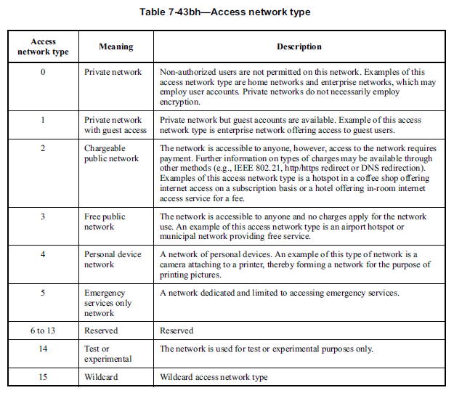
Access Network Options (2)

Slide 9
Indication of Interworking Support
It is beneficial for an 11ah AP that supports 3G offloading to include the Access Network Options field in short beacons
The one-byte “Access Network Options” field can help STAs filter out undesired APs in all scanning channels (13 2MHz channels in US!) quickly based on the frequently transmitted short beacons, without wasting time/power to track full beacons or probe responses from these APs
Proposal
Include an “interworking” bit in FC to indicate whether the AP is interworking capable or not
When the interworking bit in FC is set, a one-byte “Access Network Options” field is included in short beacon

Slide 10
Frame Control Field
Frame Control Field is updated to include
Bandwidth of the BSS
Security status of the BSS
Indications of fields in the Short Beacon
Presence of Time of Next Full Beacon field
Presence of Compressed SSID field
Presence of Access Network Options field

Slide 11
Straw Poll
Do you support the Compressed SSID as the CRC of the SSID. CRC computed using the same function as used to compute the FCS of MPDUs

Slide 12
Straw Poll
Do you support that the time of the next full beacon is indicated as the higher 3 bytes of the 4 LSBs of the AP time stamp at the next full beacon

Slide 13
Straw Poll
Do you agree to have the Time of the Next Full Beacon field to be always present in the Short Beacon frame if an AP transmits full (long) Beacon frames periodically?
Y:
N:
A:

Slide 14
Straw Poll
Do you support including an optional “Access Network Options” field in the short beacon?

Slide 15
Straw poll
Do you support including a 3 bit BW in the FC field indications as shown in slide 8
Do you support the following indications in the short beacon
Presence of Time of Next Full Beacon field
Presence of Compressed SSID field
Presence of Access Network Options field

Slide 16
Appendix

Slide 17
Use of the Short Beacon: Non Associated STAs
STA uses the Short Beacon to determine if the network it is looking for is available
From compressed SSID
On observing a short beacon with the desired compressed SSID a STA may send an Association Request to the MAC address indicated in the short beacon
Non associated STAs can quickly begin associating since short beacons can be sent more often
Association Request will be rejected if the full SSID in the Association Request does not match the full SSID of the AP
Solves the issue of multiple SSIDs mapping to the same compressed SSID
If a STA needs more information before associating it can do one of the following:
Send a unicast probe request to the desired AP (based on compressed SSID)
Use the full beacon time indication in the short beacon to receive the full beacon
STA can go into sleep state until the full beacon receive time.

Slide 18
Use of the Short Beacon: Associated STAs
Synchronization: Timestamp field is used to regularly correct the clock at associated STAs
To communicate changes in node configuration, the Short Beacon is used as follows:
Signal that network information has changed using the “Change Sequence” field in the Short Beacon.
STA can wake up to decode to full beacon at the full beacon arrival time
Time to the full beacon is indicated in the Short Beacon
TIM: Short beacons can carry a TIM element
AP may include the TIM element only in a subset of beacons, according to a schedule known to STAs

Slide 19
Operation Mode - Example
AP may operate in the following mode
Send a full beacon at every ‘full beacon’ interval
Send a short beacon at every (non full) beacon interval
Include a TIM element every N beacons (TIM period)
F=Full beacon
S= short beacon
(T)= TIM present
F(T)
S
S(T)
S
S(T)
S
F(T)
S
Slide 19

Slide 20
Analysis
Case 1: Short Beacon frames have a hash of the full SSID (e.g. CRC), the Time to Next Full Beacon field not present
Short Beacon interval = 500 mS, Beacon interval = 500 mS x 10 short Beacon intervals = 5 sec, 5 APs in different channels
STA does not have the full SSID information
Passive scanning case:
Average time a STA has to be active and wait for a long Beacon frame for the full SSID in each channel = T_{l} /2 (for this example = 2.5 sec)
Total time to scan all N channels = T_{l} /2 x N (for this example, 2.5sec x 5 = 12.5sec)
Active scanning case: Probe REQ/RSP
Channel occupancy increased by additional Probe REQ/RSP frames
Note that the size of Probe RSP is almost as large as a long Beacon
This increases with the number of APs in the channel
This defeats the purpose of having the short Beacon to reduce the channel occupancy.
(long) Beacon interval (T_{l}) = n x short beacon interval (T_{s})
Long (full)
Beacon (full SSID)
Short
Beacon (hash of full SSID, e.g. 0x5F34AB01)
Active duration waiting to receive the full Beacon for SSID
Short
beacon
interval
STA starts to scan (t0)
STA gets the full SSID of the AP (t1)
STA receives a short Beacon
Waits until it receives the next long Beacon frame

Slide 21
Analysis (cont.)
Case 2: Short Beacon frames have a hash of the full SSID (e.g. CRC) and the Time to Next Full Beacon field always present
Short Beacon interval = 500 mS, Beacon interval = 500 mS x 10 short Beacon intervals = 5 sec, 5 APs in different channels
STA does not have the full SSID information
Passive scanning case:
Average time a STA has to be active to receive the full SSID in each channel = T_{s} /2 (for this example = 250 msec) + ~10 msec (time to receive a full beacon, 200bytes transmitted at 150Kbps) = 260 msec
Total time to scan all N channels = (T_{s} /2 + full beacon reception time) x N (for this example, 260msec x 5 = 1.3sec)
(long) Beacon interval (T_{l}) = n x short beacon interval (T_{s})
Long (full)
Beacon (full SSID)
Short
Beacon (hash of full SSID, e.g. 0x5F34AB01) + (Duration to the next full Beacon)
Short
beacon
interval
STA active duration
STA starts to scan (t0)
STA wakes up to receive the full Beacon
STA gets the full SSID of the AP (t1)
STA receives a short Beacon
Do not understand the hash
Decodes the Duration to the next full Beacon field
Goes back to sleep and wakes up at the next full Beacon and receives the full SSID

