Slide 1
Supporting Authentication/Association for Large Number of Stations
Date: 2012-09-12

Slide 2
Authors:
I2R

Slide 3
Authors:
I2R

Slide 4
Introduction
The concept has been presented in IEEE [3]
This contribution is a follow-up that provides more details addressing questions and concerns raised after previous presentations

Slide 5
Motivation
IEEE 802.11ah is required to support >6000 stations [1]
In smart grid (e.g. power meter), large number of STA may try to authenticate/associate with AP simultaneously after power outage, leading to severe collision and authentication/association failure
AP is required to handle a sudden burst of authentication/association requests from many STA within a short period.

Slide 6
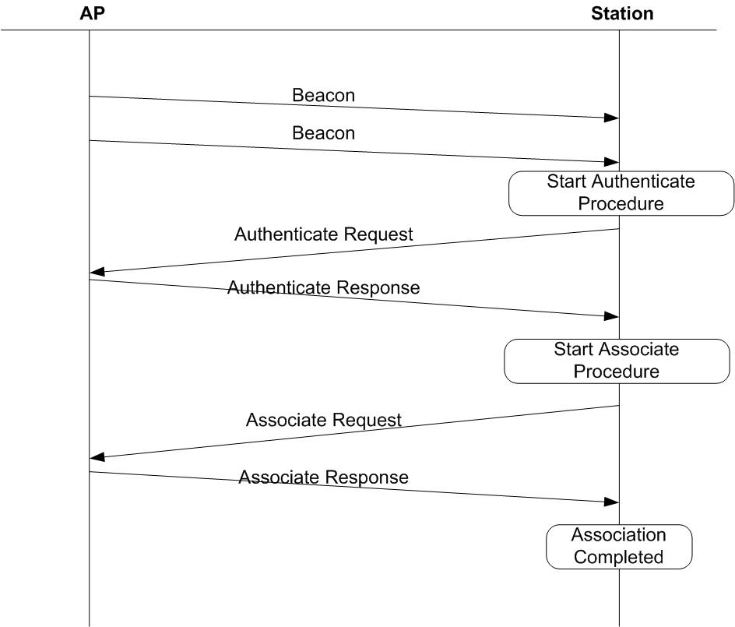
Authentication/Association Procedure

Slide 7
Simulation Parameters
Simulator
  Qualnet network simulator
Simulation parameters
  DCF mode with 1 MHz bandwidth as specified by 802.11ah frame work
  With implemented power saving protocols.
  PHY modulation: MCS0-REP2
  Transmission range: 1 km
Basic parameters
Parameter | Value | Parameter | Value
Data Rate | 150 Kbps | Backoff Win | 15 - 1023
Number of Nodes | 50- 3000 | Maximum Short Retry | 7
DIFS | 250 us | Maximum long Retry | 4
SIFS | 160 us | Time slot | 45 us
Beacon Interval | 200 milliseconds | DTIM Period | 25 (5 seconds)
PS Mode Listen Interval | 25 (5 seconds)

Slide 8
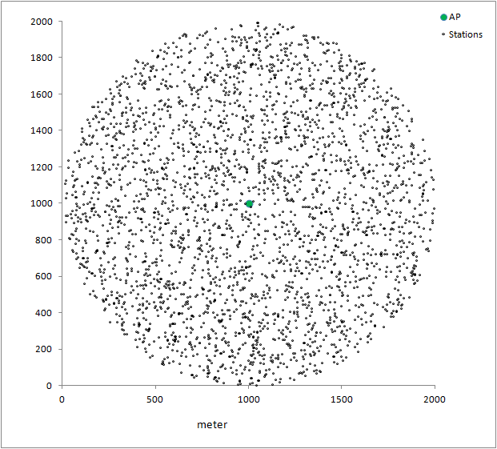
Topology

Slide 9
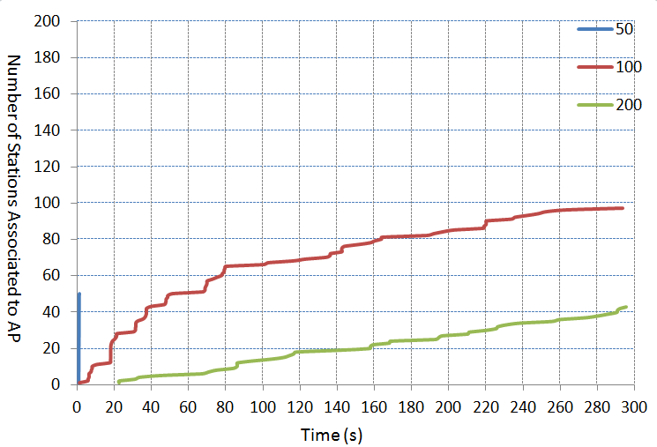
Performance Results for Authentication/Association of Stations within 300 Seconds Limit

Slide 10
Reason for Authentication/Association Failure
STAs redo the authentication due to following reasons:
  Authentication request transmission failure due to collision
  Fail to receive authentication response
    Authentication response collide with transmission from other stations
    Authentication reply timeout due to long queue at AP.
  Association request/response time out due to collision and severe transmission media contention

Slide 11
Suggested Solution: Using Random Numbers
  Make use of random number to limit the number of stations that can authenticate/associate with AP at the same time
  AP may broadcast a value V as an IE in the beacon
  Each station generates a random number R, for example when it is initialized or when it is required for authentication.
  If a station receives V in the beacon from the AP, before sending out authentication request, the station compares R with V, if R <= V , it can send authentication request to the AP. Else, it shall delay the transmission of authentication request.
  If a station does not receive V in the beacon, its authentication/association is not constrained by V.
  Stations that have already received authentication response are not constrained by value V.
  AP can adjust the value of V for every beacon.
    More details see the following slides.

Slide 12
Usage of Value V (1)
When AP starts (no change to current spec)
  AP does not need to broadcast value V in the beacon.
  As per normal, any STA can send authentication/ association request to AP
When only a few STA want to associate with AP (no change to current spec)
  E.g. Queue of management frame is very short
  AP does not need to broadcast value V in the beacon.
  As per normal, any STA can send authentication/ association request to AP

Slide 13
Usage of Value V (2)
When many stations try to associate with AP
  AP starts to broadcast Value V (e.g. set V=0)
    Larger V value = more STA is allowed to associate/authentication
    e.g. Management frames building up at AP’s buffer
    If queue length Q_{L} > Q₀, AP may consider network is congested and set value V to a smaller value such as 0.
  AP continues sending out updated value V in subsequent beacons
    AP may regulate the number of STAs through adjust value V
  STA compares value V with a random number R generated by STA
    If R <=V then STA is allowed to send authentication request
  STA does not need to check value V after STA receiving authentication response from AP

Slide 14
Example: Updating V
Before sending out a beacon, AP checks the Queue length of management frame
  AP decreases Value V when the Queue length is above a threshold
  AP increases Value V when the Queue length is below a threshold
  Maximum Value V
    255, if Value V in IE is one byte (good enough as in simulations)
    Larger number is possible using more bits in IE

Slide 15
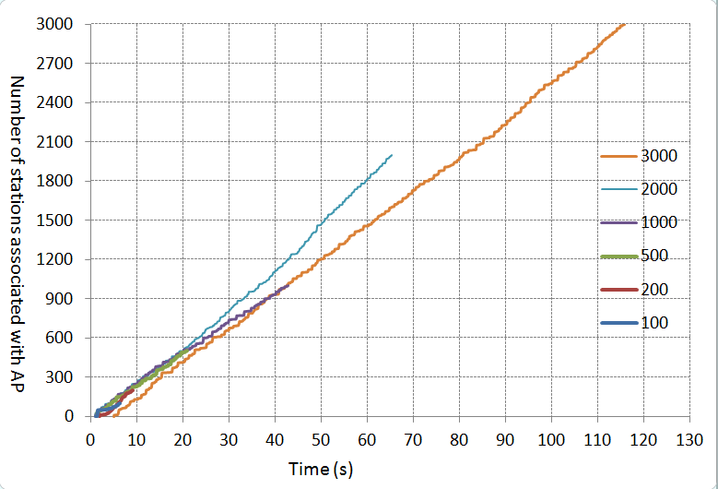
Performance Results: Using Random Numbers

Slide 16
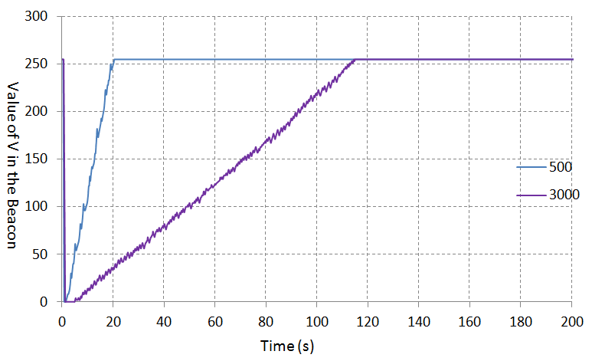
Variation of Value V over Time

Slide 17
Conclusions
Simulation results show that, it is necessary to control the number of stations performing authentication/association at the same time to improve the performance in scenario with large number of stations.

Slide 18
References
[1] Chao-Chun Wang, “Supporting Large Number of STAs in 802.11ah”, IEEE 802.11-11/1019, July 2011.
[2] Siyang Liu, Luo Zhengdong, Daning Gong, “DCF Enhancements for Large Number of STAs”, IEEE 802.11-11/1255, Sep 2011.
[3] Haiguang Wang, et. al. “Supporting Authentication/Association for Large Number of Stations”, IEEE 802.11-12/0112r3, May 2012.

Slide 19
Straw Poll 1
Do you agree that AP should limit the number of STA to be authenticated/associated at the same time?
Y:
N:
A:

Slide 20
Straw Poll 2
Do you agree that AP is allowed to broadcast a value in the beacon to control the authentication/association of STA?
  Y
  N
  A

