Slide 1
US Channelization and Bandwidth Considerations for 802.11ah
Date: 2011-11-10
Authors:

Slide 2
Abstract
This presentation considers US Channelization and bandwidth for 802.11ah.

Slide 3
Background
Sensitivity of MCS0-Rep (1MHz, 11-11-1482) is 6 dB higher than MCS0, 2MHz (11-11-1483)
Based on the path loss exponent in channel model of 11-11-0968, the range covered by MCS0-rep2 and 1.45 times higher than MCS0, 2MHz. More than half of the coverage area is only covered by MCS0-Rep2
AP will use MCS0-Rep2 PPDU in significant portion of time to reach stations in the area 2 (outer ring)
Area2/Area 1=1.1
AP
Area 1, Covered by MCS0, 2MHz
Area 2, Only covered by MCS0-Rep 2, 1MHz

Slide 4
Potential Issues
In a 2MHz BSS, AP transmits beacons using
MCS0-Rep2 1MHz
MCS0, 2MHz
Both MCS0, 2MHz and MCS0-Rep2 – double beacons
If a 2MHz BSS also supports 1MHz transmission, how much throughput improvement can be achieved over a 1MHs BSS ?
One half of the BW in 2MHz BSS is underutilized
significant portion of transmission will use 1MHz PPDU
Based on different use cases (cell phone loading versus meter/sensor network), the usage scenarios and requirements can be quite different

Slide 5
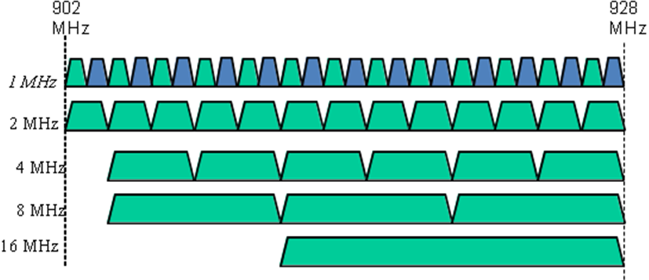
Previously Proposed US Channelizations
902 MHz
928 MHz
11-11-1535-00-00ah-us-channelization
11-11-1516-00-00ah-US-1MHz-channelization-for-11ah
902M
928M
2MHz
4MHz
4 MHz
8MHz
16MHz
8 MHz
16 MHz

Slide 6
Proposed US Channelization
Total 18 channels
In 912~928MHz, 2MHz channel spacing can be targeted for higher throughput – see 11-11-1535-00-00ah
In 902~912MHz, 1MHz channel spacing can be established for long range – see 11-11-1516-00-00ah

