Slide 1
The better spectrum utilization for the future WLAN standardization
Date: 2011-11-08
Authors:

Slide 2
Abstract
There are emerging use cases of the WLAN systems.
High quality video transmissions and cellular data offload in a residential environment are important applications which requires more and more data rates and throughputs and QoS support.
For the continuous success of WLAN, we need to find out the way to extend system capacity of WLANs and improve the respect of QoS.

Slide 3
Background#1: Changes in the use case of WLAN
Recent important use cases of WLANs
Wireless home networking:
Many appliances such as digital TVs, VCRs and game machines have a WLAN interface.
Applications using direct link need more spectrum resources
There may be another opportunity for WLANs such as home automation and home security.
Cellular data offload:
Smartphones and slate PCs also have a WLAN interface.
WLAN is expected to be an access method complementary to the cellular systems, especially in the urban areas.

Slide 4
Background#2: Wireless LAN Evolution
100G
Wireless LANs
?
10G
.11ad
Cellular
1G
.11ac
LTE-Advanced
.11n
100M
LTE
Data Rate [bit/s]
.11a
.11g
10M
.11b
HSDPA
802.11
1M
WCDMA
100k
GSM
PDC
1995
2000
2005
2010
2015
Year
Future WLANs need to have more speed, more bandwidth to support high speed applications and/or to be alternative to the cellular systems.
<Message of this slide>

Slide 5
The channelization in 5GHz bands
WLANs have traditionally increased data rate by extending channel bandwidth.
802.11n specified the optional 40MHz channel operation in addition to the conventional 20MHz channel operation
The 802.11ac is introducing 80MHz and optional 160MHz channel operations.
However, it does not seem to be a reasonable to introduce even wider channels such as 240 MHz and 320 MHz due to the limitation of total spectrum.
Although there are new frequency bands to be available for WLANs, it is important to enhance the spectrum utilization of existing frequency bands in order to offer the same user experiences.
36
40
44
48
52
56
60
64
20MHz channels
100
104
108
112
116
120
124
128
132
136
140
40MHz channels
80MHz channels
160MHz channels
5150
5250
5350
5470
5560
5650
5670
5725 [MHz]

Slide 6
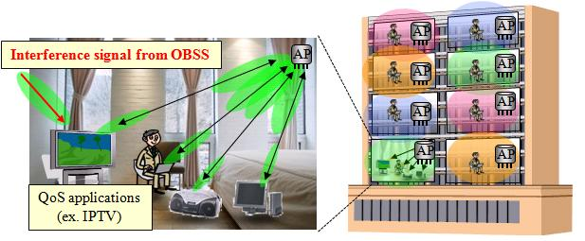
WLAN deployment
An example of deployment scenario - home networks in an apartment
There will be 802.11a, 802.11n and 802.11ac BSS and devices coexisting on the same channel in the same location.
Even in a BSS, there may be some kinds of client devices
E.g., There may be a hand set or a tablet PC with 802.11a interface associated to a 802.11ac AP.
Note: This is not a unique situation of the home networks Similar situation may be seen in other places such as hotspots.

Slide 7
For the better use of space, time and frequency resources
For simplicity, let us assume that an 802.11a, an 802.11n and an 802.11ac BSSs are operating on the same channel and in the same location.
Those client devices have different capabilities, such as channel bandwidth and the number of supported antennas.
There may be unused frequency, the secondary channels, and/or spatial resources.
Ch #
APs
11a
11n
11ac
…
56
52
48
44
40
36
STAs
Frequency
.11ac
.11ac
11a
11n
11ac
.11ac
.11ac
.11ac
.11n
.11
ac
.11n
.11ac
.11n
.11
ac
time
.11a
.11a
20MHz, 1SS
40MHz, 2SS
80MHz, 4SS
Space
There will be some ways to utilize those unused resources

Slide 8
Ideas to improve frequency and spatial resources
Frequency domain extension
Multi-channel operation
20MHz or 40MHz based flexible channel assignment including non-contiguous operations
OFDMA like approach
Flexible channel use across BSSs
Enhance frequency utilization by exchanging information between APs
Spatial domain extension
Uplink MU-MIMO
Extend 802.11ac DL MU-MIMO
Spatial multiplexing across BSSs
Extend beamforming function of MU-MIMO to enhance system capacity across BSSs exchanging information between APs

Slide 9
An example of frequency and spatial domain extension across BSSs
AP collaboration
Frequency domain extension
Frequency + Spatial domain extension
.11*
.11*
.11n
.11ac
.11a
.11ac
.11n
.11*
Ch #
…
48
44
40
36
.11*
.11ac
.11*
.11n
.11a
time
Ch #
…
48
44
40
36
.11*
.11ac
.11*
.11*
.11ac
.11*
.11*
.11ac
.11n
.11a
.11ac
.11n
.11*
.11n
time
.11*
.11n
Space

Slide 10
Conclusions
For the continuous prosperity of WLANs, we need to extend system capacity and improve QoS.
For these purposes, we need to utilize space and frequency resources more efficiently.
We would like to start discussion to find out the image of next generation WLANs and technologies for consideration.

