Slide 1
802.11ah Channel Access Improvement
Date: 2012-05-14
Authors:

Slide 2
Authors:

Slide 3
Introduction
In 11/1230r0, we introduced a high level channel access concept that gives a sensor type of STAs the highest channel access priority.
This presentation is a follow up presentation with simulation results that supports the proposed channel access concept.

Slide 4
802.11ah Use Case Categories [1]
802.11ah defines three use case categories
Use Case 1 : Sensors and meters
Use Case 2 : Backhaul sensor and meter data
Use Case 3 : Extended range Wi-Fi
Use Case 1 and 3 have different traffic characteristics
Use Case 1: small packet size and low duty-cycle
Use Case 3: large packet size and high duty-cycle
Coexistence issue between Use Case 1 and Use Case 3

Slide 5
Coexistence Issue between Use Case 1 and Use Case 3
A low duty-cycle STA (Use Case 1) suffers from high duty-cycle STA (Use Case 3)
When the channel utilization is high due to hotspot or cellular offloading applications, sensors may experience a long channel access delay → power consumption increases
STA-1
(hotspot: high duty-cycle traffic)
CW back-off =3
Data-Ack
DIFS
Data-Ack
STA-2
(sensor: low duty-cycle traffic)
CW back-off =4
DIFS
1) STA-2 waits until the channel is idle
(Idle Channel Wait Time)
2) STA-2 loses contention and waits again until the channel is idle
Sensor STA wakes up and tries to send a packet

Slide 6
Proposed Channel Access Enhancement
Give the highest priority to low duty-cycle (sensor) traffic for channel access
Sensor traffic has a very low duty-cycle compared to other hotspot or cellular offloading applications → does not hurt high-duty cycle applications
Reducing the channel access delay is critical to sensors for a long battery life
Redefine/remap EDCA access categories (AC) to give sensor traffic the highest priority
AIFS[non-sensor]
CW back-off =3
STA-1
(hotspot: high duty-cycle traffic)
DIFS
DIFS
Data-Ack
Data-Ack
5) Hotspot STA continues transmissions
AIFS[sensor]
STA-2
(sensor: low duty-cycle traffic)
CW back-off =4
DIFS
Data-Ack
4) Sensor STA goes back to sleep until next packet transmission time
2) STA-2 waits until the channel is idle
(Idle Channel Wait Time)
1) Sensor STA wakes up and tries to send a packet
3) STA-2 wins the contention

Slide 7
Simulation Setup
Sensor + Extended Wi-Fi Scenario with more traffic flows (STAs)
Extended range Wi-Fi traffic flows: 1~3
Full-buffered traffic
1500 bytes MPDU back-to-back
Packet Tx time: ~20 msec @ 600 Kbps
Use EDCA[BE] parameters with CWmin=15
Sensor traffic flows: 5
Low duty-cycle traffic
256 bytes MPDU transmission at t ~ Uniform(10 sec), average Tx period = 5 sec
Note: 5 sensor STAs with the average Tx period of 5 sec is equivalent to 30 sensor STAs with the average Tx period of 30 sec (the simulation results in the backup slide).
Packet Tx time: ~3.7 msec @ 600 Kbps
Use EDCA[Sensor]=EDCA[VO] parameters with CWmin=15
PHY/MAC parameters
PHY rate: 600 Kbps
Preamble: 240 usec (6 symbols x 40 usec)
SIFS: 64 usec
Slot-time: 45 usec (5usec+4usec x10)
EDCA[Sensor]: AIFSN[VO]=2, CWmin[VO]=3, CWmax[VO]=7
EDCA[BE] for Extended range Wi-Fi: AIFSN[BE]=3~6, CWmin[BE]=15, CWmax[BE]=1023

Slide 8
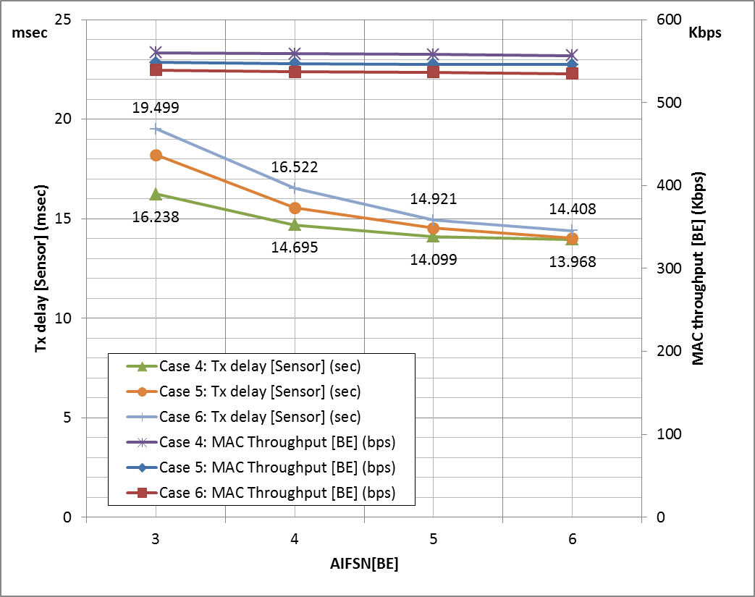
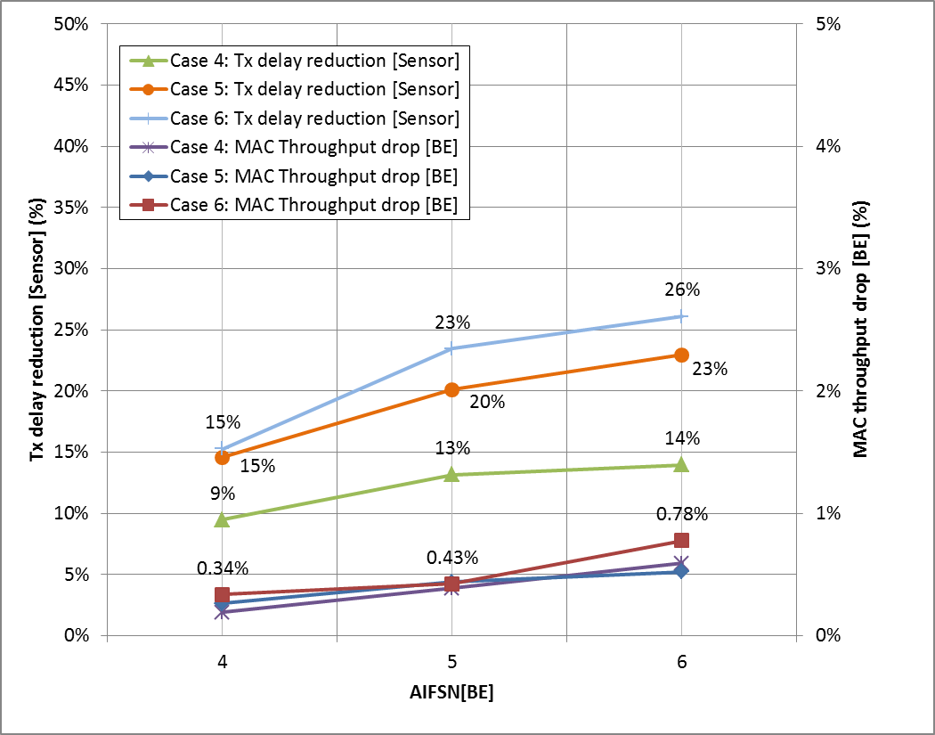
Simulation Results
Tx delay [Sensor] and aggregated MAC throughput [BE]
Case 4: 5 Sensor STAs, 1 BE STA
Case 5: 5 Sensor STAs, 2 BE STAs
Case 6: 5 Sensor STAs, 3 BE STAs
AIFSN[BE]=5 or 6 for the 2 or 3 BE STAs case
20% ~ 26% Tx delay reduction gain for the low duty-cycle traffic (sensor) compared to AIFSN[BE]=3
Less than 0.8 % MAC throughput drop for the best effort (BE) high duty-cycle traffic (Extended Wi-Fi)
BE MAC throughput
Sensor Tx delay reduction
Sensor Tx delay
BE MAC throughput drop

Slide 9
Summary
802.11ah Use Case 1 (sensor) and Use Case 3 (extended range Wi-Fi) have different traffic characteristics
Need to address the coexistence issue between the sensor use case and the extended range Wi-Fi use case
We propose to redefine/remap EDCA access categories (AC) to give sensor traffic the highest priority
AIFSN[BE]=5 or 6 for the 2 or 3 BE STAs case
20% ~ 26% Tx delay reduction gain for the low duty-cycle traffic (sensor) compared to AIFSN[BE]=3
Less than 0.8 % MAC throughput drop for the best effort (BE) high duty-cycle traffic (Extended Wi-Fi)

Slide 10
Straw Poll
Do you support that the sensor type of STAs to have the highest channel access priority?

Slide 11
References
[1] Rolf de Vegt, “Potential Compromise for 802.11ah Use Case Document,” 11-11/457r0.
[2] Minyoung Park, et. al., “802.11ah Channel Access Improvement,” 11-11/1230r0

