Slide 1
Upper Layer Data IE
Date: 2011-09-19
Authors:
Name | Affiliations | Address | Phone | email
Hiroki Nakano | Trans New Technology, Inc. | Sumitomo Seimei Kyoto Bldg. 8F, 62 Tukiboko-cho, Shimogyo, Kyoto 600-8492 JAPAN | +81-75-213-1200 | cas@trans-nt.com

Slide 2
Abstract
To reduce total time for connection setup through all layers, processing for each layer should be running in parallel and data for each layer should be conveyed in the same packet if possible.
This presentation introduces technical proposal that 802.11ai provides container framework for data of upper layers.

Slide 3
‘Data’ or ‘Message’
In my previous presentation, the word ‘Message’ is used.
IEEE802.11 uses the term ‘Data frames’ and ‘MSDU’
Which sounds good?

Slide 4
Conformance w/ TGai PAR & 5C
Conformance Question | Response
Does the proposal degrade the security offered by Robust Security Network Association (RSNA) already defined in 802.11? | No
Does the proposal change the MAC SAP interface? | No
Does the proposal require or introduce a change to the 802.1 architecture? | No
Does the proposal introduce a change in the channel access mechanism? | No
Does the proposal introduce a change in the PHY? | No
Which of the following link set-up phases is addressed by the proposal? (1) AP Discovery (2) Network Discovery (3) Link (re-)establishment / exchange of security related messages (4) Higher layer aspects, e.g. IP address assignment | 4

Slide 5
Principles
Keep the layered network architecture.
IEEE802 network is running under various upper layer protocols.
  IEEE802 should be a generic framework of link layers for upper layers.
Upper layers are responsible for their own addressing architectures.
  For example, IETF is still extending DHCPv4/v6 protocols. Should we catch up their discussion forever??
Therefore, a mission of TGai is to provide a framework enabling upper layer (e.g. EAP, IPv4, etc.) to use their own protocol. (e.g. EAPOL, DHCPv4, etc.)

Slide 6
Desirable nature of “container”
Compatibility with existing 802.11 (Required)
Convey multiple upper layer protocols simultaneously
Big enough to accommodate upper layer data
Take opportunities effectively for sending and receiving data and easy for upper layer to use
Declare and check security conditions of each container
Keep principle of layered network architecture
  802.11 does not care of inside of upper layer data
    AP implementation can be configured to check upper layer data for security.
  Least limitation on behaviours of upper layers
  Possibilities for other protocols than IPv4/v6

Slide 7
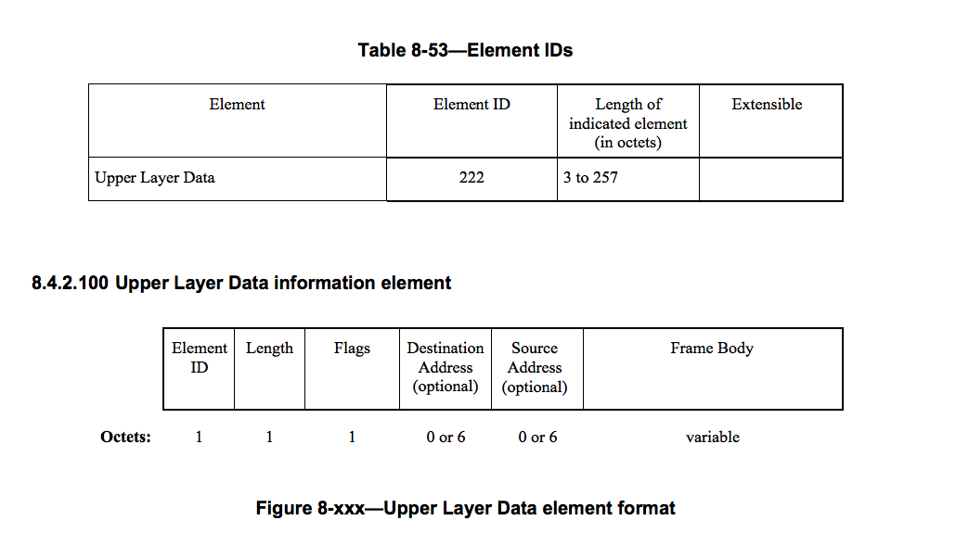
Upper Layer Data information element

Slide 8
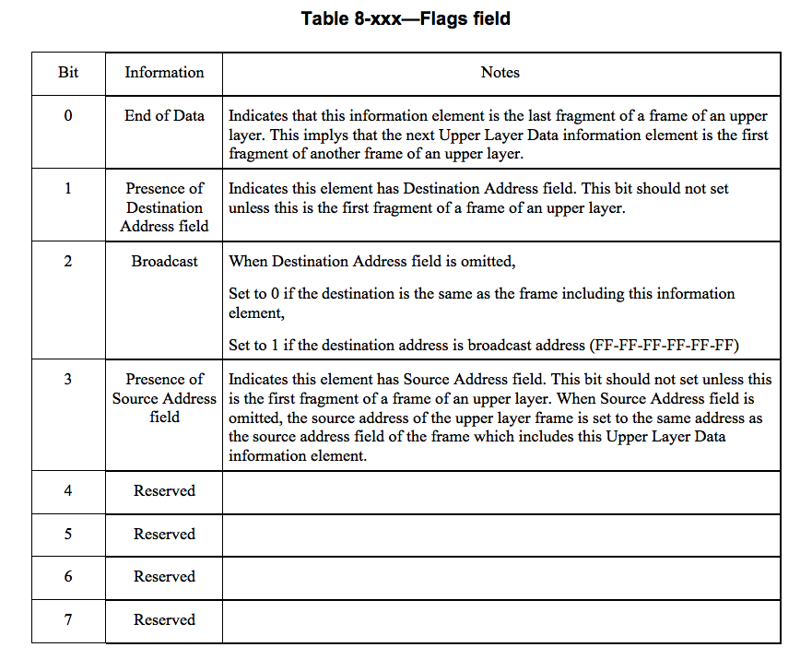
Flags field of Upper Layer Data IE

Slide 9
Fragmentation Example
a message of an upper layer
Dst. Addr.
Src. Addr.
SNAP hdr.
Ether type
Body
Upper Layer Data IE
Upper Layer Data IE
Upper Layer Data IE
split to multiple Upper Layer Data IE

Slide 10
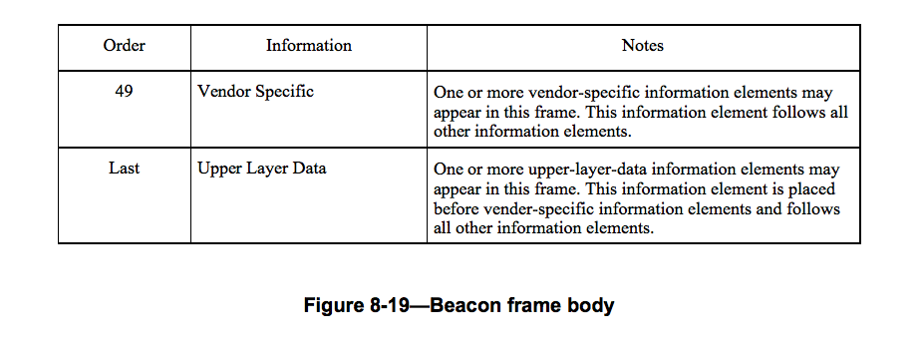
Placement of Upper Layer Data IE
Upper Layer Data IEs are placed at the last of frames except for Management MIC Element, that is, follow Vender Specific IE.

Slide 11
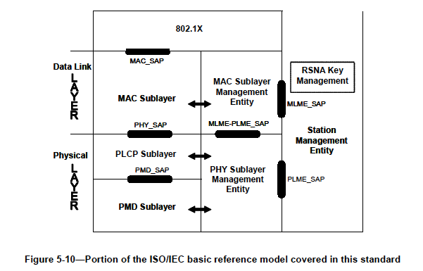
New MLME interface
General packets
DHCP etc.
Additionaly defined MLME interface

Slide 12
TGai Simplified Ideal Scenario
STA
AP
Beacon
Association Request
How about IPv4?
Association Response

Slide 13
IPv4’s case
IPv4 uses DHCPv4 for IP address assignment.
RFC4039 “Rapid Commit Option for the Dynamic Host Configuration Protocol version 4 (DHCPv4)” enables 2-message exchange.
  Only DHCPDISCOVER and DHCPACK are used.
  DHCPOFFER and DHCPREQUEST are omitted.
TGai should not define IP address management process:
  Lease time management
  Behavior of renewing lease
  Error recovery
  … all other things DHCP does
There are reasons TGai should not be involved in upper layer discussion:
  IPv4 has another minor methods like RARP, PPPoE…

Slide 14
IPv4’s case using RFC4039
STA
AP
Beacon
TGai-capable dhcp process starts.
dhcp process sends a packet via MLME interface, not a normal interface.
DHCPACK tells that DHCP server assigns IP address.
Association Request
Association Response
DHCPDISCOVER with Rapid Commit Option (RFC4039) tells that STA needs IP address.

Slide 15
TGai Evaluation
TGai can assume an ideal IPv4 environment for TGai system evaluation.
  AP has DHCP server function.
  AP’s IEEE802.11 function cooperates with its DHCP server.
IETF and each manufacturer can make effort to apply TGai to various environments.
  Management of IP address pool?
  New configuration options?

Slide 16
Conclusion
Keep the layered architecture.
  TGai should provide generic framework for upper layers.
  TGai should not define parameters for upper layers.
  TGai should not be involved in discussion about upper layer’s problems, solutions and developments.
TGai can provide Upper Layer Data IE for IP address assignment.
This presentation also shows how Upper Layer Data IE is used for IPv4 address assignment.
  IPv4 already has almost enough function for our purpose.

Slide 17
Reference
11-1003r2
11-1124r0

Slide 18
Discussion

