Slide 1
Fast Authentication in TGai
Date: 2012-07-16
Authors:
Name | Affiliations | Address | Phone | email
George Cherian Santosh Abraham Hemanth Sampath Jouni Malinen Menzo Wentink | Qualcomm | 5775 Morehouse Dr, San Diego, CA, USA | +1 (858)-651-6645 | gcherian@qualcomm.com sabraham@qualcomm.com hsampath@qualcomm.com jouni@qca.qualcomm.com mwentink@qualcomm.com
Hitoshi MORIOKA Hiroshi Mano | Allied Telesis R&D Center. | 2-14-38 Tenjin, Chuo-ku, Fukuoka 810-0001 JAPAN | +81-92-771-7630 | hmorioka@root-hq.com hmano@root-hq.com
Mark RISON | CSR | Cambridge Business Park, Cowley Road, Cambridge CB4 0WZ UK | +44-1223-692000 | Mark.Rison@csr.com
Marc Emmelmann | Fraunhofer FOKUS | Kaiserin-Augusta-Alle 31 10589 Berlin Germany | +49-30-3463-7268 | emmelmann@ieee.org
Ping Fang Zhiming Ding Phillip Barber Rob Sun | Huawei Technologies Co., Ltd. | Bldg 7, Vision Software Park, Road Gaoxin Sourth 9, Nanshan District, Shenzhen, Guangdong, China, 518057 | +86 755 36835101 | ping.fang@huawei.com dingzhiming@huawei.com pbarber@huawei.com Rob.sun@huawei.com
Chengyan Feng Bo Sun Lin Wang | ZTE Corporation |  |  | feng.chengyan@zte.com.cn sun.bo1@zte.com.cn wang.lin45@zte.com.cn

Slide 2
Conformance w/ TGai PAR & 5C
Conformance Question | Response
Does the proposal degrade the security offered by Robust Security Network Association (RSNA) already defined in 802.11? | No
Does the proposal change the MAC SAP interface? | No
Does the proposal require or introduce a change to the 802.1 architecture? | No
Does the proposal introduce a change in the channel access mechanism? | No
Does the proposal introduce a change in the PHY? | No
Which of the following link set-up phases is addressed by the proposal? (1) AP Discovery (2) Network Discovery (3) Link (re-)establishment / exchange of security related messages (4) Higher layer aspects, e.g. IP address assignment | 3, 4

Slide 3
Background
Contribution 1160r7 proposed fast authentication for FILS using EAP/EAP-RP
See the details of the contribution in the appendix
Based on the feedback from last meeting, this contribution has updates on
  Concurrent use of ERP with 4-way handshake
  Updated on Optimized EAP

Slide 4
Update on ERP

Slide 5
Option-1: Fast Association for FILS [Deferred ANonce]
Sending of ANonce to STA is deferred until step-7
AP generates PTK at step-6
STA generates PTK at step-8
IP-addr assignment req sent at step-9

Slide 6
Option-2: Fast Association for FILS [Implicit Key Confirmation]
July 2012
STA generates PTK at step-3a:
[step-3] STA generates rMSK using [RFC 5296] before sending Assoc-Req
rMSK = KDF (K, S), where K = rRK and
S = rMSK label | "\0" | SEQ | length
[step-3a] PTK is generated using rMSK, ANonce & SNonce
Implicit Key Confirmation:
[step-4]: STA applies message integrity on the combined payload that include EAP-Re-Auth, DHCP-Discover & EAPOL-Key using KCK
[step 8b] AP verifies & MIC for DHCP & EAPOL Key messages and decrypt DHCP

Slide 7
Updates on Optimized EAP

Slide 8
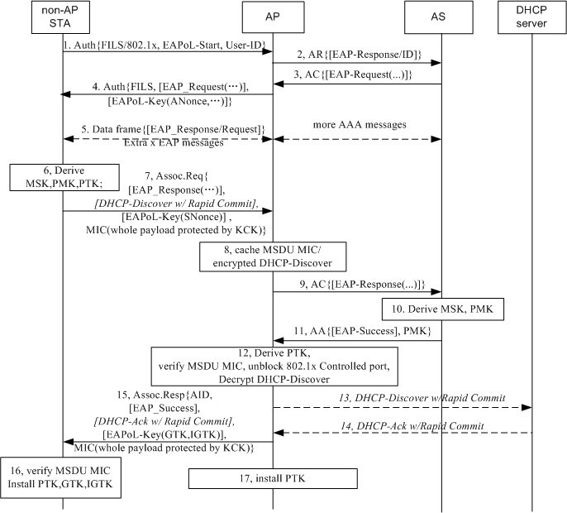
Optimized EAP with concurrent PTK handshake
Step 1: Non-AP STA indicates FILS with 802.1x is expected, and includes the User ID and EAPoL-Start message in Authentication First frame. The AP Generates an EAP-Response/ID message instead receiving an EAP-Response/ID message since it has got the User ID. So a pair of EAP-Req/ID and EAP-Resp/ID messages can be omitted on the air. This is allowed by 802.1x.
Step 4: The AP receives an EAP-Request (1st message of EAP method). The AP sends an Authentication Second frame to the non-AP STA and the EAP-Request message and an first message of 4-way handshake which includes ANonce are packed in the frame.
Step5: Extra EAP messages for some EAP methods are as normal EAPoL messages packed in data frames.
Step7: Once the non-AP derived MSK, then it also derives PTK, it sends an Association Request frame to the AP and the last EAP-Response message and an second message of 4-way handshake which includes SNonce are packed in the frame.
Step 16: The AP sends Association Response frame. An EAP-Success and a third message of 4-way handshake are packed in the frame.
A quick DHCP exchange is suggested to be concurrent with Association frames.

Slide 9
Analysis of Optimized EAP based FILS
Any EAP method can be deployed e.g. EAP-AKA/EAP-AKA’ for interworking with 3GPP or EAP-TTLS for interworking with WiMAX.
Step 4, 7, 15 included EAPoL-Key messages which fulfils the first three messages of 4-way handshake. The last message of 4-way handshake is just a confirm of message 3 and it is can be omitted actually. So the security of PTK handshake will not be downgrade. Note that current 4-way handshake is a good design which can avoid DOS attack by the non-AP STA or a fake AP sending first 4-way HS message to the non-AP STA. See subclause 11.6.6.6 in 802.11-2012.
DHCP message is forwarded after step 12 at which the AP verified the non-AP STA holds the same PTK with itself so the 802.1x controlled port can be unblocked. It complies 802.1x.
For step 7: The non-AP STA knows when it gets MSK, so it knows when it shall send Association Request.
For step 11: If the AP receives more EAP-Request but not a EAP-Success or EAP-Failure from the AS, the AP can exchange EAP messages by data frames like possible step 5 with the non-AP STA and defer sending Association Response frame.

Slide 10
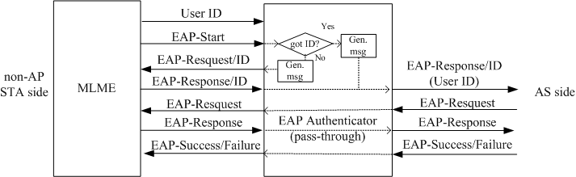
Implementation of EAP Authenticator
If the FILS with Optimized EAP is invoked, the MAC entity of AP will send the Identity received from an STA to the EAP Authenticator. The EAP Authenticator will generate an EAP-Response/ID message if it has got the Identity and send the message to AS side (maybe send to a AAA Client module in AP first), or the EAP Authenticator will generate an EAP-Request/ID message and send the message to the non-AP STA to ask a Identity.

Slide 11
Motions

Slide 12
Motion-1
Add the following text to Subsection 4.1 “Pre-established security context”:
The draft specification shall include support for the EAP-RP [as defined in IETF RFC RFC 5295/5296] for fast authentication

Slide 13
Motion-2
Add the following text to Subsection 4.2 “Concurrent operations”
The draft specification shall include support for the EAP/EAP-RP based optimized message exchanging for association, authentication and key establishment

Slide 14
Appendix
Original Proposal (1160r7)

Slide 15
An example of how the solution is applied for FILS
Use case: Hot-spot pass through:
  A user passes by (several, non overlapping) publicly accessible WiFi hot-spots (e.g. ATTwifi at Starbucks)
  While having connectivity, the user up-&downloads e-mails, twitter / facebook messages etc
Step-1: User buys an STA, performs FILS using optimized full EAP authentication as part of out-of-the-box setup with a network (say, ATTwifi )
  Step-2 [this step repeated afterwards]: The user passes by (several, non overlapping) publicly accessible WiFi hot-spots (e.g. ATTwifi at Starbucks)
  STA will perform Fast-Initial-Link setup with the ATTwifi network using EAP-RP

Slide 16
Proposal Summary
Concurrent Authentication with IP address Assignment
  DHCP with Rapid commit is used as an example for IP address assignment
  Allows protection (integrity check & encryption) for IP address assignment message
    based on STA choice
Use of EAP
  Optimized full EAP authentication when EAP-RP context is not setup or expired
    4 or more (depending on EAP method) over-the air messages after beacon
    Uses home Authentication Server
  EAP-RP based authentication during subsequent link setup
    2 over-the-air messages after beacon
    Can use visited authentication server
  Optimized full EAP & EAP-RP are complementary to each other and doesn’t depend on each other
    Optimized full EAP and EAP-RP may be deployed one without the other, but a combination would yield the best results
    Following slides present the case where both are used
  Builds on existing EAP framework in 802.1X security architecture
RSNA security
  The proposal meets the RSNA security requirement

Slide 17
Benefits of using EAP/EAP-RP for FILS
EAP/EAP-RP allows multiple authentication protocols to be supported
Allows authentication server to control which authentication protocol is used without the authenticator(Access Point) being fully configured
  Authenticator can act as a “pass through”
  Authenticator acts only on the outcome of authentication (say, deny access etc.)
Allows reuse of subscriber credentials defined for interworking with 3GPP EPC
No additional standardization effort needed for AP-AS communication
No CPU intensive cryptographic computation required at the AP
Minimal air interface occupancy
  Proposal reduces link setup including secure IP address assignment to 1.5 roundtrip (including beacon) when EAP-ERP is used
Allows encryption of IP address assignment req/resp

Slide 18
EAP-RP Overview

Slide 19
Key Hierarchy for EAP-RP
rRK, rIK is maintained by Authentication Server and STA (not passed to Access Point)
rMSK is passed to AP during ERP

Slide 20
Overview of EAP-RP
STA
Auth1
Auth2
AS
EAP Req/Identity
Full EAP Exchange
EAP Resp/Identity
Full EAP Method Exchange
MSK, EMSK
rRK, rIK
MSK, EMSK
rRK, rIK
EAP Success
EAP Success
MSK
(MSK)
EAP-RP Exchange
EAP Re-auth Initiate (authenticated with rIK)
rMSK
rMSK
EAP Re-auth Finish (authenticated with rIK)
EAP Re-auth Finish (authenticated with rIK)
rMSK
(rMSK)
      ERP is specified in RFC 5295/5296
      Re-authentication is completed using a single pair of messages

Slide 21
Proposal Details

Slide 22
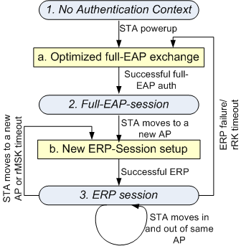
State Machine & Key storage: Conceptual Level
State-1: No Auth Context
AS: RK
AP: None
STA: RK
State-2: Full EAP session
AS: RK, EMSK, DSRK, rRK, rIK, MSK
AP: MSK
STA: RK, EMSK, DSRK, rRK, rIK, MSK
State-3: ERP session
AS: RK, EMSK, DSRK, rRK, rIK, rMSK
AP: rMSK
STA: RK, EMSK, DSRK, rRK, rIK, rMSK
  Action-a: Optimized Full EAP Exchange
  Optimized full EAP procedure can be used
  A new rRK, rIK is generated
  Action-b: New EAP-ERP Session
  A new rMSK is generated

Slide 23
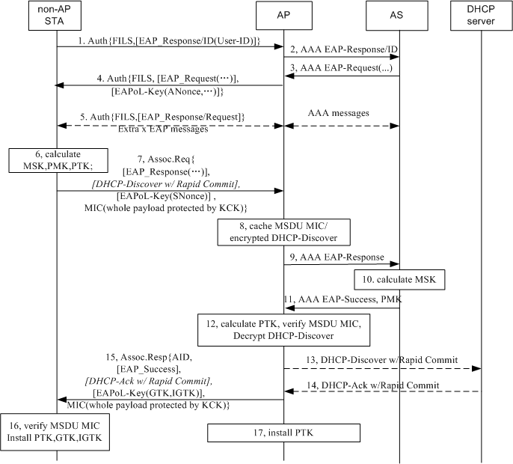
Optimized full EAP with concurrent IP address assignment
Optimized Full EAP is performed when EAP-ERP context (EMSK, rRK, rIK) is not setup or has expired.
Different IP address assignment mechanism could be used, depending on the network deployment.
Step-1: EAPoL-Start and EAP-Request/ID are skipped. An EAP-Response/ID is carried in IEs.
Step-5 is optional for SIM based device
Step-7 and 15: A MIC for whole MSDU protected by KCK are attached in Assoc Request and Assoc Response.
Step 8: AP caches MSDU MIC before PTK is available.
Step 12: AP verifies MSDU MIC once PTK is received from AS.
Step 13,14: A full DHCP procedure could be used if the DHCP server doesn’t support Rapid Commit Option.
Other IP address allocation could be used, for example AP can be pre-assigned a IP pool.
If IP address assignment server doesn’t respond within a certain period, then the AP may send Assoc Resp frame with indication of IP configuration unavailable/pending.

Slide 24
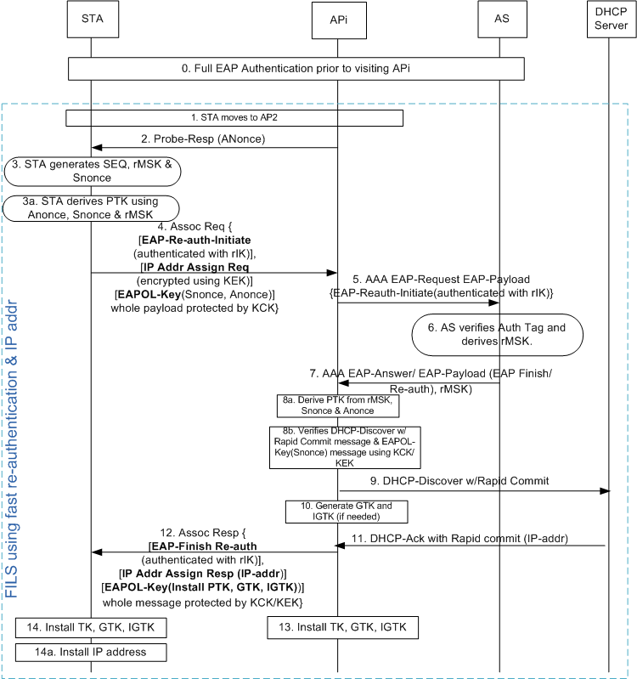
Option-1: Concurrent EAP-RP & IP Address assignment
Used when EAP-RP context is setup (rRK, rIK, EMSK)
[Step-0] Full authentication may happen using an AP or using a cellular system. Use of optimized full-EAP (proposed in slide-13) is preferred
[step 2] AP transmits the Probe Resp. which includes .11ai capability indicator for ERP & simultaneous IP addr assignment. AP changes Anonce frequent enough
[step-3] STA generates rMSK using [RFC 5296] before sending Assoc-Req
rMSK = KDF (K, S), where K = rRK and
S = rMSK label | "\0" | SEQ | length
[step-4] STA packs the following messages as IEs of Association-Request
  EAP Re-auth Initiate [Message Integrity using rIK]
  DHCP Discover with Rapid Commit [Encrypted using KEK]
  EAPOL-Key (Snonce, Anonce)
[step-4] STA applies message integrity on the combined payload that include EAP-Re-Auth, DHCP-Discover & EAPOL-Key using KCK
[step-5] AP holds the DHCP & EAPOL-Key message until it receives rMSK from AS
[step 8b] AP performs MIC for DHCP & EAPOL Key messages and decrypt DHCP

Slide 25
Option-2: Concurrent EAP-RP & IP Address assignment with Deferred ANonce
Changes w.r.t earlier option-1
ANonce is deferred to Assoc Resp
  Modified 4-way handshake
Assoc Req is not protected
  STA doesn’t generate PTK at step-3
Uses Message-4 of 4-way handshake
Uses 5-air interface messages compared to 4 air interface messages (as in option-1)

Slide 26
Straw polls
Which mechanism do you prefer?
  Option-1
  Option-2
  Either one is okay
  None of the options are okay

Slide 27
Optimized Full EAP/EAP-RP selection
Optimized Full EAP is performed when:
  No EAP was performed with the network prior to this association OR
  rRK of the EAP session has expired
Default Full EAP can be used if optimized-full-EAP is not supported
rRK session timer determination
  STA can include “lifetime flag” in the EAP-Initiate/Re-auth message to request rRK lifetime
  rRK lifetime passed to STA in EAP-Finish/Re-auth message
  RFC says: “The peer can use the rRK lifetime to know when to trigger an EAP method exchange and the rMSK lifetime to know when to trigger another ERP exchange”

Slide 28
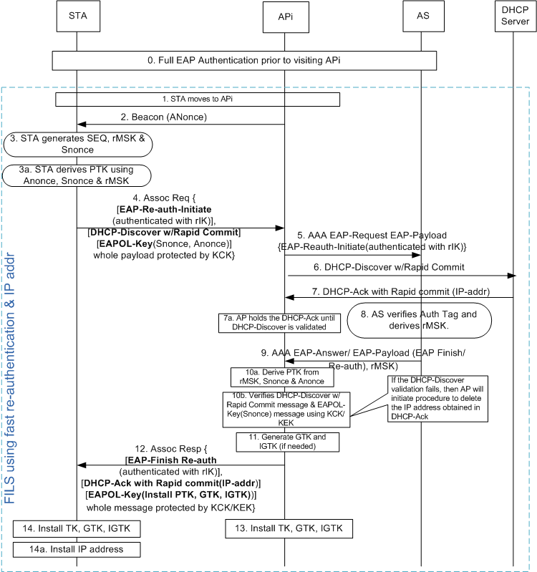
EAP-RP with simultaneous IP address assignment
Similar to slide-15 except the following:
Step-2: AP may advertise the capability that DHCP-request can be encrypted
Step-4: STA decides if the DHCP message should be encrypted or not. Several factors are taken into consideration by STA, such as if DHCP Discover contains any private information etc. If the STA decides to encrypt DHCP-discover request, then AP will hold the message [as described in option-2 & option-2a], Otherwise following steps are performed
Step-4: DHCP-Discover message IE is only Message-Integrity protected
Based on step-4, AP2 sends DHCP-Discover-With-Rapid-Commit (step 6) without waiting for response for EAP-Reauth-Initiate-Request (step-9)
  This process makes the IP address assignment to take place in parallel to EAP-(re)authentication procedure
At step-7a, AP holds the DHCPACK that came from DHCP server until step-10b, where DHCP-Discover is validated
  If the message integrity fails, then the AP initiates procedure to delete the IP address assigned using DHCP-Ack

Slide 29
Upper Layer message transport
Several proposals are submitted that enables carrying of upper layer messages such as DHCP, Authentication messages
  See 12/0032r2, 11/1047r6
This proposal doesn’t depend on the specific choice of transport mechanism.

Slide 30
Response to Questions

Slide 31
Question 1: How does the proposal compress the 4-way handshake for 11ai into just 1 round-trip, and still doesn’t compromise the security ?
  The proposal reduces 4-way handshake to 3-way handshake
Steps | Current Message | New Message | Procedure upon receiving the message
Step-1: ANonce sent from AP to STA | EAPOL-Key | Sent in the beacon. | [same for both methods] STA calculates PTK using ANonce & SNonce
Step-2: SNonce sent from STA to AP | EAPOL-Key (protected using MIC) | EAPOL-Key as an IE of Association Request (protected using MIC) | [same for both methods] AP calculates PTK using Anonce & Snonce [New procedure] AP installs the keys
Step-3: Key-Install information sent from AP to STA | EAPOL-Key (protected using MIC) | EAPOL-Key as an IE of Association Response (protected using MIC) | [Current procedure]: STA installs the key. Also, STA sends EAPOL-Key message to AP confirming temporal key is installed [New procedure] STA installs the key.
Step-4: Send confirmation of key-install from STA to AP | EAPOL-Key (protected using MIC) | Not sent (addressed in step 2) | [Current procedure] AP installs the keys

Slide 32
Question-2: Are the IP address assignment messages protected?
  Yes.
    DHCP-Discover message (sent in Association Request message) and DHCP-Ack are protected by both encryption (using KEK) and message integrity (using KCK)
Question-3: What is the latency experienced for messages sent between AP & AS?
  There is only one round of messaging between AP & AS. Depends on deployment.
  Additional latency introduced by holding DHCP message can be reduced by performing address assignment and security validation simultaneously
    See the call flow in the next page

Slide 33
Question-4: Can you transfer state information across networks so that you don’t have to repeat EAP, every time you switch networks?
  STA may have a large interval (with no WiFi connectivity) after leaving the first AP (where the STA had a connectivity) before it connects to a new AP
  Caching the information for a large number of STAs over a large period of time is not scalable
Question-5: What happens if EAP-RP fails?
  Falls back to full-EAP
Question-6: What to do if AP has multiple AS’s? How does the STA know which key to use ?
  Even though AP may be connected to multiple AS’s, only one AS should be used for an STA.
  AP forwards EAP messages to the appropriate AS based on the identity sent by the STA in “keyName-NAI” sent in the ERP-Initiate/Re-auth message

Slide 34
Question-7: How does STA know the full-authentication timer so that STA may proactively perform full authentication?
  STA can include “lifetime flag” in the EAP-Initiate/Re-auth message to request rRK lifetime
  rRK lifetime passed to STA in EAP-Finish/Re-auth message
  RFC says: “The peer can use the rRK lifetime to know when to trigger an EAP method exchange and the rMSK lifetime to know when to trigger another ERP exchange”

Slide 35
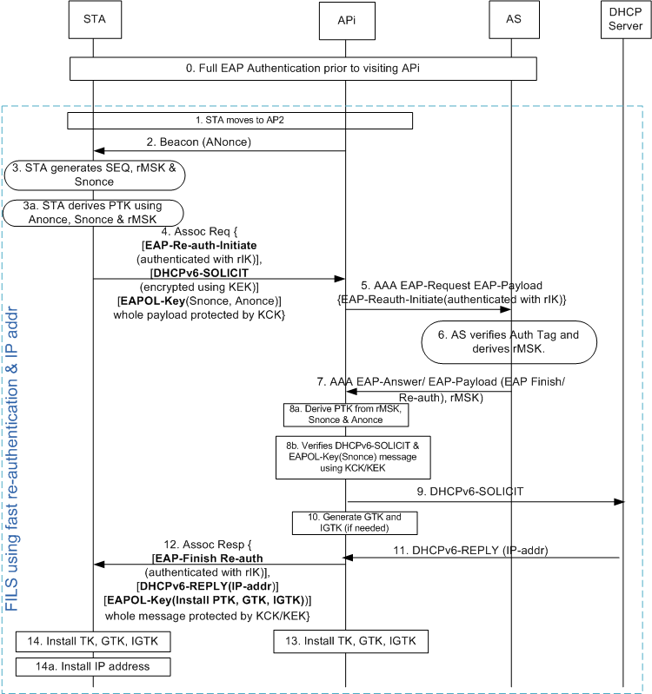
Qn. 8 How does IPv6 address assignment work?
Two options can be used
DHCPv6 (shown in the diagram)
Router Solicitation/Router Advertisement
DHCPv6 option (see diagram)
Similar to slide-12 except the following:
DHCPv6-SOLICIT message with “Rapid Commit Option” [See RFC 3315] is used instead of DHCP-Discover with Rapid Commit
DHCPv6-REPLY is used instead of DHCP-Ack
RS/RA Option
STA may send RS at step-4
AP sends RA at step-12
AP may obtain the IP address based on local configuration or from a centralized server based on RADIUS or proprietary methods
Interface ID will be based on EUI-64
  Devices will use MAC identifier

Slide 36
Qn. 9 How does STA know the support of IP address type and IP address assignment method?
  Beacon/Probe-Response sent from the AP includes the following information
    IP address type supported
      IPv4, IPv6, IPv4v6
    IP address assignment method supported
      DHCP, DHCPv6, RS/RA, etc.

