Slide 1
Fast Authentication in TGai
Date: 2012-05-14
Authors:
Name | Affiliations | Address | Phone | email
George Cherian Santosh Abraham Hemanth Sampath Jouni Malinen Menzo Wentink | Qualcomm | 5775 Morehouse Dr, San Diego, CA, USA | +1 (858)-651-6645 | gcherian@qualcomm.com sabraham@qualcomm.com hsampath@qualcomm.com jouni@qca.qualcomm.com mwentink@qualcomm.com
Hitoshi MORIOKA Hiroshi Mano | Allied Telesis R&D Center. | 2-14-38 Tenjin, Chuo-ku, Fukuoka 810-0001 JAPAN | +81-92-771-7630 | hmorioka@root-hq.com hmano@root-hq.com
Mark RISON | CSR | Cambridge Business Park, Cowley Road, Cambridge CB4 0WZ UK | +44-1223-692000 | Mark.Rison@csr.com
Marc Emmelmann | Fraunhofer FOKUS | Kaiserin-Augusta-Alle 31 10589 Berlin Germany | +49-30-3463-7268 | emmelmann@ieee.org
Ping Fang Zhiming Ding Phillip Barber Rob Sun | Huawei Technologies Co., Ltd. | Bldg 7, Vision Software Park, Road Gaoxin Sourth 9, Nanshan District, Shenzhen, Guangdong, China, 518057 | +86 755 36835101 | ping.fang@huawei.com dingzhiming@huawei.com pbarber@huawei.com Rob.sun@huawei.com
Chengyan Feng Bo Sun | ZTE Corporation |  |  | feng.chengyan@zte.com.cn sun.bo1@zte.com.cn

Slide 2
Abstract
This document proposes Fast authentication for FILS.

Slide 3
Conformance w/ TGai PAR & 5C
Conformance Question | Response
Does the proposal degrade the security offered by Robust Security Network Association (RSNA) already defined in 802.11? | No
Does the proposal change the MAC SAP interface? | No
Does the proposal require or introduce a change to the 802.1 architecture? | No
Does the proposal introduce a change in the channel access mechanism? | No
Does the proposal introduce a change in the PHY? | No
Which of the following link set-up phases is addressed by the proposal? (1) AP Discovery (2) Network Discovery (3) Link (re-)establishment / exchange of security related messages (4) Higher layer aspects, e.g. IP address assignment | 3, 4

Slide 4
Background
Contribution 1160r7 proposed fast authentication for FILS using EAP/EAP-RP
See the details of the contribution in the appendix
This contribution has updates on
  Concurrent use of ERP with 4-way handshake
  Updated on Optimized EAP

Slide 5
Update on ERP

Slide 6
Option-1: Concurrent EAP-RP & IP Address assignment
Used when EAP-RP context is setup (rRK, rIK, EMSK)
[step-2] ANonce is sent directly by the AP when a Unicast Probe Response is used.
To support passive scanning: In the case of broadcast probe-response/Beacon, AP sends ANonce-seed, which is used by the STA to generate the ANonce using a hash of ANonce-seed and the MAC address
[step-3] STA generates rMSK using [RFC 5296] before sending Assoc-Req
rMSK = KDF (K, S), where K = rRK and
S = rMSK label | "\0" | SEQ | length
[step-4] STA applies message integrity on the combined payload that include EAP-Re-Auth, DHCP-Discover & EAPOL-Key using KCK. STA includes either ANonce-seed, or ANonce (differentiated using a flag).
[step 8b] AP performs MIC for DHCP & EAPOL Key messages and decrypt DHCP
Explicit Key confirmation is not needed after step-12, since key is already verified at step 8b

Slide 7
Comparison of the use of ANonce
Properties of ANonce in the Existing standard
  ANonce is unique for STA
  ANonce is sent in clear (Uses EAPOL-Key message)
  ANonce is not predictable before transmission by the AP
Usage of ANonce in option-1 of this contribution
  AP sends ANonce in Unicast Probe Response OR
  AP sends ANonce-seed in Broadcast Probe Response/Beacon
    STA generates the ANonce using a hash of ANonce-seed and the STA MAC address
    AP generates ANonce-seed randomly and updated frequently
Properties of ANonce (based option-1 of this contribution)
  ANonce is unique for STA
  ANonce/ANonce-seed is sent in clear (Uses Probe-Resp/Beacon)
  ANonce is not predictable before transmission by the AP
We believe that the ANonce properties are equivalent between the existing standard and the proposal in option-1 of this contribution

Slide 8
Option-2: Concurrent EAP-RP & IP Address assignment with Deferred ANonce
ANonce is deferred until Assoc Resp
Fields in the Assoc Req frame can be protected using a key generated from rMSK & sNonce
STA generates PTK at step-12a

Slide 9
Discussion on comparison between option1 & option-2
Option-1
  AP needs to updated ANonce frequently
  Association Req fields can be protected using PTK
Option-2
  Need security analysis on the modified 4-way handshake
  Association Req fields cannot be protected using PTK. Instead, Association fields protected using a key generated by SNonce & rMSK (doesn’t use ANonce)

Slide 10
Straw polls
Do you support the ANonce derivation at the STA based on the ANonce seed sent by AP in Broadcast ProbeResp/Beacon?
  Yes
  No
  Abstain

Slide 11
Updates on Optimized EAP

Slide 12
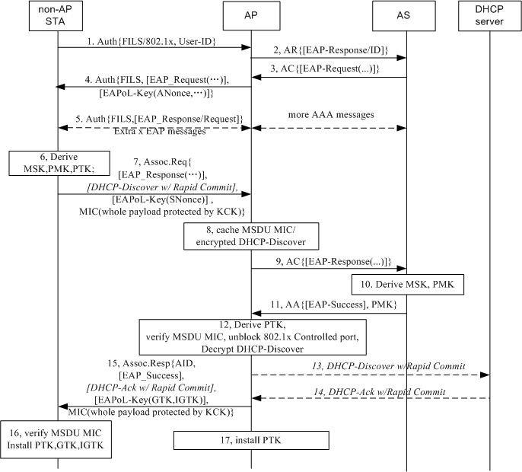
Optimized full EAP with concurrent IP address assignment
May 2012
Optimized EAP is performed to setup initial link.
Step 1 indicates FILS with 802.1x is expected, and includes the User ID.
AP Generates an EAP-Response/ID instead receiving an EAP-Response/ID after in case it receives a User ID. After that, the AP receives an EAP-Request/Challenge as an authentication started by network.
Step 5 is optional for SIM based device
Step 7 & 15: A MIC for whole MSDU protected by KCK are attached in Assoc Request and Assoc Response.
Step 8 & 12: AP caches MSDU MIC before PTK is available. And once PTK is received , AP verifies MSDU MIC . Once the MIC is verified, the 802.1x Controlled port is unblocked.
Step 13&14: A full DHCP procedure could be used if the DHCP server doesn’t support Rapid Commit Option. DHCP is an optional example in this message flow. Other IP address allocation could be used, for example AP can be pre-assigned an IP pool. If IP address assignment server doesn’t respond within a certain period, then the AP may send Assoc Resp frame with indication of IP configuration unavailable/pending.

Slide 13
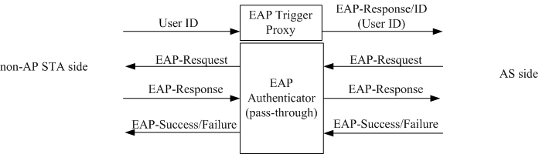
EAP Trigger Proxy
May 2012
An module named EAP Trigger Proxy is deployed in AP.
  The only input of this module is Identity;
  The only output of this module is an EAP-Response/ID message including the Identity.
If the FILS with Optimized EAP is invoked, the MAC entity of AP will send the Identity received from an STA to the EAP-Trigger Proxy. The EAP Trigger Proxy will generate an EAP-Response/ID message after it receives an Identity and send the message to AS side (maybe send to a AAA Client module in AP first). This will trigger the AS to send an EAP-Request/Challenge message to the AP to initiate an EAP authentication. For the EAP Authenticator in the AP, it is a network initiated authentication.

Slide 14
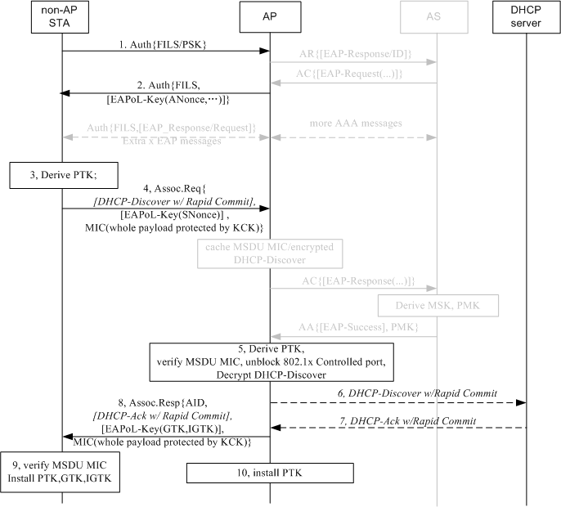
PSK authentication under the same framework
The gray entities are remained in this figure to compare with Optimized EAP flow.
Step 1 indicates FILS with PSK is expected.
Step 2, 4 and 8 fulfill the first 3 steps of 4-way handshake in current standard. Current 4-way handshake mechanism is not changed just the last step of 4-way handshake is omitted.
The first two frames are Authentication frames and the last two frames are Association frames, so the state machine will not be changed.

Slide 15
Conclusion
Proposal Summary
  4-way handshake is carried out concurrently with authentication and association to reduce message rounds and the mechanism of current 4-way handshake is kept.
  Existing EAP Method can be called so the interworking between cellular technology and WiFi technology will not be affected.
  The EAP-Request/ID and EAP-Response/ID messages are omitted to reduce messages on the air interface.
  It is easy to be compatible with current 802.11 state machine.
  AP shall support network initiated EAP authentication.

Slide 16
Stroll Poll 1
Do you support network initiated EAP authentication as mentioned in slide 9?
  Yes:
  No:
  Don’t care:

Slide 17
Stroll Poll 2
Do you support adding an EAP Trigger Proxy function in AP for EAP-Response/Identity message generating when FILS/802.1x authentication request frame with a User Identity is received, in order to skip EAP-Request/Identity and EAP-Response/Identity message on the air interface mentioned in slide 9?
  Yes:
  No:
  Don’t care:

Slide 18
Appendix
Original Proposal (1160r7)

Slide 19
An example of how the solution is applied for FILS
Use case: Hot-spot pass through:
  A user passes by (several, non overlapping) publicly accessible WiFi hot-spots (e.g. ATTwifi at Starbucks)
  While having connectivity, the user up-&downloads e-mails, twitter / facebook messages etc
Step-1: User buys an STA, performs FILS using optimized full EAP authentication as part of out-of-the-box setup with a network (say, ATTwifi )
  Step-2 [this step repeated afterwards]: The user passes by (several, non overlapping) publicly accessible WiFi hot-spots (e.g. ATTwifi at Starbucks)
  STA will perform Fast-Initial-Link setup with the ATTwifi network using EAP-RP

Slide 20
Proposal Summary
Concurrent Authentication with IP address Assignment
  DHCP with Rapid commit is used as an example for IP address assignment
  Allows protection (integrity check & encryption) for IP address assignment message
    based on STA choice
Use of EAP
  Optimized full EAP authentication when EAP-RP context is not setup or expired
    4 or more (depending on EAP method) over-the air messages after beacon
    Uses home Authentication Server
  EAP-RP based authentication during subsequent link setup
    2 over-the-air messages after beacon
    Can use visited authentication server
  Optimized full EAP & EAP-RP are complementary to each other and doesn’t depend on each other
    Optimized full EAP and EAP-RP may be deployed one without the other, but a combination would yield the best results
    Following slides present the case where both are used
  Builds on existing EAP framework in 802.1X security architecture
RSNA security
  The proposal meets the RSNA security requirement

Slide 21
Benefits of using EAP/EAP-RP for FILS
EAP/EAP-RP allows multiple authentication protocols to be supported
Allows authentication server to control which authentication protocol is used without the authenticator(Access Point) being fully configured
  Authenticator can act as a “pass through”
  Authenticator acts only on the outcome of authentication (say, deny access etc.)
Allows reuse of subscriber credentials defined for interworking with 3GPP EPC
No additional standardization effort needed for AP-AS communication
No CPU intensive cryptographic computation required at the AP
Minimal air interface occupancy
  Proposal reduces link setup including secure IP address assignment to 1.5 roundtrip (including beacon) when EAP-ERP is used
Allows encryption of IP address assignment req/resp

Slide 22
EAP-RP Overview

Slide 23
Key Hierarchy for EAP-RP
rRK, rIK is maintained by Authentication Server and STA (not passed to Access Point)
rMSK is passed to AP during ERP

Slide 24
Overview of EAP-RP
STA
Auth1
Auth2
AS
EAP Req/Identity
Full EAP Exchange
EAP Resp/Identity
Full EAP Method Exchange
MSK, EMSK
rRK, rIK
MSK, EMSK
rRK, rIK
EAP Success
EAP Success
MSK
(MSK)
EAP-RP Exchange
EAP Re-auth Initiate (authenticated with rIK)
rMSK
rMSK
EAP Re-auth Finish (authenticated with rIK)
EAP Re-auth Finish (authenticated with rIK)
rMSK
(rMSK)
      ERP is specified in RFC 5295/5296
      Re-authentication is completed using a single pair of messages

Slide 25
Proposal Details

Slide 26
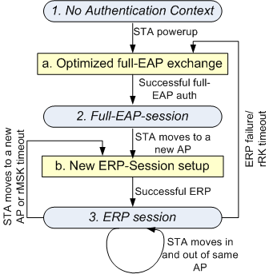
State Machine & Key storage: Conceptual Level
State-1: No Auth Context
AS: RK
AP: None
STA: RK
State-2: Full EAP session
AS: RK, EMSK, DSRK, rRK, rIK, MSK
AP: MSK
STA: RK, EMSK, DSRK, rRK, rIK, MSK
State-3: ERP session
AS: RK, EMSK, DSRK, rRK, rIK, rMSK
AP: rMSK
STA: RK, EMSK, DSRK, rRK, rIK, rMSK
  Action-a: Optimized Full EAP Exchange
  Optimized full EAP procedure can be used
  A new rRK, rIK is generated
  Action-b: New EAP-ERP Session
  A new rMSK is generated

Slide 27
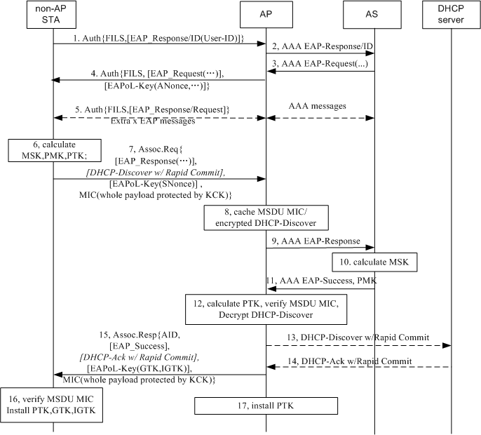
Optimized full EAP with concurrent IP address assignment
Optimized Full EAP is performed when EAP-ERP context (EMSK, rRK, rIK) is not setup or has expired.
Different IP address assignment mechanism could be used, depending on the network deployment.
Step-1: EAPoL-Start and EAP-Request/ID are skipped. An EAP-Response/ID is carried in IEs.
Step-5 is optional for SIM based device
Step-7 and 15: A MIC for whole MSDU protected by KCK are attached in Assoc Request and Assoc Response.
Step 8: AP caches MSDU MIC before PTK is available.
Step 12: AP verifies MSDU MIC once PTK is received from AS.
Step 13,14: A full DHCP procedure could be used if the DHCP server doesn’t support Rapid Commit Option.
Other IP address allocation could be used, for example AP can be pre-assigned a IP pool.
If IP address assignment server doesn’t respond within a certain period, then the AP may send Assoc Resp frame with indication of IP configuration unavailable/pending.

Slide 28
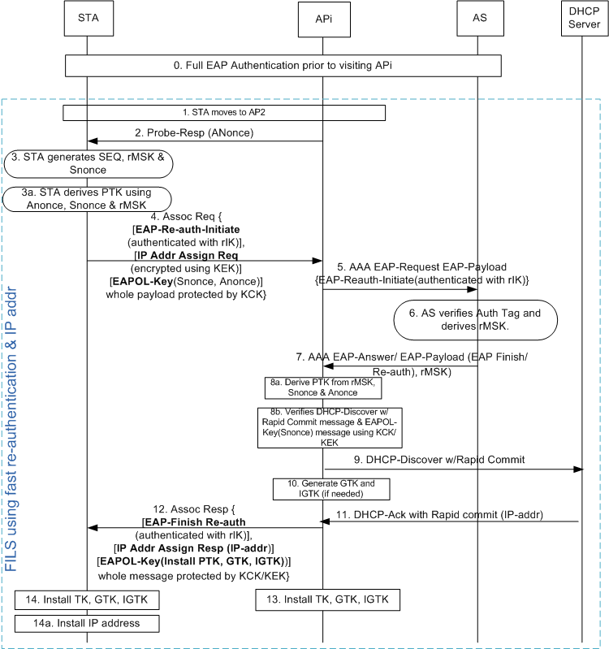
Option-1: Concurrent EAP-RP & IP Address assignment
Used when EAP-RP context is setup (rRK, rIK, EMSK)
[Step-0] Full authentication may happen using an AP or using a cellular system. Use of optimized full-EAP (proposed in slide-13) is preferred
[step 2] AP transmits the Probe Resp. which includes .11ai capability indicator for ERP & simultaneous IP addr assignment. AP changes Anonce frequent enough
[step-3] STA generates rMSK using [RFC 5296] before sending Assoc-Req
rMSK = KDF (K, S), where K = rRK and
S = rMSK label | "\0" | SEQ | length
[step-4] STA packs the following messages as IEs of Association-Request
  EAP Re-auth Initiate [Message Integrity using rIK]
  DHCP Discover with Rapid Commit [Encrypted using KEK]
  EAPOL-Key (Snonce, Anonce)
[step-4] STA applies message integrity on the combined payload that include EAP-Re-Auth, DHCP-Discover & EAPOL-Key using KCK
[step-5] AP holds the DHCP & EAPOL-Key message until it receives rMSK from AS
[step 8b] AP performs MIC for DHCP & EAPOL Key messages and decrypt DHCP

Slide 29
Option-2: Concurrent EAP-RP & IP Address assignment with Deferred ANonce
Changes w.r.t earlier option-1
ANonce is deferred to Assoc Resp
  Modified 4-way handshake
Assoc Req is not protected
  STA doesn’t generate PTK at step-3
Uses Message-4 of 4-way handshake
Uses 5-air interface messages compared to 4 air interface messages (as in option-1)

Slide 30
Straw polls
Which mechanism do you prefer?
  Option-1
  Option-2
  Either one is okay
  None of the options are okay

Slide 31
Optimized Full EAP/EAP-RP selection
Optimized Full EAP is performed when:
  No EAP was performed with the network prior to this association OR
  rRK of the EAP session has expired
Default Full EAP can be used if optimized-full-EAP is not supported
rRK session timer determination
  STA can include “lifetime flag” in the EAP-Initiate/Re-auth message to request rRK lifetime
  rRK lifetime passed to STA in EAP-Finish/Re-auth message
  RFC says: “The peer can use the rRK lifetime to know when to trigger an EAP method exchange and the rMSK lifetime to know when to trigger another ERP exchange”

Slide 32
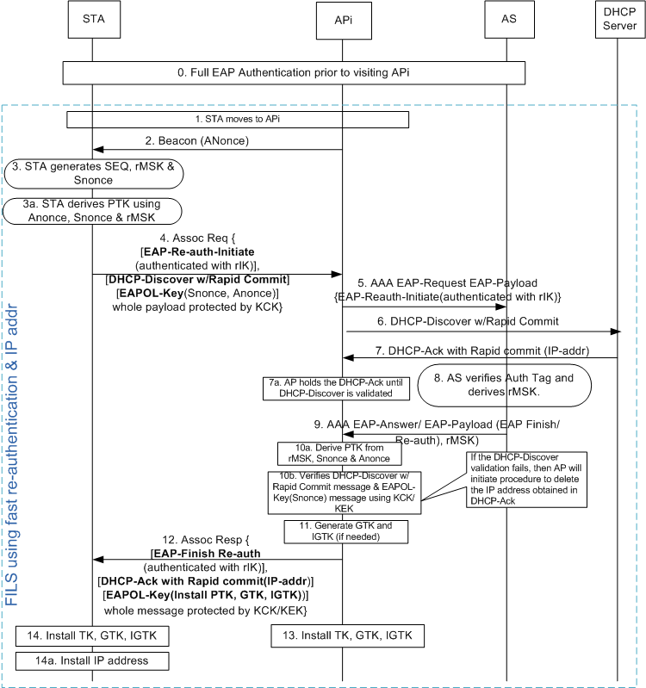
EAP-RP with simultaneous IP address assignment
Similar to slide-15 except the following:
Step-2: AP may advertise the capability that DHCP-request can be encrypted
Step-4: STA decides if the DHCP message should be encrypted or not. Several factors are taken into consideration by STA, such as if DHCP Discover contains any private information etc. If the STA decides to encrypt DHCP-discover request, then AP will hold the message [as described in option-2 & option-2a], Otherwise following steps are performed
Step-4: DHCP-Discover message IE is only Message-Integrity protected
Based on step-4, AP2 sends DHCP-Discover-With-Rapid-Commit (step 6) without waiting for response for EAP-Reauth-Initiate-Request (step-9)
  This process makes the IP address assignment to take place in parallel to EAP-(re)authentication procedure
At step-7a, AP holds the DHCPACK that came from DHCP server until step-10b, where DHCP-Discover is validated
  If the message integrity fails, then the AP initiates procedure to delete the IP address assigned using DHCP-Ack

Slide 33
Upper Layer message transport
Several proposals are submitted that enables carrying of upper layer messages such as DHCP, Authentication messages
  See 12/0032r2, 11/1047r6
This proposal doesn’t depend on the specific choice of transport mechanism.

Slide 34
Response to Questions

Slide 35
Question 1: How does the proposal compress the 4-way handshake for 11ai into just 1 round-trip, and still doesn’t compromise the security ?
  The proposal reduces 4-way handshake to 3-way handshake
Steps | Current Message | New Message | Procedure upon receiving the message
Step-1: ANonce sent from AP to STA | EAPOL-Key | Sent in the beacon. | [same for both methods] STA calculates PTK using ANonce & SNonce
Step-2: SNonce sent from STA to AP | EAPOL-Key (protected using MIC) | EAPOL-Key as an IE of Association Request (protected using MIC) | [same for both methods] AP calculates PTK using Anonce & Snonce [New procedure] AP installs the keys
Step-3: Key-Install information sent from AP to STA | EAPOL-Key (protected using MIC) | EAPOL-Key as an IE of Association Response (protected using MIC) | [Current procedure]: STA installs the key. Also, STA sends EAPOL-Key message to AP confirming temporal key is installed [New procedure] STA installs the key.
Step-4: Send confirmation of key-install from STA to AP | EAPOL-Key (protected using MIC) | Not sent (addressed in step 2) | [Current procedure] AP installs the keys

Slide 36
Question-2: Are the IP address assignment messages protected?
  Yes.
    DHCP-Discover message (sent in Association Request message) and DHCP-Ack are protected by both encryption (using KEK) and message integrity (using KCK)
Question-3: What is the latency experienced for messages sent between AP & AS?
  There is only one round of messaging between AP & AS. Depends on deployment.
  Additional latency introduced by holding DHCP message can be reduced by performing address assignment and security validation simultaneously
    See the call flow in the next page

Slide 37
Question-4: Can you transfer state information across networks so that you don’t have to repeat EAP, every time you switch networks?
  STA may have a large interval (with no WiFi connectivity) after leaving the first AP (where the STA had a connectivity) before it connects to a new AP
  Caching the information for a large number of STAs over a large period of time is not scalable
Question-5: What happens if EAP-RP fails?
  Falls back to full-EAP
Question-6: What to do if AP has multiple AS’s? How does the STA know which key to use ?
  Even though AP may be connected to multiple AS’s, only one AS should be used for an STA.
  AP forwards EAP messages to the appropriate AS based on the identity sent by the STA in “keyName-NAI” sent in the ERP-Initiate/Re-auth message

Slide 38
Question-7: How does STA know the full-authentication timer so that STA may proactively perform full authentication?
  STA can include “lifetime flag” in the EAP-Initiate/Re-auth message to request rRK lifetime
  rRK lifetime passed to STA in EAP-Finish/Re-auth message
  RFC says: “The peer can use the rRK lifetime to know when to trigger an EAP method exchange and the rMSK lifetime to know when to trigger another ERP exchange”

Slide 39
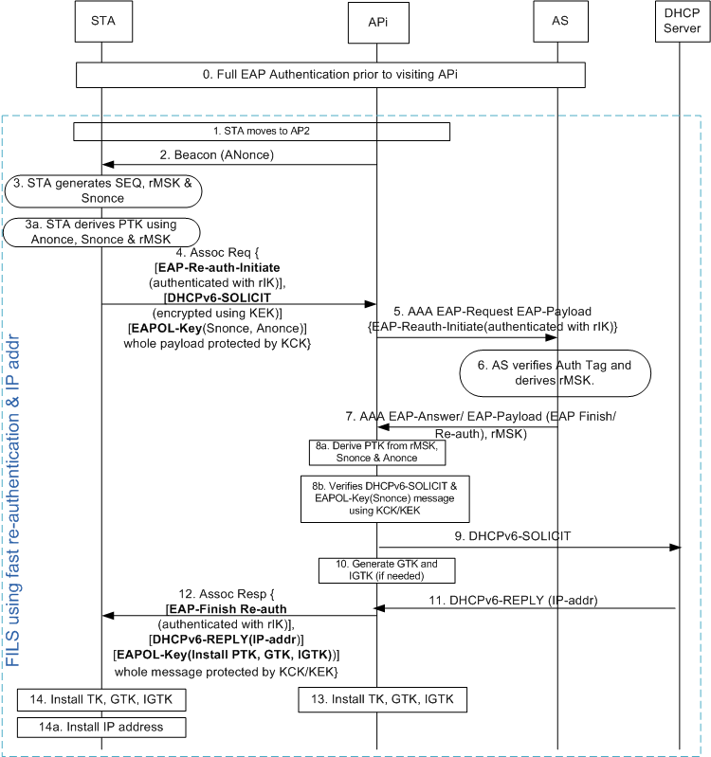
Qn. 8 How does IPv6 address assignment work?
Two options can be used
DHCPv6 (shown in the diagram)
Router Solicitation/Router Advertisement
DHCPv6 option (see diagram)
Similar to slide-12 except the following:
DHCPv6-SOLICIT message with “Rapid Commit Option” [See RFC 3315] is used instead of DHCP-Discover with Rapid Commit
DHCPv6-REPLY is used instead of DHCP-Ack
RS/RA Option
STA may send RS at step-4
AP sends RA at step-12
AP may obtain the IP address based on local configuration or from a centralized server based on RADIUS or proprietary methods
Interface ID will be based on EUI-64
  Devices will use MAC identifier

Slide 40
Qn. 9 How does STA know the support of IP address type and IP address assignment method?
  Beacon/Probe-Response sent from the AP includes the following information
    IP address type supported
      IPv4, IPv6, IPv4v6
    IP address assignment method supported
      DHCP, DHCPv6, RS/RA, etc.

