Slide 1
Using Upper Layer Message IE in TGai
Date: 2011-11-01
Authors:
Name | Affiliations | Address | Phone | email
Ping Fang | Huawei Technologies Co., Ltd. | Bldg 7, Vision Software Park, Road Gaoxin Sourth 9, Nanshan District, Shenzhen, Guangdong, China, 518057 | +86 755 36835101 | ping.fang@huawei.com
Zhiming Ding | Huawei Technologies Co., Ltd. | Bldg 7, Vision Software Park, Road Gaoxin Sourth 9, Nanshan District, Shenzhen, Guangdong, China, 518057 | +86 755 36835837 | dingzhiming@huawei.com
Phillip Barber | Huawei Technologies Co., Ltd. | 1700 Alma Rd, Ste 500 Plano, Texas 75075 USA | +1 972-509-5599 | pbarber@huawei.com
Rob Sun | Huawei Technologies Co., Ltd. | Suite 400, 303 Terry Fox Drive, Kanata, Ontario K2K 3J1 | +1 613 2871948 | Rob.sun@huawei.com

Slide 2
Abstract
This document describes a technical proposal for FILS. In this proposal, association, authentication and 4-way handshake are carried out concurrently to reduce message rounds, and Upper Layer Message IEs are proposed to encapsulate EAP, EAPoL-Key and DHCP.

Slide 3
Conformance w/ Tgai PAR & 5C
Conformance Question | Response
Does the proposal degrade the security offered by Robust Security Network Association (RSNA) already defined in 802.11? | No
Does the proposal change the MAC SAP interface? | No
Does the proposal require or introduce a change to the 802.1 architecture? | No
Does the proposal introduce a change in the channel access mechanism? | No
Does the proposal introduce a change in the PHY? | No
Which of the following link set-up phases is addressed by the proposal? (1) AP Discovery (2) Network Discovery (3) Link (re-)establishment / exchange of security related messages (4) Higher layer aspects, e.g. IP address assignment | 3,4

Slide 4
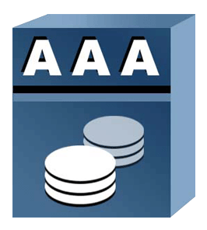
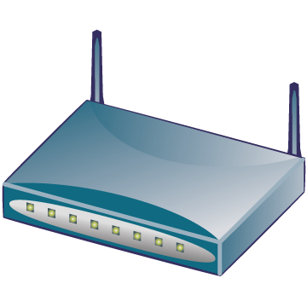

Why do we need FILS?
Cellular core
Internet
AAA
HA
WiFi access
Cellular access
BS
AP
Dual mode MS
BS
WiFi
interface
Cellular interface
Hot-Spot Pass-Through Internet Access: Users on vehicle/train passing near an AP with a mobile phone must have the ability to access various Internet services in a few seconds to his/her e-mail/twitter/facebook or to offload traffic carried by other networks e.g. 3G.
If a dual mode MS makes a seamless handoff from cellular network to WiFi network, the time of WiFi ILS should be minimized.
3GPP TS23.327(Mobility between 3GPP-WLAN, not support seamless HO yet) and WMF T37 (WiMAX WiFi Interworking, support seamless HO but effect is not proved, using pre-authentication) have supported this scenario.
Notes:
虽然offload不需要做到无缝切换，但尽快地完成切换总是有好处的，因为大量用户同时连接WiFi又很快离开。

Slide 5

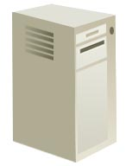
Usual WiFi network architecture
& initial link setup
1 Discovery & Association
2 EAP authentication
STA
3 IP address Assignment
5 Move in WiFi ESS
4 After link setup
AP
AS
Internet
11r Interface
Router
6 Possible Fast transition
AP
DHCP Server
User Device
WiFi Access Network
Internet

Slide 6
How to reduce the time of ILS?
Reduce message rounds
Main scope of this contribution
AP prefigured with IP pool or IP assignment concurrently carried out
STA
AP
AS
Internet
11r Interface
Router
Key hierarchy should not be changed!
AP
DHCP Server
User Device
WiFi Access Network
Internet

Slide 7
Why keep EAP?
In 3GPP TS33.402（SAE Security aspects of non-3GPP accesses）, it is specified:
  Access authentication for non-3GPP access in EPS shall be based on EAP-AKA (IETF RFC 4187) or on EAP-AKA’ (IETF RFC 5448).
In WiMAX NWG T37(WiMAX WiFi Interworking), EAP is also conducted by AAA server in WiMAX CSN during WiFi ILS.
Considering the MIP keys are derived from EMSK which is an outcome of an EAP procedure in current network specifications (see 3GPP TS33.402 and WMF T32), the EAP should be kept in FILS.

Slide 8
DHCP or not?
DHCP is the main protocol for IP address allocation even in IPv6 (DHCPv6).
DHCP is not only used to assign an IP address , but also used to deliver many other information.
  An very important example is that in BBF TR069 a CPE identifies itself to the DHCP server as supporting ACS Discovery method defined in TR069 by including the string “dslforum.org” in DHCP option 60 (in DHCP Discovery/Request) and then the DHCP server includes an ACS URL and a provisioning code in DHCP option 43 in its response (DHCP Offer/ACK) .
IF a STA has to acquire more information, then extra steps besides FILS are needed. Problems are just delayed to the following steps.
DHCP is still a good option in FILS, but IP assignment mechanism is the choice of network operator.

Slide 9
Upper Layer Message IE
New Upper Layer Message IE can be defined as below
Element ID
length
ULM
Control
ULM body
Octets.
1
1
1
1-253
ULM Fragment Flag
ULM
Tag
The ULM body consists of the ULM IE-SDU, or a fragment thereof.
The ULM IE-SDU is an MSDU which is supposed to be carried in one or more MAC data frames, but now is encapsulated into ULM IEs. Such SDU can be a EAPoL frame or a DHCP packet etc.
1 bit 7bits
0: No more fragment
1:More fragment
Identifier of upper layer message
Multiple Fragments for upper layer message shall be kept in sequence.
Upper layer message IE element format

Slide 10
Authentication or Association frame?
For existing standards, the initial state of any STA in AP is always unauthenticated& unassociated.
If Association is used for FILS, the AP has to judge what Association frame is received.
  In case the AP doesn’t have a record of the STA, for normal Association request receiving the AP shall ignore or reject the Association request, but for FILS Association request received, AP shall create a new record for the STA.
So for AP, it is different to use Authentication or Association frame
Authentication is better.

Slide 11
Message Flows-FILS over 802.1x
EAPoL-Start and EAP-Request/ID are skipped.
Different IP address assignment mechanism could be used, depending on the network deployment.
The extra step doesn’t exist for SIM based device.
DHCP with rapid commit is proposed.

Slide 12
Conclusion
Proposal Summary
  Association, authentication and 4-way handshake are carried out concurrently to reduce message rounds
  Upper Layer Message IEs are proposed to encapsulate EAP, EAPoL-Key and DHCP
  Existing authentication protocol can be used and compatible with 3GPP interworking.
Changes to normative text
  FILS Capability indication in Beacon and Probe Response
  No association for FILS
  Changes to 4-Way handshake with concurrently running EAP
  Changes to state machine for FILS authentication.
  New information element for encapsulating upper layer message
  IP address assigning in Authentication frames with DHCP rapid commit
  Detailed change text can be found in contribution 11/1453

Slide 13
Questions & Comments

