Slide 1
Using Upper Layer Message IE in TGai
Date: 2011-09-19
Authors:
Name | Affiliations | Address | Phone | email
Ping Fang | Huawei Technologies Co., Ltd. | Bldg 7, Vision Software Park, Road Gaoxin Sourth 9, Nanshan District, Shenzhen, Guangdong, China, 518057 | +86 755 36835101 | ping.fang@huawei.com
Zhiming Ding | Huawei Technologies Co., Ltd. | Bldg 7, Vision Software Park, Road Gaoxin Sourth 9, Nanshan District, Shenzhen, Guangdong, China, 518057 | +86 755 36835837 | dingzhiming@huawei.com
Phillip Barber | Huawei Technologies Co., Ltd. | 1700 Alma Rd, Ste 500 Plano, Texas 75075 USA | +1 972-509-5599 | pbarber@huawei.com

Slide 2
Abstract
This document describes a technical proposal for TGai. In this proposal, association, authentication and 4-way handshake are carried out concurrently to reduce message rounds, and Upper Layer Message IEs are proposed to encapsulate EAP, EAPoL-Key and DHCP.

Slide 3
Conformance w/ Tgai PAR & 5C
Conformance Question | Response
Does the proposal degrade the security offered by Robust Security Network Association (RSNA) already defined in 802.11? | No
Does the proposal change the MAC SAP interface? | Maybe
Does the proposal require or introduce a change to the 802.1 architecture? | No
Does the proposal introduce a change in the channel access mechanism? | No
Does the proposal introduce a change in the PHY? | No
Which of the following link set-up phases is addressed by the proposal? (1) AP Discovery (2) Network Discovery (3) Link (re-)establishment / exchange of security related messages (4) Higher layer aspects, e.g. IP address assignment | 3,4

Slide 4

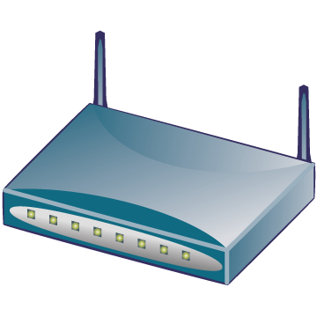

Why do we need FILS?
Cellular core
Internet
AAA
HA
WiFi access
Cellular access
BS
AP
Dual mode MS
BS
WiFi
interface
Cellular interface
Hot-Spot Pass-Through Internet Access: Users on vehicle/train passing near an AP with a mobile phone must have the ability to access various Internet services in a few seconds to his/her e-mail/twitter/facebook or to offload traffic carried by other networks e.g. 3G.
If a dual mode MS makes a seamless handoff from cellular network to WiFi network, the time of WiFi ILS should be minimized.
3GPP TS23.327(Mobility between 3GPP-WLAN, not support seamless HO yet) and WMF T37 (WiMAX WiFi Interworking, support seamless HO but effect is not proved, using pre-authentication) have supported this scenario.
Notes:
虽然offload不需要做到无缝切换，但尽快地完成切换总是有好处的，因为大量用户同时连接WiFi又很快离开。

Slide 5


Usual WiFi network architecture
& initial link setup
Here too many message rounds
1 Discovery & Association
2 EAP authentication
STA
3 IP address Assignment
5 Move in WiFi ESS
4 After link setup
AP
AS
Internet
11r Interface
Router
6 Possible Fast transition
AP
DHCP Server
User Device
WiFi Access Network
Internet

Slide 6
How to reduce the time of ILS?
Reduce message rounds
AP prefigured with IP pool or IP assignment concurrently carried out
STA
AP
AS
Internet
11r Interface
Router
Key hierarchy should not be changed!
AP
DHCP Server
User Device
WiFi Access Network
Internet

Slide 7
Ways to reduce message rounds
Carry out EAP, IP assign, 4-way handshake concurrently
  EAP messages, EAPoL-Key and DHCP messages are encapsulated in Upper Layer Message IEs.
  The 4-way handshake must keep in step with EAP.
  The Association frames are removed. AID is delivered in the last message.
Non AP STA
AP
FILS, EAP(…)/UID[,DHCP Discover]
FILS, EAP(…) ,(ANounce)[,DHCP Offer]
(MSK, PMK, PTK)
FILS, EAP(…), (Anounce, SNounce)[,DHCP Request]
(PTK)
FILS, EAP(…), (AID, GTK)[,DHCP Ack]

Slide 8
Why keep EAP?
In 3GPP TS33.402（SAE Security aspects of non-3GPP accesses）, it is specified:
  Access authentication for non-3GPP access in EPS shall be based on EAP-AKA (IETF RFC 4187) or on EAP-AKA’ (IETF RFC 5448).
In WiMAX NWG T37(WiMAX WiFi Interworking), EAP is also conducted by AAA server in WiMAX CSN during WiFi ILS.
Considering the MIP keys are derived from EMSK which is an outcome of an EAP procedure in current network specifications (see 3GPP TS33.402 and WMF T32), the EAP should be kept in FILS.

Slide 9
DHCP or not?
DHCP is the main protocol for IP address allocation even in IPv6 (DHCPv6).
DHCP is not only used to assign an IP address , but also used to deliver many other information.
  An very important example is that in BBF TR069 a CPE identifies itself to the DHCP server as supporting ACS Discovery method defined in TR069 by including the string “dslforum.org” in DHCP option 60 (in DHCP Discovery/Request) and then the DHCP server includes an ACS URL and a provisioning code in DHCP option 43 in its response (DHCP Offer/ACK) .
IF a STA has to acquire more information, then extra steps besides FILS are needed. Problems are just delayed to the following steps.
DHCP is still a good option in FILS, but IP assignment mechanism is the choice of network operator.

Slide 10
Upper Layer Message IE
New Upper Layer Message IE can be defined as below
Element ID
length
ULM
Control
ULM body
Octets.
1
1
1
1-252
ULM Fragment Flag
ULM Type
1 bit 7bits
0: No more fragment
1:More fragment
1:EAP
2:EAPoL-Key
3:DHCPv4
4:DHCPv6
…
Upper layer message IE element format

Slide 11
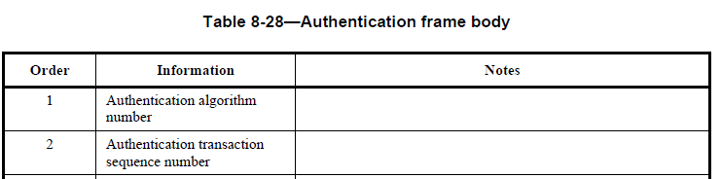
How to be compatible with legacy STAs
Authentication frames must be kept.
Add a new enumerative value to the field Algorithm in Authentication frame to indicate using FILS procedure.
Definitions in 11mb (D10.0):
1 = Open System
2 = Shared Key
3 = FT (first defined in 11r)
4 = FILS (first defined in 11ai)

Slide 12


How to be compatible with other possible FILS?
More AKM suite selectors (suite type) could be defined.
Authentication algorithm = 4 (FILS)
“And FILS”
Suite type = 1, 802.1x
Suite type = 2, PSK (mean only 4-way HS without EAP, PMK is PSK)
Suite type = 3, FT over 802.1x
Suite type = 4, FT over PSK
…
Suite type = 10, FT over ERP
Suite type = 11, FILS over 802.1x
Suite type = 12, FILS over PSK

Slide 13
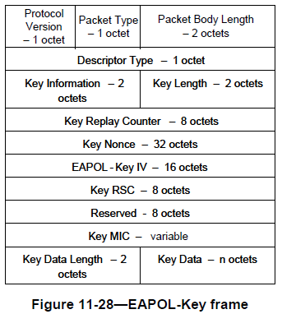
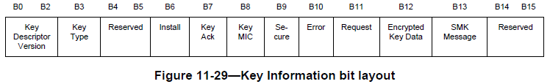
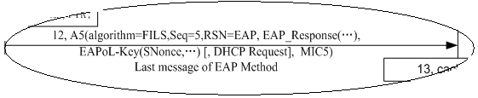
MIC of 4-WAY handshake
EAPoL-Key frame is defined in IEEE 802.1x and is carried in IEEE 802.11 data frame for 4-way handshake.
Key MIC is always set to 0 to indicate no MIC is in the EAPoL-Key frame.
NO MIC in EAPoL-Key frame
MIC for whole MAC frame

Slide 14

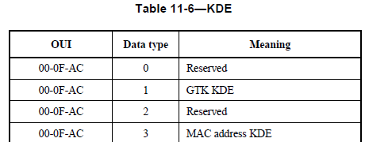

Consideration of AID delivery
AID is delivered in Asscociation Response frame from AP to non-AP STA in current specification.
The temporary ID of a terminal is considered as a privacy in other network specification. AID may be carried as a KDE in EAPoL-Key frame if FILS is called.
New Data type:
11-AID

Slide 15
Possible Protocol Detail

Slide 16
Key changes to normative text
Capability of FILS shall be indicated in Beacon and Probe Response frame.
An information element for encapsulating upper layer message will be defined.
Association should be skipped if FILS is called.
4-Way handshake is concurrently carried out with EAP procedure in Authentication frames if FILS is called.
IP address can be assigned in Authentication frames with DHCP or other solutions.

Slide 17
Questions & Comments

Slide 18
Comparison to other proposals
Proposals | Use EAP | Association& authentication | Upper Layer Container IE | IP assignment
11/1047r3 | EAP AKA | 2 rounds | yes | 2 steps or 4 steps, use DHCP IE
11/976r3, 977r2 | / | 1.5 round PSK | yes | 2 steps , use DHCP IE
11/1108r1 | / | / | N/A | 2 steps, new IE
11/1124r0, 11/1103r2 | / | / | yes | 2 steps or 4 steps, use DHCP IE
11/1160r2 | EAP AKA | 1.5 round Reauthentication | / | /

