Slide 1
Using Upper Layer Message IE in TGai
Date: 2011-08-23
Authors:
Name | Affiliations | Address | Phone | email
Ping Fang | Huawei Technologies Co., Ltd. | Bldg 7, Vision Software Park, Road Gaoxin Sourth 9, Nanshan District, Shenzhen, Guangdong, China, 518057 | +86 755 36835101 | ping.fang@huawei.com
Zhiming Ding | Huawei Technologies Co., Ltd. | Bldg 7, Vision Software Park, Road Gaoxin Sourth 9, Nanshan District, Shenzhen, Guangdong, China, 518057 | +86 755 36835837 | dingzhiming@huawei.com
Phillip Barber | Huawei Technologies Co., Ltd. | 1700 Alma Rd, Ste 500 Plano, Texas 75075 USA | +1 972-509-5599 | pbarber@huawei.com

Slide 2
Abstract
This document describes a technical proposal for TGai. In this proposal, Upper Layer Message IEs are proposed for EAP and DHCP; Association, authentication and 4-Way handshake are carried out concurrently to improve efficiency.

Slide 3
Conformance w/ Tgai PAR & 5C
Conformance Question | Response
Does the proposal degrade the security offered by Robust Security Network Association (RSNA) already defined in 802.11? | No
Does the proposal change the MAC SAP interface? | Yes, possible
Does the proposal require or introduce a change to the 802.1 architecture? | No
Does the proposal introduce a change in the channel access mechanism? | No
Does the proposal introduce a change in the PHY? | No
Which of the following link set-up phases is addressed by the proposal? (1) AP Discovery (2) Network Discovery (3) Link (re-)establishment / exchange of security related messages (4) Higher layer aspects, e.g. IP address assignment | 3,4

Slide 4

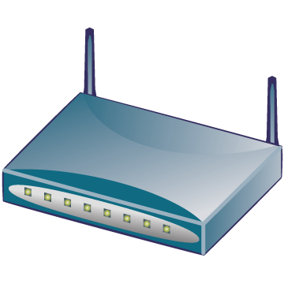

Why do we need FILS?
Cellular core
Internet
AAA
HA
WiFi access
Cellular access
BS
AP
Dual mode MS
BS
WiFi
interface
Cellular interface
Hot-Spot Pass-Through Internet Access: Users on vehicle/train passing near an AP with a mobile phone must have the ability to access various Internet services in a few seconds to his/her e-mail/twitter/facebook or to offload traffic carried by other networks e.g. 3G.
If a dual mode MS makes a seamless handoff from cellular network to WiFi network, the time of WiFi ILS should be minimized.
3GPP TS23.327(Mobility between 3GPP-WLAN, not support seamless HO yet) and WMF T37 (WiMAX WiFi Interworking, support seamless HO but effect is not proved, using pre-authentication) have supported this scenario.

Slide 5

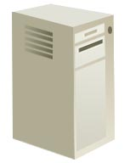
Usual WiFi network architecture
& initial link setup
Here too many message exchanges
1 Discovery & Association
2 EAP authentication
STA
3 IP address Assignment
5 Move in WiFi ESS
4 After link setup
AP
AS
Internet
11r Interface
Router
6 Possible Fast transition
AP
DHCP Server
User Device
WiFi Access Network
Internet

Slide 6
How to reduce the time of ILS?
802.21 MIH could be used by cellular network to help DM-MS to find vicinal WiFi AP (location technology needed).
  This is out of scope of this proposal.
To reduce message exchanges on air interface.
To reduce message exchanges on network side (e.g. AP is configured an IP address pool and works as DHCP proxy) and reduce workload of calculating (e.g. prepared authentication vectors in AKA method).
Don’t use methods based on certificate.

Slide 7
Our scope and essential principle
We work on here
Usually RADIUS or DIAMETER protocol is here.
No changes here would be better.
STA
AP
AS
IEEE 802.11r may be deployed if mobility in WiFi network is supported.
Internet
11r Interface
Router
Key hierarchy must not be changed!
AP
DHCP Server
User Device
WiFi Access Network
Internet

Slide 8
How to reduce rounds on air interface?
The whole flow of ILS according to current specification and mobility is considered.
To carry out EAP procedure, IP address allocation procedure, 4-Way handshake and AID assigning concurrently.
  EAP messages and DHCP messages are encapsulated into Upper Layer Message IEs and included in Authentication frames if the FILS procedure is indicated.
  The fields of 4-way handshake messages are included into the Authentication frames and 4-way handshake steps must be in step with EAP steps.
  The Association frames are removed. AID is delivered together with the GTK through the third step of the 4-way handshake.
Other IP address allocation approach could be used.
This can not be as a part of ILS.

Slide 9
Could EAP be ignored?
In 3GPP TS33.402（SAE Security aspects of non-3GPP accesses）, it is specified:
  Access authentication for non-3GPP access in EPS shall be based on EAP-AKA (IETF RFC 4187) or on EAP-AKA’ (IETF RFC 5448).
In WiMAX NWG T37(WiMAX WiFi Interworking), EAP is also conducted by AAA server in WiMAX CSN during WiFi ILS.
Considering the MIP keys are derived from EMSK which is an outcome of an EAP procedure in current network specifications (see 3GPP TS33.402 and WMF T32), the EAP should be kept in FILS.

Slide 10
Could DHCP be ignored?
DHCP is the main protocol for IP address allocation even in IPv6 (DHCPv6).
DHCP is not only used to assign an IP address , but also used to deliver many other information.
  An very important example is that in BBF TR069 a CPE identifies itself to the DHCP server as supporting ACS Discovery method defined in TR069 by including the string “dslforum.org” in DHCP option 60 (in DHCP Discovery/Request) and then the DHCP server includes an ACS URL and a provisioning code in DHCP option 43 in its response (DHCP Offer/ACK) .
IF a STA uses FILS and has to acquire some information in extra steps, then FILS is not complete. Problems are just left for the following steps.
So, we may not use DHCP to assign IP address in FILS, but we can not ignore DHCP in FILS. How to assign IP address is the choice of network operator.

Slide 11
Possible Protocol Detail

Slide 12
Upper Layer Message IE
New Upper Layer Message IE can be defined as below
Element ID
length
Upper layer message
e.g. 143
1 Oct.
Flag
ULM
Type
ULM body
1 bit 7bits
0: No more segment
1:More segment
1:EAP
2:DHCPv4
3:DHCPv6
…
Upper layer message IE element format

Slide 13
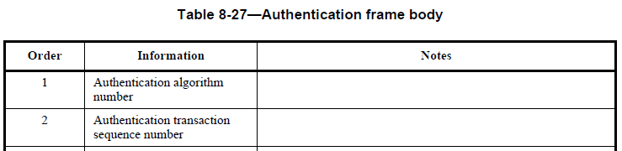
How to be compatible with legacy STAs
Authentication frames must be kept.
Add a new enumerative value to the field Algorithm in Authentication frame to indicate using FILS procedure.
Definitions in 11mb:
1 = Open System
2 = Shared Key
3 = FT (first defined in 11r)
4 = FILS (first defined in 11ai)

Slide 14


How to be compatible with other possible FILS?
More AKM suite selectors (suite type) could be defined.
Authentication algorithm = 4 (FILS)
“And FILS”
Suite type = 1, 802.1x
Suite type = 2, PSK (mean only 4-way HS without EAP, PMK is PSK)
Suite type = 3, FT over 802.1x
Suite type = 4, FT over PSK
…
Suite type = 8, FILS over 802.1x
Suite type = 9, FILS over PSK (maybe not use current 4-way HS)

Slide 15
Modifications
Maximum length of IE is limited to 256 octet. So one EAP or DHCP message may be divided into multiple IEs.
Association frames are ignored if FILS is called.
4-Way handshake procedure is concurrently carried out with EAP procedure in Authentication frames if FILS is called.
IP address can be allocated in Authentication frames with standard DHCP or only with fields under some special circumstance.

Slide 16
Questions & Comments

