Slide 1
Using Upper Layer Message IE in TGai
Date: 2011-07-17
Authors:
Name | Affiliations | Address | Phone | email
Ping Fang | Huawei Technologies Co., Ltd. | Bldg 7, Vision Software Park, Road Gaoxin Sourth 9, Nanshan District, Shenzhen, Guangdong, China, 518057 | +86 755 36835101 | ping.fang@huawei.com
Zhiming Ding | Huawei Technologies Co., Ltd. | Bldg 7, Vision Software Park, Road Gaoxin Sourth 9, Nanshan District, Shenzhen, Guangdong, China, 518057 | +86 755 36835837 | dingzhiming@huawei.com
Xiandong Dong | Huawei Technologies Co., Ltd. | Bldg 7, Vision Software Park, Road Gaoxin Sourth 9, Nanshan District, Shenzhen, Guangdong, China, 518057 | +86 755 33913618 | dongxiandong@huawei.com

Slide 2
Abstract
This document describes a technical proposal for TGai which Upper Layel Message IEs are used in order to concurrent EAP, DHCP and 4-Way handshake.

Slide 3

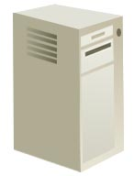
Usual network architecture
& initial link setup
1 Discovery & Association
2 EAP authentication
STA
3 IP address Assignment
4 After link setup
AP
AS
5 Move
Internet
11r Interface
Router
6 Possible Fast transition
AP
DHCP Server
User Device
WiFi Access Network
Internet

Slide 4
Our scope and essential principle
We work on here
We shall not change this!
STA
AP
AS
Internet
11r Interface
Router
Key hierarchy must not be changed!
AP
DHCP Server
User Device
WiFi Access Network
Internet

Slide 5
How to reduce rounds on air interface?
Concurrent EAP procedure, DHCP procedure, 4-Way handshake and AID assigning.
  EAP messages and DHCP messages are encapsulated into the Authentication frames as Upper Layer Message IEs if the FILS procedure is indicated.
  The 4-way handshake function are merged into the Authentication frames.
  The Association frames are removed. The functions of the Association frames are moved to Authentication frames. The key point is that the AID is delivered together with the GTK through the third message of the 4-way handshake.

Slide 6
Upper Layer Message IE
New Upper Layer Message IE may be defined as below
Element ID
length
Upper layer message
Special value
254
2 Oct.
ULM
Type
ULM body
1 Oct.
1:EAP
2:DHCP
…
Upper layer message IE element format

Slide 7
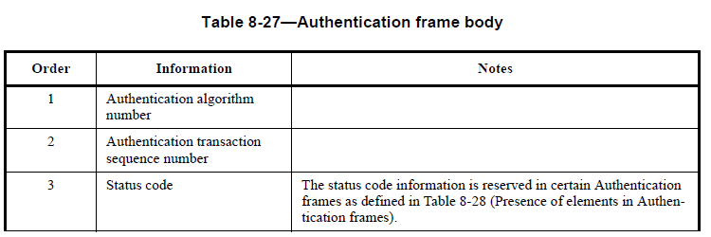
How to compatible with old STAs
Authentication frames must be kept.
Add a new enumerative value to the field Algorithm in Authentication frame which means using FILS procedure.
Definitions in 11mb:
1 = Open systen
2 = Shared Key
3 = Fast BSS Transition
4 = FILS

Slide 8
Modifications
Maximum length of IE is limited to 256 octet. So one EAP or DHCP message may be divided into multiple IEs. But if a special EID is defined with the meaning the length field is in two octets, a single IE can carry a whole upper layer message.
Association frames are not ignored if FILS is called.
4-Way handshake procedure is concurrent with EAP procedure if FILS is called.

Slide 9
Possible Protocol Detail

Slide 10
Questions & Comments

