Slide 1
Upper Layer Data on Management frames
Date: 2011-07-18
Authors:
Name | Affiliations | Address | Phone | email
Hiroki Nakano | Trans New Technology, Inc. | Sumitomo Seimei Kyoto Bldg. 8F, 62 Tukiboko-cho, Shimogyo, Kyoto 600-8492 JAPAN | +81-75-213-1200 | cas@trans-nt.com

Slide 2
Abstract
To reduce total time for connection setup through all layers, processing for each layer should be running in parallel and data for each layer should be conveyed in the same packet if possible.
This presentation introduces technical proposal that 802.11ai provides container framework for data of upper layers.

Slide 3
Conformance w/ TGai PAR & 5C
Conformance Question | Response
Does the proposal degrade the security offered by Robust Security Network Association (RSNA) already defined in 802.11? | No
Does the proposal change the MAC SAP interface? | No
Does the proposal require or introduce a change to the 802.1 architecture? | No
Does the proposal introduce a change in the channel access mechanism? | No
Does the proposal introduce a change in the PHY? | No
Which of the following link set-up phases is addressed by the proposal? (1) AP Discovery (2) Network Discovery (3) Link (re-)establishment / exchange of security related messages (4) Higher layer aspects, e.g. IP address assignment | 4

Slide 4
Grammatical: Upper or Higher?
In 802.11-2007, both ‘upper layer’ and ‘higher layer’ are used.
Do they have the same meanings?

Slide 5
Desirable nature of “container”
Compatibility with existing 802.11 (Required)
Convey multiple upper layer protocols simultaneously
Big enough to accommodate upper layer data
Take opportunities effectively for sending and receiving data and easy for upper layer to use
Declare and check security conditions of each container
Keep principle of layered network architecture
  Do not care of inside of upper layer data
  Least limitation on behaviours of upper layers
  Possibilities for other protocols than IPv4/v6

Slide 6
Compatibility
Convey on :
  Beacon, Association Request/Response and Action.
  Any other type of frames?
Use newly-defined IE
  Old AP and stations ignore it. (7.2.3)
Element ID of new IE is larger than one of vendor specific IE.
  >221
  in order to keep the order of IEs
  upper layer data should be placed at last of packets.

Slide 7
Compatibility (cont.)
It’s ok that there are multiple number of the same IEs in a frame.
  Vendor specific IE do so. (7.3.2.26)
In the following story, let’s assume that new IE ‘Upper Layer IE’ is defined, whose element ID is 222.
 | Element ID | length | data
Octets: | 1 | 1 | 1 - 255

Slide 8
Multiple protocols
Each of data frame has a protocol type.
  Normal LLC header can be used.
  IPv4/v6 uses SNAP header (RFC1042) aa-aa-03-00-00-00
  DSAP and SSAP also can be used.
Each of ‘data block’ should be had a protocol type in the same manner.
  Example shows the case of IP
  data block = IE? go to the next slide.
 | Element ID | length | SNAP header | protocol | data
Octets: | 1 | 1 | 6 | 2 | 1 - 247

Slide 9
Size of data block and IE
IE has 1-byte length field.
  Maximum size of IE is 1(type) + 1(length) + 255(data)
  This is too small for some kinds of upper layer protocols.
‘Data block’ for an upper layer protocol should be fragmented to several IEs when needed.
New IE has to have the ‘More IE Fragment’ bit.
Order of New IEs must not be changed during transmission.
  otherwise, each of New IE have sequence number?
802.11 has fragmentation mechanism for big frames
  Fragment Number field (7.1.3.4.2)

Slide 10
Size of data block and IE (cont.)
More IE fragment bit = 1
 | Element ID | length | flags | SNAP header | protocol | data
Octets: | 1 | 1 | 1 | 6 | 2 | 1 - 246
 | Element ID | length | flags | data (cont.)
Octets: | 1 | 1 | 1 |  | 1 - 254
More IE fragment bit = 0

Slide 11
More opportunities for data exchange
Action frames (7.2.3.12) with new IEs should be permitted to be exchanged between Association Request and Response, moreover, after Association Response.
For a convenience for upper layer programmers, MLME interface of this framework should be able to used after association completed (that is, after Association Response)
  upper layer setup may not be finished until Association Response.

Slide 12
More opportunities for exchange (cont.)
STA
AP
Association Request
Action
Association Response
Action

Slide 13
Declare and check security status
802.11ai may provide multiple authentication and key management protocols.
Security status of a packet varies according to protocols and their state.
  No security
  Signed (data is not altered during transmission)
  Encrypted (data is not revealed during transmission)
  Trusted (creator of data is trusted by sender)
802.11ai should tell upper layers such status.
upper layers should tell 802.11ai requirement of security nature of data to be sent, and 802.11ai checks it.

Slide 14
Declare and check security status (cont.)
‘Request to be signed’ bit = 1
More IE fragment bit = 1
 | Element ID | length | flags | SNAP header | protocol | data
Octets: | 1 | 1 | 1 | 6 | 2 | 1 - 246
 | Element ID | length | flags | data (cont.)
Octets: | 1 | 1 | 1 |  | 1 - 254
More IE fragment bit = 0

Slide 15
Declare and check security status (cont.)
On sending:
On receiving:
Compare flags supplied by upper layer with current security status.
  If matched, a packet with IEs is sent.
  if not matched, the upper layer IE is removed or queued before sending packet and may inform upper layer of this result.
Compare flags in a packet with current security status.
  if matched, upper layer data is re-built and passed to upper layer.
  if not matched, packet is discarded.

Slide 16
Two types of MLME interfaces
MLME interface following .11 protocol
  This is the existing interface.
  Extended to have capability to pass ‘Upper Layer IE’
New MLME interface for upper layer protocols
  This interface resembles MAC data services (MAC_SAP) (6.2.1)
  Extended to have additional capabilities.

Slide 17
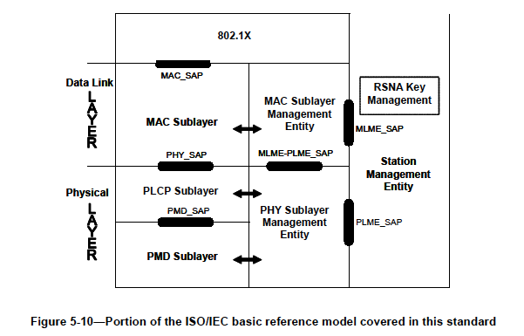
New MLME interface
General packets
DHCP etc.
Additionaly defined MLME interface

Slide 18
“for example assignment of IP address”
IPv4
  original DHCP can be used.
    Original 4-way DHCP can run using Action frames.
    In order to reduce time, ‘timeout’ operation should be eliminated.
  For more efficiency, 2-way version (omitting OFFER and REQUEST) should be defined. (It’s business of IETF)
IPv6
  RS and RA can be used as is.
    RFC6106 enables RA to carry DNS server information.
  DHCPv6 also can be used.
PPPoE
  NTT’s wireless LAN service “flets spot” uses PPPoE.
  LCP and IPCP can run via management frames.

Slide 19
Conclusion
This presentation shows generic container framework for connection setup for upper layers without violation against the layered network architecture.
Key ideas are:
  Including protocol identifier of upper layers
  Fragmentation of new Upper layer IE
  Utilizing Action frames
  Checking security conditions of Upper layer IE
New MLME interface is proposed for connection setup messages of upper layers.

Slide 20
Discussion

