Slide 1
Traffic Information Dissemination Use Case
Date: May 9, 2011
Authors:
Name | Company | Address | Phone | email
Ping Fang | Huawei Technologies Co., Ltd. | Bldg 7, Vision Software Park, Road Gaoxin Sourth 9, Nanshan District, Shenzhen, Guangdong, China, 518057 | +86 755 36835101 | ping.fang@huawei.com
George Calcev | Huawei Technologies Co., Ltd. | 3601 Algonquin Road, Suite 1000 Rolling Meadows, IL 60008, USA | +1 847 387 9606 | George.Calcev@huawei.com
Zhiming Ding | Huawei Technologies Co., Ltd. | Bldg 7, Vision Software Park, Road Gaoxin Sourth 9, Nanshan District, Shenzhen, Guangdong, China, 518057 | +86 755 36835837 | dingzhiming@huawei.com

Slide 2
Objective
This contribution proposes traffic and local information dissemination as a use case for IEEE 802.11ah.

Slide 3
About IEEE 802.11ah
  This amendment defines an Orthogonal Frequency Division Multiplexing (OFDM) Physical layer (PHY) operating in the license-exempt bands below 1 GHz, e.g., 868-868.6 MHz (Europe), 950 MHz -958 MHz (Japan), 314-316 MHz, 430-434 MHz, 470-510 MHz, and 779-787 MHz (China), 917 – 923.5 MHz (Korea) and 902-928 MHz (USA), and enhancements to the IEEE 802.11 Medium Access Control (MAC) to support this PHY, and provides mechanisms that enable coexistence with other systems in the bands including IEEE 802.15.4 and IEEE P802.15.4g.
  The data rates defined in this amendment optimize the rate vs. range performance of the specific channelization in a given band.
  This amendment also adds support for:
    transmission range up to 1 km
    data rates > 100 kbit/s
  while maintaining the 802.11 WLAN user experience for fixed, outdoor, point to multi point applications.
Slide 3
Slide 3

Slide 4

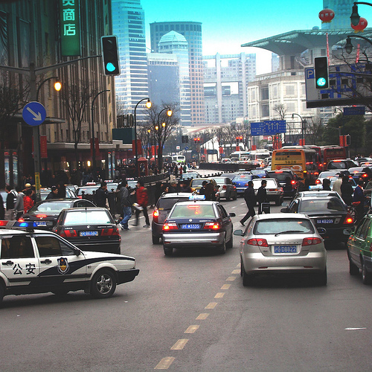
Use Case 1: Traffic Information Dissemination
AP
AP
802.11 ah
802.11 ah
STA
STA
802.11 ah
802.11 ah

Slide 5
Use Case 1: Scenario Description
Traffic Information Distribution
  When you are driving along the road, you can receive traffic information being broadcast by the APs deployed beside the road.
  This information can be local traffic information (e.g. road closures), and can be combined with GPS information to make better navigation.
  In addition, the APs can broadcast promotions from local businesses.
  An STA can also request specific info like gas stations, mechanic shops, or restaurants in the neighborhood. We envision that only small amount of data is exchanged between AP and STA in unicast mode.

Slide 6
Traffic Information Distribution: Requirements
# | Category | Comment
1 | Location | Outdoor
2 | Environment type | Urban
3 | STA/AP communication | 2-way (Multicast/Broadcast/Unicast) Traffic & Ads
4 | Data rate | <20Mbps
5 | BER/PER requirement | PER<10%
6 | Mobility | Low/Medium
7 | Traffic type | Burst/Periodic
8 | Security requirement | Low
9 | Reliability | Medium
10 | STA/AP capacity | STA: 200, AP: 1
11 | STA/AP category | STA: Mobile/Stationary, AP: Fixed
12 | STA/AP elevation | STA: 1m,..,2m, AP: 2m,..,20m
13 | Actors | Mobile Device, AP

Slide 7
Thank you!

Slide 8
StrawPoll
Add this traffic information dissemination use case into the draft of the 802.11ah Use Case document
Yes
No
Abstain

