Slide 1
TX Mask Shoulders vis-à-vis ACI
Date: 2011-05-04
Authors:

Slide 2
Abstract
A comment requesting a change to the way spectral mask levels are calculated was submitted [1]
The comment states that due to the increase in 11ac in the allowable in-band ripple from +/-2dB to +/-4dB there is a risk that the adjacent channel leakage (which is measured relative to peak power) will also increase by 2dB if device manufacturers take advantage of the increased allowable in-band ripple and hence will increase interference and reduce network Tput
We therefore study here the effect on system Tput of increased adjacent channel leakage by 2dB to quantify the potential degradation
We use PHY system simulations to compare the effect of different CCA levels on system Tput as in [2]
We also show results of some MAC-level system simulations

Slide 3
Spectral Mask

Slide 4
PHY System Simulation Parameters
36 APs and 4 STA per AP are dropped in an area of size 300x300 ft and 600x600ft
APs are placed regularly with 5ft std
STAs are associated with closest AP according to path loss (which includes random shadowing)
One valid transmission per BSS is assumed
BSSs are chosen randomly that meet CCA rules (50% probability to choose an AP as transmitter)
After all transmitters were chosen SINR is calculated at each receiver and mapped to MCS
SISO links over one 40MHz channel are assumed with 15dBm transmit power
CCA level is fixed at -79dBm
4 different frequencies are assigned to the 36 AP in two different ways:
  Ordered frequency allocation
    2 4 2 4 2 4
    1 3 1 3 1 3
    4 2 4 2 4 2
    3 1 3 1 3 1
    2 4 2 4 2 4
    1 3 1 3 1 3
  Random frequency allocation – in each drop each BSS randomly chooses one of four frequencies
Simulation uses 50 drops and 250 TXOP per drop. In each TXOP a maximum number of transmitters across all frequencies are chosen without violating the CCA levels
The Baseline ACL was assumed either -25dBr or -40dBr for all other three frequencies to separately reflect the average interference values with adjacent and alternate adjacent ACL.
Tput loss is then measured with -23dBr and -38dBr

Slide 5
Results

Slide 6
MAC Sim Parameters Case 5
Case 5:
  Office environment
    Approx 30 x 50 m
    One floor simulated
  2 BSS
    1 BSS on each of two adjacent channels
    AP0 + 10 clients
    AP11 + 10 clients
  TCP flows in both directions for every AP-client pair
  ED-CCA level = -62 dBm
  CRS level = -90 dBm

Slide 7
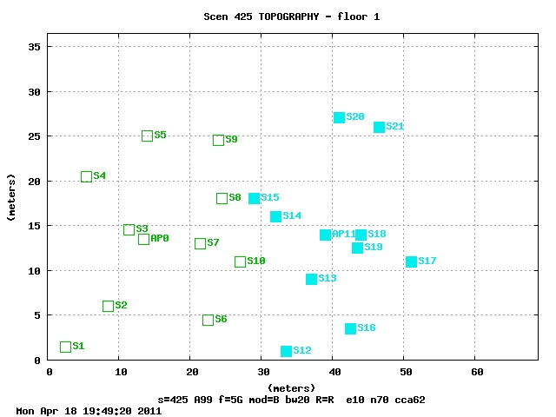
MAC Sim Topography Case 5

Slide 8
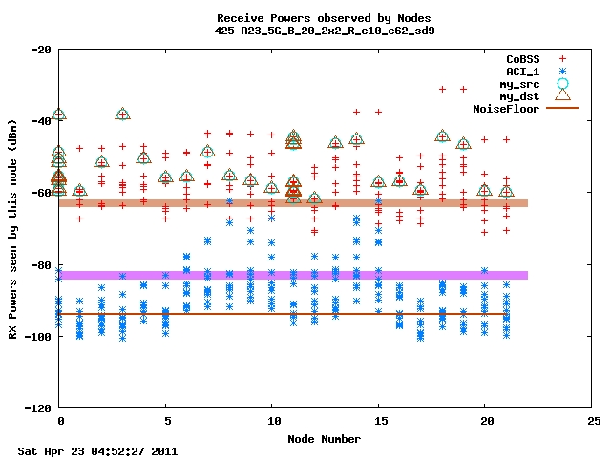
MAC Sim RXPWR Case 5

Slide 9
MAC_SIM Results Case 5
    s_425_A23_5G_B_20_2x2_R_e10_c62 = 82.29 Mbps
    s_425_A25_5G_B_20_2x2_R_e10_c62 = 83.44 Mbps
    s_425_A38_5G_B_20_2x2_R_e10_c62 = 84.61 Mbps
    s_425_A40_5G_B_20_2x2_R_e10_c62 = 84.67 Mbps
    s_425_A99_5G_B_20_2x2_R_e10_c62 = 92.30 Mbps

Slide 10
MAC Sim Parameters Case 6
Case 6:
  Same floor area as Case 1
  2 BSS
    1 BSS on one channel, 1 BSS on a second channel (adjacent)
  2 clients per BSS
    6 STA total AP plus clients
  TCP flows in both directions for every AP-client pair
  ED-CCA level = varied from -53 dBm to -71 dBm
  CRS level = -90 dBm

Slide 11
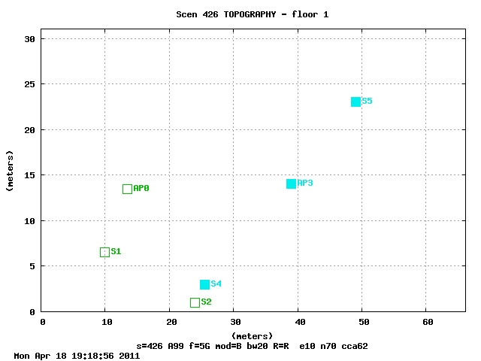
MAC Sim Topography Case 6

Slide 12
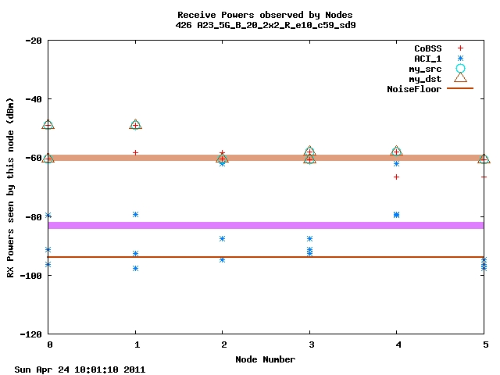
MAC Sim RXPWR Case 6

Slide 13
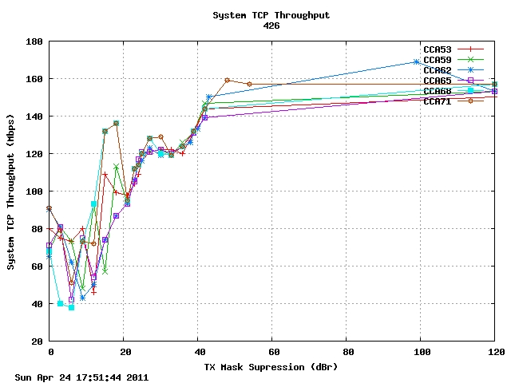
MAC_SIM Results Case 6

Slide 14
MAC Sim Parameters Case 7
Case 7:
  Same floor area as Case 1
  2 BSS
    1 BSS on one channel, 1 BSS on a second channel (adjacent)
  2 clients per BSS
    6 STA total AP plus clients
    Note client placement
  Flows:
    U = 4x TCP flows only UPLINK for each AP-client pair
    D = 4x TCP flows only DOWNLINK for each AP-client pair
    UD = 2x TCP flows: AP0 -> C2, C4 -> AP3
    DU = 4x TCP flows: AP0 -> C2, C1 -> AP0, C4 -> AP3, AP3 -> C5

Slide 15
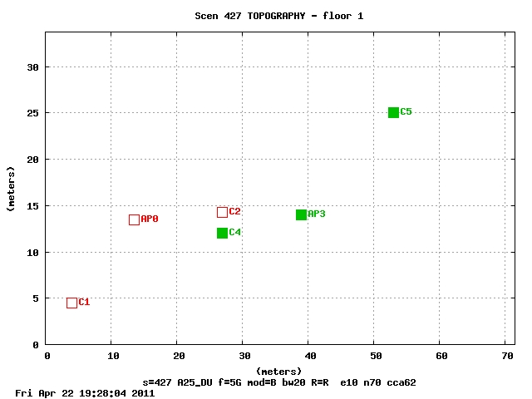
MAC Sim Topography Case 7

Slide 16

MAC Sim RXPWR Case 7

Slide 17
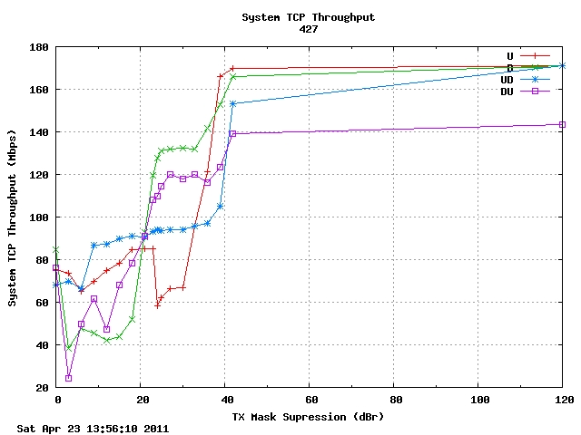
MAC_SIM Results Case 7

Slide 18
MAC Sim Parameters Case 8
Case 8:
  Slightly different from case 7 – APs are farther apart
    Attempt to get main link margin to be smaller
  2 BSS
    1 BSS on one channel, 1 BSS on a second channel (adjacent)
  2 clients per BSS
    2 AP and 4 clients (effectively only two clients)
  2 TCP flows:
    U = C4 -> AP3, C2 -> AP0
    D = C4 <- AP3, C2 <- AP0
    UD =C4 -> AP3, AP0 -> C2

Slide 19
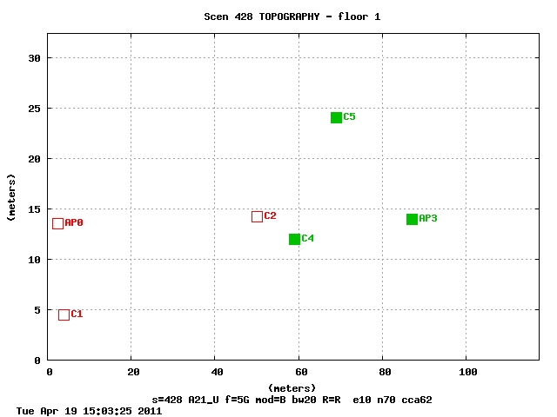
MAC Sim Topography Case 8

Slide 20
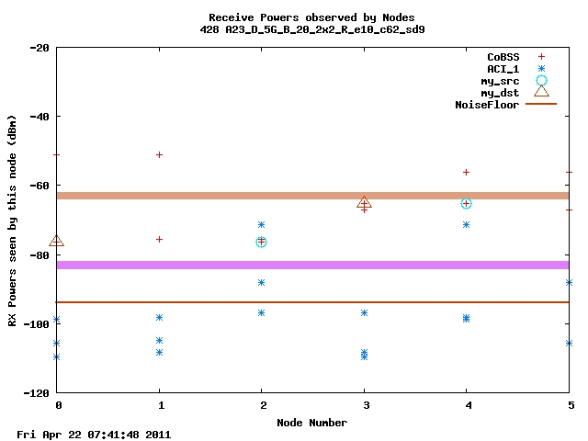
MAC Sim RXPWR Case 8

Slide 21
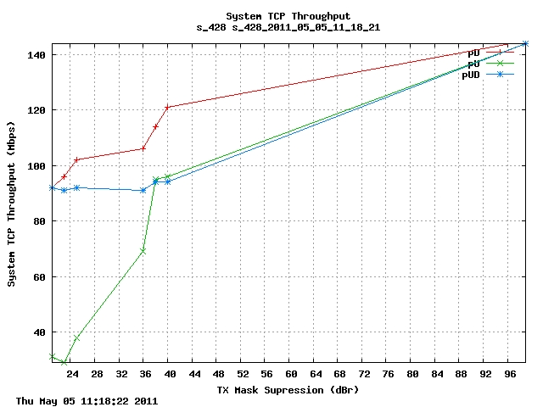
MAC_SIM Results Case 8

Slide 22
MAC Sim Parameters Case 9-C2R4
Case 9-C2R4:
  3 Floor office building
  9 BSS per floor (2500 sq ft per BSS maximum)
    Semi-rigid AP locations with random variance
    Random channel assignment from 2 adjacent channels
  1-3 clients per BSS (randomly assigned, randomly located)
    Over 110% of BSS area
  TCP flows:
    3:1 ratio DOWN to UP, randomly assigned
      One flow per client
  CCA level = -62 dBm
  R4, R5, R6 = distinct randomizations

Slide 23
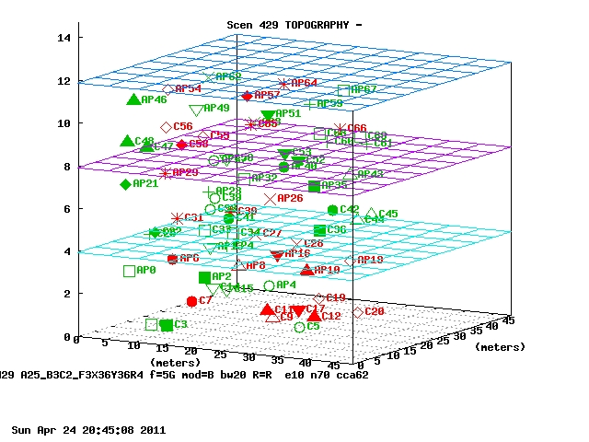
MAC Sim Topography Case 9-C2R4 common color = common channel

Slide 24
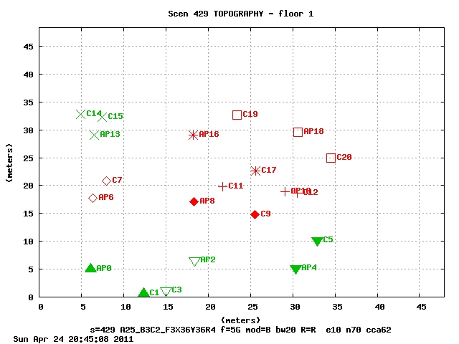
MAC Sim Topography Case 9-C2R4 common color = common channel

Slide 25
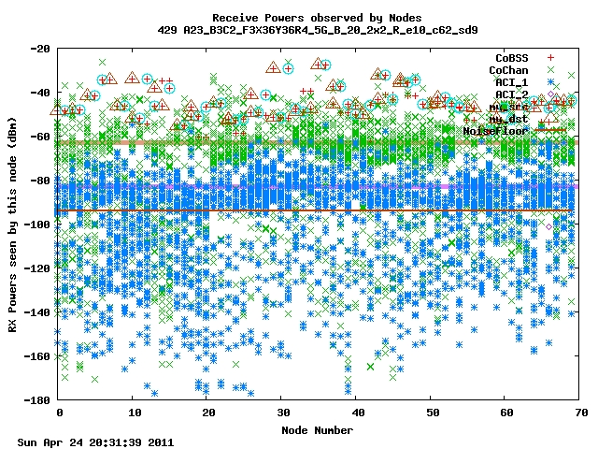
MAC Sim RXPWR Case 9-C2R4

Slide 26
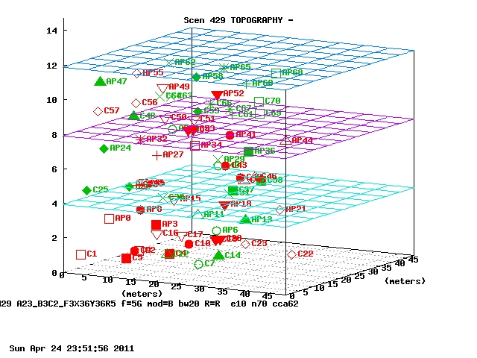
MAC Sim Topography Case 9-C2R5

Slide 27
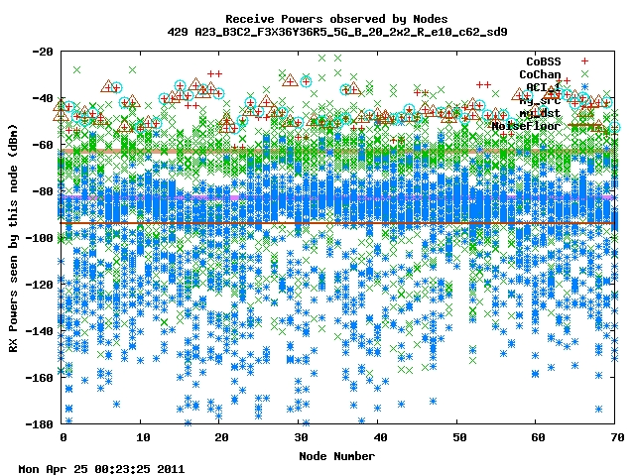
MAC Sim RXPWR Case 9-C2R5

Slide 28
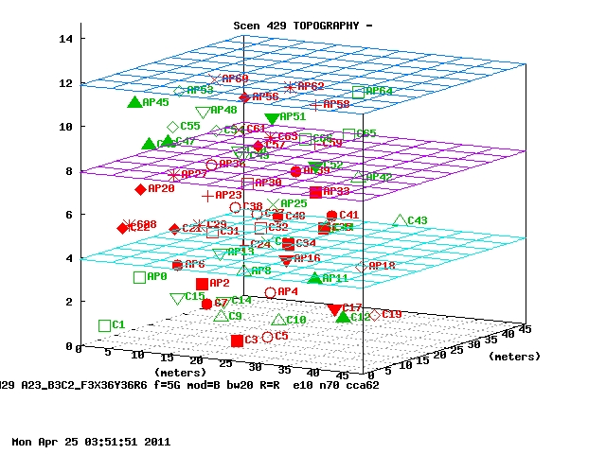
MAC Sim Topography Case 9-C2R6

Slide 29
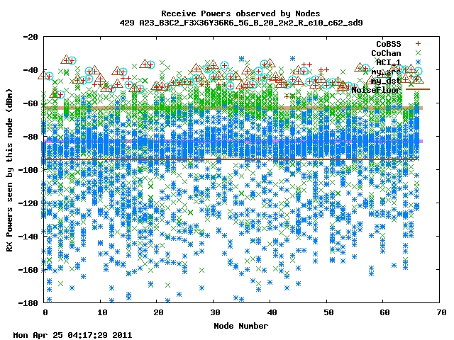
MAC Sim RXPWR Case 9-C2R6

Slide 30
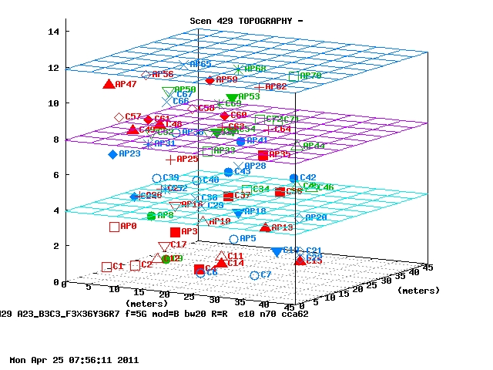
MAC Sim Topography Case 9-C3R7
3 Channels to choose from

Slide 31
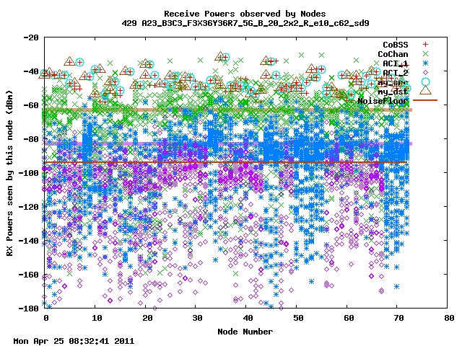
MAC Sim RXPWR Case 9-C3R7

Slide 32
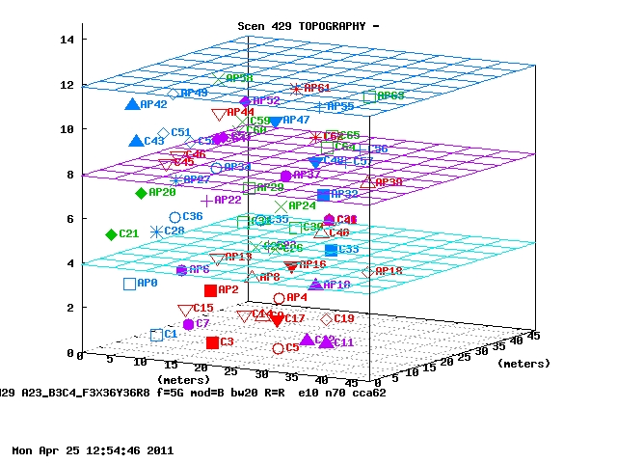
MAC Sim Topography Case 9-C4R8
Four channels to choose from

Slide 33
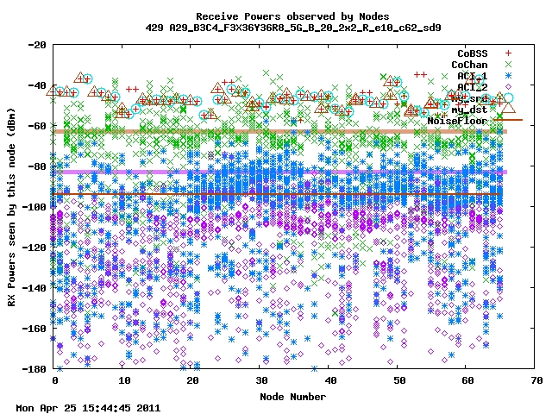
MAC Sim RXPWR Case 9-C4R8

Slide 34
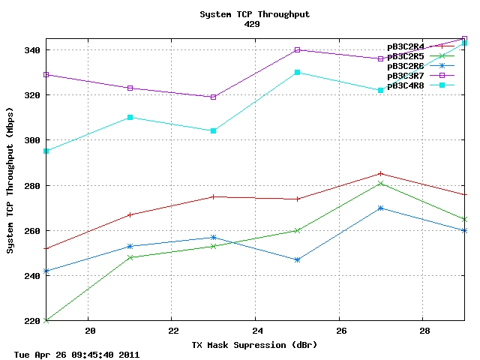
MAC Sim Results Case 9

Slide 35
MAC Sim Parameters Case 10
Case 10:
  1 floor
  2 BSS
    Semi-rigid AP locations with random variance
    2 adjacent channels
    Varying TX Mask shoulders
    Randomized placements
    Randomized up and down pair flows
      3:1 ratio DOWN to UP, randomly assigned
      One flow per client
    Cases 10.0 = typical AP separation = 7 m
    Cases 10.1 = typical AP separation = 11 m

Slide 36
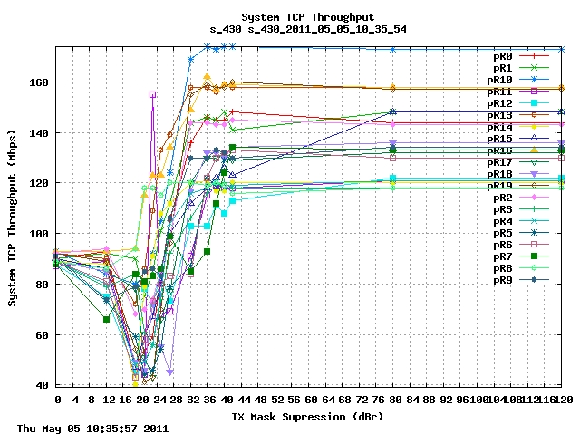
MAC Sim Results Case 10.0
20 randomized cases

Slide 37
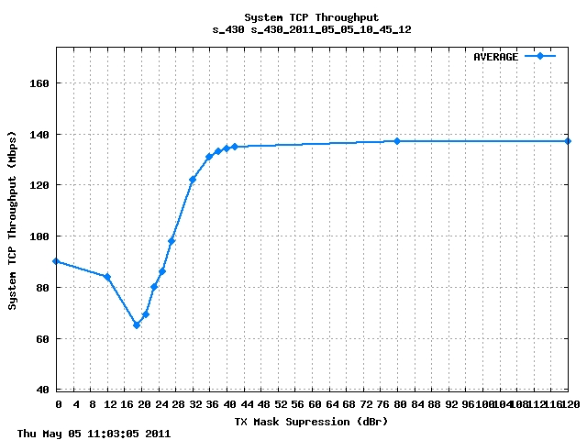
MAC Sim Results Case 10.0
20 randomized cases averaged

Slide 38
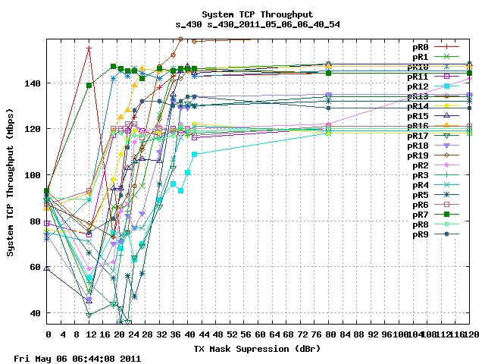
MAC Sim Results Case 10.1
20 randomized cases

Slide 39
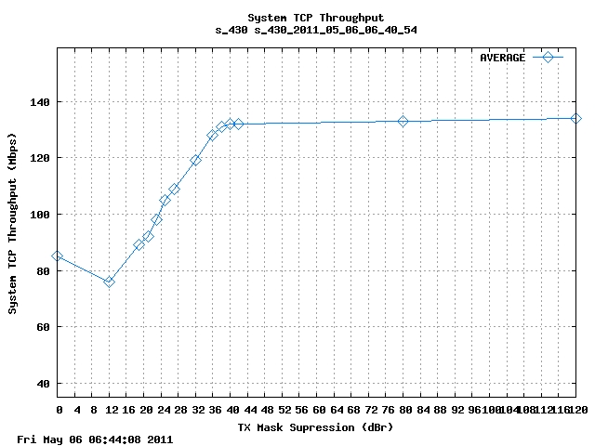
MAC Sim Results Case 10.1
20 randomized cases averaged

Slide 40
MAC Sim Parameters Case 11
Case 11:
  1 floor
  2 BSS
    Semi-rigid AP locations with random variance
    2 adjacent channels
    Varying TX Mask shoulders
    Randomized placements
    Randomized up and down pair flows
      3:1 ratio DOWN to UP, randomly assigned
      One flow per client
    Typical AP separation = 15 m

Slide 41
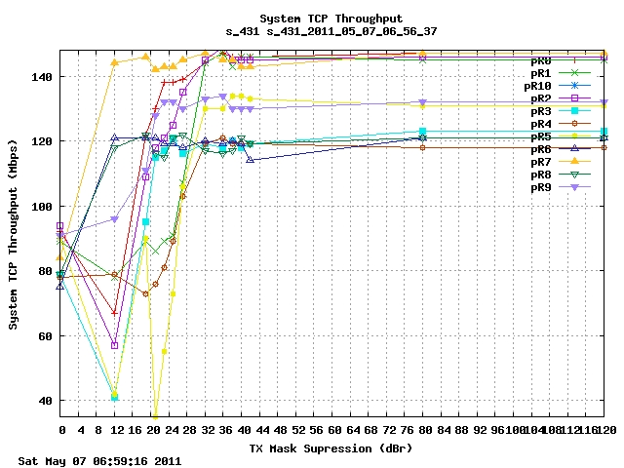
MAC Sim Results Case 11
10 randomized cases

Slide 42
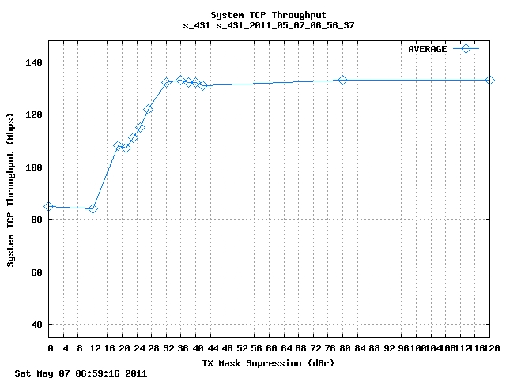
MAC Sim Results Case 11
10 randomized cases averaged

Slide 43
Simulation Conclusions
Minimal per-link Tput degradation.
No sum network Tput degradation for increase from -40 to -38dBr
Small (few % points) network Tput degradation for increase from -25 to -23dBr probably due to reduced average number of concurrent transmissions
Notes:
  In reality when many channels are available (as in the case of 40MHz channels) the interference level will be mostly -40dBr since most channels are not adjacent.
  Interference level of -25dBr will only be the dominant case if only 2-3 channels are available
  The simulation assumes full buffer – all nodes always have something to transmit – this is a worst case scenario from interference point of view.
While it’s not clear that implementations of 802.11ac will actually have in-band signal power variations of +/-4dB, the effect on network Tput is modest. Therefore, we propose not to include restrictions (equations, etc.) to the spectral flatness.

Slide 44
References
[1] 11-11-0276-11-00ac-tgac-d0-1-comments.xls
  CID 488
[2] 11-11-0061-00-00ac-cca-threshold-levels.ppt

Slide 45
Appendix
Randomly selected topographies

Slide 46
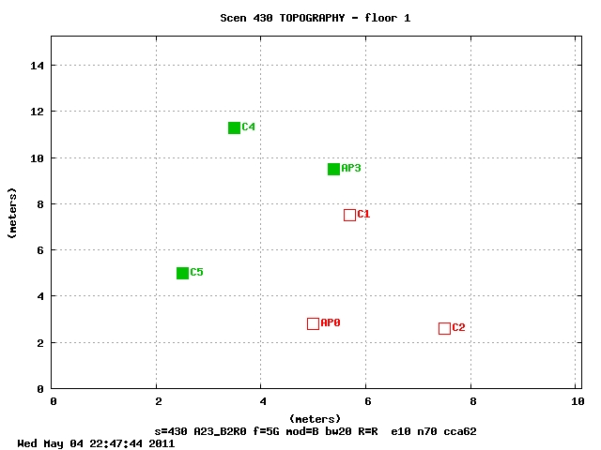
MAC Sim Topography Case 10.0-0

Slide 47
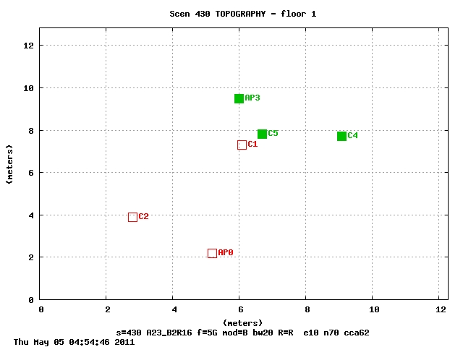
MAC Sim Topography Case 10.0-16

Slide 48
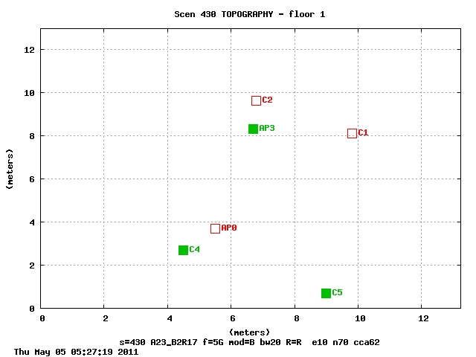
MAC Sim Topography Case 10.0-17

Slide 49
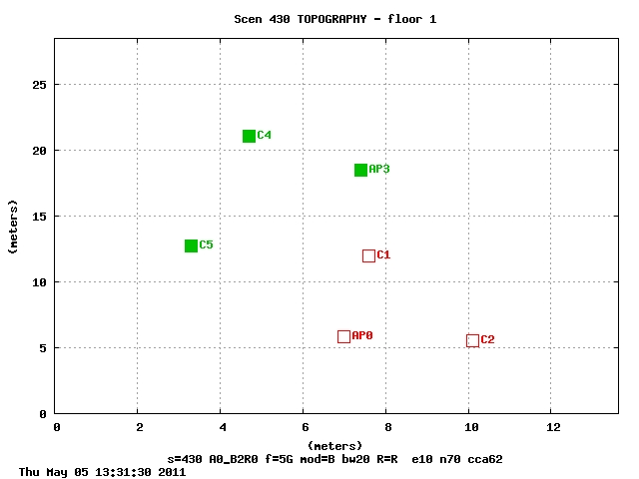
MAC Sim Topography Case 10.1-0

Slide 50
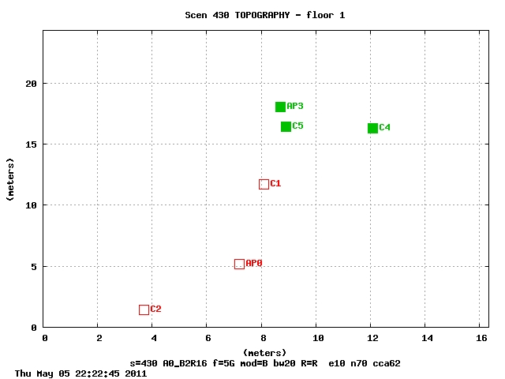
MAC Sim Topography Case 10.1-16

Slide 51
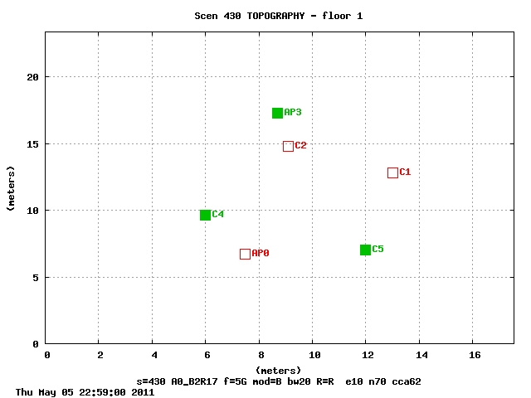
MAC Sim Topography Case 10.1-17

