Slide 1
Use of sub-Ghz frequencies in India
Date: 2010-10-17
Authors:

Slide 2
Abstract
This presentation discusses the availability of sub-GHz spectrum in India, summarizes the importance of such spectrum for Indian broadband requirements and thereby proposes a channel model study in the 400MHz band specific to Indian deployment scenarios

Slide 3
Broadband in India
Tele-density in India is ~59%. Rural tele-density is at 26% and growing (leapfrogging to wireless is a major factor) ¹
ARPU is dropping (33% drop from 2009 to 2010) ²
Prohibitive entry costs for operators to service rural India – low ROI.
Broadband penetration is a mere 1% of the number of telephone connections (wireless and wireline) in India.²
  86% of Broadband connections use DSL implying that most of this growth is limited to bigger cities and metros with existing wireline infrastructure²
Base Station infrastructure costs accounts for more than 80% of CAPEX.
CAPEX could reduce significantly :
  802.11 access technology, thanks to volumes!
  Turning to sub-GHz bands with ‘friendlier’ propagation losses implying fewer base station deployments

Slide 4
Sub-Ghz spectrum allocation in India
902 – 928 MHz is not unlicensed in India (allocated for cellular services)
434 – 438 MHz : Amateur band
368 – 380 MHz : Fixed Mobile band Note: could be considered for rural communications on a case-by-case basis
470 – 520 MHz : Fixed and Mobile services to be considered on a case-by-case basis
582 – 806 MHz : Analog TV band (Note: Requirements of IMT and BWA to be considered)
Other bands:
  There may be scope for use of other bands that are allocated for fixed mobile services
  Spectral re-farming could be considered in cellular services’ band (890-960 MHz) and possibly other bands
There is spectrum availability in the sub-GHz band that could be used for low-cost deployments in India

Slide 5
Proposal
Propose to undertake a channel model study in one (or more) bands in the sub-GHz frequency range for Indian rural and urban conditions
400MHz is a good starting point given the spectrum availability pattern

Slide 6
References
http://www.trai.gov.in/WriteReadData/trai/upload/PressReleases/767/August_Press_release.pdf
http://www.trai.gov.in/WriteReadData/trai/upload/PressReleases/768/quarterly_press_release_final.pdf

Slide 7
Figures

Slide 8
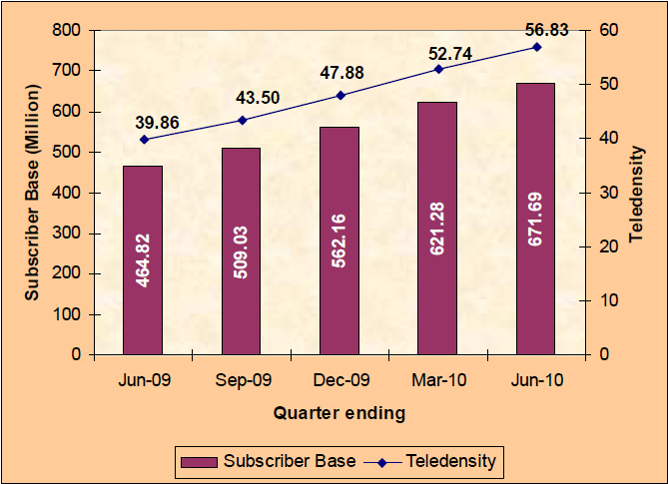
Figure 1 : Tele-density in India

Slide 9
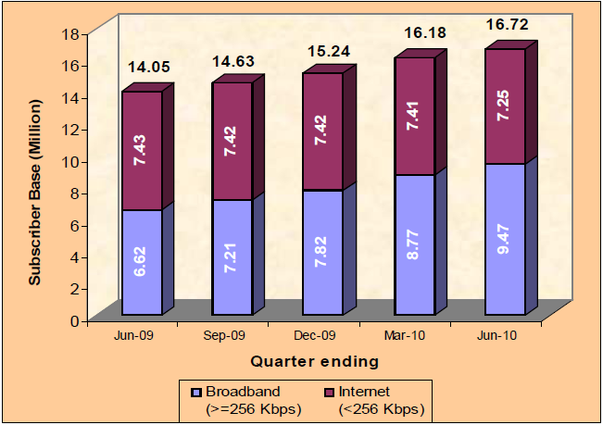
Figure 2 : Broadband subscription in India

