Slide 1
Sub 1 GHz license-exempt Use Cases
Date: 2010-09-03
Authors:

Slide 2
Abstract
Provide use cases to help guide standardization effort.

Slide 3
Excerpts from PAR
This amendment also adds support for:
- transmission range up to 1 km
- data rates > 100 kbit/s
while maintaining the 802.11 WLAN user experience for fixed, outdoor, point to multi point applications.

Slide 4
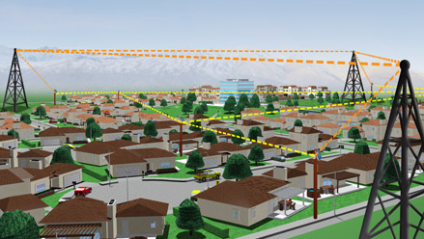
Outdoor
Bridging and Mesh Backhaul solutions

Slide 5
Outdoor - Bridging and Mesh Backhaul solutions
Channel Width | Clocking | Data rates in Mbits/S
5 MHz | ¼ | 13.5, 12, 9, 6, 4.5, 3, 2.25, 1.5
2.5 MHz | 1/8 | 6.7, 6, 4.5, 3, 2.25, 1.5, 1.1, .75

Slide 6
Outdoor Access with low data rates Smart Grid
From nist_80211_MAC_readme.pdf,
With 1 Mbit/s and 100 byte payload, saturation of a single channel is at 6.4 kbits/s.
If sensors send 100 byte payload ever 15 minutes, can support 7200 devices.

Slide 7
Outdoor Access with low data rates Other than Smart Grid
Devices in following areas,
Ranching
Mountainous
Farming and Agricultural
Hunting Lodge
Light residential and suburban
Types of traffic
Sensors
Video surveillance

Slide 8
Indoor access with low data rates
Q: Why if IEEE 802.11 is already widely available indoors?
A: Depending on the aggregate low data rate traffic volume and packet sizes, its clustering in space and time, the low data rate traffic can affect the high rate traffic operating on the same channel. Depending on the number of channels available, this may not be a problem.

Slide 9
Indoor Access with low data rates
Types of traffic
Sensors
Video surveillance
Consumer electronics
Cameras
Healthcare
Bio-sensors

Slide 10
References
11-10-0001-13-0wng-900mhz-par-and-5c
https://mentor.ieee.org/802.11/dcn/10/11-10-0001-13-0wng-900mhz-par-and-5c.doc
nist_80211_MAC_readme.pdf
http://collaborate.nist.gov/twiki-sggrid/pub/SmartGrid/PAP02Wireless/nist_80211_MAC_readme.pdf

