Slide 1
towards carrier-grade 802.11 at
Disney theme parks
Date: 2010-03-16
Authors:

Slide 2
introduction
desire to connect wireless devices in theme parks
  full coverage
  carrier-grade (reliability, QoS, etc.)
  low cost transceivers
802.11 shortcomings
  hard to install 802.11 infrastructure in theme parks
  access points need to be hidden from view – high cost
TV bands offer better link margin
  fewer access points (for example only one for Magic Kingdom theme park)
  Indoor coverage
however, FCC rules for TVWS are complex
  not enough channels available (FDM mitigates this problem)
FDM option
  FDM is step towards carrier-grade
  other spectrum, including licensed, become possible (regulators require different downlink and uplink channels)
we present at WNG because the idea seems long term with broad impact

Slide 3
about Disney
some of our divisions / holdings:
  Walt Disney Studio Entertainment
  Disney Consumer Products
  Walt Disney Parks and Resorts
  Disney Cruise Line
  Disney Interactive Media Group
  Disney-ABC Television Group
  ESPN Inc.
  Radio Disney

Slide 4
about Disney Research
mission
  Invent new technologies for the media & entertainment industry
  Take research results to market: spin-in or spin-out
organization
  Association of research labs: Disney Research Zurich & Pittsburgh, Pixar Research, Walt Disney Animation Studios Research, Walt Disney Imagineering Research, Disney Interactive Media Group Research
areas of research
  AI & Autonomous Agents, Computer Graphics, Computer & Sensor Networks, Computer Vision, Display Technologies, Mobile Computing, Radios & Antennas, Robotics, Video Processing, …

Slide 5
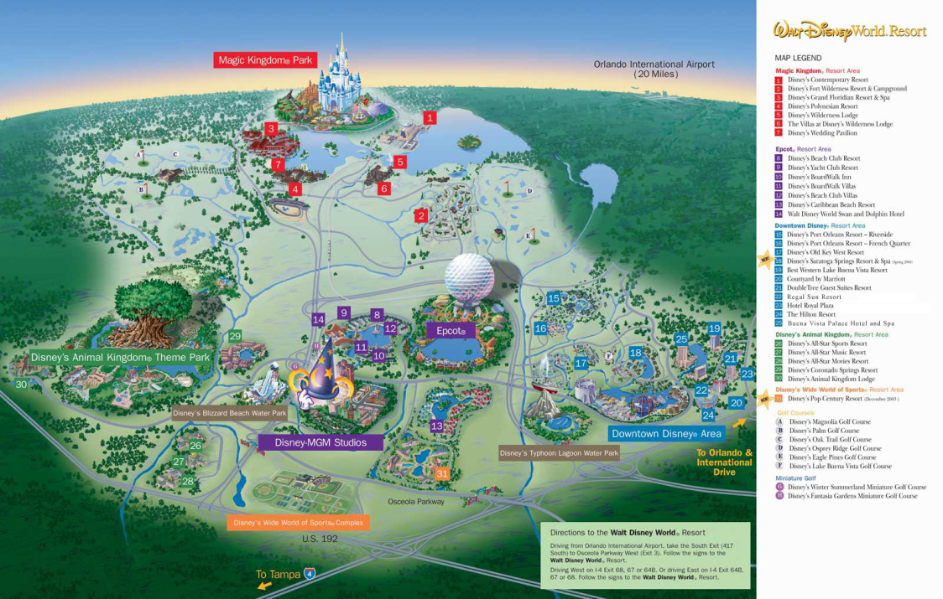
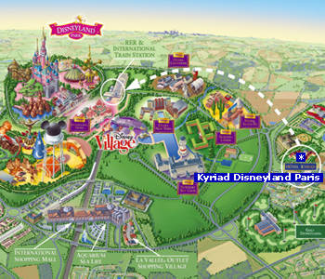
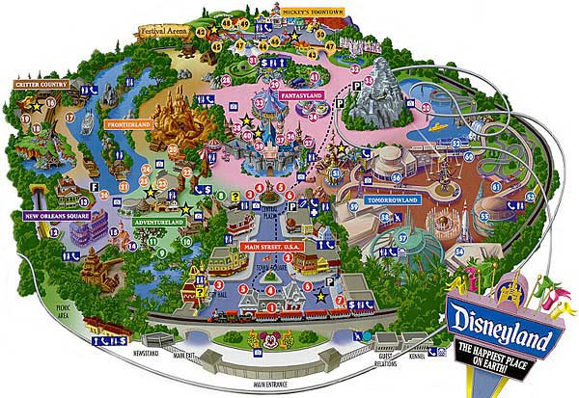
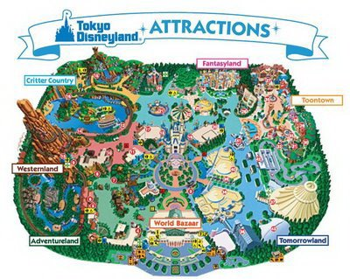
deployment areas of carrier-grade 802.11

Slide 6
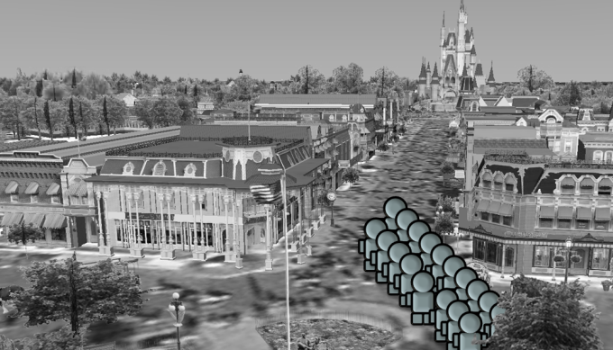

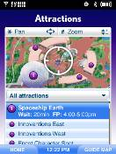
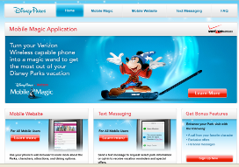
application examples of carrier-grade 802.11
802.11-enabled handheld
audio and video streaming
real time information
interactive games in queues
real time social interaction
example: Mobile Magic
  disneyparksmobile.com
  m.disneyland.com

Slide 7
Magic Kingdom example

Slide 8
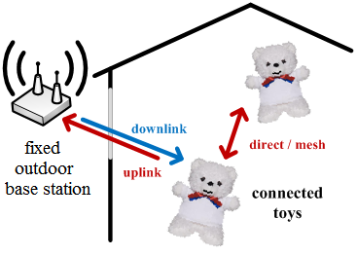
Magic Kingdom
around 50,000 visitors per day
  Source: TEA/ERA. “Theme Park Attendance Report 2008”
  www.themeit.com [2009]
size around 370m radius (107 acres)
one access point in the middle of the park
  carrier-grade access point

Slide 9
Magic Kingdom application requirements
long range
  large coverage area (connected toys)
  hard to install infrastructure because of attractions
high capacity
  high user density, especially in proximity of rides
high throughput
  audio and video streaming
good QoS
  interactive games
low-complexity
  affordable in consumer electronics

Slide 10
Magic Kingdom
TVWS
a few channels available in Disneyworld
FCC regulations separate fixed and portable channels
Source: www.showmywhitespace.com

Slide 11
link budget estimation
Transmitter characteristics Downlink Uplink
Transmitter power 1 W 0.04 W
TX antenna gain 10 dBi 0 dBi
Receiver characteristics
RX antenna gain 0 dBi 10 dBi
Imp Loss 3 dB 2 dB
NF 6 dB 4 dB
SNR (64-QAM 5/6) 19.9 dB 19.9 dB
Channel BW 5 MHz 5 MHz
RX sensitivity 78 dBm 81 dBm
Diversity gain 0 dB 3 dB
Total receiver gain 78 dB 94 dB
Margins
Coverage probability (cell edge) 0.98 0.98
Shadow Fading Margin 20 dB 20 dB
Allowed propagation loss 98 dB 90 dB
Range
Carrier frequency 200 MHz 700 MHz
BS antenna height 15 m 15 m
MS antenna height 1.5 m 1.5 m
Range 1.04 km 0.37 km
Path loss mode: Okumura-Hata, suburban
Thanks to Sid Shetty (shettysid@gmail.com) for contribution to the link budget

Slide 12
system throughput estimation
802.11 modulation parameters
  64-QAM, 5/6, 5MHz bandwidth. 16.25Mbps at 800ns GI
available spectrum
  8 channels x 5 MHz
throughput
  132Mbps data rate, single spatial stream
  528Mbps data rate, four spatial streams
comparison with other technologies
  only one access point as compared to 802.11g or 802.11n
  single-cell throughput comparable to WiMAX

Slide 13
Frequency Division Multiplex

Slide 14
frequency division multiplex

Slide 15
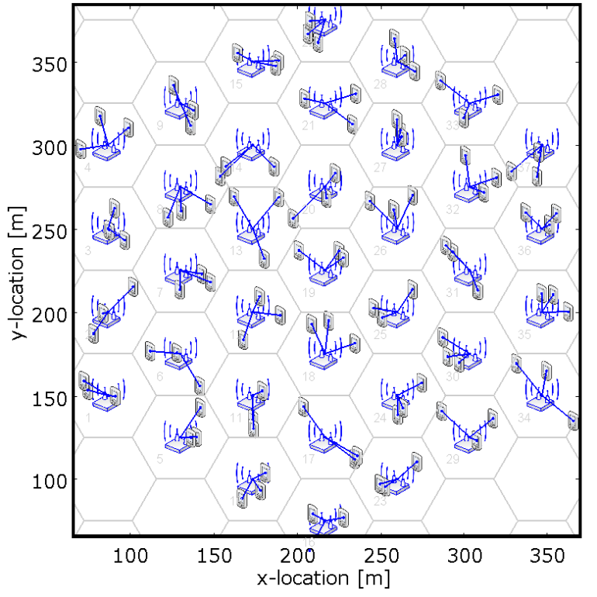
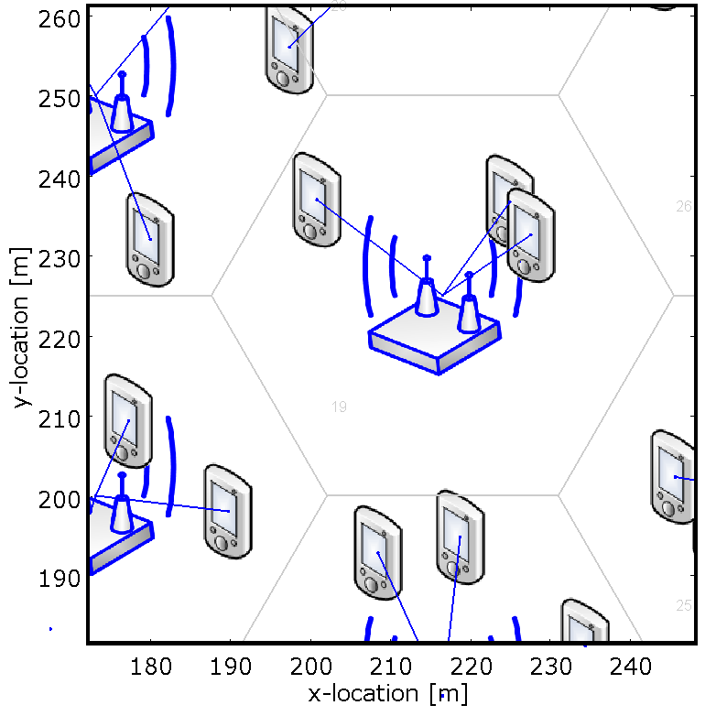
evaluation scenario
3 clients per access point

Slide 16
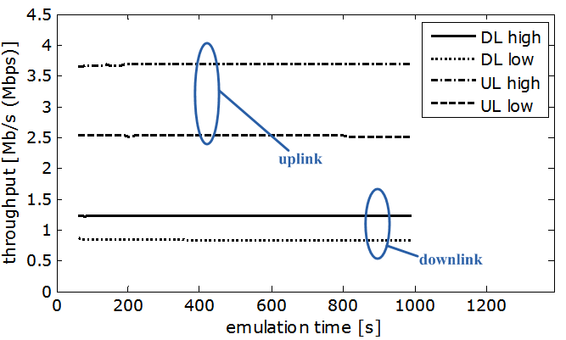
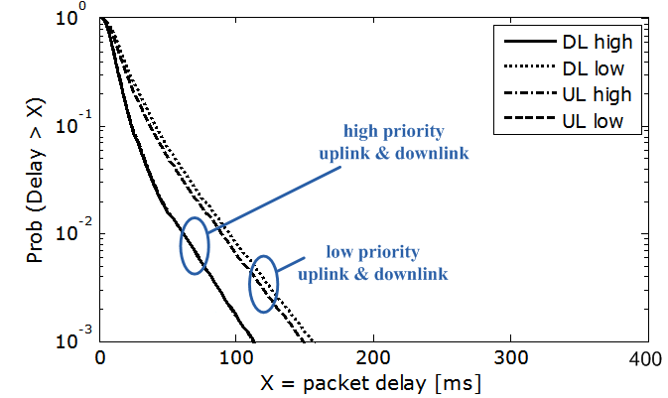
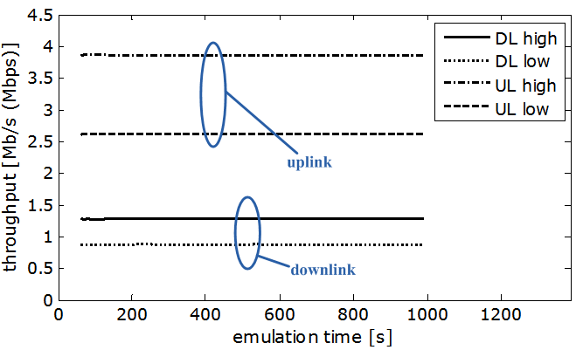
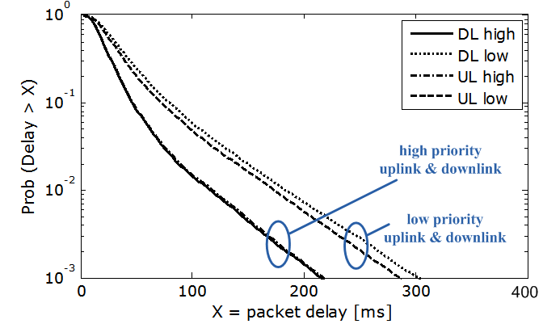
comparing FDD with 802.11
scenario: two downlink & two uplink streams (high and low priority)
802.11:
single channel
1x12Mb/s
FDD:
dual channel
2x6Mb/s
same thrp.
slightly higher
delay

Slide 17
FDD advantages
potentially more TVWS channels available for 802.11
  example: Magic Kingdom application
802.11 could be deployed in any paired spectrum
  regulators require separate downlink and uplink channels
  WiMAX
  LTE, including 700 MHz
facilitates regulation for multiple operators
performance
  simulation shows FDD throughput similar to 802.11
  FDD allows to reserve capacity to the access point for carrier-grade networks
other potential advantages
  allows to reserve capacity to the access point
  collision detection instead of collision avoidance

Slide 18
conclusions
potential use of 802.11 enabled handhelds in Disney theme parks
  mobile and fixed operation
  single base station to cover the theme park
Magic Kingdom example
  system in TV spectrum meets requirements
  FDM mitigates problems due to FCC regulations
a step towards carrier-grade 802.11 with FDM
  enables use of other spectrum
  introduces other potential advantages (to be verified)
FDM would require
  single transmitter for half duplex: dual channel CCA & NAV
  coordinated dual-radio for full duplex: dual channel CCA & NAV
  modified NAV rules

Slide 19
thank you for your attention! www.disneyresearch.com

