Slide 1
802.1 consent agenda items for LMSC Closing Plenary
November 2024
(V4 – 802.1 version #)

Slide 2
Agenda
PARs to NesCom
  5.051 – 802.1CBec
  5.052 – 802.1CB-2017 rev
Drafts to SA Ballot
  5.053 – P802.1DP (conditional)
Drafts to RevCom
  5.054 – P802-REV
  5.055 – P802.1Qdy (conditional)

Slide 3
Agenda
Liaisons and external communications (ME)
  7.011 – Approve sending ballot comment responses to ISO/IEC JTC1 SC6 on: IEEE Std 802.1AEdk, IEEE Std 802.1Qcz and IEEE Std 802.1Qdj
  7.012 – Approve Sending draft(s) to ISO/IEC JTC1 SC6 for information under the PSDO agreement, when SA ballot starts: IEEE 802.1DP
  7.013 – Approve Sending standard(s) to ISO/IEC JTC1 SC6 for adoption under the PSDO agreement, when published: IEEE 802.1Qdy, IEEE 802
  7.014 – Approve sending communication to ITU-T SG15 on OTNT Standardization Work Plan Issue 34
  7.015 – Approve sending communication to ITU-T SG13
  7.016 – Approve establishing a liaison relationship with IEC TC 57/WG15 for collaboration on MACsec profiles.
  7.017 – Appoint Standards Committee External Liaison coordinator for IEC TC 57/WG15
Liaisons and external communications (II)
  7.018 – Approve sending IEC/IEEE 60802 D3 to OPC Foundation

Slide 4
802.1 Motions
2024-11
Consent Agenda
PARs to NesCom

Slide 5
5.051 – Motion
Approve forwarding P802.1CBec PAR documentation in https://www.ieee802.org/1/files/public/docs2024/ec-PAR-1124-v01.pdf to NesCom
Approve CSD documentation in https://www.ieee802.org/1/files/public/docs2024/ec-CSD-1124-v01.pdf
In the WG, Proposed: Stephan Kehrer ,
Second: János Farkas
  PAR (y/n/a): 28, 0, 5
  CSD (y/n/a): 29, 0, 4
In EC, mover: Glenn Parsons, Second: David Law
  (y/n/a): <y>,<n>,<a>

Slide 6
5.052 – Motion
Approve forwarding P802.1CB-2017-Revision PAR documentation in
https://www.ieee802.org/1/files/public/docs2024/cb-Hantel-draft-PAR-0924-v01.pdf
to NesCom
  Note: there is no CSD statement since this maintenance project is not intended to provide any new functionality
In the WG, Proposed: Mark Hantel Second: Karen Randall
  Sending draft (y/n/a): 31, 0, 1
In the EC, mover: Glenn Parsons Second: David Law
  (y/n/a): <y> , <n> , <a>

Slide 7
802.1 Motions
2024-11
Consent Agenda
Drafts to SA Ballot

Slide 8
5.053 – Motion
Conditionally approve sending P802.1DP D3.0 to Standards Association ballot
Confirm the CSD for P802.1DP in https://mentor.ieee.org/802-ec/dcn/21/ec-21-0096-00-ACSD-p802-1dp.pdf
P802.1DP D2.1 had 100% approval at the end of the last WG ballot
In the WG, Proposed: János Farkas, Second: Jessy Rouyer
  Sending draft (y/n/a): 28, 0, 5
  CSD (y/n/a): 28, 0, 4
In EC, mover: Glenn Parsons, Second: David Law
  (y/n/a): <y>,<n>,<a>

Slide 9
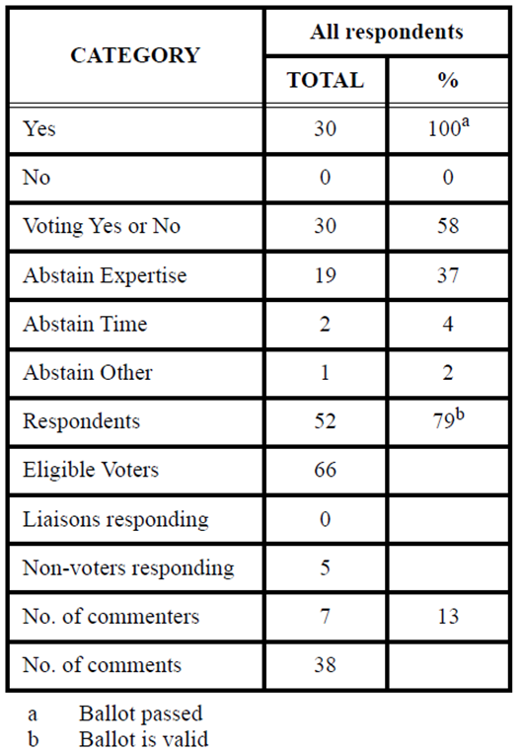
Supporting Information P802.1DP
WG ballot closed: 5 November 2024
All WG ballot requirements are met
The ballot resulted in
  0 Disapprove votes
  0 Must Be Satisfied (MBS) comments
Comment resolution available here: https://www.ieee802.org/1/files/private/dp-drafts/d2/802-1DP-d2-1-dis-v01.pdf
Recirculation ballot will be conducted during November/December with comment resolution in the regularly scheduled P802.1DP meetings. A possible final recirculation in January/February if required with comment resolution in the regularly scheduled P802.1DP meetings.
Ballot results:

Slide 10
802.1 Motions
2024-11
Consent Agenda
Drafts to RevCom

Slide 11
5.054 – Motion
Approve sending P802-REVc to RevCom
  Note: there is no CSD statement since this maintenance project is not intended to provide any new functionality
P802-REVc D2.2 had 96% approval at the end of the last SA ballot
In the WG, Proposed: Mark Hantel Second: Karen Randall
  Sending draft (y/n/a): 28, 1, 3
In the EC, mover: Glenn Parsons Second: David Law
  (y/n/a): <y> , <n> , <a>

Slide 12
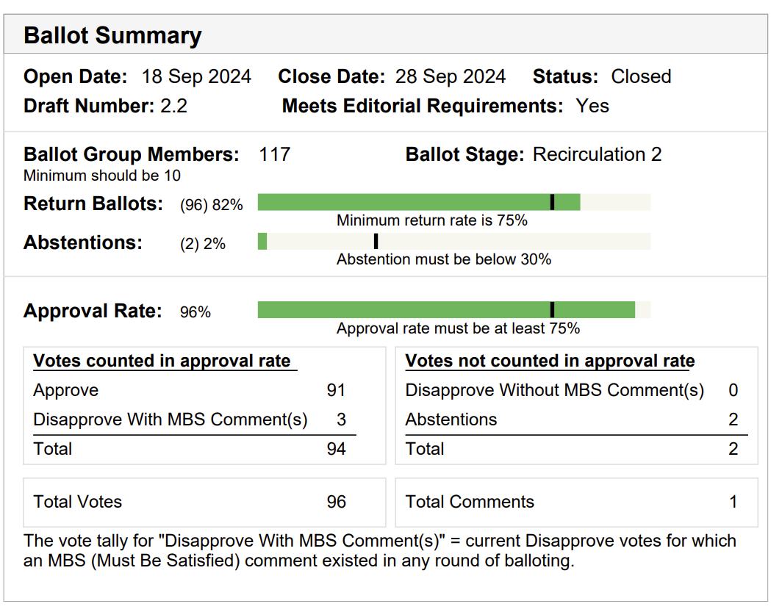
Supporting Information P802-REVc
SA ballot closed: 28 Sept 2024
All SA ballot requirements are met
The 2nd recirculation ballot resulted in
  0 new Disapprove votes
  1 Disapprove votes with MBS comments
  1 Comment
Final Comment resolution available here: https://mentor.ieee.org/802.1/dcn/24/1-24-0054-01-Mntg-p802-revc-sa-second-recirculation-ballot-report.pdf
The disapprove vote accompanied by the MBS comment was changed to abstain after final D2.2 comment resolution.
3 disapprove votes were maintained from the previous ballots

Slide 13
5.055 – Motion
Conditionally approve sending P802.1Qdy to RevCom
Approve CSD documentation in https://mentor.ieee.org/802-ec/dcn/23/ec-23-0149-00-ACSD-p802-1qdy.pdf
P802.1Qdy D2.1 had 97% approval at the end of the last SA ballot
In the WG, Proposed: Mick Seaman, Second: János Farkas
  Sending draft (y/n/a): 30, 1, 2
  CSD (y/n/a): 29, 1, 2
In EC, mover: Glenn Parsons, Second: David Law
  (y/n/a): <y>,<n>,<a>

Slide 14
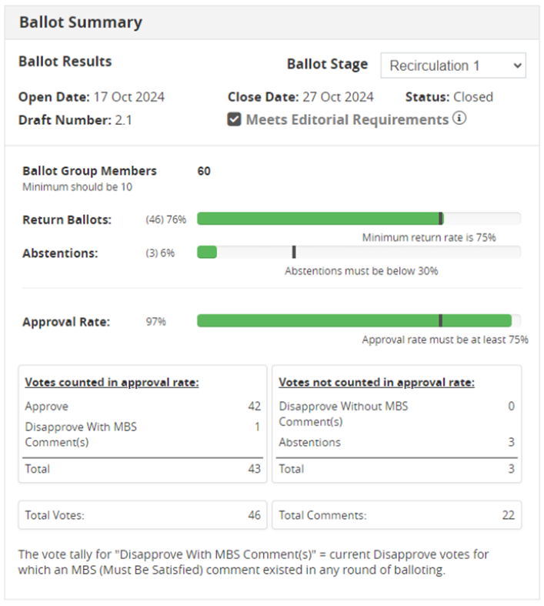
Supporting Information P802.1Qdy
SA ballot closed: 27 Oct 2024
All SA ballot requirements are met
The recirculation ballot resulted in
  0 new Disapprove votes
  1 Disapprove votes with MBS comments
  22 comments
  0 outstanding MBS comments
Comment resolution available here: https://www.ieee802.org/1/files/private/dy-drafts/d2/802-1Qdy-d2-1-dis-v02.pdf
Recirculation ballot will be conducted during November/December with comment resolution in the regularly scheduled TSN TG meetings. A possible final recirculation in January/February if required with comment resolution in the regularly scheduled TSN TG meetings.

Slide 15
Supporting Information P802.1Qdy
Murugan Balraj, the voter maintaining Disapprove vote is satisfied with the resolution of his comments; however, he wants to see the revised document and YANG files.

Slide 16
802.1 Motions
2024-11
Consent Agenda
Liaisons and external communications (ME)

Slide 17
7.011 – Motion
Approve sending ballot comment responses to ISO/IEC JTC1 SC6 on: IEEE Std 802.1AEdk, IEEE Std 802.1Qcz and IEEE Std 802.1Qdj
https://www.ieee802.org/1/files/public/docs2024/liaison-randall-SC6CommentResponse8021Qdj-1124.pdf
https://www.ieee802.org/1/files/public/docs2024/liaison-randall-SC6CommentResponse8021QczFDIS-1124.pdf
https://www.ieee802.org/1/files/public/docs2024/liaison-randall-SC6CommentResponse8021AEdkFDIS-1124.pdf
In the WG, Proposed: Mark Hantel Second: Karen Randall
  Sending draft (y/n/a): 31, 0 ,1
In EC, mover: Glenn Parsons Second: David Law
  (y/n/a): <y>,<n>,<a>

Slide 18
7.012 – Motion
Approve sending draft, when SA ballot starts, to ISO/IEC JTC1 SC6 for information under the PSDO agreement: IEEE 802.1DP
In the WG, Proposed: Mark Hantel Second: Karen Randall
  Sending draft (y/n/a): 31, 0 ,1
In EC, mover: Glenn Parsons Second: David Law
  (y/n/a): <y>,<n>,<a>

Slide 19
7.013 – Motion
Approve sending standard(s), when published, to ISO/IEC JTC1 SC6 for adoption under the PSDO agreement: IEEE 802 and IEEE 802.1Qdy
In the WG, Proposed: Mark Hantel Second: Karen Randall
  Sending standards (y/n/a): 33, 1, 0
In EC, mover: Glenn Parsons Second: David Law
  (y/n/a): <y>,<n>,<a>

Slide 20
7.014 – Motion
Approve
https://www.ieee802.org/1/files/public/docs2024/liaison-response-itu-t-SG15-LS135-OTNTStdznWorkPlan34-1124.pdf
as communication to ITU-T SG15 on OTNT Standardization Work Plan Issue 34 granting the IEEE 802.1 WG chair (or his delegate) editorial license.
  This approval is under LMSC OM “Procedure for public statements to government bodies”
In the WG, Proposed: Mark Hantel Second: Karen Randall
  Sending (y/n/a): 32, 0, 2
In EC, mover: Glenn Parsons Second: David Law
  (y/n/a): <y>,<n>,<a>

Slide 21
7.015 – Motion
Approve https://www.ieee802.org/1/files/public/docs2024/liaison-response-itu-t-SG13-LS208-DetermNetwrking-1124-v01.pdf as communication to ITU-T SG13 granting the IEEE 802.1 WG chair (or his delegate) editorial license.
  This approval is under LMSC OM “Procedure for public statements to government bodies”
In the WG, Proposed: János Farkas, Second: Karen Randall
  (y/n/a): 31, 0, 3
In EC, mover: Glenn Parsons, Second: David Law
  (y/n/a): <y>,<n>,<a>

Slide 22
7.016 – Motion
Approve establishing a liaison relationship between the IEEE 802.1 Working Group and IEC TC 57/WG15 for collaboration on MACsec profiles.
In the WG, Proposed: Mick Seaman Second: Karen Randall
  (y/n/a): 30, 2, 1
In the EC, mover: Glenn Parsons Second: David Law
  (y/n/a): <y> , <n> , <a>

Slide 23
7.017 – Motion
Approve appointing Maik Seewald as the Standards Committee External Liaison coordinator from IEEE 802.1 Working Group to IEC TC 57/WG15.
In the WG, Proposed: Mick Seaman Second: Karen Randall
  (y/n/a): 27, 0, 4
In the EC, mover: Glenn Parsons Second: David Law
  (y/n/a): <y> , <n> , <a>

Slide 24
802.1 Motions
2024-11
Consent Agenda
Liaisons and external communications (II)

Slide 25
7.018 – Motion
Approve sharing IEC/IEEE 60802 Draft 3.0 with OPC Foundation
In the WG, Proposed: Martin Mittelberger Second: Janos Farkas
  Sending draft (y/n/a): 31, 1, 1
In the EC for information

